Slide 1


A large-scale compact base station antenna array with improved radiation performance
Speaker: Jiayue Jiang Xidian university
Supervisor: Luyu Zhao School of Electronic and Information Engineering , Anhui university

Slide 2

Contents
紧耦合天线阵列研究
可重构透射阵列研究
其他天线
目前已发表论文
博士阶段计划
Background
Design Of The Proposed Antenna Array
Results and Discussion
1
1
2
2
3
4
3
5

Slide 3

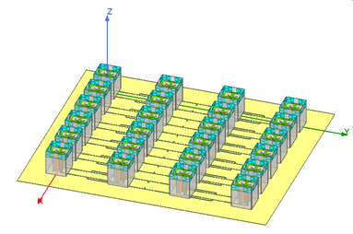
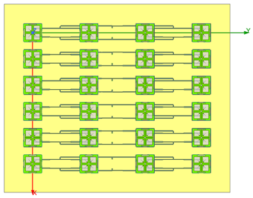
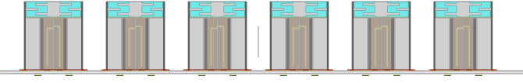
Background
3
Severe radiation patterns distortion problem in compact large-scale dual-polarized antenna array
Compact dual-polarized base station antenna array suffers from distorted radiation patterns and decrease of realized gain.
Subarray1
0.36λ
Subarray2
Subarray3
Subarray4
Horizontal plane
Subarray5
Subarray6
Vertical plane
Strong mutual couplings between antennas distort the (horizontal) radiation patterns of subarrays.
Notes:
Obviously, the subarray in the center of the array suffers from severest distortion of radiation patterns
重要性：精准波束赋形

Slide 4
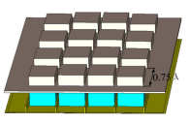
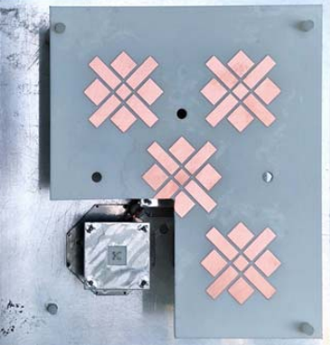
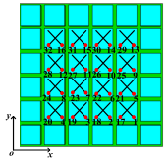
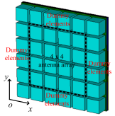
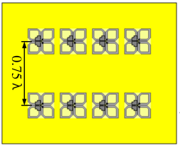
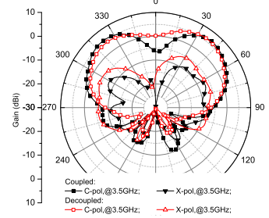
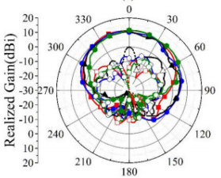
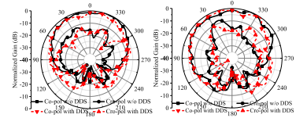
Background
3
Some representive works on compact large-scale dual-polarized antenna array
Researches focus on enhancement of port isolation.
Patterns of central subarray are not provided
Central element suffers from distortion of pattern
The subarray suffers from reduction of realized gain
The element suffers from pattern distortion and reduction of XPD
[1] 5 elements with Array Decoupling Surface
[2] 4x4 array with dielectric stubs
[3] 4x4 array with dieletric superstrate
[1] C. Wei, Z. -Y. Zhang and K. -L. Wu, "Phase Compensation for Decoupling of Large-Scale Staggered Dual-Polarized Dipole Array Antennas," in IEEE Transactions on Antennas and Propagation, vol. 68, no. 4, pp. 2822-2831, April 2020.
[2] P. Mei, Y. -M. Zhang and S. Zhang, "Decoupling of a Wideband Dual-Polarized Large-Scale Antenna Array With Dielectric Stubs," in IEEE Transactions on Vehicular Technology, vol. 70, no. 8, pp. 7363-7374, Aug. 2021.
[3] B. Liu, Y. Da, X. Chen and A. A. Kishk, "Hybrid Decoupling Structure Based on Neutralization and Partition Schemes for Compact Large-Scale Base Station Arrays," in IEEE Antennas and Wireless Propagation Letters, vol. 21, no. 2, pp. 267-271, Feb. 2022.
Notes:
主流的大规模基站天线阵列研究重点：去耦合（提升隔离度），但很多天线阵列存在着水平面方向图畸变严重，增益下降等问题，例如：。。。

Slide 5
The Proposed Antenna Array
3
Configuration of the proposed array
The proposed array includes 24 dual-polarized antenna elements, a nonuniform metasurface and metal baffles.
Notes:
Obviously, the subarray in the center of the array suffers from severest distortion of radiation patterns
重要性：精准波束赋形

Slide 6
The Proposed Antenna Array
3
Configuration of the antenna element
The proposed array includes 24 dual-polarized antenna elements, a nonuniform metasurface and metal baffles.
The antennas’ radiation arms are bended upward to achieve miniaturization.[4]
The size of antenna elements : 0.25λ x 0.25λ x 0.31λ
Operation frequency band: 1.71GHz---2.17GHz
Reflection coefficient: < -14dB
Realized Gain: ~7.5dBi within 1.71---2.17GHz
HPBW:72±2°
[4]H. Yang et al., "Aperture Reduction Using Downward and Upward Bending Arms for Dual-Polarized Quadruple-Folded-Dipole Antennas," in IEEE Antennas and Wireless Propagation Letters, vol. 22, no. 3, pp. 645-649, March 2023.
Notes:
Obviously, the subarray in the center of the array suffers from severest distortion of radiation patterns
重要性：精准波束赋形

Slide 7
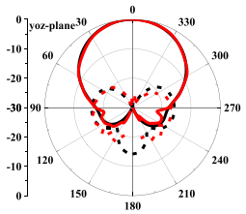
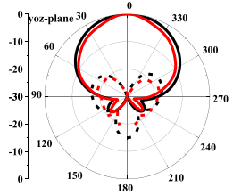
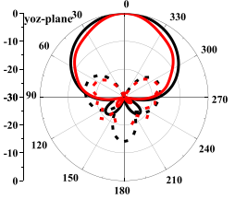
The Proposed Antenna Array
3
Radiation patterns at 1.71GHz
Radiation patterns at 1.98GHz
Radiation patterns at 2.17GHz
Configuration of the feed network
The network consists of microstrip lines, chip resistors and dieletric substrate. 7 degrees downtilt is realized.
100Ω chip resistors
100Ω chip resistors
100Ω chip resistors
port
port
Microstrip line
Dieletric substrate
Ground
Notes:
Obviously, the subarray in the center of the array suffers from severest distortion of radiation patterns
重要性：精准波束赋形

Slide 8
The Proposed Antenna Array
3
Configuration of the nonuniform metasurface
There are two different parts, part1 above subarray1/6 and part2 above subarray2/3/4/5.
Top view of the proposed array
Part1 of the metasurface
Part2 of the metasurface
Notes:
Obviously, the subarray in the center of the array suffers from severest distortion of radiation patterns
重要性：精准波束赋形

Slide 9
The Proposed Antenna Array
3
Characteristics of part1 and part2 of the metasurface
The infinite part1 and part2 are simulated in CST microwave studio.
Unitcell of part1
Unitcell of part2
Reflection and transimission coefficients of infinite part1/2
Effective permittivity and permeability of infinite part1/2
Notes:
Obviously, the subarray in the center of the array suffers from severest distortion of radiation patterns
重要性：精准波束赋形

Slide 10
The Proposed Antenna Array
3
Analysis of the near E-field of two antennas of subarray3 in original and proposed antenna array
Horizontal electric field distributions(in XOZ plane)
The electric field distributions in the proposed array are concentrated to the desired radiation direction(+z) rather than the dispersive electric field distributions in the original array
Notes:
Obviously, the subarray in the center of the array suffers from severest distortion of radiation patterns
重要性：精准波束赋形

Slide 11
Results and Discussion
7
The reflection coefficients and couplings
The reflection coefficients of all the ports of the proposed antenna array are below -17dB and all the mutual couplings are below -22dB.
Reflection coefficients of port1-6
Main couplings

Slide 12
Results and Discussion
7
Radiation patterns of all subarrays
The radiation patterns’ distortion of subarrays are improved by proposed metasurface and metal baffles. The realized gains of subarrays are improved, too.
subarray1 at 1.71GHz
subarray1 at 1.98GHz
subarray1 at 2.17GHz
subarray2 at 1.71GHz
subarray2 at 1.98GHz
subarray2 at 2.17GHz

Slide 13
Results and Discussion
7
Radiation patterns of all subarrays
The severe radiation patterns’ distortion of subarray3 are improved and the realized gain of subarray3 is enhanced from 9.15±1.05dBi to 10.4±0.6dBi.
subarray3 at 1.71GHz
subarray3 at 1.98GHz
subarray3 at 2.17GHz
The horizontal/vertical spacing of the array : 0.36λ /0.76λ
Reflection coefficient: < -14dB; Port isolation: > 22dB
Operation frequency band: 1.71GHz---2.17GHz(23.7%)
Realized Gain: 10.8±1dBi
HPBW: 105±15°
XPD: >9dB within ±60°of horizontal radiation patterns

Slide 14
Thank you！

