Slide 1

tram
Presentation on
“Brain Tumor Detection”
Carried Out At
<<Poornima College of Engineering>>
(Session 2024-2026)
Team Description:
1. Rahul Prajapat
2. Ujala Soni
3. Bhumi Khandelwal
4. Jai Singhal
Notes:
Title

Slide 2


Brain Cancer Detection
and Classification using
Images
Notes:
Introduction of the project

Slide 3
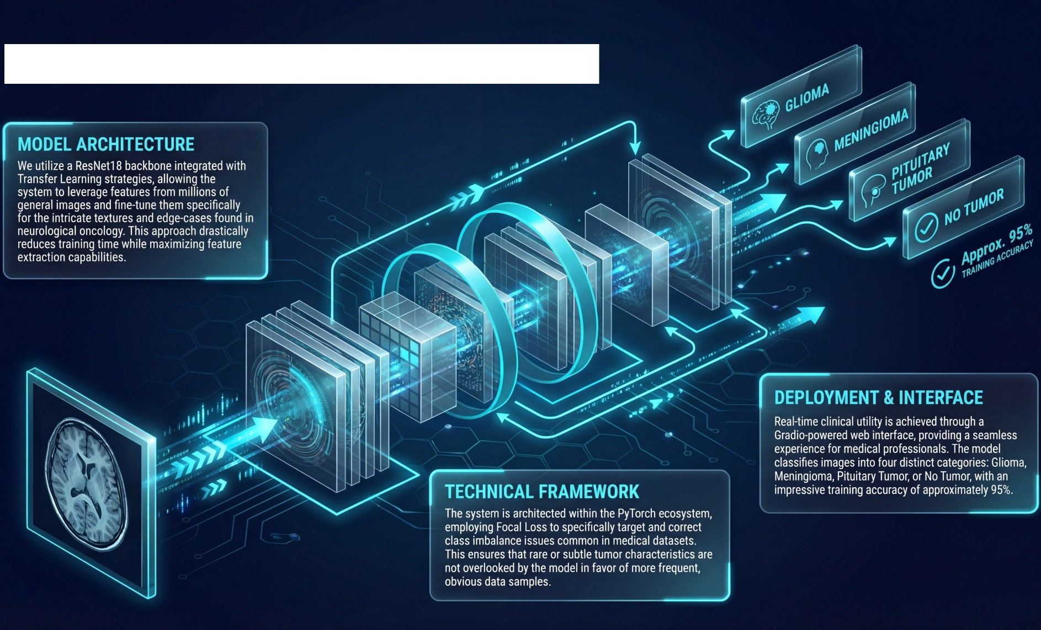
Project Overview & Architecture
Notes:
Overview

Slide 4
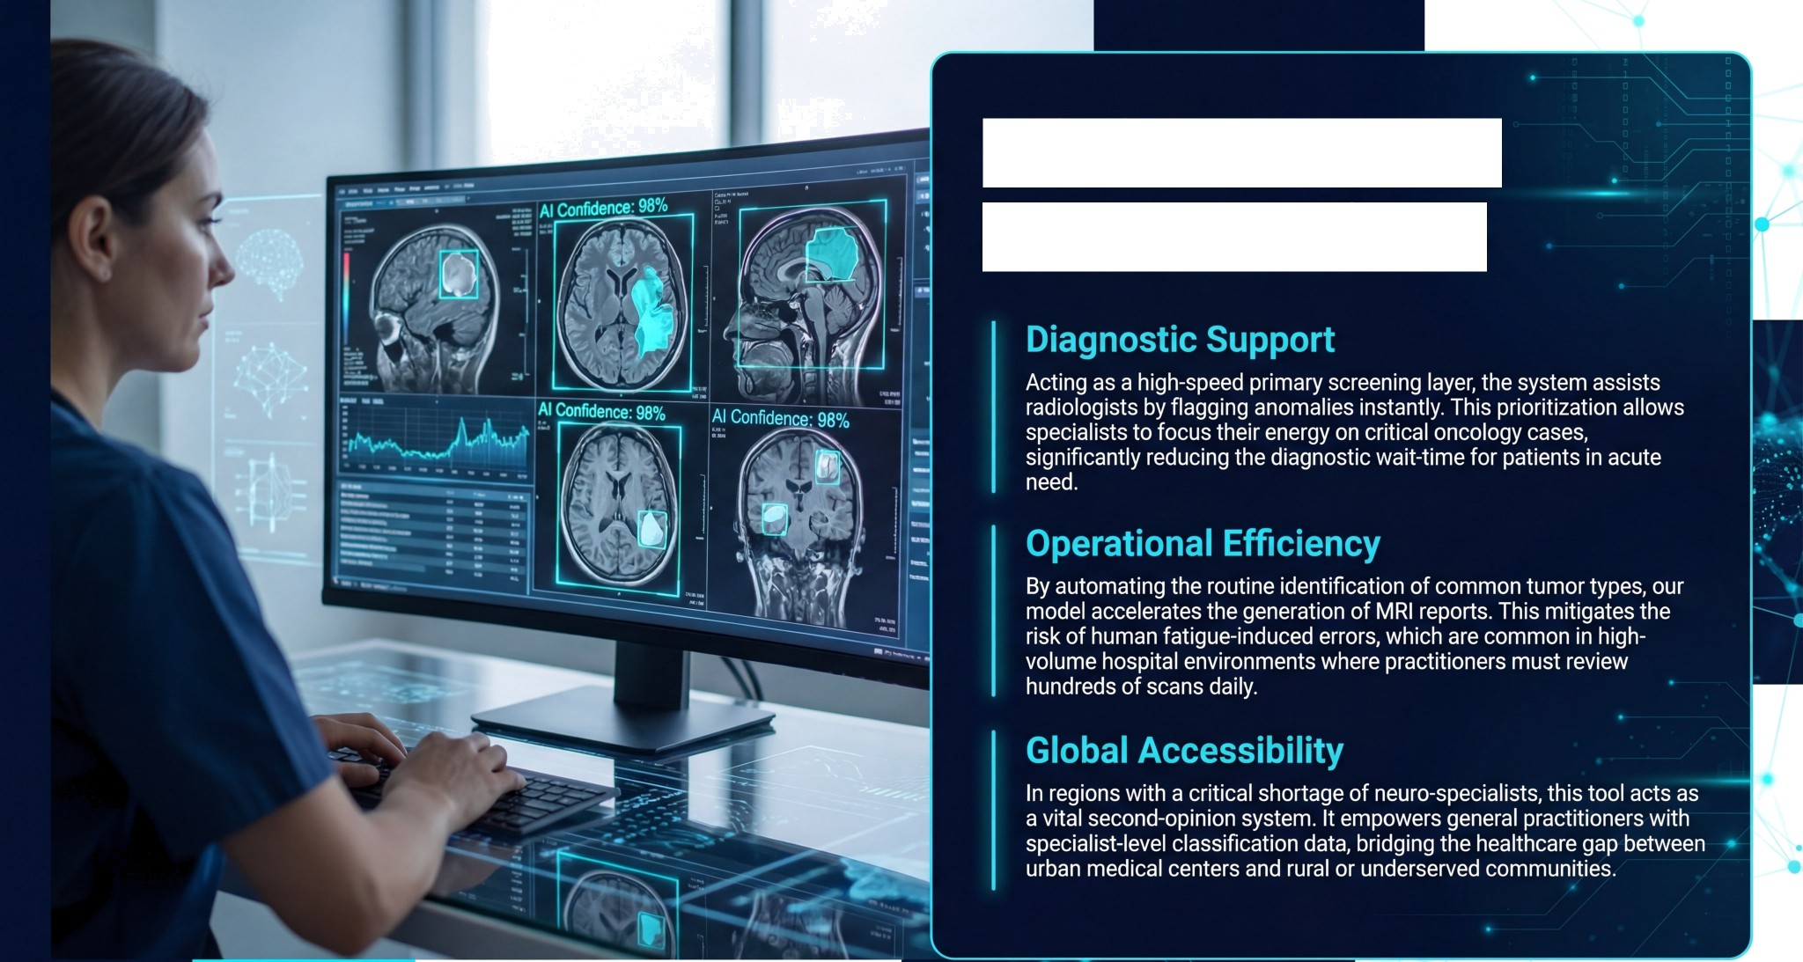

Clinical Impact
& Applications
Notes:
Accuracy metrics

Slide 5
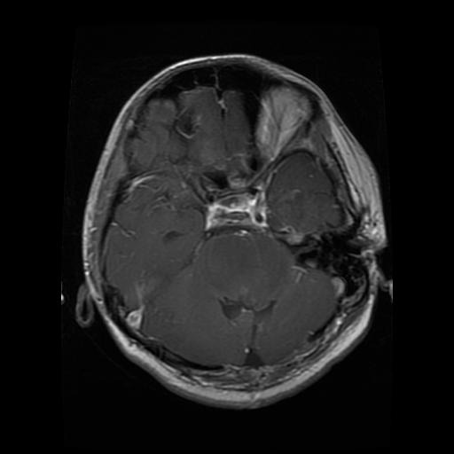
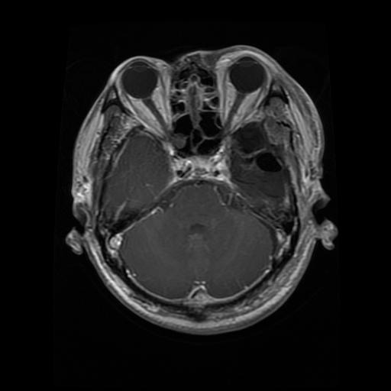
System Flow & Data Strategy
MRI Images
RAW MRI INPUT PREPROCESSING RESNET18 ENGINE GRADIO INTERFACE
CAT 0
& CONFIDENCE
DATA
AUGMENTATION
Our diagnostic pipeline is engineered for absolute consistency and clinical robustness. It initiates with raw MRI input, which immediately undergoes rigorous preprocessing: resizing to a standardized 224x224 resolution, pixel-value normalization, and strategic data augmentation to ensure orientation invariance. The core ResNet18 engine processes these frames to classify them into one of four clinical categories. The final result is served via a Gradio interface, displaying both the classification and a confidence score. To ensure the model remains unbiased and generalizes well to unseen patients, we implemented a strict 80/10/10 split for training, validation, and final testing datasets.
Notes:
Workflow

Slide 6
The evolution of this system focuses on deepening its diagnostic intelligence and clinical reach.
We are currently exploring the
integration of multi-hospital longitudinal datasets to improve model generalization across different MRI hardware and protocols.
Furthermore, we aim to implement Explainable AI (XAI) frameworks that
generate visual heatmaps, showing exactly which neural features influenced the
diagnosis.
Ultimately, we seek to develop lightweight, quantized versions of these models for mobile deployment and direct integration into hospital PACS
systems for a pervasive diagnostic ecosystem.
A key roadmap item is the transition from classification to segmentation using UNet architectures, enabling precise tumor volume localization.
Notes:
Future scopes

