Slide 1
Causal Inference
Causal Effect of Physical Activities on Depression
Group G
Tianran Zhang
Wenyu Zhu
Yinuo Liu

Slide 2
Study background
During 2013 - 2016, 8.1% of American adults age 20 and over had depression in a given 2-week period. Women (10.4%) were almost twice as likely as were men (5.5%) to had depression. Besides, depression is less prevalence in a family with higher income compared to those with lower income. Depressions are also related with health status, drug, alcohol, disabilities, comorbidities, and sleep conditions. Observational studies have shown that adults who reported low physical activity levels are at elevated risks of depression compared with those who reported moderate or higher levels of activity levels. We are interested in the causal effect of physical activities and depression in American adults. The outcome of interest is depression levels, and the population of interest is American adults age 20-65. We have 14 pre-intervention covariates age gender, family income, …. Data were collected form 2015 - 2016 National Health and Nutrition Evaluation Survey (NHANES)[1].

Slide 3
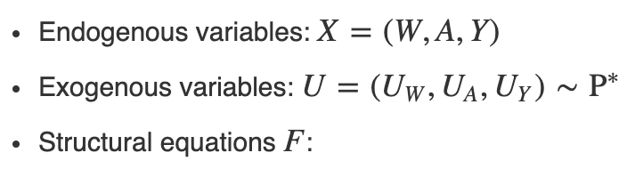
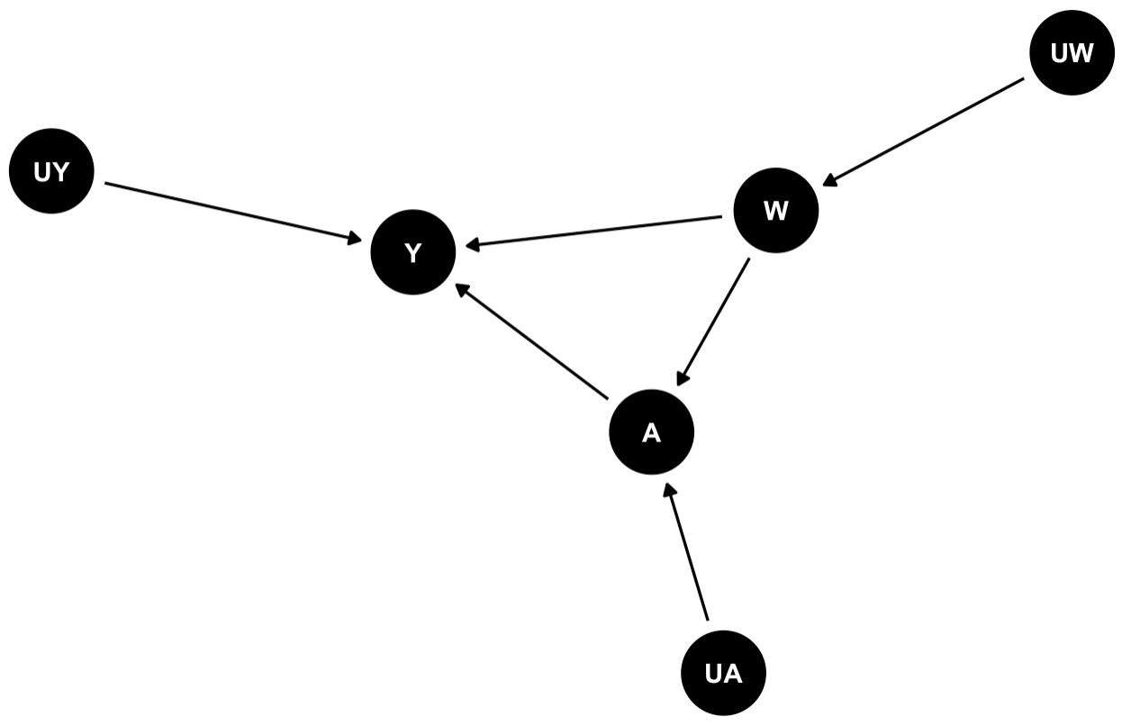
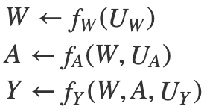
Step 0: Scientific Question
What is the causal effect of physical activities on depression among American adults age 20-65?
Step 1: Structural Causal Model

Slide 4



Step 2: Target Causal Parameter
Counterfactuals derived from the SCM
Y₁ :
Y₀ :
(Y₁,Y₀)~P*
Define Target Causal Parameter
Average Treatment Effect :

Slide 5

Step 3: Observed data & link to causal model.
Observed data: O = (W, A, Y) ~ P
Identification is the task of linking the two worlds
SCM: Specific interventions (counterfactual world)
Observed data: Existing conditions (real world)
No restrictions on the distributions of the observed data.
We have specified Y<—f_{Y}(W,A,U_{Y})
We have not specified Y<—β₀+β₁A+β₂W+U_{Y}

Slide 6
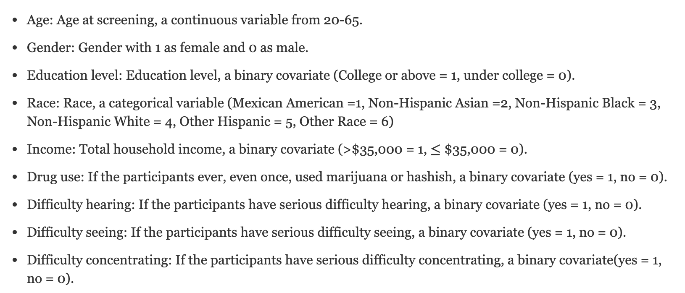
Variables Description

Slide 7
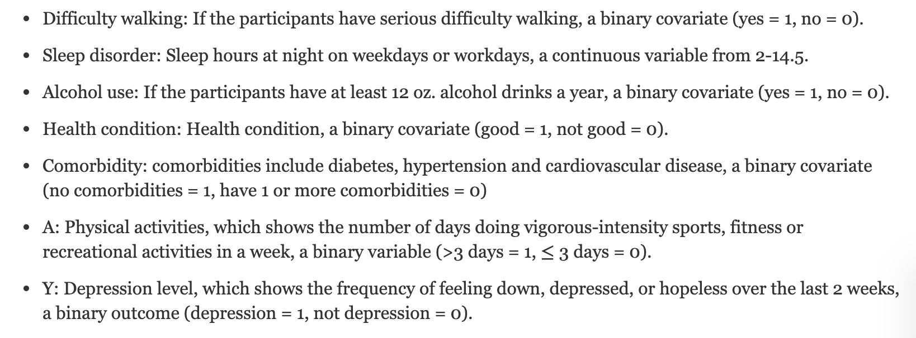
Variables Description

Slide 8
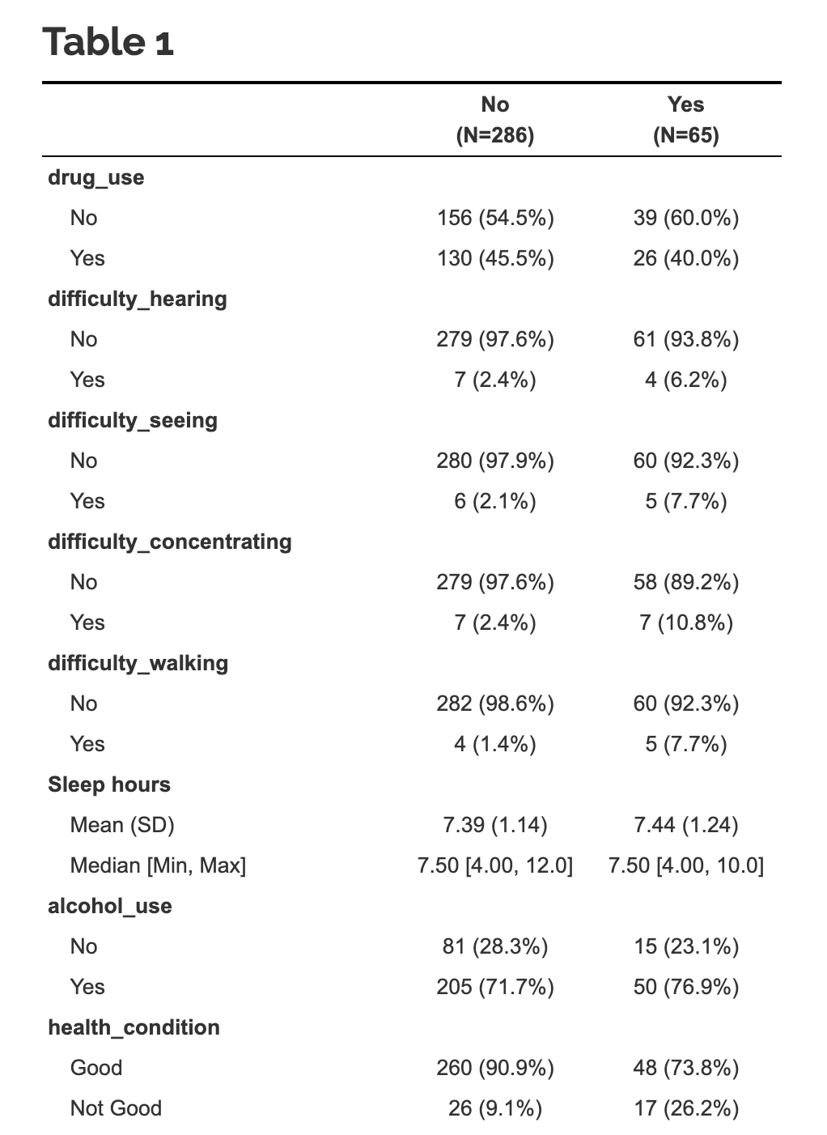
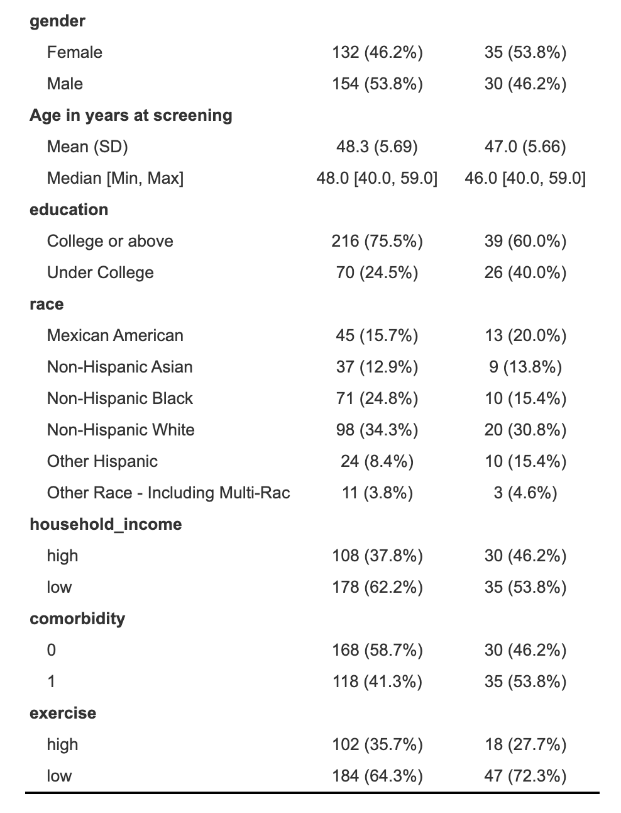

Slide 9

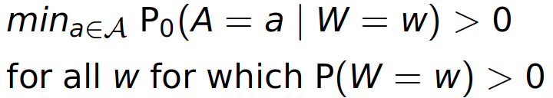
Steps 4-5: Identifiability & Committing to a statistical estimand
Randomization assumption:
Back-door criterion
W blocks all “back-door" paths from A to Y
No node in W is a descendant of A
Positivity assumption:

Slide 10
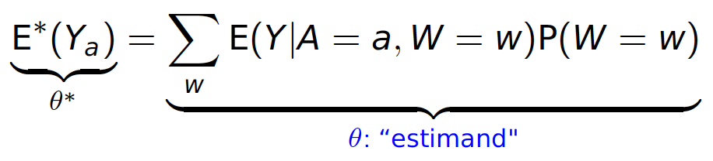
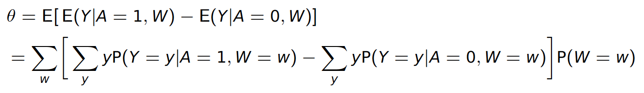
Steps 4-5: Identifiability & Committing to a statistical estimand
W satisfies the back-door criterion, the effect of exposure A on outcome Y is identified via the G-computation formula:
Statistical estimand

Slide 11
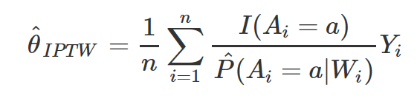
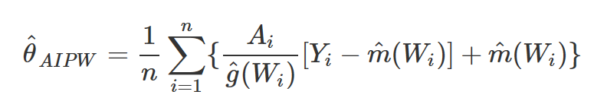
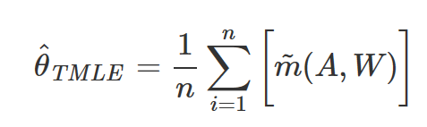
Steps 6: Estimate
Simple substitution estimator
IPTW
AIPW
TMLE

Slide 12
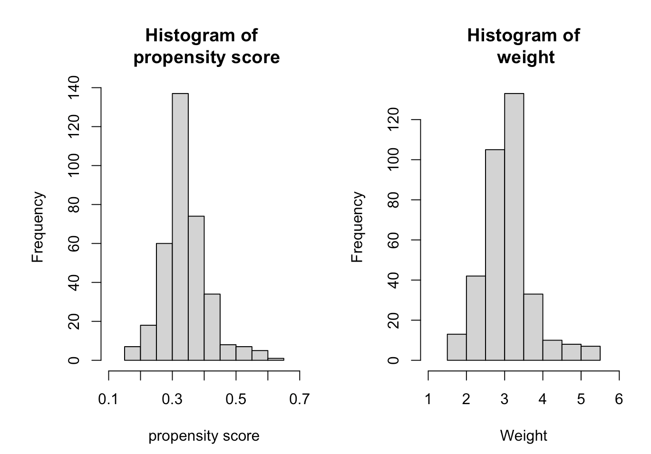
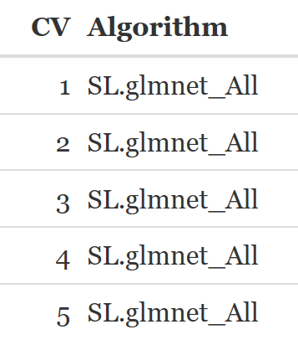
Steps 6: Estimate
Super Learner
Library: SL.glm, SL.glmnet, SL.earth
Cross validation Super Learner
Check the positivity assumption
Notes:
In statistics, the generalized linear model (GLM) is a flexible generalization of ordinary linear regression that allows for response variables that have error distribution models other than a normal distribution. The GLM generalizes linear regression by allowing the linear model to be related to the response variable via a link function and by allowing the magnitude of the variance of each measurement to be a function of its predicted value.
Glmnet is a package that fits a generalized linear model via penalized maximum likelihood. The regularization path is computed for the lasso or elasticnet penalty at a grid of values for the regularization parameter lambda. The algorithm is extremely fast, and can exploit sparsity in the input matrix x. It fits linear, logistic and multinomial, poisson, and Cox regression models. A variety of predictions can be made from the fitted models. It can also fit multi-response linear regression.
In statistics, multivariate adaptive regression splines (MARS) is a form of regression analysis introduced by Jerome H. Friedman in 1991.^{[1]} It is a non-parametric regression technique and can be seen as an extension of linear models that automatically models nonlinearities and interactions between variables.
As the corresponding non-stabilized weights range from 1 to 6, there is no extreme weight. Therefor, we do not add truncation to the corresponding non-stabilized weights.
be sure to specify the outcome, predictors, and SL library. Specify the cross-validation scheme by including `cvControl=list(V=5))` and `innerCvControl=list(list(V=10))`.
returns the algorithm with lowest CV risk (discrete Super Learner) at each step

Slide 13
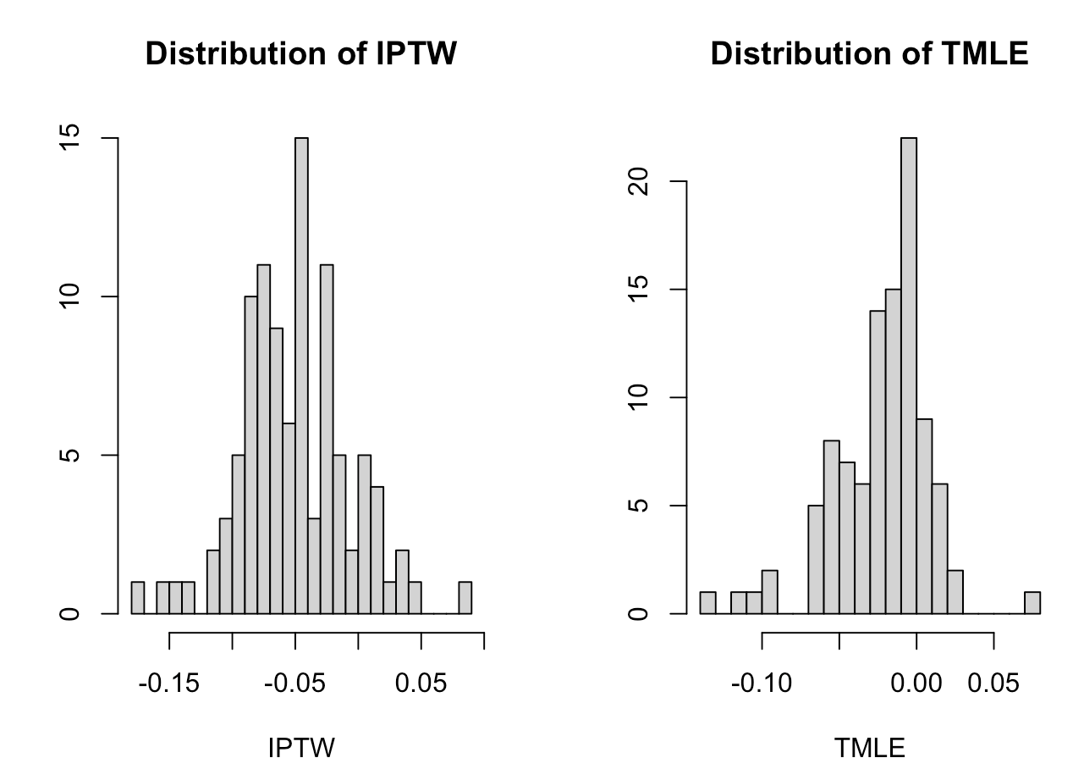
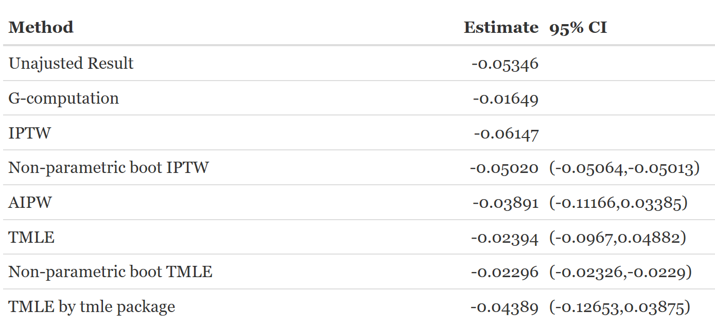
Steps 6: Estimate
Non-parametric bootstrap of IPTW and TMLE
Result
Notes:
From the plots, we can see the distribution of IPTW is nearly normal distribution with the mean of -0.05, which range form -0.15 to 0. For TMLE, the distribution is right skewed.
Based on the analyses described above, physical activity is negatively associated with depression among American adults. To be specific, the chance of diagnosing depression is a bit lower in American adults who spent more than 3 days doing vigorous-intensity sports, fitness, or recreational activities in a week compared to those who spent less than 3 days doing vigorous-intensity sports, fitness or recreational activities in a week.
We computed the unadjusted estimator (without considering any covariates), two IPTW estimators (by hand code and by non-parametric bootstrap), IPTW, and three TMLE estimators (by hand code, non-parametric bootstrap, and tmle package). Among all these estimators, the IPTW has the lowest estimated value (-0.061) compared to others, while G-computation has the highest estimated value (-0.016). We also derived the 95% confidence intervals for IPTW, TMLE and AIPW estimators based on the sample data. It seems like at a 0.05 significance level, only the non-parametric bootstrap estimator (IPTW and TMLE) is significantly lower than 0.

Slide 14
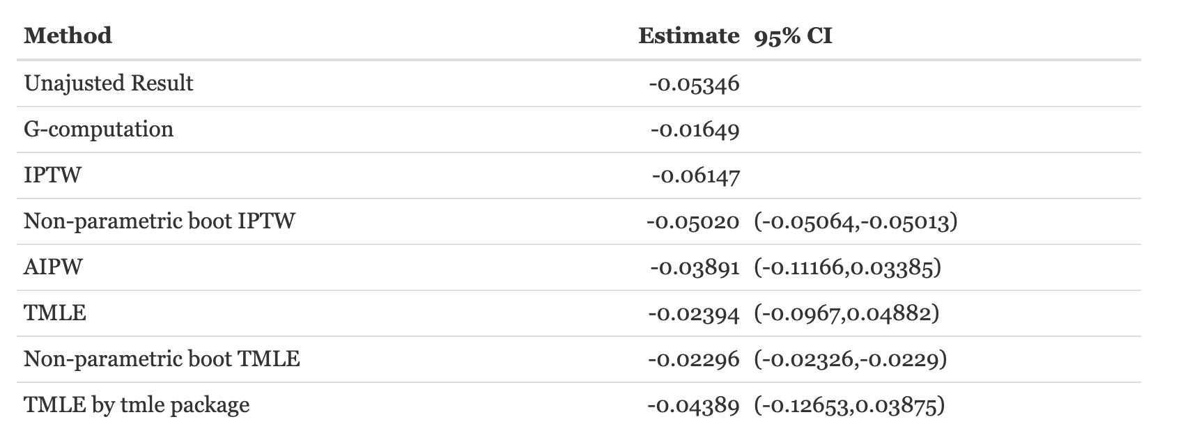
Step 7: Interpretation
Comparison table

Slide 15
Step 7: Interpretation
Statistical Interpretation
Based on the analyses described above, physical activity is negatively associated with depression among American adults. To be specific, the chance of diagnosing depression is a bit lower in American adults who spent more than 3 days doing vigorous-intensity sports, fitness, or recreational activities in a week compared to those who spent less than 3 days doing vigorous-intensity sports, fitness or recreational activities in a week.

Slide 16
Step 7: Interpretation
Causal Interpretation
Based on the analyses described above, physical activities have a negative causal effect on depression among American adults. To be specific, the chance of diagnosing with depression in the counterfactual world that all American adults spent more than 3 days doing vigorous-intensity sports, fitness or recreational activities in a week is a bit lower compared to the counterfactual world that all American adults spent less than 3 days doing vigorous-intensity sports, fitness or recreational activities in a week.
This result is plausible since much research suggested that physical activity can reduce depression symptoms. [1]

Slide 17
Step 7: Interpretation
Impact on Policy
Our results might inspire policy makers to focus more on people’s physical activities and encourage American adults to do more exercise to lower the prevalence of depression.

Slide 18
Step 7: Interpretation
Limitations
Lack of data (only 351 observations)
Self-reported depression might not correctly reflect everyone‘s depression situation
Lack of covariates

Slide 19
Step 7: Interpretation
Future Directions
Use data from another study with more subjects.
Use the frequency of some symptoms to reflect depression. (The feeling of sadness, tearfulness, emptiness or hopelessness.)
Consider more covariates in the future study based on new background knowledge.

Slide 20
References
[1] [NHANES]<cdc.gov/nchs/nhanes/index.htm>. [2] Staff, M. C. Depression and anxiety: Exercise eases symptoms [Online].[cited 2009].

Slide 21
Q & A

Slide 23
Critiquing
The report is well organized!
Creating wrappers to include their own parametric regressions is great to improve the Super Learner performance.

Slide 24
Critiquing
The study subject is interesting!
The data is collected in 2011. It may be better to use the updated data related to job class and wage of males.
For the intervention type of job, there is two categories, one is industrial and the other is information, it might be better if make it more specific. And in the future, it might be better to include more social, economic, and behavioral variables associated with wage into the study to make the assumption of randomization more plausible.

Slide 25
Critiquing
The estimation part is impressive!
You defined newly superlearner libraries and added tuning hyperparameters especially for ensemble methods and achieved a higher accuracy with less computing time.
How do you tune your parameters for superlearner?

