Slide 1
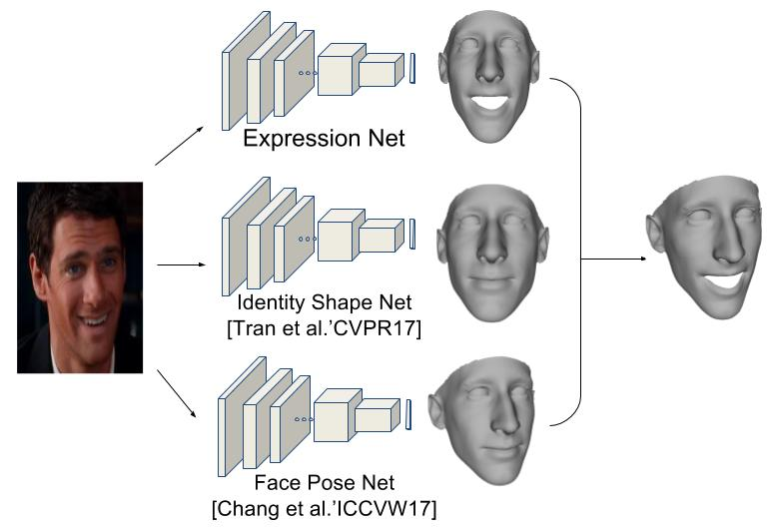
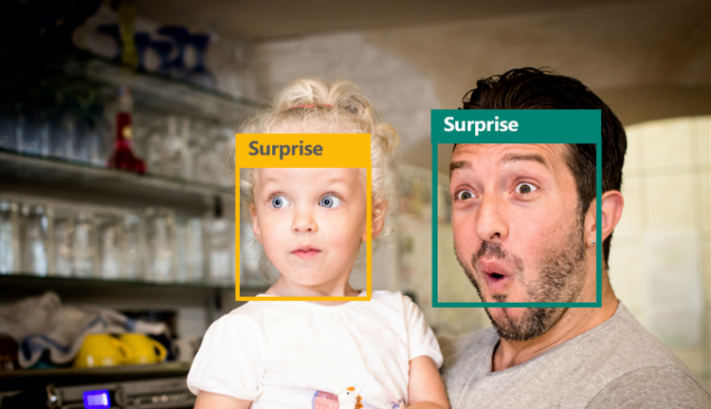
Facial Emotion Recognition using python
Problem Id :
Domain: Advance Deep Learning
Difficulty Level: Difficult

Slide 2
Challenge description with context
Title:-Facial Emotion Recognition python.
Description:-The Indian education landscape has been undergoing rapid changes for the past 10 years owing to the advancement of web-based learning services, specifically, eLearning platforms.
Global E-learning is estimated to witness an 8X over the next 5 years to reach USD 2B in 2021. India is expected to grow with a CAGR of 44% crossing the 10M users mark in 2021. Although the market is growing on a rapid scale, there are major challenges associated with digital learning when compared with brick and mortar classrooms. One of many challenges is how to ensure quality learning for students. Digital platforms might overpower physical classrooms in terms of content quality but when it comes to understanding whether students are able to grasp the content in a live class scenario is yet an open-end challenge. In a physical classroom during a lecturing teacher can see the faces and assess the emotion of the class and tune their lecture accordingly, whether he is going fast or slow. He can identify students who need special attention.

Slide 3
Expected Outcomes
System Model With using Webcam Scan face emotion and display the Correct emotion of the person .

Slide 4
Potential Impact
Digital classrooms are conducted via video telephony software program (ex-Zoom) where it’s not possible for medium scale class (25-50) to see all students and access the mood. Because of this drawback, students are not focusing on content due to lack of surveillance.

Slide 5
Technologies Involved: Advance Deep learning using Python .
Datasets: Easily Available on Kaggle.
Tutorials/Links: Facial Emotion Recognition Tutorials

Slide 6
Reference
https://www.techopedia.com/definition/30819/emotion-recognition
https://www.frontiersin.org/articles/10.3389/fpsyg.2021.759485/full

