Slide 1
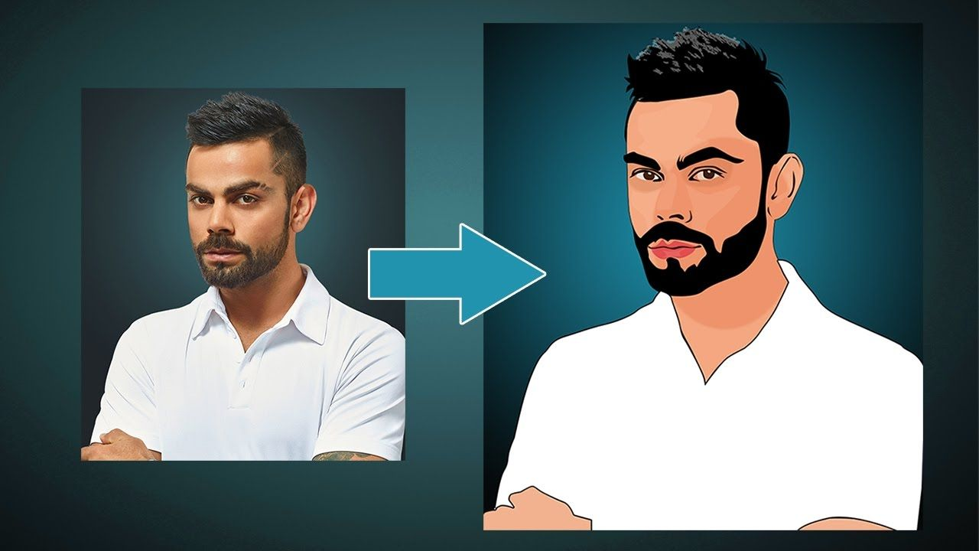
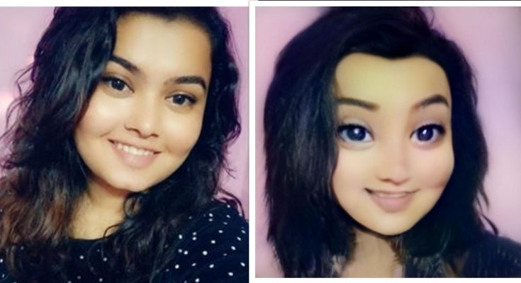
Cartoonify Image with Machine Learning
Problem Id :CV008
Domain: Computer Vision
Difficulty Level: Meduim

Slide 2
Challenge description with context
Title:-Cartoonify Image with Machine Learning
Description:-We will build one interesting application that will cartoonify the image provided to it. To build this cartoonifyer application we will use python and OpenCV. This is one of the exciting and thrilling applications of Machine Learning. While building this application we will also see how to use libraries like easygui, Tkinter, and all. Here you have to select the image and then the application will convert that image into its cartoon form.

Slide 3
Expected Outcomes
System Model With using Webcam Scan Image boundary or colour .

Slide 4
Potential Impact
With computer vision scanning of image and converting into cartoon texture would be easy.

Slide 5
Technologies Involved: Computer Vision Python .
Datasets: Easily Available on Google.
Tutorials/Links: Cartoonify image with machine learning

Slide 6
Reference
https://projectworlds.in/image-to-cartoon-python-opencv-machine-learning
Cartoonify an Image with OpenCV in Python - DataFlair (data-flair.training)

