Slide 1
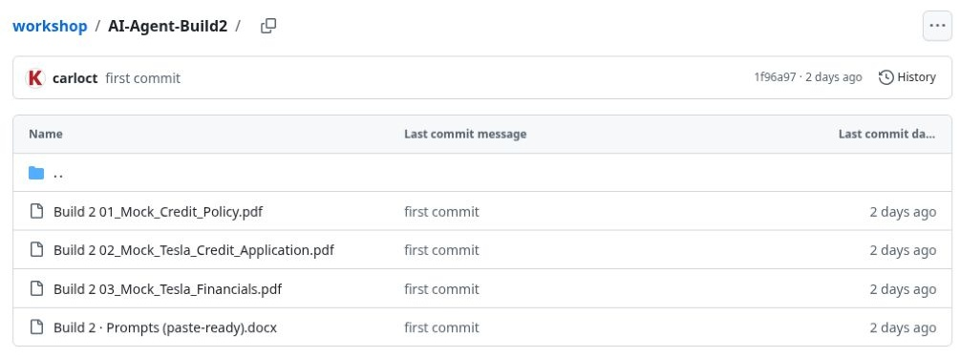
01
The four Build 2 files
Download the prompt and all three PDFs.
Project Sources:
prompt + PDF 01 policy.
Customer chat:
PDF 02 application + PDF 03 financials.
The prompt and policy are reusable. Customer evidence changes with every review.
Build 2 / Fictional training data / 21 October 2026
Notes:
Download all four workshop files, but place them in two different locations in ChatGPT. The Build 2 prompt describes the method and PDF 01 supplies the reusable credit policy. Those two belong in the project’s Sources. PDF 02 is the example customer’s application and PDF 03 is that customer’s financial statements; attach both in a new chat for that customer. Future customers use their own application and financials. All workshop company figures are fictional training inputs.
Corrected ChatGPT run: https://chatgpt.com/g/g-p-6ad8b88e73f8819182661b4e46dbebb4-build-2-credit-application-review-walkthrough/c/6ad8c544-1e18-83eb-b470-3cd96ee9b8a1

Slide 2
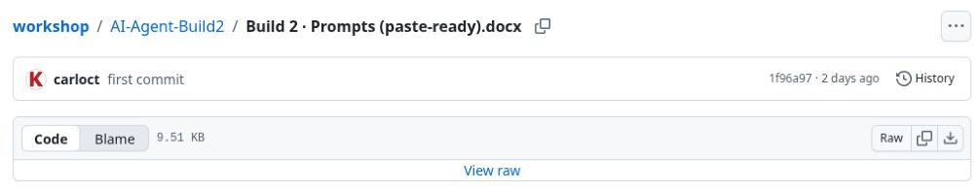
02
Individual file downloads
Open each file on GitHub.
Click Download raw file at the right of the file controls.
Repeat for all four files.
Keep the two customer PDFs ready for the chat.
Download four files; upload only the prompt and policy to project Sources.
Build 2 / Fictional training data / 21 October 2026
Notes:
The individual download control saves the file currently open on GitHub. Download the Word prompt, 01_Mock_Credit_Policy.pdf, 02_Mock_Tesla_Credit_Application.pdf and 03_Mock_Tesla_Financials.pdf. Downloading them together does not mean all four belong in project Sources. The customer application and statements will be attached to the customer’s chat at step 10.
Corrected ChatGPT run: https://chatgpt.com/g/g-p-6ad8b88e73f8819182661b4e46dbebb4-build-2-credit-application-review-walkthrough/c/6ad8c544-1e18-83eb-b470-3cd96ee9b8a1

Slide 3
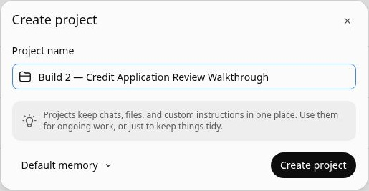
03
A dedicated review project
Open Projects and choose Create.
Enter a clear project name, then click Create project.
Reuse this project’s workflow and policy for separate customer chats.
Project name: Build 2 — Credit Application Review Walkthrough
Build 2 / Fictional training data / 21 October 2026
Notes:
The project holds the reusable Build 2 workflow and credit policy. Start a separate chat within it for each customer and attach the relevant customer documents in that chat. This is a document-scoping convention, not a security boundary. The saved instructions require the current chat’s customer files and must not substitute another customer’s documents or an earlier review.
Corrected ChatGPT run: https://chatgpt.com/g/g-p-6ad8b88e73f8819182661b4e46dbebb4-build-2-credit-application-review-walkthrough/c/6ad8c544-1e18-83eb-b470-3cd96ee9b8a1

Slide 4
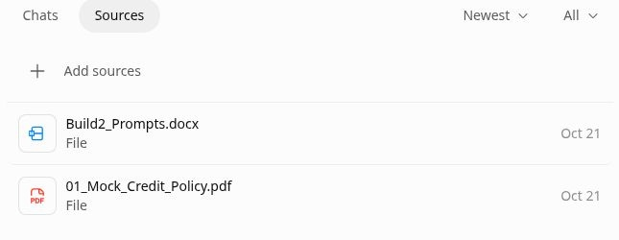
04
Upload the reusable sources
Open Sources, then Add sources.
Upload Build2_Prompts.docx and PDF 01, the mock credit policy.
Wait for both uploads to finish.
Only the workflow and policy belong in project Sources.
Build 2 / Fictional training data / 21 October 2026
Notes:
Choose Add sources and Upload for the reusable project material. Select only Build2_Prompts.docx and 01_Mock_Credit_Policy.pdf. The screenshot shows the corrected project source list after those two files were retained. Do not add the customer application or financials here: those vary by customer and belong in the current customer’s chat. The original setup has been corrected and the review rerun with the customer documents attached to the chat.
Corrected ChatGPT run: https://chatgpt.com/g/g-p-6ad8b88e73f8819182661b4e46dbebb4-build-2-credit-application-review-walkthrough/c/6ad8c544-1e18-83eb-b470-3cd96ee9b8a1

Slide 5
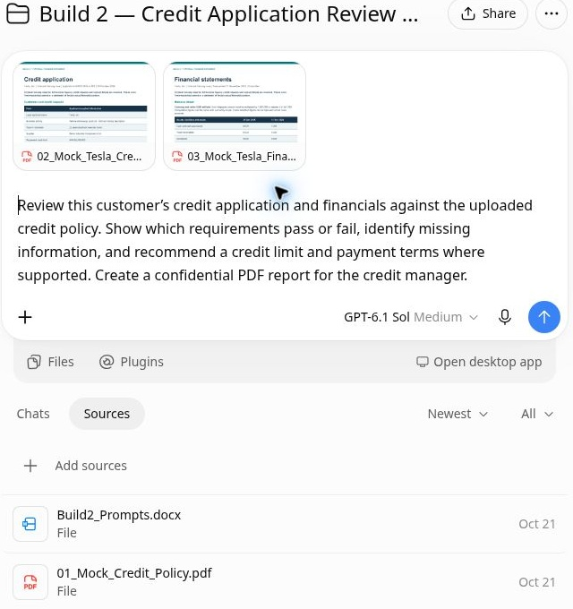
05
Two sources; customer files in chat
Check that Sources contains exactly two reusable files.
Start a new chat for each customer.
Attach that customer’s application and financials in the message.
Top: customer PDFs in the chat. Bottom: prompt and policy in project Sources.
Build 2 / Fictional training data / 21 October 2026
Notes:
The complete screenshot makes the separation visible. The two PDF cards above the message are the customer application and financial statements. Below, the project Sources list contains only the prompt and policy. A new customer requires a new chat and a new set of customer evidence; do not reuse this fictional applicant’s documents. Naming the customer in the chat helps identify the review, but the matching legal entity and reporting period must still be checked.
Corrected ChatGPT run: https://chatgpt.com/g/g-p-6ad8b88e73f8819182661b4e46dbebb4-build-2-credit-application-review-walkthrough/c/6ad8c544-1e18-83eb-b470-3cd96ee9b8a1

Slide 6
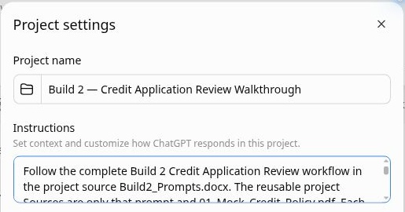
06
Project instructions
Open Project settings.
Tell ChatGPT to follow the prompt and policy.
Require the customer documents attached to the current chat.
Save the instructions.
Use the current chat’s customer evidence; ask if either document is missing.
Build 2 / Fictional training data / 21 October 2026
Notes:
The saved instructions identify the reusable sources as Build2_Prompts.docx and 01_Mock_Credit_Policy.pdf. They require each customer’s application and statements to be attached to the current chat and prohibit substituting another customer’s documents or earlier chat results. If an input is missing, ask for it. The instructions also retain the original controls: no external research, use calculation tools, cite source pages, identify exceptions and generate a confidential PDF. This training demonstration recommends only; the credit manager decides.
Corrected ChatGPT run: https://chatgpt.com/g/g-p-6ad8b88e73f8819182661b4e46dbebb4-build-2-credit-application-review-walkthrough/c/6ad8c544-1e18-83eb-b470-3cd96ee9b8a1

Slide 7
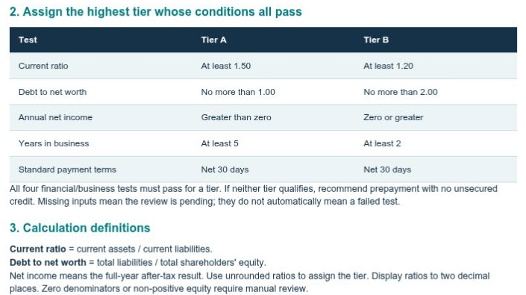
07
The policy defines the tests
The policy offers Tier A and Tier B.
Every test must pass for a tier.
ChatGPT must use the stated thresholds, then select the highest qualifying tier.
Both tiers use Net 30.
Source: mock credit policy, page 1.
Build 2 / Fictional training data / 21 October 2026
Notes:
Tier A requires current ratio at least 1.50, debt to net worth at most 1.00, annual net income greater than zero and at least five years in business. Tier B requires current ratio at least 1.20, debt to net worth at most 2.00, annual net income zero or greater and at least two years in business. All four tests must pass. Missing inputs trigger a pending review. If neither tier qualifies on complete inputs, the policy recommends prepayment and no unsecured credit. Source: 01_Mock_Credit_Policy.pdf, page 1.
Corrected ChatGPT run: https://chatgpt.com/g/g-p-6ad8b88e73f8819182661b4e46dbebb4-build-2-credit-application-review-walkthrough/c/6ad8c544-1e18-83eb-b470-3cd96ee9b8a1

Slide 8
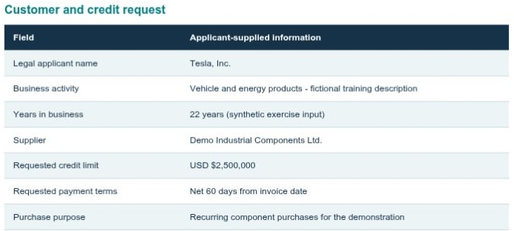
08
The applicant’s request
The mock application states:
USD $2,500,000 requested credit.
Net 60 payment terms.
22 years in business.
These are the figures to compare with the policy.
PDF 02 is this customer’s application. Attach it in the customer chat.
Build 2 / Fictional training data / 21 October 2026
Notes:
The fictional application is DEMO-TESLA-001, dated 19 October 2026. It identifies Tesla, Inc., the fictional supplier, a simulated finance contact and an applicant declaration. The case supplies its required contact and declaration information. Bank and trade references are expressly unnecessary under this exercise's policy. No real customer contact or verification took place. Source: 02_Mock_Tesla_Credit_Application.pdf, page 1.
Document placement: attach this application in the current customer’s chat. It is not a reusable project Source. Replace it with the next customer’s own application for a new review.
Corrected ChatGPT run: https://chatgpt.com/g/g-p-6ad8b88e73f8819182661b4e46dbebb4-build-2-credit-application-review-walkthrough/c/6ad8c544-1e18-83eb-b470-3cd96ee9b8a1

Slide 9
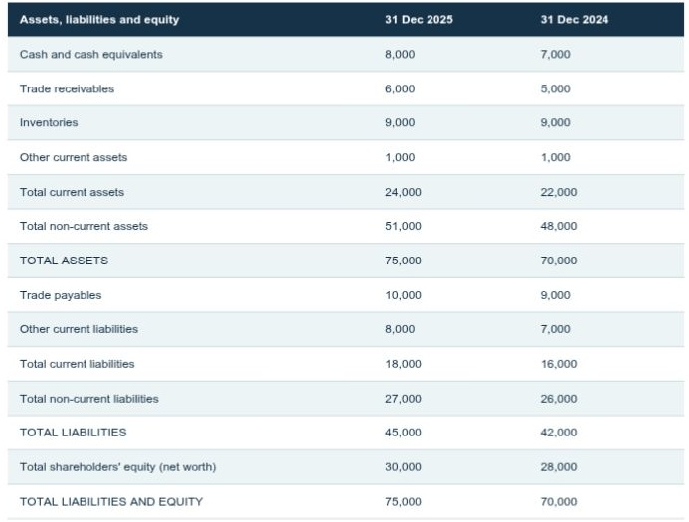
09
The reporting year and units
Use FY2025, the latest full year.
The statements use USD millions.
Check that the applicant and statement entities match.
Convert figures to full USD before calculating a dollar limit.
PDF 03 goes in the customer chat. 30,000 USD millions equals $30bn.
Build 2 / Fictional training data / 21 October 2026
Notes:
The balance sheet is dated 31 December 2025, within 15 months of the application date, 19 October 2026. Calendar arithmetic gives an age of 292 days. FY2024 figures are comparatives and are excluded from policy tests. Current assets are 24,000, current liabilities 18,000, total liabilities 45,000 and equity 30,000, all in USD millions. FY2025 after-tax net income is 4,000 USD millions. The statements are synthetic and unaudited, which this demo policy allows if disclosed. Sources: financials pages 1–2, application page 1, policy page 1.
Document placement: attach the financial statements in the same customer chat as the application. They are not a reusable project Source. Check the period, currency, units and exact applicant entity for each new customer.
Corrected ChatGPT run: https://chatgpt.com/g/g-p-6ad8b88e73f8819182661b4e46dbebb4-build-2-credit-application-review-walkthrough/c/6ad8c544-1e18-83eb-b470-3cd96ee9b8a1

Slide 10
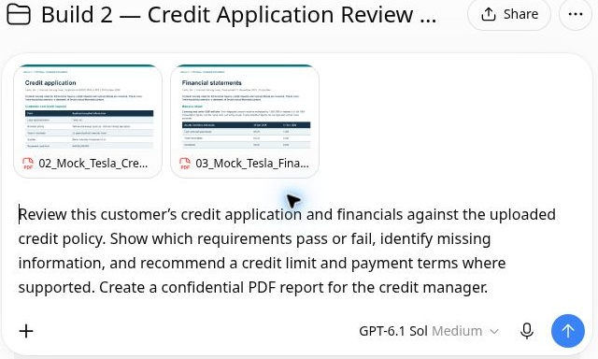
10
Attach customer documents and run
Start a new customer chat.
Use + to attach PDF 02 and PDF 03.
Paste the workshop review prompt and click Send.
Keep the policy in project Sources.
The two customer PDFs accompany the request in this chat.
Build 2 / Fictional training data / 21 October 2026
Notes:
In a new chat inside the project, use the composer’s plus control, then Add photos & files and Upload from computer. Select 02_Mock_Tesla_Credit_Application.pdf and 03_Mock_Tesla_Financials.pdf. Wait until both PDF cards are ready before sending the workshop run prompt shown here. Ask ChatGPT to compare the current customer’s evidence with the reusable policy, show pass/fail checks, identify missing information, recommend a supported limit and terms, and create a confidential report. For another customer, use that customer’s files in a fresh chat.
Corrected ChatGPT run: https://chatgpt.com/g/g-p-6ad8b88e73f8819182661b4e46dbebb4-build-2-credit-application-review-walkthrough/c/6ad8c544-1e18-83eb-b470-3cd96ee9b8a1

Slide 11
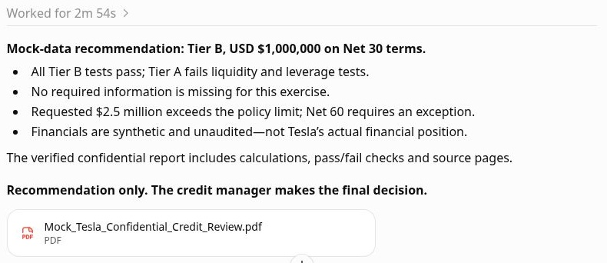
11
The completed policy review
ChatGPT reads the reusable workflow and policy.
It reviews the customer files attached to this chat and calculates the policy tests.
The corrected run completed in 2m 54s.
The review was rerun with the application and financials attached to the chat.
Build 2 / Fictional training data / 21 October 2026
Notes:
This screenshot is from the corrected run. The application and financial statements were attached to the user’s message, while project Sources held only the prompt and policy. ChatGPT completed the review in 2 minutes 54 seconds and returned the same supported training recommendation: Tier B, USD $1,000,000, Net 30. Timing is an observed example, not a guaranteed service time. The following slides inspect the new three-page PDF generated by this corrected run.
Corrected ChatGPT run: https://chatgpt.com/g/g-p-6ad8b88e73f8819182661b4e46dbebb4-build-2-credit-application-review-walkthrough/c/6ad8c544-1e18-83eb-b470-3cd96ee9b8a1

Slide 12
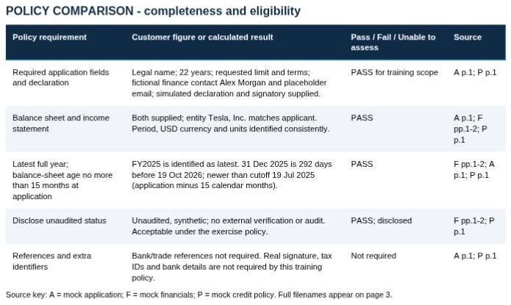
12
Completeness and eligibility checks
The report confirms that required inputs are present.
It checks the entity, reporting period, currency and units.
The statements meet the policy’s age rule, and the report discloses their unaudited status.
The first report page records the customer, source basis and policy version.
Build 2 / Fictional training data / 21 October 2026
Notes:
All required information was present and readable for this fictional exercise. The legal name matched across the application and statements, the reporting scope was consistent, and the latest full year was identified. The report's completeness table cites individual source pages. No test was unable to assess. This result applies only to the supplied mock case. It does not verify a real business, contact or signature.
Corrected ChatGPT run: https://chatgpt.com/g/g-p-6ad8b88e73f8819182661b4e46dbebb4-build-2-credit-application-review-walkthrough/c/6ad8c544-1e18-83eb-b470-3cd96ee9b8a1

Slide 13
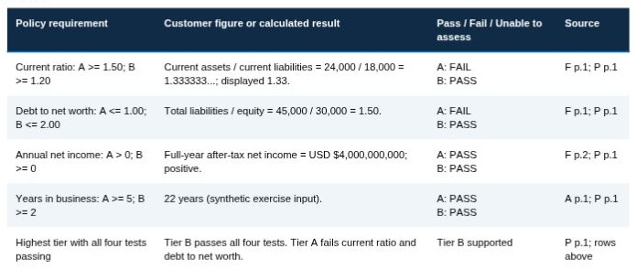
13
Why the case qualifies for Tier B
Current ratio:
24,000 ÷ 18,000 = 1.33.
Debt to net worth:
45,000 ÷ 30,000 = 1.50.
Both fail Tier A and pass Tier B.
Profit and business age pass both tiers.
The unrounded results determine the tier. Two decimals are for display.
Build 2 / Fictional training data / 21 October 2026
Notes:
Current ratio is 1.333333…, below Tier A's 1.50 minimum but above Tier B's 1.20 minimum. Debt to net worth is 1.50, above Tier A's 1.00 maximum but below Tier B's 2.00 maximum. Positive annual net income of 4,000 USD millions and 22 years in business pass both tiers. Tier B is the highest tier whose four conditions all pass. Positive income and business age do not offset Tier A's two failed ratios. Financial sources: page 1 for balance sheet figures, page 2 for net income. Application page 1 supplies the business age.
Corrected ChatGPT run: https://chatgpt.com/g/g-p-6ad8b88e73f8819182661b4e46dbebb4-build-2-credit-application-review-walkthrough/c/6ad8c544-1e18-83eb-b470-3cd96ee9b8a1

Slide 14
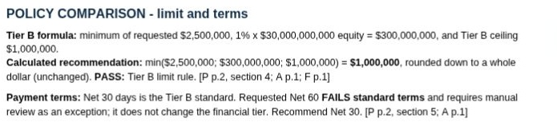
14
How the $1 million limit is calculated
Tier B takes the lowest of:
Requested limit: $2.5m.
1% of equity: $300m.
Policy cap: $1m.
The supported recommendation is $1,000,000.
The absolute policy cap determines the limit in this case.
Build 2 / Fictional training data / 21 October 2026
Notes:
Equity conversion: 30,000 × $1,000,000 = $30,000,000,000. One percent is $300,000,000. The policy formula is min($2,500,000 requested, $300,000,000 equity allowance, $1,000,000 Tier B cap) = $1,000,000. Rounding down to a whole dollar leaves that result unchanged. The common USD-million scale cancels in ratios, but dollar caps require the full-USD conversion. Policy page 2 defines the formula. Application page 1 and financials page 1 supply the inputs.
Corrected ChatGPT run: https://chatgpt.com/g/g-p-6ad8b88e73f8819182661b4e46dbebb4-build-2-credit-application-review-walkthrough/c/6ad8c544-1e18-83eb-b470-3cd96ee9b8a1

Slide 15
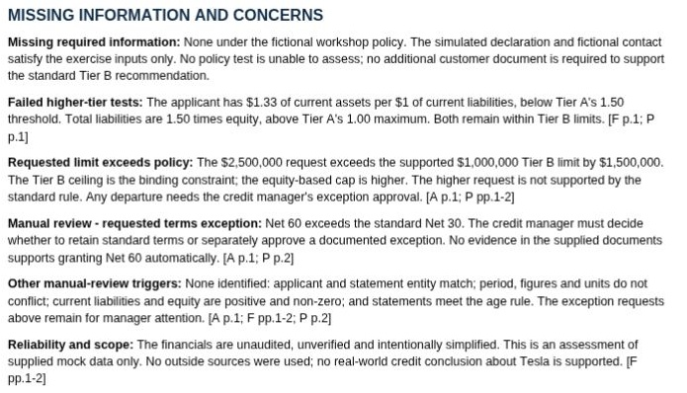
15
Exceptions and concerns
The requested $2.5m exceeds the supported limit.
Net 60 exceeds the standard Net 30 terms.
The report flags both for the manager and discloses the synthetic, unaudited evidence.
Longer terms require review and do not change the financial tier.
Build 2 / Fictional training data / 21 October 2026
Notes:
Policy page 2 says a longer term request does not change the financial tier. The supported recommendation remains Net 30, with Net 60 referred for manual review. A full $2.5 million limit would also exceed the Tier B policy ceiling and require an exception. No exception approval was supplied or granted. The report found no missing policy inputs, stale statements, mismatched entities, conflicting units, zero denominators or non-positive equity. These findings are specific to the supplied exercise documents.
Corrected ChatGPT run: https://chatgpt.com/g/g-p-6ad8b88e73f8819182661b4e46dbebb4-build-2-credit-application-review-walkthrough/c/6ad8c544-1e18-83eb-b470-3cd96ee9b8a1

Slide 16
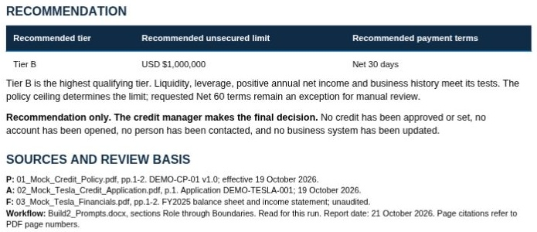
16
The recommendation for the credit manager
Recommended tier: B.
Unsecured limit: $1,000,000.
Payment terms: Net 30.
The credit manager makes the final decision.
Recommendation only. No credit approval or system update took place.
Build 2 / Fictional training data / 21 October 2026
Notes:
The recommendation is supported by all Tier B tests passing and the $1 million absolute cap. The report recommends standard Net 30 terms and refers the requested exception to the credit manager. The assistant did not approve credit, set a business-system limit, create an account, contact a customer or update any business system. All inputs and the resulting recommendation are fictional training material.
Corrected ChatGPT run: https://chatgpt.com/g/g-p-6ad8b88e73f8819182661b4e46dbebb4-build-2-credit-application-review-walkthrough/c/6ad8c544-1e18-83eb-b470-3cd96ee9b8a1

Slide 17
17
The completed PDF handover
The final chat summarises the result and links the report.
Click the PDF card to preview it.
Use Download, then PDF, to save it.
The report contains three confidential pages.
The finished report includes source pages, calculations, concerns and the recommendation.
Build 2 / Fictional training data / 21 October 2026
Notes:
The corrected run’s final message summarises the mock recommendation and contains the PDF card Mock_Tesla_Confidential_Credit_Review.pdf. Click the card to preview the three-page report, then use the viewer’s Download control and choose PDF. The report’s first page covers completeness; the second shows financial tests, unit conversions, the limit calculation and terms; the third explains concerns and the recommendation. Confidential and mock-data markings appear on every page. No credit approval or business-system update took place.
Corrected ChatGPT run: https://chatgpt.com/g/g-p-6ad8b88e73f8819182661b4e46dbebb4-build-2-credit-application-review-walkthrough/c/6ad8c544-1e18-83eb-b470-3cd96ee9b8a1

