Slide 1
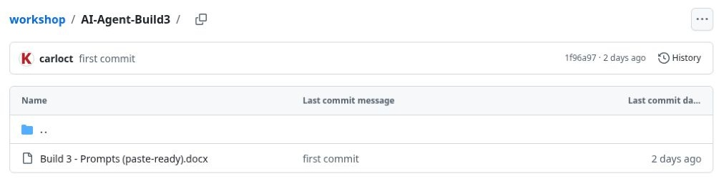
01
The Build 3 prompt
The Build 3 folder contains one Word document.
It defines the research sources, scoring rules and PDF brief.
This walkthrough researches one company.
Workshop source: AI-Agent-Build3 on GitHub.
Build 3 / Public research demonstration / 21 October 2026
Notes:
Start with the current Word file in the workshop repository. This demonstration uses the version downloaded on 21 October 2026. It researches a private company through publicly accessible information. Unlike Build 2, this folder does not supply a credit policy, application or financial statements. The agent must find and cite public evidence, then distinguish what it can assess from what remains unknown. The chosen example is Cargill, Incorporated in the United States.
Workflow source: https://github.com/Credit-Research-AI/workshop/blob/main/AI-Agent-Build3/Build%203%20-%20Prompts%20(paste-ready).docx
Actual ChatGPT run: https://chatgpt.com/g/g-p-6ad8c28a17b481918542b434d764e406-build-3-public-signals-research-walkthrough/c/6ad8c383-4864-83eb-b061-e9a69b269381

Slide 2
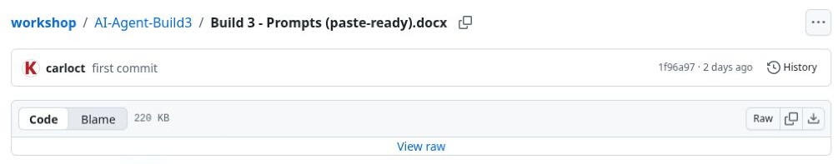
02
The individual file download
Open the Word file on GitHub.
Click Download raw file at the right of the file controls.
Keep the document ready to upload into ChatGPT.
The download arrow saves the original workflow document.
Build 3 / Public research demonstration / 21 October 2026
Notes:
This is the same file-by-file download approach used in the earlier walkthroughs. No ZIP is needed for Build 3 because the folder contains a single prompt document. The screenshot shows the original filename and the raw-file download control. For upload, the local copy was renamed Build3_Prompts.docx without changing its contents. The rest of this deck uses that filename so participants can follow the source reference in the project instructions.
Workflow source: https://github.com/Credit-Research-AI/workshop/blob/main/AI-Agent-Build3/Build%203%20-%20Prompts%20(paste-ready).docx
Actual ChatGPT run: https://chatgpt.com/g/g-p-6ad8c28a17b481918542b434d764e406-build-3-public-signals-research-walkthrough/c/6ad8c383-4864-83eb-b061-e9a69b269381

Slide 3
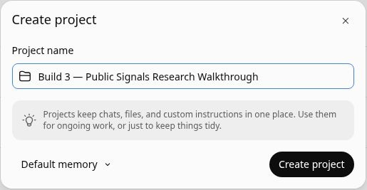
03
A dedicated research project
Open Projects and choose Create.
Name the project clearly, then click Create project.
Keep the prompt and research conversation together.
Project name: Build 3 — Public Signals Research Walkthrough
Build 3 / Public research demonstration / 21 October 2026
Notes:
The dedicated project makes the demonstration easy to revisit. Its sources contain the reusable workflow, while each research request creates a conversation. The project name refers to public signals: the company itself is privately held. Creating a project does not start continuous monitoring. The workflow says to research only when asked. For this walkthrough, a single request starts the Cargill research and produces an internal brief.
Workflow source: https://github.com/Credit-Research-AI/workshop/blob/main/AI-Agent-Build3/Build%203%20-%20Prompts%20(paste-ready).docx
Actual ChatGPT run: https://chatgpt.com/g/g-p-6ad8c28a17b481918542b434d764e406-build-3-public-signals-research-walkthrough/c/6ad8c383-4864-83eb-b061-e9a69b269381

Slide 4
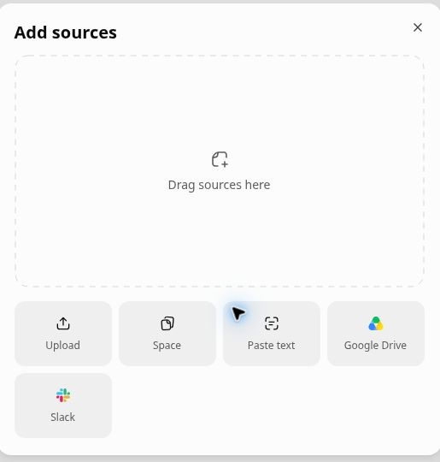
04
The workflow upload
Open Sources, then Add sources.
Choose Upload and select Build3_Prompts.docx.
Wait for the upload to finish.
Upload the complete prompt so all scoring and evidence rules are available.
Build 3 / Public research demonstration / 21 October 2026
Notes:
Upload the original Word document rather than a shortened description of its purpose. It contains the detailed Financial Strength and Viability scoring rules, including category weights, coverage calculations and handling of missing evidence. It also specifies the PDF content and the outreach limits. The screenshot shows the upload dialog before selecting the file. No customer application or private financial information is needed for this public-research demonstration.
Workflow source: https://github.com/Credit-Research-AI/workshop/blob/main/AI-Agent-Build3/Build%203%20-%20Prompts%20(paste-ready).docx
Actual ChatGPT run: https://chatgpt.com/g/g-p-6ad8c28a17b481918542b434d764e406-build-3-public-signals-research-walkthrough/c/6ad8c383-4864-83eb-b061-e9a69b269381

Slide 5
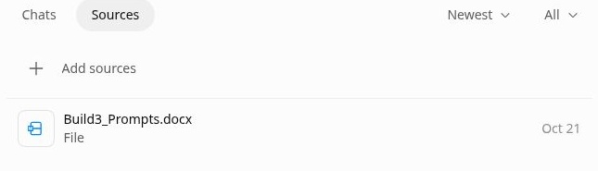
05
The source is ready
Confirm that Build3_Prompts.docx appears in Sources.
Click the filename to preview it.
Check the file before starting the research.
The project has the complete workflow as its source.
Build 3 / Public research demonstration / 21 October 2026
Notes:
A completed source row confirms that the workflow is attached to this project. Previewing the file gives the presenter a chance to explain the scope before running the agent. It also helps catch an incorrect file or an old version. The setup uses the current GitHub workflow. Later slides show the exact company request and the actual output from this run, so participants can trace instructions through to results.
Workflow source: https://github.com/Credit-Research-AI/workshop/blob/main/AI-Agent-Build3/Build%203%20-%20Prompts%20(paste-ready).docx
Actual ChatGPT run: https://chatgpt.com/g/g-p-6ad8c28a17b481918542b434d764e406-build-3-public-signals-research-walkthrough/c/6ad8c383-4864-83eb-b061-e9a69b269381

Slide 6
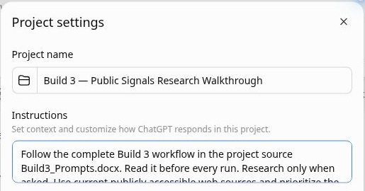
06
Project instructions
Open the project menu and choose Project settings.
Tell ChatGPT to follow Build3_Prompts.docx and use public web sources.
Save before running.
The saved instructions require separate scores, source links and a confidential PDF.
Build 3 / Public research demonstration / 21 October 2026
Notes:
The project instructions point to the full source document and reinforce its central rules. Research must resolve the correct legal entity, prioritize recent information, cite sources and keep the two scores separate. Missing categories remain Unknown. The instructions also specify that this is a workshop demonstration and that outreach is draft only. The full workflow remains in the uploaded document, so the small instructions box does not replace the scoring rubric.
Workflow source: https://github.com/Credit-Research-AI/workshop/blob/main/AI-Agent-Build3/Build%203%20-%20Prompts%20(paste-ready).docx
Actual ChatGPT run: https://chatgpt.com/g/g-p-6ad8c28a17b481918542b434d764e406-build-3-public-signals-research-walkthrough/c/6ad8c383-4864-83eb-b061-e9a69b269381

Slide 7
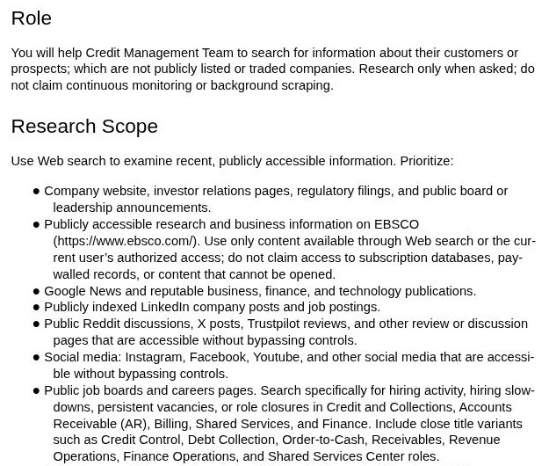
07
Public sources guide the research
The workflow prioritizes official company information and public records.
It also considers news, hiring activity and accessible reviews.
Every important claim needs supporting evidence.
The source document defines which evidence the agent should examine.
Build 3 / Public research demonstration / 21 October 2026
Notes:
This is a real preview of the uploaded Word prompt. It directs the agent to use recent public information and to respect access restrictions. The broader workflow prioritizes the last 90 days and calls for independent corroboration of material findings. Social posts and reviews may suggest a question to investigate, but they are not proof of distress. Hiring information also needs context: a vacancy alone does not demonstrate a staffing problem.
Workflow source: https://github.com/Credit-Research-AI/workshop/blob/main/AI-Agent-Build3/Build%203%20-%20Prompts%20(paste-ready).docx
Actual ChatGPT run: https://chatgpt.com/g/g-p-6ad8c28a17b481918542b434d764e406-build-3-public-signals-research-walkthrough/c/6ad8c383-4864-83eb-b061-e9a69b269381

Slide 8
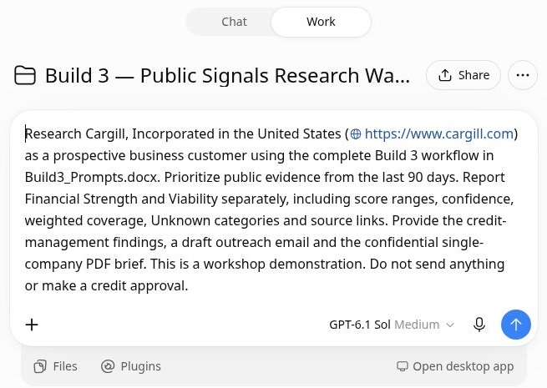
08
The company research request
Enter the legal company name, country and website.
Ask for separate scores, evidence coverage and source links.
Request the confidential PDF and a draft outreach email.
The live example researches Cargill, Incorporated in the United States.
Build 3 / Public research demonstration / 21 October 2026
Notes:
This is the actual request submitted in Work mode. The reusable workshop prompt does not name a company, so this demonstration adds Cargill, Incorporated and its official website as the target. The request emphasizes separate Financial Strength and Viability outputs, ranges when evidence is missing, and the single-company PDF. It explicitly limits outreach to a draft and does not authorize a credit approval. The request starts one research run, not scheduled monitoring.
Workflow source: https://github.com/Credit-Research-AI/workshop/blob/main/AI-Agent-Build3/Build%203%20-%20Prompts%20(paste-ready).docx
Actual ChatGPT run: https://chatgpt.com/g/g-p-6ad8c28a17b481918542b434d764e406-build-3-public-signals-research-walkthrough/c/6ad8c383-4864-83eb-b061-e9a69b269381

Slide 9
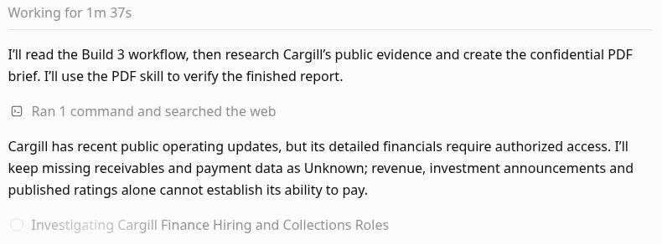
09
The live public research
ChatGPT reads the workflow, then searches public sources.
The progress message identifies restricted financial data.
Missing evidence remains Unknown.
Actual progress capture. The complete run took 5m 18s.
Build 3 / Public research demonstration / 21 October 2026
Notes:
This screenshot captures the live run at 1 minute 37 seconds. The full run completed in 5 minutes 18 seconds. It read the project prompt and searched the public web. Its progress message identifies a central limitation: detailed financial information requires authorized access. Revenue, investment announcements and published ratings do not by themselves prove payment capacity. The workflow does not create a reason to bypass access restrictions. The timing is an observed example and will vary by company and available sources.
Report: Cargill_Build3_Confidential_Brief_2026-10-21.pdf, actual ChatGPT output dated 21 October 2026. This deck documents the demonstration and does not independently award a credit score.
Workflow source: https://github.com/Credit-Research-AI/workshop/blob/main/AI-Agent-Build3/Build%203%20-%20Prompts%20(paste-ready).docx
Actual ChatGPT run: https://chatgpt.com/g/g-p-6ad8c28a17b481918542b434d764e406-build-3-public-signals-research-walkthrough/c/6ad8c383-4864-83eb-b061-e9a69b269381

Slide 10
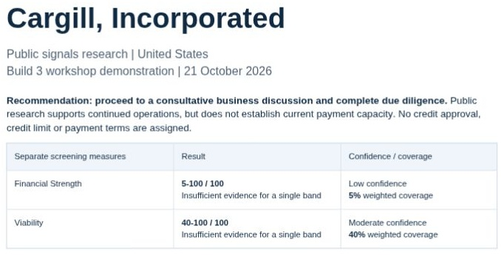
10
Two assessments in the finished brief
Financial Strength:
5–100; Low confidence;
5% weighted coverage.
Viability:
40–100; Moderate confidence;
40% weighted coverage.
No single band is supported.
The ranges show uncertainty. The endpoints are not awarded company scores.
Build 3 / Public research demonstration / 21 October 2026
Notes:
The cover summarises the actual run’s results. Financial Strength concerns financial condition and ability to pay. Viability concerns legal existence and continued operations. They answer different questions and must never be averaged. Both ranges cross multiple rubric bands, so the report states insufficient evidence for a single band. The recommendation is to hold a business discussion and complete due diligence; it does not assign a credit limit, payment terms or approval. Confidence describes evidence reliability, while coverage reflects the weights of assessed categories.
Report: Cargill_Build3_Confidential_Brief_2026-10-21.pdf, actual ChatGPT output dated 21 October 2026. This deck documents the demonstration and does not independently award a credit score.
Workflow source: https://github.com/Credit-Research-AI/workshop/blob/main/AI-Agent-Build3/Build%203%20-%20Prompts%20(paste-ready).docx
Actual ChatGPT run: https://chatgpt.com/g/g-p-6ad8c28a17b481918542b434d764e406-build-3-public-signals-research-walkthrough/c/6ad8c383-4864-83eb-b061-e9a69b269381

Slide 11
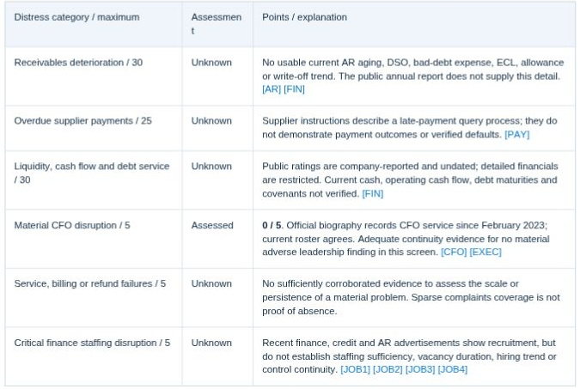
11
Financial categories remain Unknown
Five of six categories lack enough evidence.
The run assesses CFO continuity at zero distress points.
Unknown categories are included in the uncertainty range.
A missing adverse finding is not sufficient evidence for a zero-distress assessment.
Build 3 / Public research demonstration / 21 October 2026
Notes:
The rubric assigns maximum distress weights of 30 to receivables, 25 to overdue supplier payments, 30 to liquidity/cash/debt service, and 5 each to CFO disruption, material billing/service problems and critical finance staffing disruption. This run assessed only CFO continuity, using the official biography and current roster. Both are company sources, not independent corroboration. The remaining categories were Unknown because evidence was absent, restricted or insufficient to establish current conditions. The overall Financial Strength confidence remains Low.
Sources: https://www.cargill.com/about/joanne-knight ; https://www.cargill.com/about/executive-team ; https://www.cargill.com/about/financial/credit-financial-information
Report: Cargill_Build3_Confidential_Brief_2026-10-21.pdf, actual ChatGPT output dated 21 October 2026. This deck documents the demonstration and does not independently award a credit score.
Workflow source: https://github.com/Credit-Research-AI/workshop/blob/main/AI-Agent-Build3/Build%203%20-%20Prompts%20(paste-ready).docx
Actual ChatGPT run: https://chatgpt.com/g/g-p-6ad8c28a17b481918542b434d764e406-build-3-public-signals-research-walkthrough/c/6ad8c383-4864-83eb-b061-e9a69b269381

Slide 12
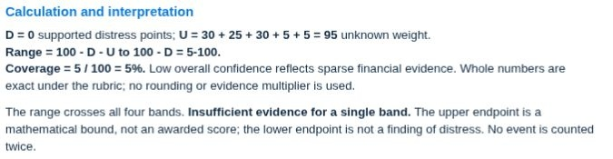
12
The Financial Strength range
Supported distress D = 0.
Unknown weight U = 95.
100 − D − U to 100 − D
= 5–100.
Weighted coverage = 5%.
The wide range describes missing knowledge; it is not a finding of financial distress.
Build 3 / Public research demonstration / 21 October 2026
Notes:
Walk through the formula explicitly. Supported distress points D are zero. Unknown maximum weights add to 95: 30 + 25 + 30 + 5 + 5. The worst mathematical bound is 100 − 0 − 95 = 5; the best bound is 100 − 0 = 100. Only the five-point CFO category is assessed, so weighted coverage is 5%. Do not interpret 100 as an earned score or 5 as an allegation of distress. The range crosses all four bands. The report’s Low confidence is reported separately and does not multiply the score.
Report: Cargill_Build3_Confidential_Brief_2026-10-21.pdf, actual ChatGPT output dated 21 October 2026. This deck documents the demonstration and does not independently award a credit score.
Workflow source: https://github.com/Credit-Research-AI/workshop/blob/main/AI-Agent-Build3/Build%203%20-%20Prompts%20(paste-ready).docx
Actual ChatGPT run: https://chatgpt.com/g/g-p-6ad8c28a17b481918542b434d764e406-build-3-public-signals-research-walkthrough/c/6ad8c383-4864-83eb-b061-e9a69b269381

Slide 13
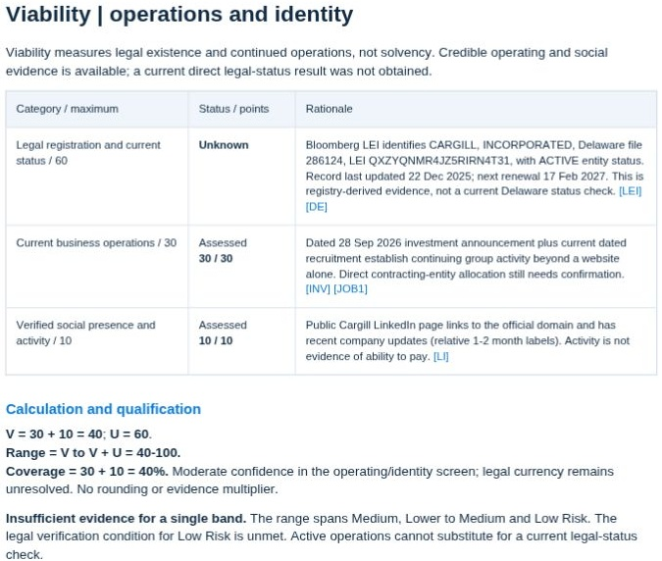
13
Viability is a separate assessment
Current operations: 30.
Verified social activity: 10.
Current legal status: Unknown, weight 60.
Range: 40–100.
Coverage: 40%.
Continued activity does not establish solvency or satisfy current legal-status verification.
Build 3 / Public research demonstration / 21 October 2026
Notes:
The run awards 30 points for current group operating evidence and 10 for a verified active company social page. The current legal-status category, worth 60, remains Unknown. Therefore supported V = 40 and unknown U = 60, producing 40–100 with 40% coverage. The report describes Moderate confidence in this operations/identity screen. Its Bloomberg LEI evidence was registry-derived and last updated in December 2025; it was not a fresh Delaware entity-status result. The workflow’s legal verification condition for Low Risk remains unmet. The precise contracting company still needs confirmation.
Sources: https://lei.bloomberg.com/leis/view/QXZYQNMR4JZ5RIRN4T31 ; https://icis.corp.delaware.gov/ecorp/entitysearch/namesearch.aspx ; https://www.linkedin.com/company/cargill/
Report: Cargill_Build3_Confidential_Brief_2026-10-21.pdf, actual ChatGPT output dated 21 October 2026. This deck documents the demonstration and does not independently award a credit score.
Workflow source: https://github.com/Credit-Research-AI/workshop/blob/main/AI-Agent-Build3/Build%203%20-%20Prompts%20(paste-ready).docx
Actual ChatGPT run: https://chatgpt.com/g/g-p-6ad8c28a17b481918542b434d764e406-build-3-public-signals-research-walkthrough/c/6ad8c383-4864-83eb-b061-e9a69b269381

Slide 14
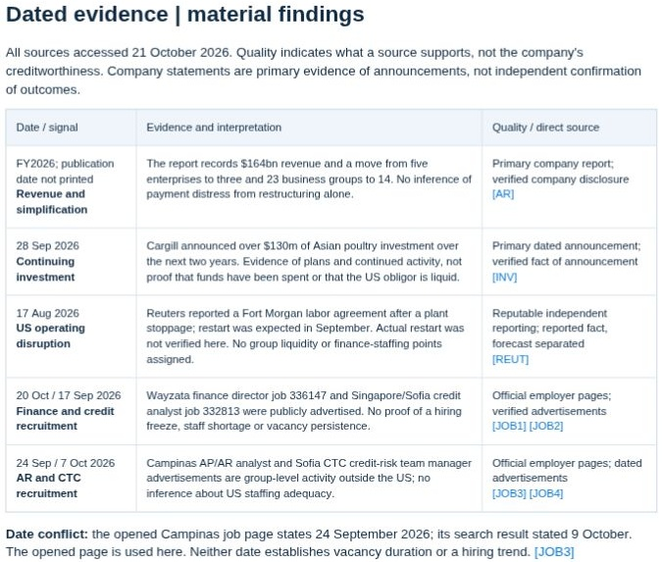
14
Dated evidence and interpretation
The evidence table records dates, findings and direct links.
It separates announcements from outcomes.
A job advertisement alone does not prove a staff shortage.
Source quality describes what a source supports, not the company’s creditworthiness.
Build 3 / Public research demonstration / 21 October 2026
Notes:
This report page provides an audit trail. An official investment announcement establishes that a plan was announced; it does not establish that the money has been spent or that the US obligor is liquid. Employer job pages establish recruitment, not a hiring freeze or persistent vacancies. Reuters reporting is distinguished from company statements, and syndicated copies count as the same source. The run records a date discrepancy between an indexed job result and the opened employer page. It uses the opened page’s date and avoids inferring vacancy duration. Read the linked evidence before relying on a conclusion.
Sources: https://www.cargill.com/2026/cargill-invests-usd-130-million-to-expand-poultry-operations ; https://www.cargill.com/about/doc/1451394341550/2026-cargill-annual-report.pdf
Report: Cargill_Build3_Confidential_Brief_2026-10-21.pdf, actual ChatGPT output dated 21 October 2026. This deck documents the demonstration and does not independently award a credit score.
Workflow source: https://github.com/Credit-Research-AI/workshop/blob/main/AI-Agent-Build3/Build%203%20-%20Prompts%20(paste-ready).docx
Actual ChatGPT run: https://chatgpt.com/g/g-p-6ad8c28a17b481918542b434d764e406-build-3-public-signals-research-walkthrough/c/6ad8c383-4864-83eb-b061-e9a69b269381

Slide 15
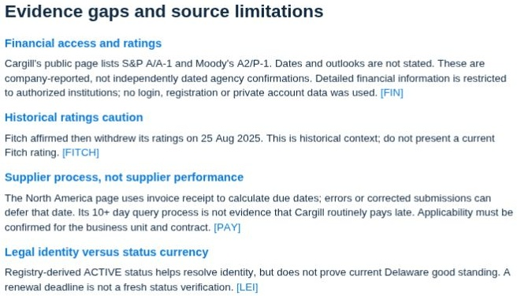
15
Access limits stay visible
Detailed financials require authorized access.
Undated ratings need current confirmation.
Supplier payment instructions describe a process, not actual payment performance.
The report describes access limits without filling gaps with assumptions.
Build 3 / Public research demonstration / 21 October 2026
Notes:
The limitations page explains how source access affects the analysis. Cargill’s public financial information page lists ratings but does not provide all the dated financial evidence needed by this rubric. The report treats historical Fitch material as context rather than claiming a current rating. Supplier guidance describes invoice receipt and payment queries; a late-payment enquiry procedure is not proof that the company routinely pays late. Similarly, registry-derived identity evidence cannot replace a current legal-status verification. These distinctions prevent an accessible webpage from being overinterpreted.
Sources: https://www.cargill.com/about/financial/credit-financial-information ; https://www.cargill.com/supplier-central/en/payment-north-america
Report: Cargill_Build3_Confidential_Brief_2026-10-21.pdf, actual ChatGPT output dated 21 October 2026. This deck documents the demonstration and does not independently award a credit score.
Workflow source: https://github.com/Credit-Research-AI/workshop/blob/main/AI-Agent-Build3/Build%203%20-%20Prompts%20(paste-ready).docx
Actual ChatGPT run: https://chatgpt.com/g/g-p-6ad8c28a17b481918542b434d764e406-build-3-public-signals-research-walkthrough/c/6ad8c383-4864-83eb-b061-e9a69b269381

Slide 16
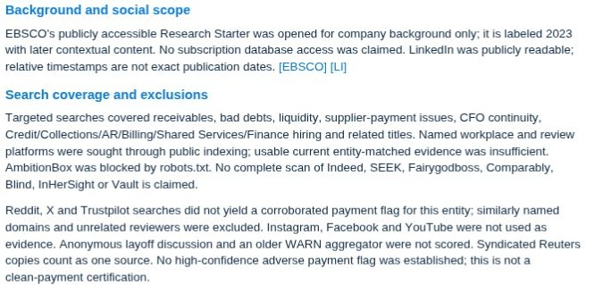
16
Search coverage has boundaries
The report names the sources it could use and the gaps that remain.
Older background is labelled.
Unverified reviews and social claims do not become distress points.
“No corroborated flag found” is not a clean-payment certification.
Build 3 / Public research demonstration / 21 October 2026
Notes:
The report documents what its search did and did not cover. It used an accessible EBSCO Research Starter for background and did not claim subscription database access. It records limited review-site coverage and an access restriction rather than pretending to have read unavailable material. Relative social timestamps are not exact publication dates. Anonymous discussions and weakly matched review evidence were not scored. This is a snapshot of public research, not exhaustive verification or continuous monitoring. Its refresh recommendation is 20 November 2026, sooner if material facts change. Refreshing requires a new requested run.
Report: Cargill_Build3_Confidential_Brief_2026-10-21.pdf, actual ChatGPT output dated 21 October 2026. This deck documents the demonstration and does not independently award a credit score.
Workflow source: https://github.com/Credit-Research-AI/workshop/blob/main/AI-Agent-Build3/Build%203%20-%20Prompts%20(paste-ready).docx
Actual ChatGPT run: https://chatgpt.com/g/g-p-6ad8c28a17b481918542b434d764e406-build-3-public-signals-research-walkthrough/c/6ad8c383-4864-83eb-b061-e9a69b269381

Slide 17
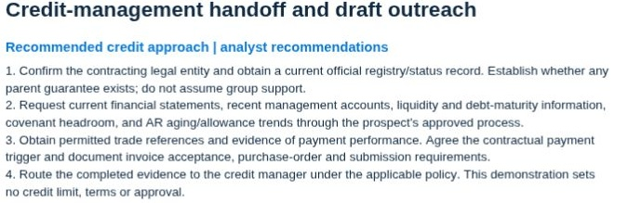
17
The due-diligence handoff
Verify the contracting entity and current legal status.
Request financial and payment evidence.
Confirm invoice acceptance requirements.
Route the evidence to the credit manager.
The output is a documented next step for human review, with no credit approval.
Build 3 / Public research demonstration / 21 October 2026
Notes:
The report turns evidence gaps into a practical request list: current financial statements and management accounts, liquidity, debt maturities, covenant headroom, receivables aging and allowance trends. Obtain permitted trade references and actual payment evidence. Match the purchase order, contract and invoice to the correct obligor, and verify any guarantee rather than assuming parent support. Agree the payment trigger and invoice acceptance process. The completed file then goes to the credit manager under the applicable policy. The research demonstration makes no credit decision and does not update business systems.
Report: Cargill_Build3_Confidential_Brief_2026-10-21.pdf, actual ChatGPT output dated 21 October 2026. This deck documents the demonstration and does not independently award a credit score.
Workflow source: https://github.com/Credit-Research-AI/workshop/blob/main/AI-Agent-Build3/Build%203%20-%20Prompts%20(paste-ready).docx
Actual ChatGPT run: https://chatgpt.com/g/g-p-6ad8c28a17b481918542b434d764e406-build-3-public-signals-research-walkthrough/c/6ad8c383-4864-83eb-b061-e9a69b269381

Slide 18
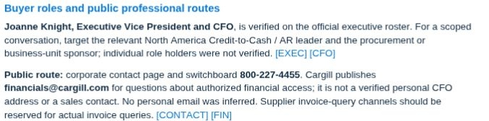
18
Verified roles and contact routes
Name a decision-maker only when the role is sourced.
Use the relevant finance or procurement role when a person is unverified.
Do not guess personal email addresses.
Official contact routes support discovery; they are not permission to send outreach.
Build 3 / Public research demonstration / 21 October 2026
Notes:
The run verifies Joanne Knight’s CFO role against the official roster and biography. It does not verify individual holders of the relevant North America Credit-to-Cash/AR and procurement roles, so it names those functions rather than inventing people. The public corporate route is distinct from a specialized mailbox for authorized financial-information access. That mailbox is not a personal CFO address or a sales channel. Verify the intended recipient and business purpose before using any route. This walkthrough does not contact anyone.
Sources: https://www.cargill.com/about/executive-team ; https://www.cargill.com/about/joanne-knight ; https://www.cargill.com/page/cargill-contact-us
Report: Cargill_Build3_Confidential_Brief_2026-10-21.pdf, actual ChatGPT output dated 21 October 2026. This deck documents the demonstration and does not independently award a credit score.
Workflow source: https://github.com/Credit-Research-AI/workshop/blob/main/AI-Agent-Build3/Build%203%20-%20Prompts%20(paste-ready).docx
Actual ChatGPT run: https://chatgpt.com/g/g-p-6ad8c28a17b481918542b434d764e406-build-3-public-signals-research-walkthrough/c/6ad8c383-4864-83eb-b061-e9a69b269381

Slide 19
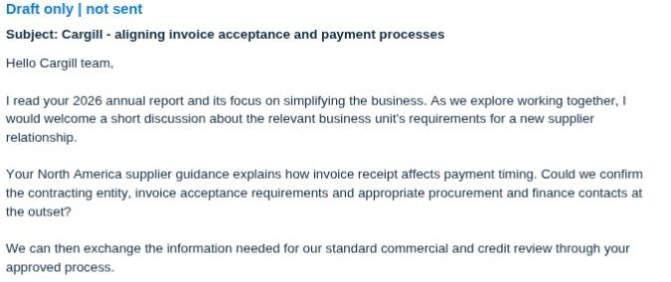
19
Outreach remains a draft
The draft refers to published business priorities and invoice processes.
It asks for the right entity and contacts.
Review the facts and recipient before sending.
Draft only. No message was sent.
Build 3 / Public research demonstration / 21 October 2026
Notes:
The outreach draft uses the company’s annual report and North America supplier guidance to propose a grounded discussion. It asks for the contracting entity, invoice acceptance requirements and appropriate procurement and finance contacts. It does not allege write-offs, supplier defaults, hiring freezes or distress that the research did not establish. A working-capital opportunity remains a discussion hypothesis. The screenshot is cropped before the personal signature so the slide focuses on the message content. The actual run produced a draft only, and no email or other communication was sent.
Sources: https://www.cargill.com/about/doc/1451394341550/2026-cargill-annual-report.pdf ; https://www.cargill.com/supplier-central/en/payment-north-america
Report: Cargill_Build3_Confidential_Brief_2026-10-21.pdf, actual ChatGPT output dated 21 October 2026. This deck documents the demonstration and does not independently award a credit score.
Workflow source: https://github.com/Credit-Research-AI/workshop/blob/main/AI-Agent-Build3/Build%203%20-%20Prompts%20(paste-ready).docx
Actual ChatGPT run: https://chatgpt.com/g/g-p-6ad8c28a17b481918542b434d764e406-build-3-public-signals-research-walkthrough/c/6ad8c383-4864-83eb-b061-e9a69b269381

Slide 20
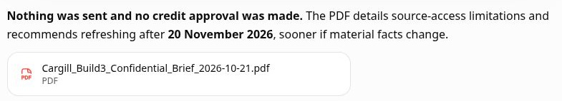
20
The completed PDF handover
Open the PDF card in the chat.
Review all six pages and the linked evidence.
Use Download → PDF to save the brief.
Refresh the research before relying on it later.
The confidential report is a research snapshot for human review.
Build 3 / Public research demonstration / 21 October 2026
Notes:
The finished ChatGPT response links Cargill_Build3_Confidential_Brief_2026-10-21.pdf. Open the card to preview it, then choose Download and PDF. The six pages cover the profile, Financial Strength, Viability, dated evidence, limitations and handoff/outreach. The actual run verified the confidentiality marking and clickable citations, and the report was opened in the walkthrough. Review every source and the exact obligor before using the analysis. The suggested refresh date is 20 November 2026, sooner if material facts change; this does not schedule monitoring. Nothing was sent and no credit approval was made.
Workflow source: https://github.com/Credit-Research-AI/workshop/blob/main/AI-Agent-Build3/Build%203%20-%20Prompts%20(paste-ready).docx
Actual ChatGPT run: https://chatgpt.com/g/g-p-6ad8c28a17b481918542b434d764e406-build-3-public-signals-research-walkthrough/c/6ad8c383-4864-83eb-b061-e9a69b269381

