Slide 1
Slide 1

Slide 2


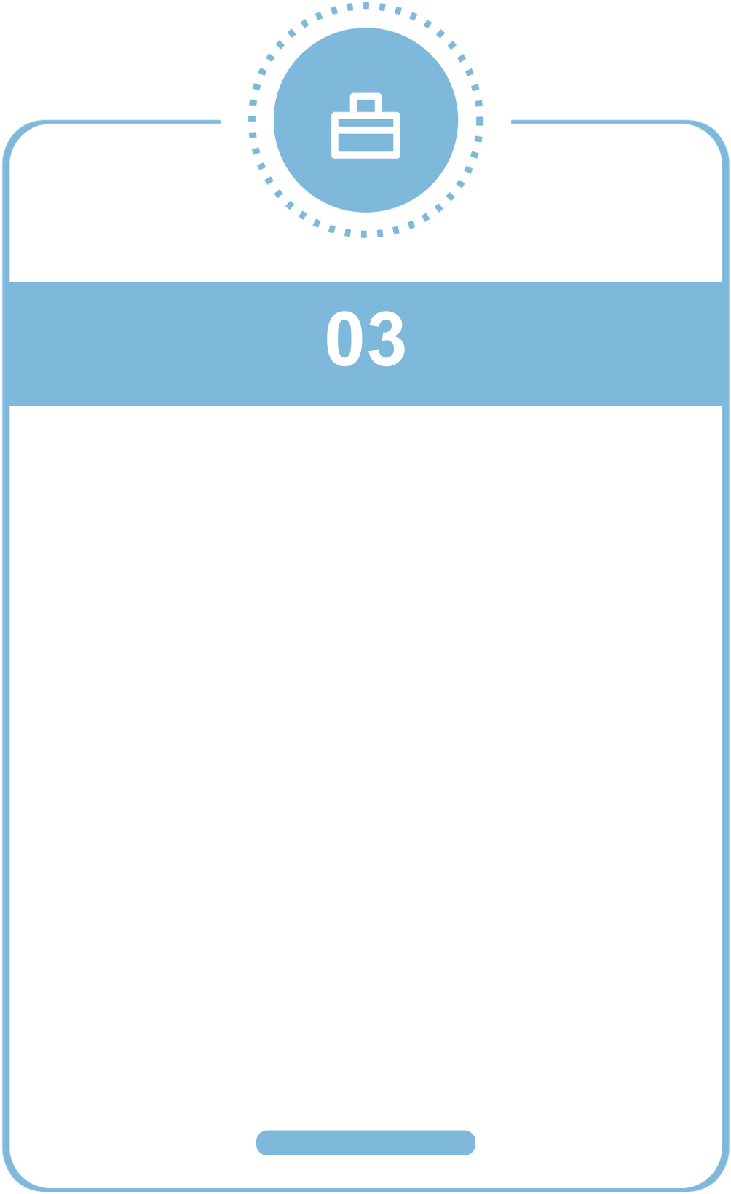
Unraveling the Impossible: Exploring the science, the paradox, and the human heart. Our Journey Through a Frozen World
Session 1
Session 2
Session 3
Tonight, we will explore the scientific mysteries…
Each chapter brings us closer to understanding…
Tonight, we will explore the scientific mysteries…
Notes:
This slide sets the stage for our exploration by outlining the key themes and chapters of the presentation. Use the minimalist timeline visual to emphasize the progression through four pivotal moments, each representing a chapter in understanding a world where time has stopped. The tone should inspire curiosity and a sense of wonder about the scientific and human dimensions of this frozen reality. Encourage the audience to reflect on how life and physics intertwine when tomorrow ceases to exist.

Slide 3








When Physics Breaks: The laws of nature unravel in midnight’s stillness. The Science of a Stopped Universe
MOTION…
LIGHT…
PERCEPTION……
SCIENCE…
Every atom, every wave, every heartbeat…
Photons no longer move, casting the world in a…
Human senses and thoughts, bound to…
Where our knowledge ends, wonder begins.
Notes:
This slide explores the profound consequences of time stopping on fundamental physics and perception. Each column explains a core beat: motion locking, light freezing, suspended perception, and the boundary between science and speculation. The line chart illustrates the steep decline of active physical processes as time slows to a halt, emphasizing the collapse of dynamic phenomena. The vivid frozen cityscape image visually reinforces the concept, using electric-cyan and silver colors on a midnight blue backdrop to evoke a bold, poster-style graphic. The speaker should highlight how time’s flow underpins everything from gravity to thought, and invite the audience to imagine what might lie beyond known physics in this frozen universe.

Slide 4
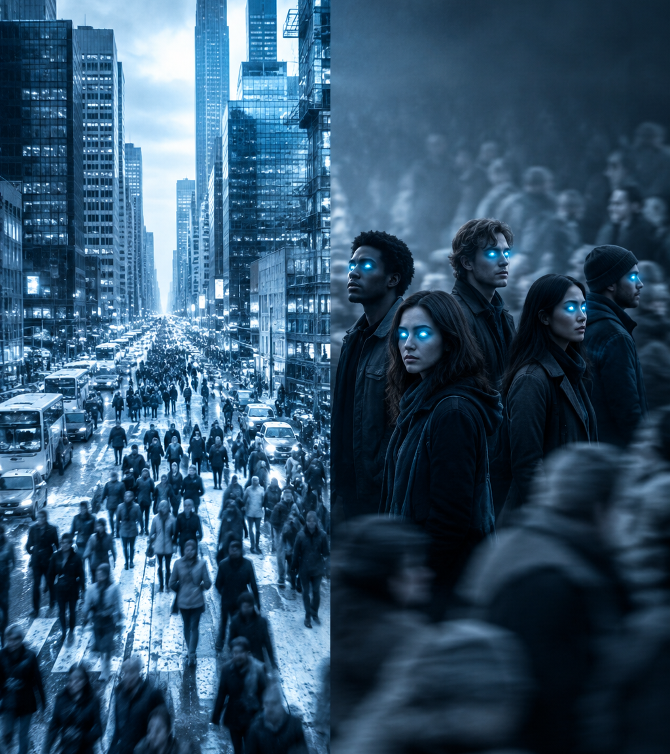
Humanity in a Frozen World: Life at the Edge of Time
In a metropolis gripped by stillness, time has halted—freezing streets, homes, and hearts in a single endless moment. Amid the frozen masses, a few conscious souls remain, isolated with their memories and fears. This silence breeds profound moral questions: does responsibility vanish ...
Notes:
This slide sets the emotional and ethical context of a world where time has stopped. Emphasize the contrast between the frozen cityscape and the few aware individuals, highlighting their isolation and internal struggles. The bullets describe the core human experiences and dilemmas in this paused reality, inviting the audience to reflect on endurance and empathy when change is impossible. The cinematic split image visually reinforces the duality of frozen stillness and conscious awareness.

Slide 5


00:01: What Happens Next? The Second That Could Change Everything
IF TIME RETURNED, WHAT WOULD YOU DO?
Seize your moment: choose your path in the first 60 seconds of time’s return
hello@company.com
Notes:
This closing slide captures the pivotal moment when time resumes after an eternal freeze. The headline emphasizes the urgency and significance of that one second. The subtitle challenges the audience to reflect personally. The body text paints a vivid, emotional picture of rebirth and possibility. The three bullets break down the narrative beats: the first movement in time, the dawn of light, and the individual's choice. The image prompt calls for a bold, poster-style visual with strong contrast and electric-cyan highlights to convey hope and awakening. The CTA encourages the audience to seize the moment, inspiring them to act now as time returns.

