Slide 1
Computerized Violation Processing & Records Management System
PHILIPPINE NATIONAL POLICE | LA UNION POLICE PROVINCIAL OFFICE
LIVE CHECKPOINT SCREENING
ALARM
Plate ABC-1234: stolen vehicle match
WARNING
PNP-CVPRMS
Expired registration or suspended license
Real-time checkpoint screening, automatic fines, thermal citations and treasury sync.
CLEAR
Valid driver, no flags on any watchlist
Software Engineering 2 | Final Capstone Defense
Agoo Municipal Police Station, Region 1 | Release v2.0-PRO
Casey Freud (Lead) · Angelo · Antonio · Augusto Manuel · Benjie · Emmanuel John · Genuflect · Ranier
Notes:
SLIDE 1 | CASEY FREUD | about 45 seconds
Good day to our respected panel and professors. Today, our team proudly presents PNP-CVPRMS, the Computerized Violation Processing and Records Management System.
We built it for the Philippine National Police, with the Agoo Municipal Police Station as our pilot site. The idea is simple: a roadside checkpoint should not run on handwritten paper tickets. Our system screens a plate, a license, and a driver against watchlists in real time, calculates the fine automatically, prints a thermal citation, and syncs with the Municipal Treasury.
All eight of us are here, and every member will present a part of the system and answer your questions. Let's begin with our roadmap.

Slide 2
Who Presents What
C
Casey Freud (Lead)
A
Angelo
A
Augusto Manuel
E
Emmanuel John
Opening, problem, analytics
Objectives & scope
Requirements, context DFD
Level 1 DFD, challenges
A
Antonio
R
Ranier
B
Benjie
G
Genuflect
ERD & trade-offs
Structure chart, SCM
Tech stack & algorithms
Testing & QA results
Presentation + live demo: 20 min
Panel Q&A: 10 min
Every member answers at least one question.
Notes:
SLIDE 2 | CASEY FREUD | about 35 seconds
We have thirty minutes in total: twenty for the presentation and live demo, and ten for your questions.
To keep everyone accountable, we divided the content by what each member owns in our configuration management plan. I will cover the problem and the analytics. Angelo takes objectives and scope. Augusto Manuel and Emmanuel John walk you through the data flow diagrams. Antonio covers the data model, Benjie the tech stack and algorithms, Ranier the structure chart and our process, and Genuflect our testing. Then we demo together.
Every member will answer at least one question in the Q&A. So let me start with why we built this.

Slide 3








The Checkpoint Problem
Slow paper tickets
No live screening
Repeat offenders slip through
Slow treasury sync
8–12 minutes per stop, with illegible entries
Stolen vehicles and warrants go unchecked
Records at one post are invisible to the others
Reconciling slips takes days or weeks
BUILT FOR
Officers
Station commander
Municipal Treasury
Motorists
Clear / Warning / Alarm in under 60 s
Live dashboard of arrests, fines, alerts
Auto-calculated fines, instant balances
Itemized thermal receipt
Notes:
SLIDE 3 | CASEY FREUD | about 1 minute 10 seconds
Picture a checkpoint on MacArthur Highway in Agoo. Hundreds of vehicles pass through every shift, and today the officer works on paper.
That creates four problems. First, a handwritten ticket takes eight to twelve minutes per motorist, so traffic backs up. Illegible entries also mean wrong plates and contested citations.
Second, there is no real-time screening. An officer cannot instantly tell if a motorcycle is on the HPG stolen vehicle list, or if a driver has a court warrant.
Third, a record at one post is invisible to the other posts, so repeat offenders slip through.
And fourth, reconciling paper slips with the Municipal Treasury takes days or even weeks, so fines go uncollected.
At the bottom are the four groups we designed for: officers who need speed, the station commander who needs visibility, the Treasury that needs instant reconciliation, and motorists who deserve a clear, itemized receipt.
Next, Angelo will show how we measured success.

Slide 4
Five Measurable Goals
90%
<500 ms
0
100%
100%
Faster issuance
Screening time
Fine discrepancies
Offline-ready
Auditable
8–12 min down to under 60 s
Plates, licenses and warrants
Per LTO JAO 2014-01
Embedded SQLite, no data loss
Every citation ties to a treasury receipt
Met in v2.0-PRO: citation + receipt in under 45 s, and 14 of 14 tests passing.
Notes:
SLIDE 4 | ANGELO | about 1 minute
Thank you, Casey. We did not want vague goals, so we set five measurable targets and tested against each one.
One: speed. We cut roadside processing from eight to twelve minutes down to under sixty seconds, about ninety percent faster. In practice, issuing a citation and printing the receipt takes under forty-five seconds.
Two: screening in under half a second against plates, licenses, and warrants.
Three: zero fine discrepancies. Every fine follows the LTO JAO 2014-01 schedule, and any manual override is logged.
Four: full offline resilience. Because we use an embedded SQLite database, the checkpoint keeps working even when cellular signal drops.
Five: complete auditability. Every citation can be traced to a treasury receipt, and all fourteen of our automated tests pass.
Now let me explain the boundary of what we built.

Slide 5
Vision vs. Prototype
TARGET VISION
BUILT FOR THIS DEFENSE
Multi-station cloud
Self-contained edge app
One API for stations, HQs and patrols
PostgreSQL cluster with replicas
Live alert push (WebSockets / SSE)
LTO, HPG and payment gateways
Node.js + Express at the station
Embedded SQLite file
Rule-based screening data
58 / 80 mm thermal receipts
One-click Start-CVPRMS.bat
Why edge? Zero downtime, no network dependency, a fully predictable demo.
Notes:
SLIDE 5 | ANGELO | about 55 seconds
Our system has two faces, and we want to be clear about both.
On the left is the target vision: a multi-station cloud platform. One API would connect stations, regional headquarters, and mobile patrols, backed by a PostgreSQL cluster. Alerts would be pushed live, and the system would connect to LTO, HPG, and online payment gateways.
On the right is what we actually built for this defense: a self-contained edge app. A Node.js and Express server runs at the checkpoint, with an embedded SQLite database, rule-based screening data, thermal receipt printing, and a one-click launcher.
We chose this on purpose. It gives us zero downtime, no dependence on classroom Wi-Fi or police VPNs, and a fully predictable demo. The cloud design is our roadmap.
Next, Augusto Manuel will show how every requirement is traced.

Slide 6
Requirements → Code → Tests
REQ | REQUIREMENT | IMPLEMENTED IN | VERIFIED BY TEST
FR-01 | Live screening vs. HPG alarms | assessScreening() | Flags ALARM and WARNING
FR-02 | Alt-ID for unlicensed drivers | validateViolationPayload() | Rejects missing Alt-ID
FR-03 | Statutory fine totaling | calculateViolationTotal() | Adds multiple fees
FR-04 | Impound slip required | validateViolationPayload() | Blocks Impounded without slip
FR-05 | Settlement status + CSV export | PATCH /api/violations/:id/status | Updates; rejects invalid status
Every requirement maps to a function, a UI element and an automated test.
Notes:
SLIDE 6 | AUGUSTO MANUEL | about 1 minute
In software engineering, every feature should trace back to a requirement and be proven by a test. This is our traceability matrix.
Each row follows one requirement through the whole system. For example, FR-01, live screening, is implemented by the assessScreening function, and a test confirms it raises ALARM and WARNING correctly.
FR-02 handles unlicensed drivers. The system demands an alternative government ID, and our tests check both the failure when it is missing and the success with a valid National ID.
FR-03 totals multiple statutory fines. FR-04 refuses to save an impounded vehicle without a receipt slip. And FR-05 manages settlement status and the Excel-ready CSV export.
So every critical requirement maps to a backend function, a UI element, and an automated regression test. Now let's look at the design, starting with the data flow diagrams.

Slide 7
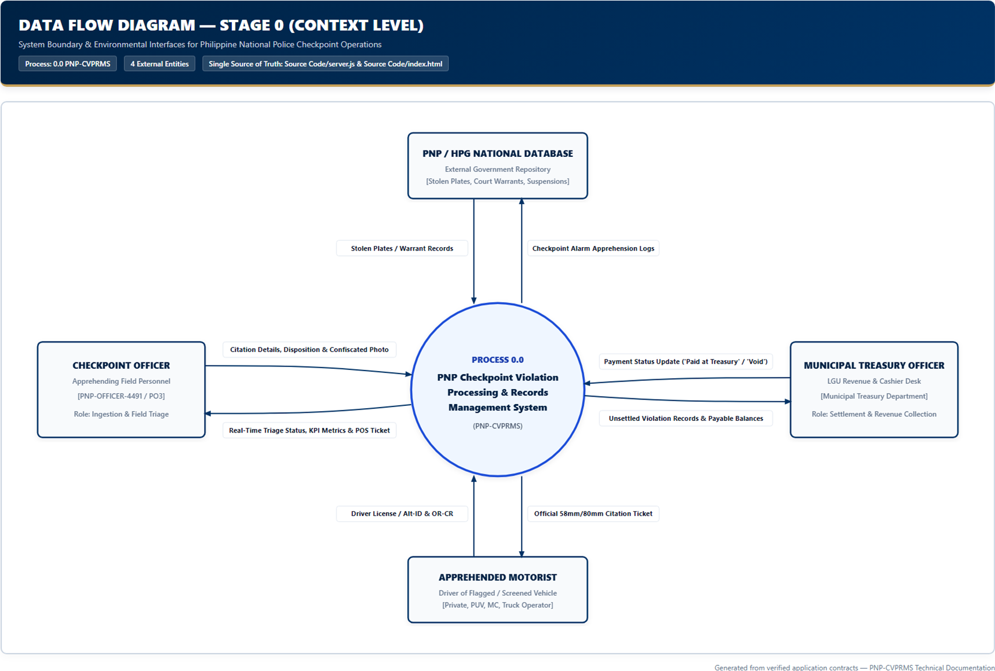
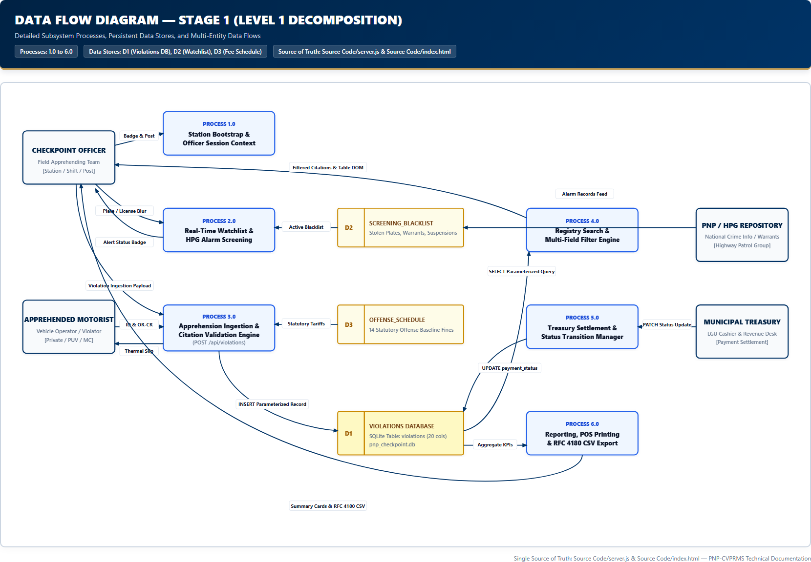
Data Flow: Context to Level 1
Context diagram (Stage 0)
Level 1 diagram
One process, five external entities
Eight subsystems, four data stores
Notes:
SLIDE 7 | AUGUSTO MANUEL, then EMMANUEL JOHN | about 1 minute 30 seconds
[AUGUSTO MANUEL, left diagram]
Here is the system boundary, our Stage 0 context diagram. At the center is one process, PNP-CVPRMS, and it talks to five external entities.
The officer sends session details and evidence photos, and gets back a screening badge, fines, and a ticket ID. The motorist receives the printed thermal citation. The Municipal Treasury confirms official receipts and receives outstanding balances. External registries supply stolen vehicle alarms and court warrants. And the station commander gets KPIs, audit trails, and CSV exports.
Emmanuel John will now go one level deeper.
[EMMANUEL JOHN, right diagram]
Thank you, Augusto. On the right is our Level 1 diagram, which breaks the system into eight subsystems and four data stores.
Process 1 sets up the checkpoint session. Process 2 screens against the blacklists in data store D3. Process 3 validates the violation, calculates the fine from the D2 schedule, and saves it to D1. Process 4 prints the thermal slip. Processes 5 to 7 handle search, payment settlement, and KPI export. And Process 8 writes every action to an append-only audit log.
Antonio will now show how we store this data.

Slide 8
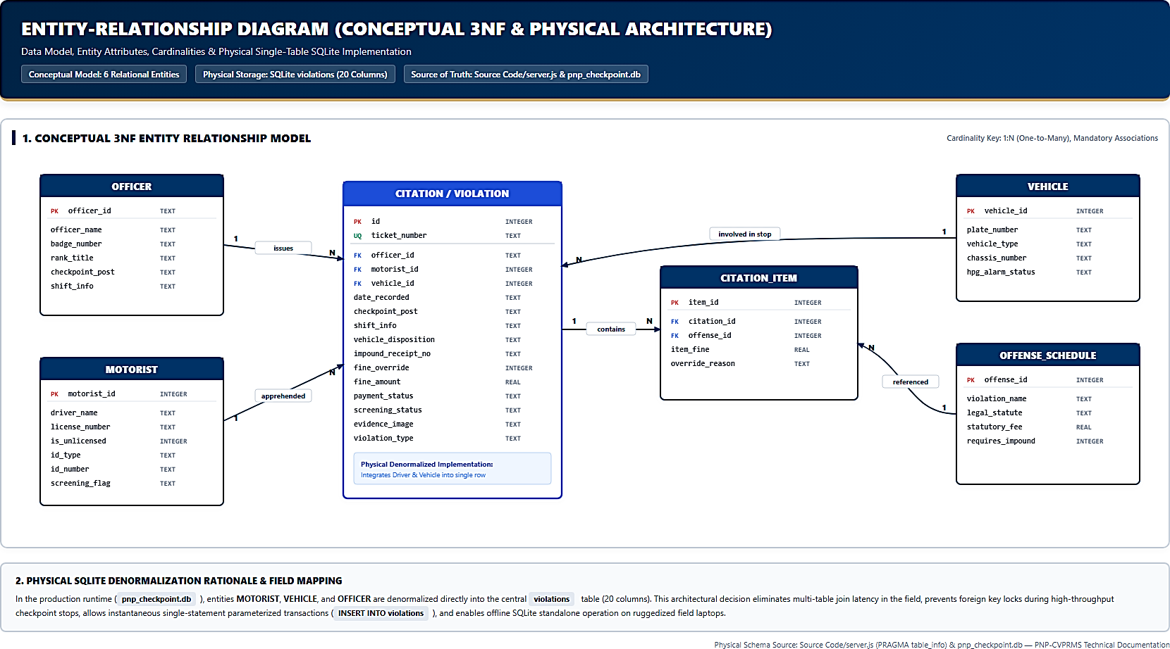
Data Model: One Table Now, 3NF Later
PROTOTYPE
1 SQLite table
20 columns, sub-millisecond local reads and writes
CLOUD TARGET
8-entity 3NF
Plus an audit log. Scales to a nationwide police cloud.
Notes:
SLIDE 8 | ANTONIO | about 45 seconds
Our data design has two tiers. For the running prototype we use one edge-optimized SQLite table with twenty columns: ticket, driver, vehicle, itemized violations, overrides, and evidence. That gives sub-millisecond local reads and writes, and it keeps working offline.
For the cloud target, we documented a normalized Third Normal Form model with eight core entities, plus an audit log: officers, checkpoints, violators, vehicles, offenses, tickets, ticket offenses, and payments. So the design scales from one laptop to a nationwide police cloud.
Ranier will cover how the code is organized.

Slide 9
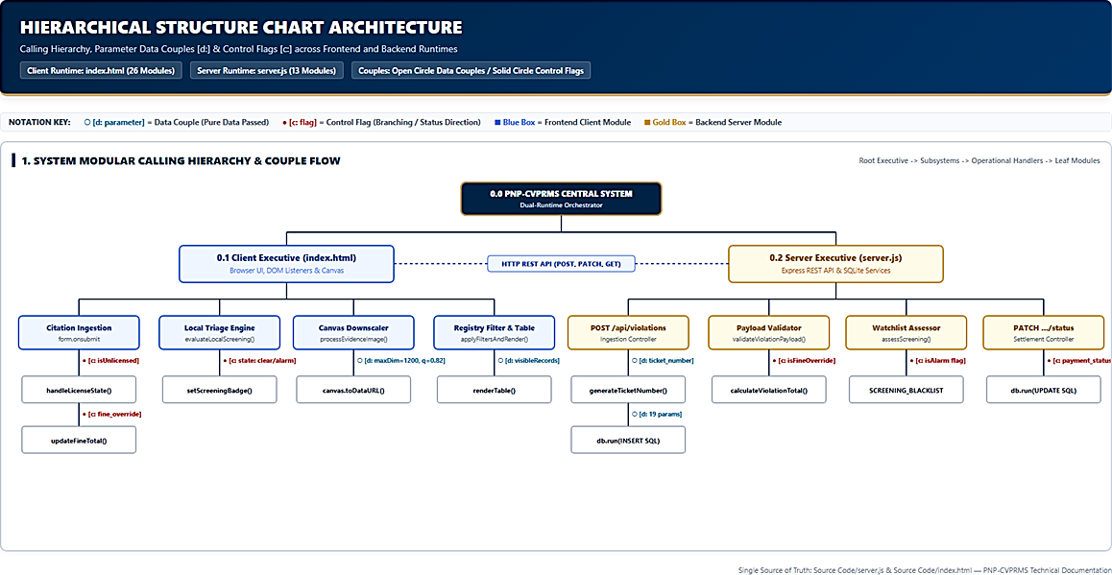
Modular Design: Structure Chart
CLIENT TIER
index.html controllers
SERVER TIER
server.js REST services
LOOSE COUPLING
JSON data couples, HTTP status control couples
Notes:
SLIDE 9 | RANIER | about 45 seconds
Thank you, Antonio. This is our structure chart, built by top-down decomposition. The browser side has controllers for session, screening, the apprehension form, search, payment, and thermal print. The server side has an Express dispatcher that calls validation, the screening engine, the fine calculator, the ticket ID generator, and the SQLite data layer.
The modules pass sanitized JSON as data couples, and HTTP status codes as control couples. That keeps coupling loose and lets us test every routine in isolation.
Benjie will now explain our technology choices.

Slide 10




Tech Stack & Trade-offs
Node.js + Express
SQLite3
HTML5 + JS
Batch launchers
Async REST API
Zero-config, USB-portable file DB
Vanilla ES6+, no build step, under 100 KB
One-click start with preflight check
TRADE-OFFS WE ACCEPTED
SQLite over a cloud DB
+ 100% offline uptime
– No multi-writer concurrency
Vanilla JS over SPA frameworks
+ Instant load, no build step
– Manual DOM updates
Local blacklist over live APIs
+ Reliable demo, no VPN
– Curated prototype data
Notes:
SLIDE 10 | BENJIE, then ANTONIO | about 1 minute 10 seconds
[BENJIE, top row]
Our stack favors simplicity. The backend is Node.js with Express for lightweight asynchronous REST routing, with parameterized queries that stop SQL injection. Data lives in an embedded SQLite file that needs no setup and can be carried on a USB drive. The front end is plain HTML5, CSS, and modern JavaScript, with print styles for thermal rolls. And our batch launchers check dependencies and start everything in one click.
[ANTONIO, trade-offs]
Thanks, Benjie. Good engineering means defensible trade-offs, and we accepted three.
SQLite instead of a cloud database gives us full offline uptime, but not multi-writer concurrency, so PostgreSQL is on our roadmap.
Vanilla JavaScript instead of a framework gives instant load with no build step, at the cost of manual DOM updates, which is fine for a single-screen workflow.
And a local blacklist instead of live APIs gives a reliable demo without VPNs, but it uses curated prototype data.
Benjie will now show the core algorithms.

Slide 11
Core Algorithms
1
Screening engine
2
Unlicensed workflow
3
Fine totaling
assessScreening()
validateViolationPayload()
calculateViolationTotal()
ALARM
Stolen plate (HPG)
No Driver's License locks the license field
No false alarms on N/A licenses
Alt-ID required: PhilID, SSS, Passport…
Missing ID is rejected
No license
₱1,500
Expired registration
₱1,200
ALARM
Court-warrant driver
No helmet
₱1,000
WARNING
Suspended license
Total
₱3,700
WARNING
Expired registration
Overrides are allowed, and the original total is logged.
CLEAR
No flags found
Notes:
SLIDE 11 | BENJIE | about 1 minute
Here are the three core algorithms in our server code.
Algorithm one is the screening engine. It checks in priority order. A stolen plate or a driver with a court warrant raises a red ALARM. A suspended license or an expired registration raises an amber WARNING. If nothing matches, the officer sees a green CLEAR.
Algorithm two is the unlicensed driver workflow. When the officer picks No Driver's License, the system locks the license field and skips license checks, so there are no false alarms. It then requires an alternative ID, such as PhilID, SSS, or a passport, and rejects the submission without it.
Algorithm three is the fine calculator. It reads the offense schedule and adds up multiple violations. In our example, no license, expired registration, and no helmet total three thousand seven hundred pesos. A supervisor can override the amount, but the original statutory total is always logged for audit.
Emmanuel John will share the problems we hit along the way.

Slide 12
Four Problems We Solved
1
HTTP 413 errors
2
Garbled ₱ in Excel
5–10 MB phone photos crashed uploads
CSV showed broken peso signs
Browser compression to under 150 KB (~95% smaller)
UTF-8 byte order mark added to the export
FIX
FIX
3
Thermal vs. A4 printing
4
Impound chain of custody
Slips overflowed or printed blank
Vehicles saved without a slip number
Print CSS with a fixed 76 mm container
Client and server both reject it
FIX
FIX
Notes:
SLIDE 12 | EMMANUEL JOHN | about 1 minute
Real projects are defined by problems, and we solved four.
First, HTTP 413 errors. Phone photos of five to ten megabytes crashed our uploads. We now compress images in the browser before sending, to under 150 kilobytes, which is about ninety-five percent smaller.
Second, garbled peso signs. When the Treasury opened our CSV in Excel, the symbols were corrupted. We fixed it by adding a UTF-8 byte order mark to the export.
Third, printing. Thermal rolls overflowed and A4 pages printed blank. Custom print styles with a fixed 76-millimeter container now fit both.
Fourth, chain of custody. Impounded vehicles were sometimes saved without a slip number. Validation on both the client and the server now blocks that.
Genuflect will show how we verify all of this.

Slide 13
Testing: 14 of 14 Passing
AUTOMATED TEST SCOREBOARD
1
Unit tests
Fine totals, ticket ID format, screening logic
14 / 14
2
Defensive validation
Alt-ID, fine overrides, impound slip
100% pass rate
5.69 s run · 0 flaky · 0 skipped
3
Integration & API
REST + SQLite: status updates, search, KPIs, 100 KB+ photos
RE-RUN ANYTIME | native node:test, isolated local SQLite
cd 'Source Code' && node --test
Notes:
SLIDE 13 | GENUFLECT | about 1 minute 15 seconds
We tested at three levels, and the result is fourteen out of fourteen passing, in under six seconds.
Level one is unit testing: fine totals, ticket number format, and the screening logic for alarm, warning, and clear.
Level two is defensive validation: an alternative ID is required for unlicensed drivers, overrides must be authorized, and an impound slip is mandatory.
Level three is integration: our REST endpoints and SQLite database, including status updates, search, report KPIs, and photo uploads over a hundred kilobytes with no payload errors.
We used Node's built-in test runner, so there are no heavy third-party dependencies, and every test uses an isolated local database, so none of them are flaky. For example, we verify that multiple violations add up to exactly fourteen thousand two hundred pesos, and that unlicensed drivers never trigger a false license alarm.
Don't take our word for it. Any panel member can open a terminal and run node --test to verify all fourteen results.
Ranier will explain how we managed the work.

Slide 14
Process & SCM Governance
SPRINT 1
SPRINT 2
SPRINT 3
SPRINT 4
Discovery & baseline
Backend & schema
UI & thermal POS
Hardening & audit
Agoo MPS interviews, SCM plan
Express, SQLite, fine engine
Daylight-ready UI, thermal receipts
14 tests, CSV export, final audit
20
v1.0.0 → v2.0-PRO
0
controlled configuration items
strict semantic versioning
direct pushes: tests gate every merge
CHANGE WORKFLOW
Change request
Reason
Develop & test
PR review
Approve & merge
Notes:
SLIDE 14 | RANIER | about 1 minute
We managed the project with Agile Scrum across four sprints. Sprint one was discovery, including stakeholder interviews at Agoo MPS, and a configuration baseline. Sprint two built the backend and schema. Sprint three delivered the interface and thermal printing. Sprint four was hardening: the test suite, the CSV export, and a configuration audit that produced the v2.0-PRO tag.
Behind this is a formal Software Configuration Management plan. It controls twenty configuration items in five classes: code, schema, dependencies, tests, and documentation. We follow strict semantic versioning from v1.0.0 to v2.0-PRO, and we have zero direct pushes, because tests gate every merge.
Every change follows five steps: a change request, the reason for it, development and testing, a pull request review, and approval to merge. That discipline let eight people work at the same time without overwriting each other.
Now Casey and the team will show the system running.

Slide 15
Live Demo: 8 Steps
1
Start session
2
Live screening
3
Unlicensed flow
4
Impound rule
Agoo MPS · San Nicolas Norte · Shift 2
Green CLEAR, amber WARNING, red ALARM
Alt-ID required, total ₱3,700
No slip number, no submission
5
Evidence & print
6
Registry search
7
Settlement
8
Export & KPIs
Photo, ticket ID, thermal receipt
Ticket, plate, driver, filter chips
Dossier to Paid, OR number saved
Excel CSV, live header counters
Browser: http://localhost:3000
Notes:
SLIDE 15 | CASEY FREUD and TEAM | about 6 minutes
[ACTION: Switch to the browser at http://localhost:3000]
Now for the live demo of our v2.0-PRO system.
STEP 1: SESSION
[Point to the session banner]
Our banner shows the station, Agoo MPS, the post, San Nicolas Norte, Shift 2, and a synchronized clock. The officer is now bound to this checkpoint.
STEP 2: SCREENING
[Run the valid driver test case] A green CLEAR badge. [Run the expired registration test case] An amber WARNING. [Enter plate ABC-1234] A red ALARM: an HPG stolen vehicle match. All of this happens in under a second.
STEP 3: UNLICENSED FLOW
[Select No Driver's License] Notice the license field locks, and the system now asks for a PhilID. [Add Expired Registration and No Helmet] The total updates instantly to three thousand seven hundred pesos.
STEP 4: IMPOUND RULE
[Set the disposition to Impounded, then try to submit] The system blocks the submission until a slip number is entered.
STEP 5: EVIDENCE AND RECEIPT
[Attach a photo] It is compressed instantly. [Click Submit] A unique ticket ID is created. [Open the print preview] Here is the 58 and 80 millimeter thermal receipt.
STEP 6: REGISTRY SEARCH
[Scroll to the registry and search for the new ticket] We can search by ticket, plate, or driver. [Toggle Unsettled Only and Flagged Alarms] Filter chips narrow the list instantly.
STEP 7: SETTLEMENT
[Open the dossier] [Change the status to Settled and enter an OR number] This simulates the Municipal Treasury confirming payment.
STEP 8: EXPORT AND KPIs
[Click Export CSV] The peso signs display correctly in Excel. [Point to the header counters] And the KPIs have updated in real time.
[ACTION: Return to the slides]
That is the system end to end. Casey will now show the analytics behind it.

Slide 16
Operational Analytics
284
₱440,000
62
189
Apprehensions
Fines levied
Flagged alerts (22%)
Unsettled (66%)
Unlicensed + helmet violations = 51% of cases: prioritize motorcycle checkpoints.
Notes:
SLIDE 16 | CASEY FREUD | about 45 seconds
Beyond citations, the system gives commanders analytics through a single reports endpoint. On our dashboard we see 284 apprehensions, 440,000 pesos in fines levied, 62 flagged alerts, which is 22 percent, and 189 unsettled cases, 66 percent, still owed at the Treasury.
On the left are the top offenses. No driver's license and no helmet or seatbelt together make up about fifty-one percent of all cases. That justifies focused motorcycle checkpoint interdiction.
On the right, the afternoon shift, 2 to 10 PM, produces the most fine revenue, about 210,000 pesos. And by post, San Nicolas Norte is the busiest, with 98 citations.
This is how the data turns into decisions.

Slide 17
Summary & Roadmap
DELIVERED
LESSONS LEARNED
NEXT: CLOUD ROADMAP
Working v2.0-PRO edge prototype
Every requirement traced to a passing test
Full docs: DFD, ERD, HIPO, SCM plan
Set up SCM early
Validate on the server
Design for real hardware
PostgreSQL + live alerts
LTO / PNP gateways, online payments
Offline-first mobile patrol app
Thank you. We are ready for your questions.
Notes:
SLIDE 17 | CASEY FREUD and RANIER | about 1 minute, then Q&A
To wrap up. We delivered a working v2.0-PRO prototype: a Node.js and SQLite edge app that issues a citation in under a minute, screens in real time, and prints thermal receipts. Every requirement is traced to a function and a passing test, and the full lifecycle is documented: DFDs, ERD, HIPO, data dictionary, and the SCM plan.
[RANIER]
We also learned three lessons. Set up configuration management early, because ownership and test gates kept eight people from overwriting each other. Always validate on the server, because client checks are easy to bypass. And design for real hardware, like phone photos and narrow thermal rolls, because that is what separates a toy demo from a field-ready tool.
[CASEY]
Our roadmap is cloud migration with PostgreSQL, live alerts, LTO and PNP gateways, online payments, and an offline-first mobile app.
Thank you, panel, for your time and guidance. We are ready for your questions, and every member will answer at least one.

