Slide 1
The internet should be censored
Mc : Robert Gabriel
For : Michael Mahoney
Against : Robert Gabriel

Slide 2
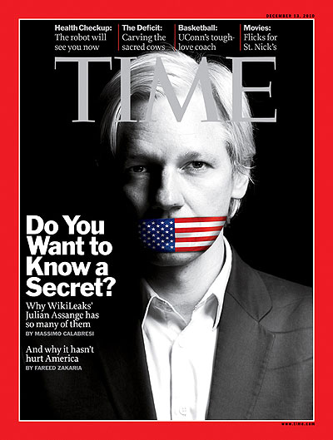
What is censorship on the internet?
Notes:
Talk about the censorship , Juiasa and edward . Goverment leaks

Slide 3
Lets take a vote
For or Against

Slide 4
Reasons For
The internet allows minors to access graphic content with relative ease.

Slide 5
Reasons For
The internet contains falsified information which leads to people being misinformed.

Slide 6
Reasons For
The internet exposes the people to racial hatred.

Slide 7
Reasons For
All other forms of media are censored and the internet should be no different.

Slide 8
Reasons Against
Too Much Government Control

Slide 9
Reasons Against
There are already laws against things like inciting crime and child pornography. Not by censoring the internet at the risk of infringing on innocent people's speech

Slide 10
Reasons Against
It is a blatant violation of Internet privacy and freedom of press .

Slide 11


Reasons Against
Being able to help and change the world and getting your message out, for example, the use of this during Turkey's wars.

Slide 12
Debate

Slide 13
Questions and Answers

Slide 14
Lets vote

