Slide 1

Yetti
Build a search engine for your website in minutes http://yettii.azurewebsites.net/

Slide 2
What is Yetti?
Yetti is a search engine plug-in
Followers can access all your social media content from one hub
Import their existing content (blog posts, videos, pictures, etc.)
Create a seamless search experience.

Slide 3
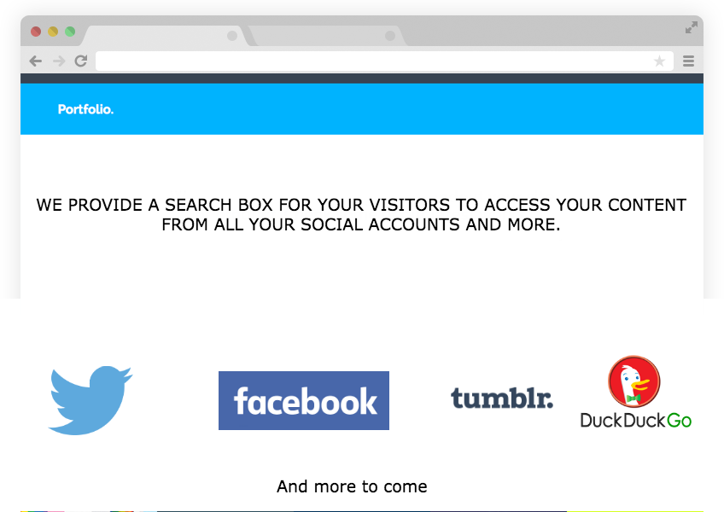
Who is Yetti for?
ARE YOU A STARTUP OR CONTENT CREATOR?
WANT YOUR VISITORS TO BE ABLE
TO SEARCH YOUR CONTENT EASILY?
DON'T WANT TO WASTE VALUABLE TIME WITH CODING AND HASSLE?

Slide 4

How does it work?
You sign up
Add the contents you want to be searchable eg links, files, videos
Voila! That's it!
Less talking - more action !

Slide 5
Why Yetti ?
Yetti
Yetti is currently the only plug-in search engine available (that we know of)
Allows you to unify different social media
Yetti is extremely easy to use - just input a single line of code
Help improve your site’s visibility

Slide 6
Customer Validation
“that sounds like a great idea as it's hard to get people from YouTube over to social media so if it was possible to view them all on one website or even a app that would be fantastic for both us and our viewers”
Warmest regards
Sarah - a leading make-up blogger

Slide 7
Pricing
Yetti
OPEN VERSION
FREE
BLOGGER’S PACKAGE
$24.99
START-UP PACKAGE
$49.99
5 THEMES
LIFETIME SUPPORT
UNLIMITED USAGE!
INCLUDES TWITTER
INCLUDES OPEN VERSION
PLUS
5 NEW THEMES
DEDICATED SERVERS
CUSTOM DOMAIN
ALSO INCLUDES INSTAGRAM, YOUTUBE AND MORE
INCLUDES BLOGGER’S PACKAGE
PLUS
INCLUDES BUSINESS-ORIENTED INTEGRATIONS SUCH AS DROPBOX, GOOGLE APPS AND MORE

Slide 8
Financing the project
Yetti will be launched initially as a private business
We already have sufficient funding to bootstrap the project for it’s initial 12 months

Slide 9
Short-term objectives
Month Paying Customers
3 500 - 1,000
6 1,500 - 2,000
9 3,000 - 4,000
12 4,500 - 6,000

Slide 10
How Yetti Will Advertise
Our primary advertisers will be linkedin, facebook, twitter and pinterest
Apart from these we'll advertise on sites geared towards tech startups
These include Techcrunch, Go2Web20, Muckrack, Startuptunes and PSFK

Slide 11
Yetti
Get Value , Get speed, Get Yetti
http://yettii.azurewebsites.net/

