Slide 1
Arm Command
Lucas Katayama
Shiwei Hu

Slide 2
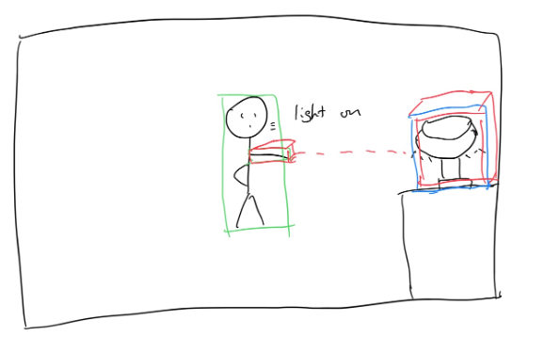
Motivation and Objectives
As home automation becomes more popular, users may seek a more intuitive way of interacting with smart home devices such as lights and other electronics. As the number of devices in one’s house increases, the manual setup process can become somewhat of a burden.
By using an Intel NUC, a camera, and a Lidar, we are able to detect a person's fingers and determine which object the user is pointing to. Then, with a simple command (such as saying "on/off") the user can control it.

Slide 3
Technical approach and novelty
State of the Art
Setup devices and scenes through app
User interaction based on voice prompts using devices’/scenes names
Gesture controls need wearable devices.
Limitations
Have to remember the name of devices
Tedious/hard setup process
Need of a wearable device
Novelty
Integration of camera and Lidar (tof sensor) to compute direction in which the user is pointing and then interacting with smart devices.
No need of wearable device
No need to call the names every devices

Slide 4
Methods
Hand Skeleton Detection Model: Mediapipe
Object detection Model: Yolo v5

Slide 5
Evaluation and Metrics
Accuracy when determining which device user is pointing to
Accurate distance in between devices
Time taken to determine device
Time taken from the moment user start an interaction to when the device turns on/off

Slide 6
Current Status and Next Steps
Media pipe hand detection
Lidar working
Camera mapping between lidar and rgb camera
Next steps
Object detection
Determining object being pointed to

