Slide 1
Arm Command
Lucas Katayama, Shiwei Hu

Slide 2
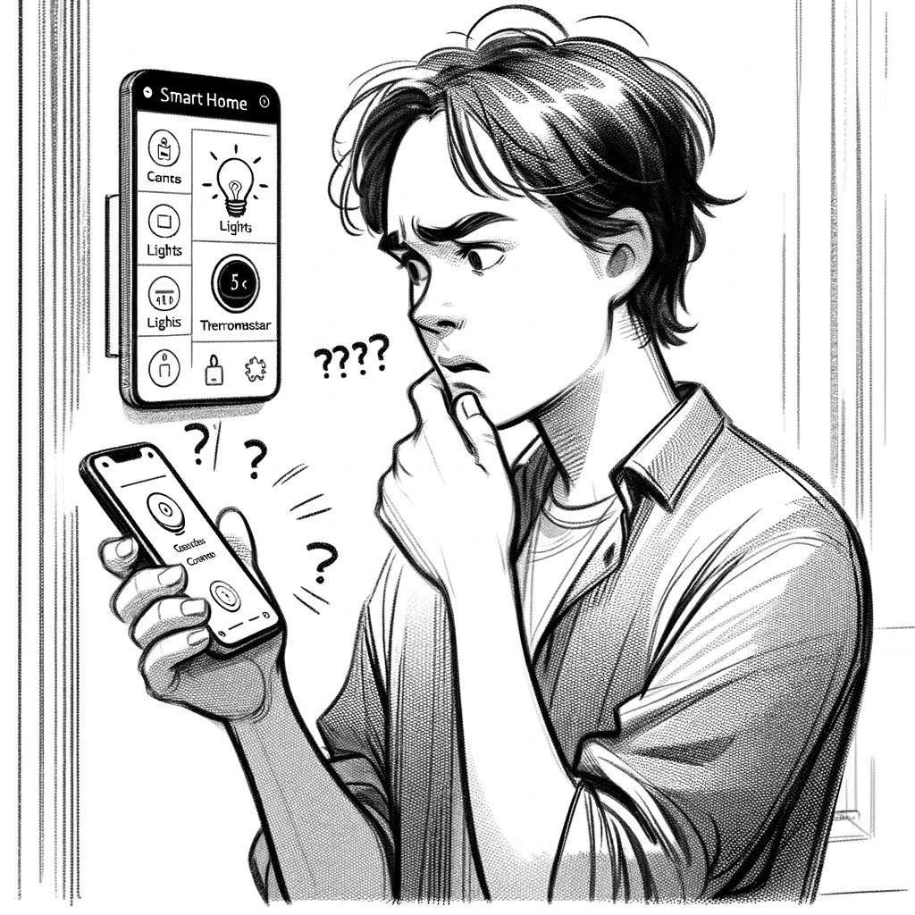
Project Motivation
As home automation becomes more popular, users may seek a more intuitive way of interacting with smart home devices such as lights and other electronics. However, the current approach used by the majority of the main automation services requires a tedious setup process.
As the number of devices in one’s house increases, this can become a burden.

Slide 3
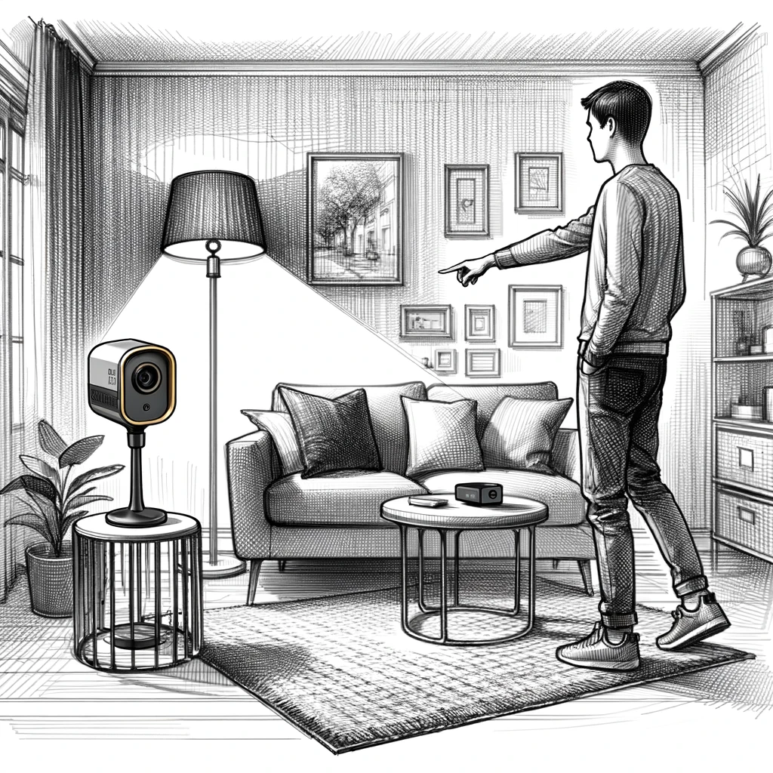
Project Goal
Our goal is to turn smart home interaction into a streamlined, simple process, allowing users to control devices with their hands.
By using an intel NUC, a Lidar, and a regular camera, we can detect the user’s hand and determine which device he/she is pointing to. Then, using a simple command, the smart device will be turned on/off.

Slide 4
Prior Work and novelty
Prior Work
SeleCon: This paper presents the idea of using a ultra-wideband (UWB) equipped smartwatch to implement a pointing approach to interact with smart devices. This is similar to our approach but it relies on a wearable device and pre-configured "scenes" to determine where the user is pointing to.
Minuet : This paper explores the HCI aspect of using of multimodal approach to interacting with smart home devices.
Novelty
Integration of camera and Lidar (tof sensor) to compute direction in which the user is pointing and then interacting with smart devices.
No need of wearable device
No need to call the names every devices

Slide 5
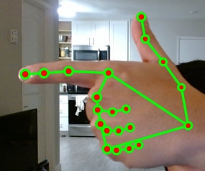
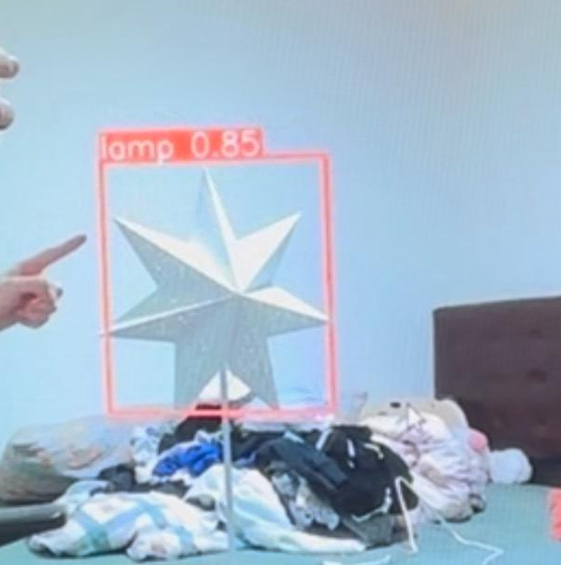
Technical Implementation
For the hand detection algorithm, we are using MediaPipe’s hand detection model.
We created a vector of the finger in the 3d space to then determine which object it is pointing to.
We trained a YOLO v5s model to perform the object detection of both the lamp and computer monitor. We then create a boundary cube around the objects to serve as a hitbox.

Slide 6
Technical Implementation
We then calculate the intercept between the finger vector and the objects’ hitbox to determine which object is being pointed to.
Then, by using the fingers landmarks, we determine if the user does a thumbs up to then toggle on/off the pointed object.
Communicating to the Kasa smart plugs through wifi.

Slide 7
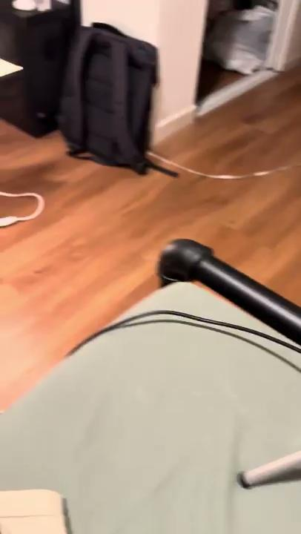

Demo

Slide 8
Measuring success
Our first success metric is related to response time: time elapsed from the moment the user controlled a device until when the action happened. In the current setting, we measured an average response time of less than 1 second.
Another success metric is related to detection accuracy: how close can objects be and still be accurately controllable. In our testing, as long as the objects are not overlapping, the system will work as expected.

Slide 9
Limitations
There are a couple of limitations to our approach: First, as we’re only using one camera, we cannot control a device if it is behind another object. Another consequence is that the precise hitbox of an object can’t be determined, thus we have to calculate a hitbox based on partial values.
Second, we were limited in our capability to perfectly detect the computer monitor due to the sheer time taken to train the YOLO model. We had to train the model with fewer images than ideal or it would take MORE THAN A WEEK to train using 1000 images. As such, our monitor detection is not always accurate.
Third, due to the hardware limitations, we can’t use a specialized model to detect the hand gestures, we have to calculate by ourselves. So currently the gesture we used to turn on/ off the light is simple.

Slide 10
Future work
Train the models to make it able to detect more objects.
Work on some different approaches of object detection
Optimize gesture recognition algorithms

Slide 11
Thank you
Q&A

