Slide 1
Game 2D FastDelivery
Student: Tran Quoc Bao
Nguyen Tuan Anh

Slide 2
Table of contents
01
Reason for choosing topic
02
Introduction to the game
03
Tools for making the game

Slide 3
01
Reason for choosing topic

Slide 4
Choose make Game 2D
Easier to develop: 2D games generally require less complex programming and art creation compared to 3D games.
Broader appeal: They often have a simpler and easier-to-learn gameplay style, which can appeal to a wider range of gamers, including casual gamers.
Greater creative freedom: 2D art allows for a lot of creativity and variety. You can create unique and stylized visuals that wouldn't be possible with 3D graphics.

Slide 5
Learn about delivery game
Euro Truck Simulator 2:
Death Stranding:
Pizza Connection 3:
Grubhub:
A
A realistic truck simulation game that allows players to drive trucks across Europe to make deliveries.
B
An action-adventure game set in a post-apocalyptic world, where players must deliver cargo across a ravaged landscape.
C
A restaurant management game where players run a pizza parlor and must manage deliveries.
D
A food delivery app that allows players to order food from local restaurants and track their delivery status.

Slide 6
02
Introduction to the game

Slide 7

Introduce about Fast Delivery
FastDelivery is an innovative 2D game that immerses players in the exciting world of food delivery. Unlike traditional delivery games, FastDelivery introduces a unique twist: players can only see the item they need to deliver when they are close to the designated location. This adds an element of surprise and challenge to the gameplay, as players must navigate the map and anticipate the location of their deliveries.

Slide 8
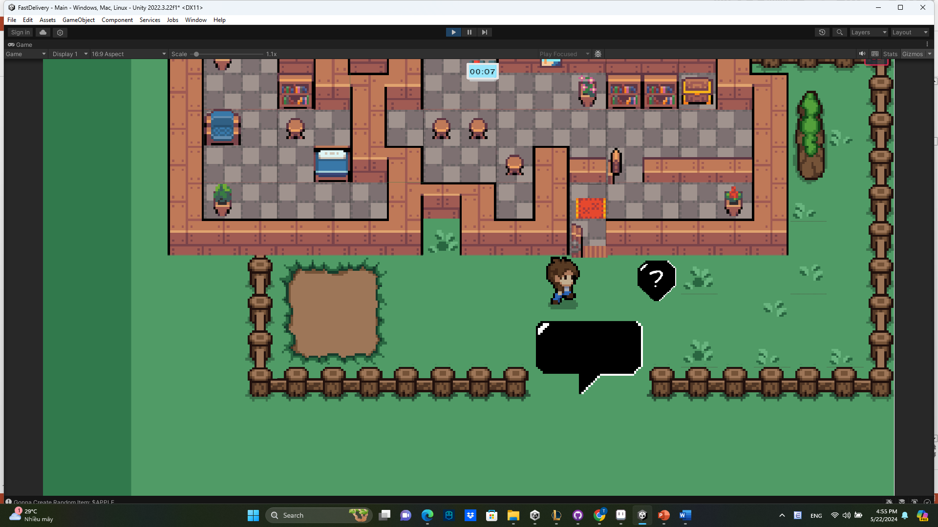
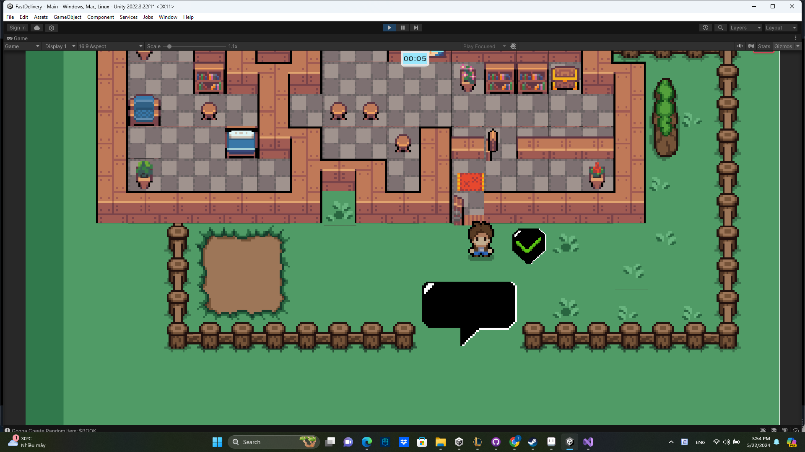
Game Play

Slide 9
03
Tools for making the game

Slide 10



Tools
Unity Engine
Aseprite
Visual Studio

Slide 11
Thank you for listening

