Slide 1
Capstone check-in
Creighton Ashton

Slide 2

Opening box office gross
Data collected from
IMDB
Box Office Mojo
The Movie DB
MVP
A model that predicts opening box office gross
What features affect opening box office gross the most
Stretch goals
predict total gross over time
My observations will be a single movie and my target will be opening box office gross
I will use movie data to build a regression model that predicts opening weekend box office gross in order to set budgets for upcoming productions.

Slide 3
Additional notes
Combining data from multiple sources could be an issue
Determining what features effect opening weekend could be extensive
Lost in the details
Should I look into sentiment analysis
The stretch goal may require time series which we haven’t covered yet

Slide 4

The search for intelligent life
Data collected from
Berkeley’s SETI
MVP
A model that predicts the probability that a region of space contains intelligent life.
Stretch goals
Automate a process to update model when new information is published
Each of my observations will be a star system
I will use space observational data to build a classification model that predicts if a region of space has appropriate conditions for life in order to help limit the search for extra-terrestrial life.

Slide 5
Additional notes
Seems crazy ambitious and I am not an expert
Massive amounts of complicated, math heavy data
If anyone has knowledge of AstroPy, let me know
I would need to do more research into what goes into searching for intelligent life

Slide 6
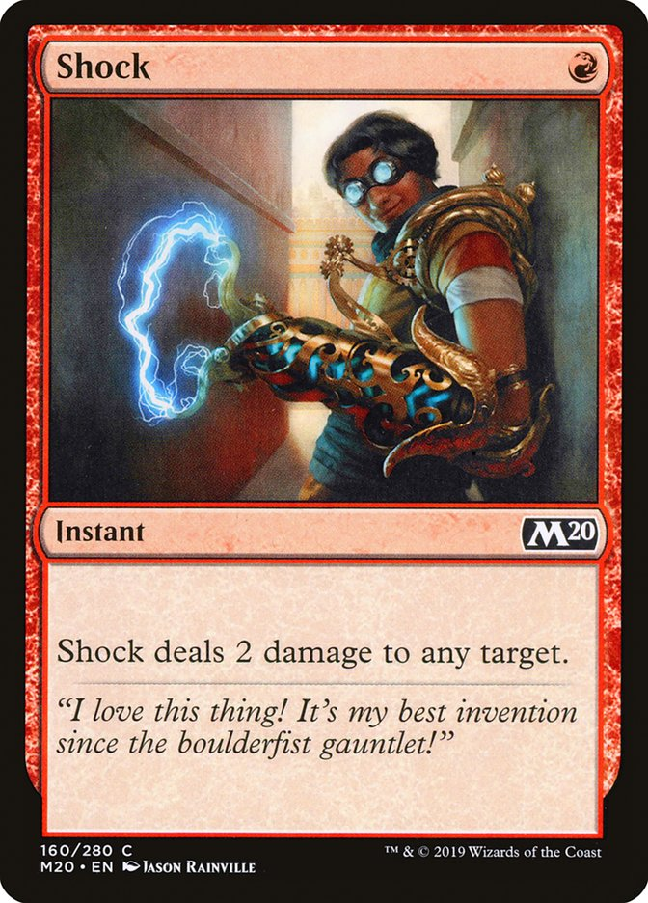
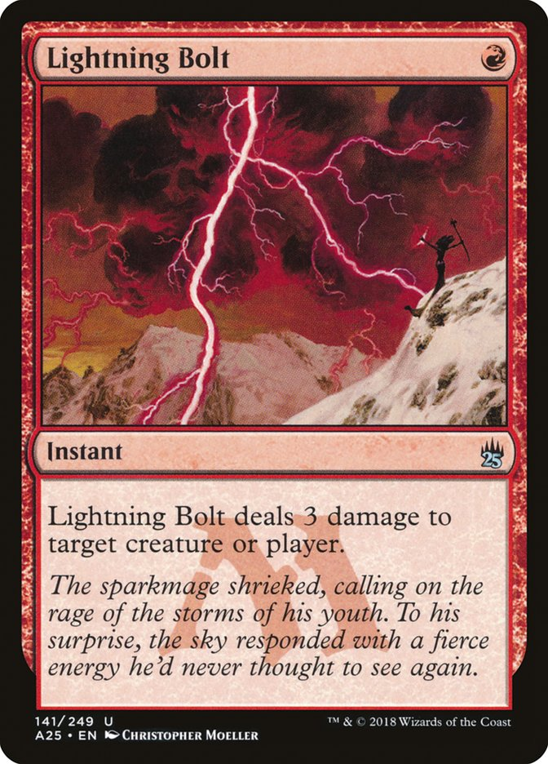
Magic: the gathering card recommender
Data collected from
ScryFall
MTG Goldfish
MVP
A model that recommends similar cards to user selected cards
Stretch goals
Keep a running list of user specified data to add to the data collection and continuously improve the model
Each of my observations will be a single magic card and my target will be similar cards
I will use data on magic the gathering cards to build a classification model that predicts and recommends similar cards in order to improve card selection

Slide 7
Additional notes
Haven’t learned recommenders
May be larger scope than I anticipate
I should do more research on what features are important when determining similarity

