Slide 1




Views 2 from the top down
Larry Garfield
Palantir.net
Database maintainer
PHP 5 evangelist
General gadfly

Slide 2
Agenda
Views overview
Query structure overview
Plugins vs. handlers
Display plugins
Style plugins

Slide 3
Views
A tool for making lists of Things

Slide 4
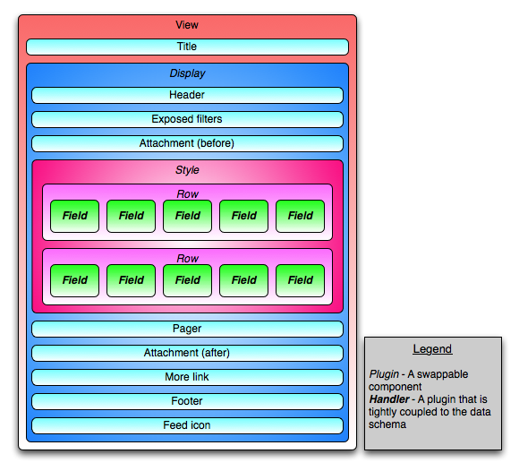
Anatomy of a View
Notes:
Not all displays will use all pieces.

Slide 5
Plugins
Themeable
  Display
  Style
  Row style
Non-themeable
  Access
  Arg default
  Arg validator
Handlers
  Field
  Filter
  Argument
  Sort
  Relationship
Notes:
Display: Where a View goes
Style: How a View appears
Row style: How Things in a View behave
Field: An element within a Thing
Filter: A restriction on what Things to show
Argument: A context-sensitive filter
Relationship: How to combine Things together
Sort: How to order your Things
Access: Who is allowed to see the View
Argument default: Default context for an argument
Argument validator: Validate and mutate; hack point
Too much to cover everything today. Go get the book.

Slide 6
Sneak peak at Views 3...
Query object
Header/footer
Pager
Caching
Internationalization
Coming when it's done to a Drupal near you...

Slide 7
Plugins
Registry hook
Definition class
Preprocess
Template (or theme function)
Notes:
Registry hook: Defines metadata about the plugin
Definition class: Handles configuration, UI, and interaction with the query.
Preprocess: Corresponding preprocess function for the plugin; usually does the heavy lifting of the display layer.
Template: Layout if any.

Slide 8
Plugin registry hook
function HOOK_views_plugins() {
return array(
'display' => array(...),
'style' => array(...),
'row' => array(...),
'argument default' => array(...),
'argument validator' => array(...),
'access' => array(...),
);
}
Notes:
All plugins defined in one massive declaration hook.
One key for each type of plugin.
Each key defines 1 or more plugins.

Slide 9
Display plugin
'display' => array(
'node_content' => array(
'title' => t('Node content'),
'admin' => t('Node content'),
'help' => t("Display the view as part of a node's content."),
'handler' => 'views_attach_plugin_display_node_content',
'theme' => 'views_attach_node_content_view',
'theme file' => 'views_attach.theme.inc',
// ...
'help topic' => 'display-node-content',
),
),
Notes:
Example from views_attach for the "node_content" display.
admin: The label on the Views admin list
handler: The definition class (May change in Views 3)
theme: The theme key
theme file: file where the theme key lives (theme function or preprocess)
theme path: Optional
Lots of other flags for what is/isn't available (pager, ajax, etc.)
help topic: What advanced_help key to link to from UI.

Slide 10
Display definition class
class myclass extends views_plugin_display {
function option_definition () {}
function options_summary(&$categories, &$options) {}
function options_form(&$form, &$form_state) {}
function options_submit($form, &$form_state) {}
function execute() {
$data = $this->view->render();
return $data;
}
}
Notes:
option_definition: Define available options and defaults. Like variables.
options_summary: Display the UI block in Views admin
options_form: FAPI fragment
options_submit: FAPI submit preprocessor; don't save here. Views saves it for you.
execute: Actually run the query, generate the output, and return everything inside the display (the style plugin and down).
And various others we won't go into right now... (Earl, others to mention?)

Slide 11
Show me some real code!
Notes:
Go walk through views_attach.

Slide 12
Style plugin
'style' => array(
'cycle' => array(
'title' => t('Cycle'),
'help' => t('Display the results using the jQuery cycle plugin'),
'handler' => 'views_cycle_plugin_style_cycle',
'theme' => 'views_cycle',
'uses options' => TRUE, 'uses row plugin' => TRUE, 'uses fields' => TRUE, 'uses grouping' => FALSE,
'type' => 'normal',
'parent' => 'list',
'theme file' => 'views_cycle.theme.inc',
),
),
Notes:
Example from views_cycle.
uses options: Yes this style is configurable.
uses row plugin: True to theme rows separately, False if the style plugin does it all.
uses fields: False to disable fields entirely (eg, for Node listings)
uses grouping: Enable the "grouping" field behavior.
parent: Parent style type; include or PHP breaks. PHP4-ism.

Slide 13
Style definition class
Very similar to display class...

