Slide 1
Italian Government Stability by Davide Cremonini – FAIKR Module 3 Project

Slide 2
Objectives
Italy historically has a problem with short lived governments.
More than 70 governments led Italy from 1948 to today, is it possible to use these data to help us predict future instabilities?
The project goal is to implement a model to predict instability based on statistical data.

Slide 3
The Dataset
As there was no available dataset on the topic, a new one had to be created.
The dataset used for the project contains historical data on every Italian government from the first to the eighteenth legislation. There are a total of 26 columns.

Slide 4
Preprocessing
Some of the columns were transformed or unified with others to produce a simpler model.
To highlight patterns and ease calculations, continuous or sparse data was discretized into categories.
After the discretization, every column value was encoded with integer numbers.

Slide 5
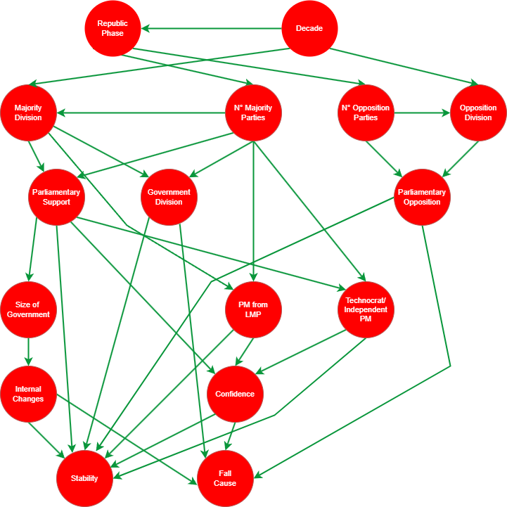
The Network – Variables
16 nodes, each corresponding to the most relevant variables.
Only one true, independent, variable, two output variables.
Mostly integer value except for a few Boolean ones.

Slide 6
The Network – Causal Links
32 causal links based on reasonable assumptions in the political landscape.
Starting from Decade, every link was drawn iteratively considering every other node, until the last ones.

Slide 7
Queries
Test Query: «Which is the Probability that a Government which was denied confidence to be unstable and fall because of it?
Predicted to be Unstable and to fall for a lack of confidence.
First Query: «What is the predicted stability of the current government and how will it fall?»
Predicted to have an average stability and to fall to perform a reshuffle.
Second Query: «Is it true that, given a strong parliamentary support, a Technocrat-led government is more stable than a Political one?»
Predicted a strong stability for the technocratic/independent-led government.
Predicted a weak stability for the politically-led government.

Slide 8
Queries
Third Query: «If we know that a government fell for external pressure and we know it had a strong opposition, what are the probabilities of it being divided in its composition?»
In 79% of cases a government fell for external pressure with a strong opposition, the government internal division was high.
Fourth Query: «If we want a Government have at least a Solid Stability and reach the end of legislation, what are the best configurations for Majority Division and Government Division?»
The best observed configurations include a fragmented majority which supports a coalition or a large coalition government.
Fifth Query: «If a government aims at changing the constitution directly without consulting oppositions, how many parties should it contain, if we suppose it needs have a solid stability to perform the reform from beginning to end?
To reform the constitution alone the government is expected to be a broad coalition formed by a fragmented majority, but these conditions heavily reduce its stability and enhances its probabilities to fall for internal struggles.

Slide 9
Conclusions & Future Developments
The presented prediction model can make interesting and debatable predictions despite the simplifications introduced.
Different results may be achieved with another network configuration, as the building process required some assumptions.
The model can be expanded to include other important factors such as local election results or to take into consideration political alignment.
The model can be generalized for other parliamentary systems across the world.

Slide 10
Thanks for your attention
Davide Cremonini
davide.cremonini8@studio.unibo.it

