Slide 1


TKO Women UI Function
By:
Matt Crater, Darian Saunders, Dave Ports, Ashleigh Davis

Slide 2

Project Overview
We are creating a UI function that interfaces with the website of TKO Women and adding a minting function so that when people go to the website to purchase the NFTs, they can select their fighter and mint simultaneously. We used Streamlit to run the code and used piñata to store the NFTs to be able to pull the images of the NFTs for the web UI to have the NFTs appear on the local host.
Tools Used
Ganache
Ganache is a personal blockchain for rapid Ethereum and Corda distributed application development. You can use Ganache across the entire development cycle; enabling you to develop, deploy, and test your dApps in a safe and deterministic environment.
Streamlit
Streamlit is an open-source app framework in Python language. It helps us create web apps for data science and machine learning in a short time.
Pinata
Pinata is a media management company that provides media infrastructure and NFT platforms for creators and developers.

Slide 3
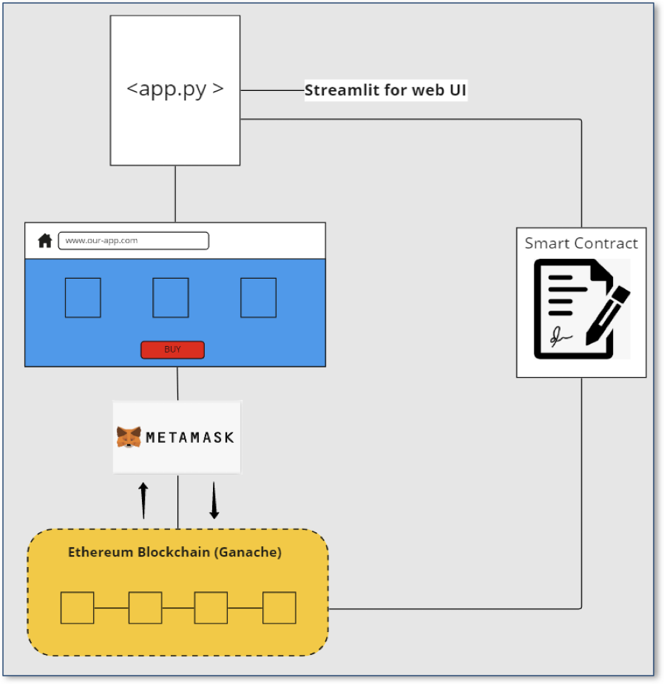

Infrastructure & Design
Initial idea was to build live production version on Ethereum testnet
Not enough time to build out fully
The team leveraged Ganache to build POC version
Streamlit module was used to power web-based UI

Slide 4
User Experience
TKO women was created to build a community for women through hand drawn artwork that is sold on the blockchain.
The Women are stored on Piñata
The user picks their fighter
Once they select a fighter, they can purchase and mint their NFT.
The purchase are then stored and able to view as they are selected.
In the future these purchases will enable the user access to future air drops and become part of the growing TKO Women community.

Slide 5

Selecting your Fighter Demo

