Slide 1

Weekly Global Foreign Exchange Market Review
FICC-Currency
Minjae Hwang/ SeongKyu Lee
A Week of Two Regimes: Local Flows, Global Rates
Executive Summary: Daily % Change Heatmap of G10 Basket & KRW (USD Perspective)
This Week’s Key Notations
KRW rally turns flow-driven: Heavy exporter, custody and foreign-bank dollar selling pushed USD/KRW as low as 1,347, with month- and quarter-end supply overwhelming the broader dollar signal early in the week.
U.S. yield surge revives dollar strength: Strong U.S. activity data and weak Treasury demand drove the 10-year yield above 5.20% and DXY above 101.
Yen intervention risk jumps: Rising concern over yen undervaluation and closer Japan–U.S. FX communication triggered a sharp USD/JPY reversal from the 158 area, easing some regional dollar pressure into the weekend.
Currency |  | Sep. 21st | Sep. 22nd | Sep. 23rd | Sep. 24th | Sep. 25th
 | EUR | -0.03% | 0.13% | 0.15% | 0.58% | -0.09%
 | GBP | -0.23% | 0.13% | 0.21% | 0.77% | -0.04%
 | AUD | -0.09% | 0.04% | 0.10% | 1.11% | 0.37%
 | NZD | 0.09% | 0.20% | -0.23% | 0.88% | 0.31%
 | JPY | 0.59% | 0.21% | 0.06% | 0.51% | 0.34%
 | CHF | -0.27% | -0.23% | 0.00% | 0.51% | 0.40%
 | CAD | 0.03% | 0.28% | 0.23% | 0.28% | 0.29%
 | NOK | -0.10% | 0.34% | -0.01% | 0.47% | 0.34%
 | SEK | 0.13% | 0.01% | -0.05% | 0.86% | 0.13%
 | KRW | 0.39% | -0.81% | -1.70% | 0.90% | 0.36%
Next Week’s Outlook
U.S. labor data takes center stage: August JOLTS arrives Sep. 29, followed by the September employment report on Oct. 2, making labor-market strength the key test for further Fed tightening and the recent Treasury selloff.
BOJ signals and Tankan in focus: BOJ July meeting minutes are due Sep. 28, while the Sep. meeting Summary of Opinions and quarterly Tankan arrive Oct. 1, keeping the policy path and renewed yen-intervention risk firmly in focus.
China PMI and quarter-end flows: China’s September PMI is scheduled for Sep. 30, just before the National Day holiday.
-3.5%
-3.5%
-2.0%
-2.0%
-1.0%
-1.0%
- 0.5%
- 0.5%
0.5%
0.5%
1.0%
1.0%
2.0%
2.0%
3.5%
Volatility Scale
3.5%
Volatility Scale

Slide 2
Weekly Issue
FICC-Currency
Brief Review
Sep 21 (Mon) — Two-way flow keeps USD/KRW near 1,380
USD/KRW finished at 1,381.00, down 2.30 won. The pair opened at 1,387.00 but exporter offers from semiconductor and heavy-industry names met dollar buying from foreign banks, keeping the market two-way throughout the session. Softer USD/JPY also limited the topside, while import-related demand helped prevent a deeper decline. U.S. rates still supported the dollar, but lower oil and steady local supply kept USD/KRW pinned near the 1,380 area.
Sep 22 (Tue) — Pre-holiday dollar supply drives the sharpest fall since July
USD/KRW dropped 22.80 won to 1,358.00 after touching 1,352.90, the biggest Seoul-session decline since Jul. 8. Exporter selling accelerated ahead of Chuseok, month-end and quarter-end, while custody and foreign-bank offers hit a market with weak bids. Long stops added momentum once 1,370 gave way, and the pace of the fall suggested positioning had become one-sided. The won strengthened even as DXY recovered toward 100.5, showing that local flow clearly dominated the global dollar signal.
Sep 23 (Wed) — USD/KRW breaks 1,350, then reverses with the global dollar
USD/KRW opened at 1,355.00 and fell to 1,347.10 as month-end exporter selling, passive dollar supply and improved risk sentiment carried over from Tuesday. Lower oil and easing Middle East tension also supported the won, keeping selling pressure intact through the morning. The move stalled in the 1,340s as bargain dollar demand and foreign buying of USD futures provided support. DXY then climbed toward 100.7, pulling USD/KRW back above 1,350 and to a 1,358.40 close. The reversal showed that local supply remained strong, but the pair was becoming more sensitive again to the broader dollar backdrop.
Sep 24 (Thu) — U.S. yield shock sends USD/KRW sharply higher (Korean holiday)
USD/KRW rose 7.60 won to 1,366.00 after briefly reaching 1,376.00 in thin holiday trading. September U.S. composite PMI jumped to 58.4, oil rebounded and weak Treasury demand pushed the 10-year yield above 5.10%, the highest since 2007. DXY broke above 101 and USD/JPY moved into the 158s, sharply tightening financial conditions across the region. The initial USD/KRW spike faded as follow-through buying weakened at higher levels, while exporter offers and a firmer yen capped the move. Even so, the session marked a clear shift back toward rates-driven dollar strength.
Sep 25 (Fri) — Yen rebound and softer oil unwind part of the dollar move (Korean holiday)
USD/KRW fell 8.50 won to 1,357.50 after its first trade near 1,368.00. The dollar stayed firm early as the U.S. 10-year yield pushed through 5.20% and DXY held above 101. The yield surge increasingly looked like a real-rate repricing tied to firm growth, heavy technology investment and policy-rate expectations rather than an unanchoring of inflation expectations. Fiscal sustainability concerns also remained an additional source of pressure on the long end. A Japan-U.S. finance call reinforced concern over yen undervaluation, lifting intervention risk and sending USD/JPY down by nearly 2 yen from its intraday high. Oil also reversed lower as renewed hopes for reopening the Strait of Hormuz improved. USD/KRW ended the week 28.50 won below the prior Friday, while elevated bond volatility kept carry-position deleveraging risk in focus.
Source: ING, Reuters, Seoul Money Brokerage

Slide 3
Regional Performance – East Asia
FICC-Currency
Weekly Performance Heatmap & Overview
※ All currencies were quoted with USD as the base currency
Current | WoW(%) | MoM(%) | YTD(%)
1,367.36 | -0.88% | -1.17% | -5.28%
Deviation from \n15 year High (%) | MDD(%) | RSI | Vol 20 Days
-12.04% | -20.48% | 46.6 | 11.84%
Current | WoW(%) | MoM(%) | YTD(%)
158.81 | 1.72% | -0.28% | 1.33%
Deviation from \n15 year High (%) | MDD(%) | RSI | Vol 20 Days
-3.08% | -20.48% | 59.0 | 11.70%
Current | WoW(%) | MoM(%) | YTD(%)
6.7111 | 0.06% | -0.17% | -4.07%
Deviation from \n15 year High (%) | MDD(%) | RSI | Vol 20 Days
-8.69% | -14.16% | 44.3 | 1.12%
Current | WoW(%) | MoM(%) | YTD(%)
31.69 | -0.49% | -0.35% | 1.25%
Deviation from \n15 year High (%) | MDD(%) | RSI | Vol 20 Days
-6.03% | -94.45% | 45.2 | 3.70%
-3.5%
-3.5%
-2.0%
-2.0%
-1.0%
-1.0%
- 0.5%
- 0.5%
0.5%
0.5%
1.0%
1.0%
2.0%
2.0%
3.5%
Volatility Scale
3.5%
Volatility Scale
Source: KRX, SMB, Yahoo Finance

Slide 4
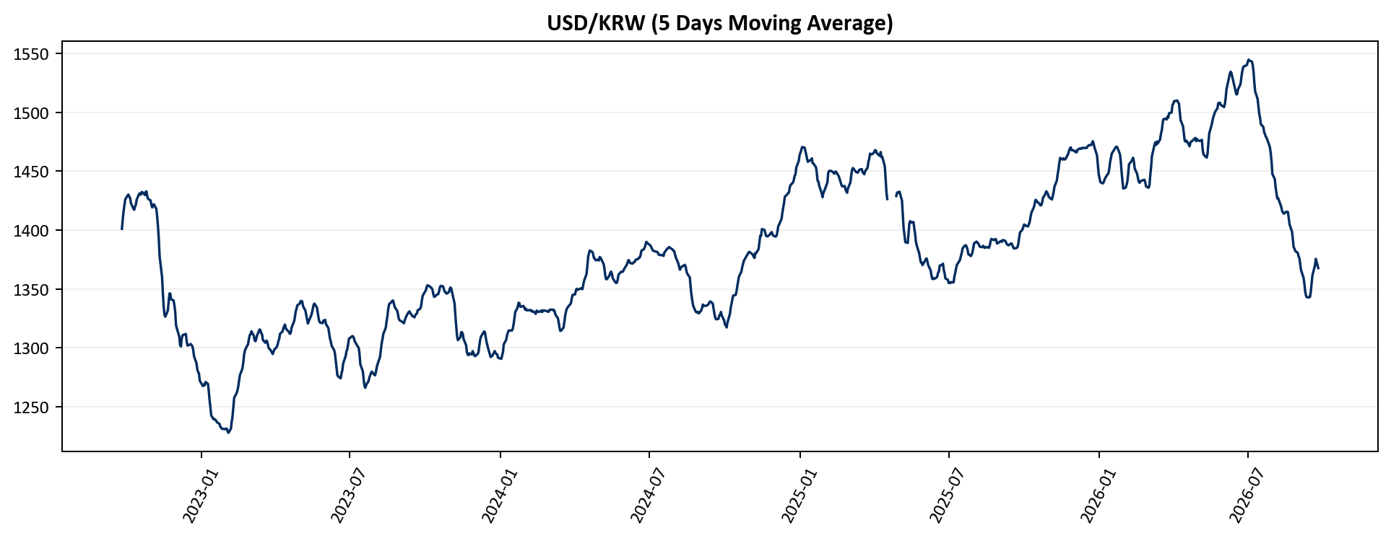
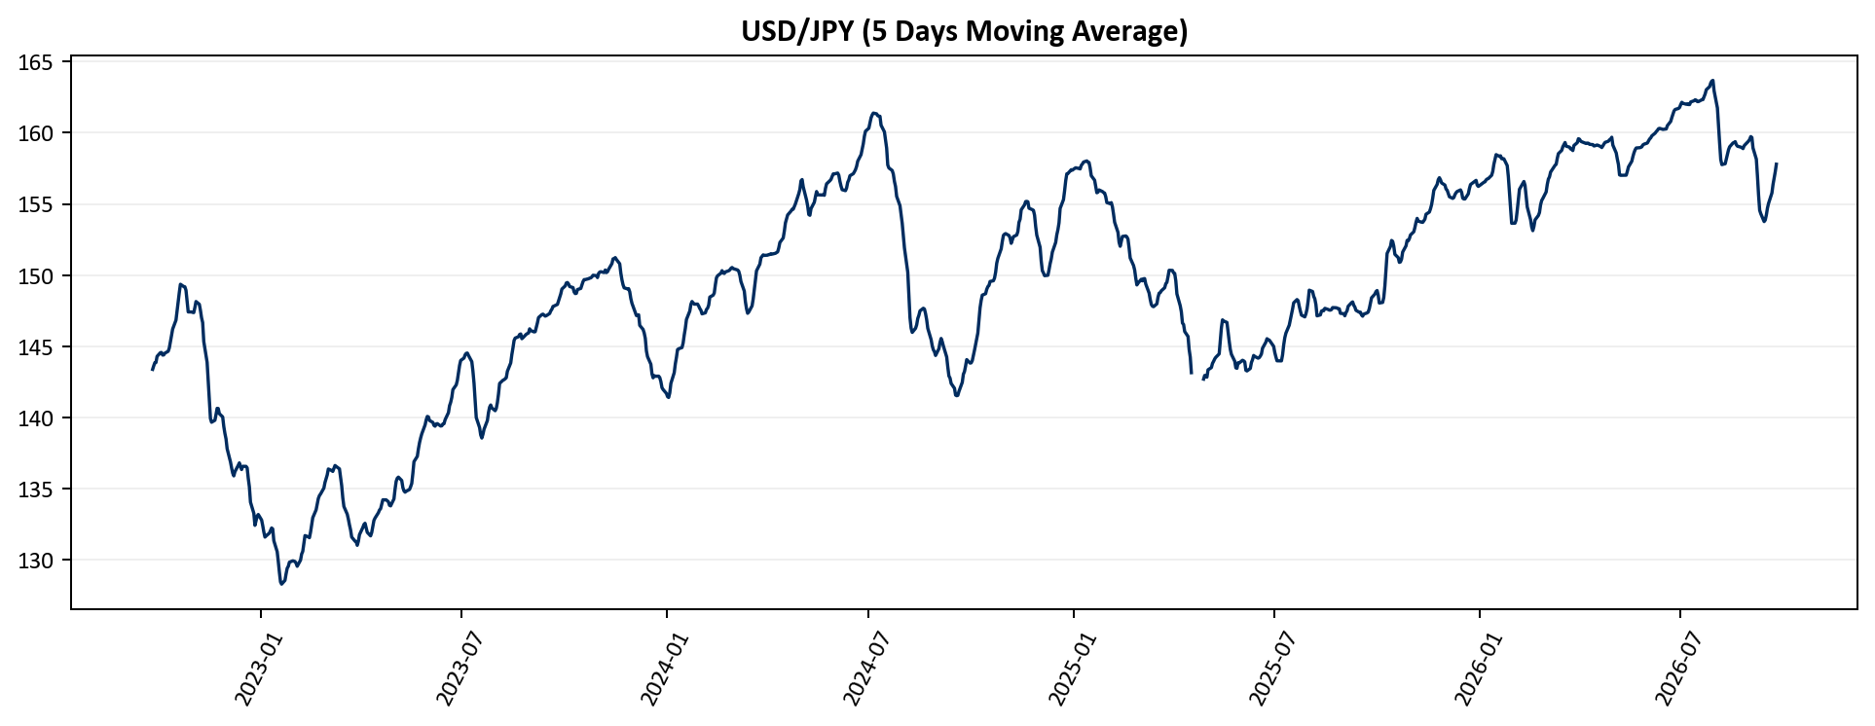
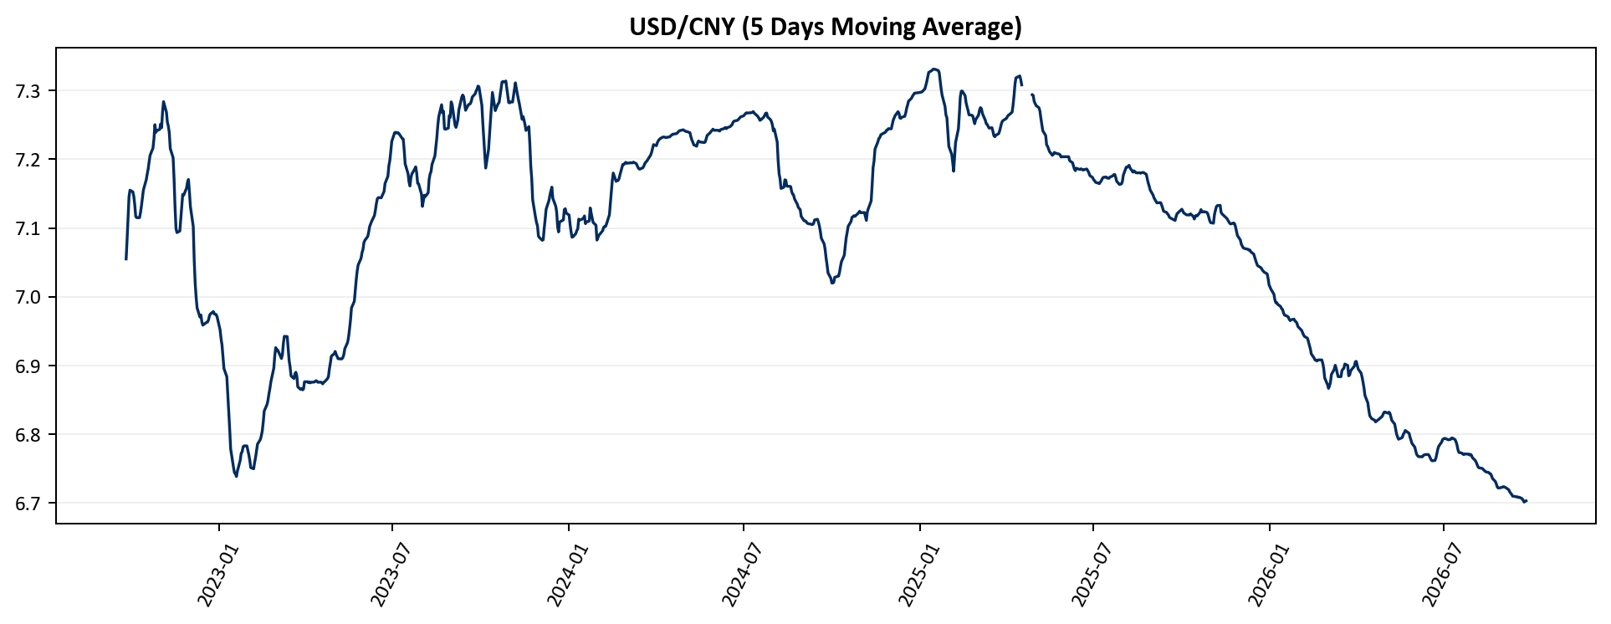
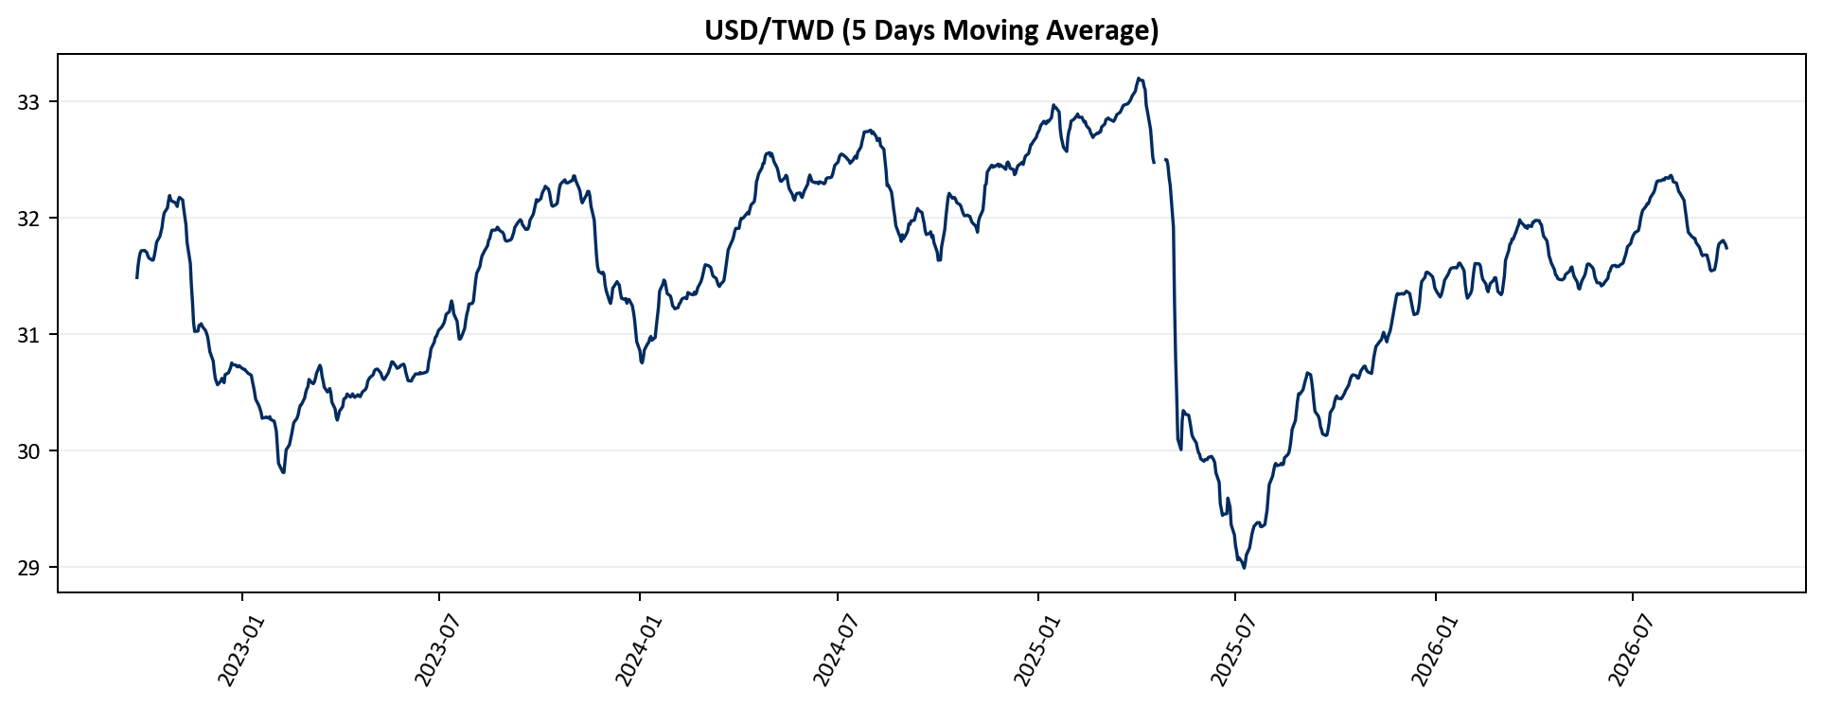
FX Historical Trends
FICC-Currency
Up-To-Date Historical Trends of notable currencies in East Asia
USD/KRW (5 Days Moving Average)
USD/JPY (5 Days Moving Average)
USD/CNY (5 Days Moving Average)
USD/TWD (5 Days Moving Average)
Source: KRX, Yahoo Finance

Slide 5
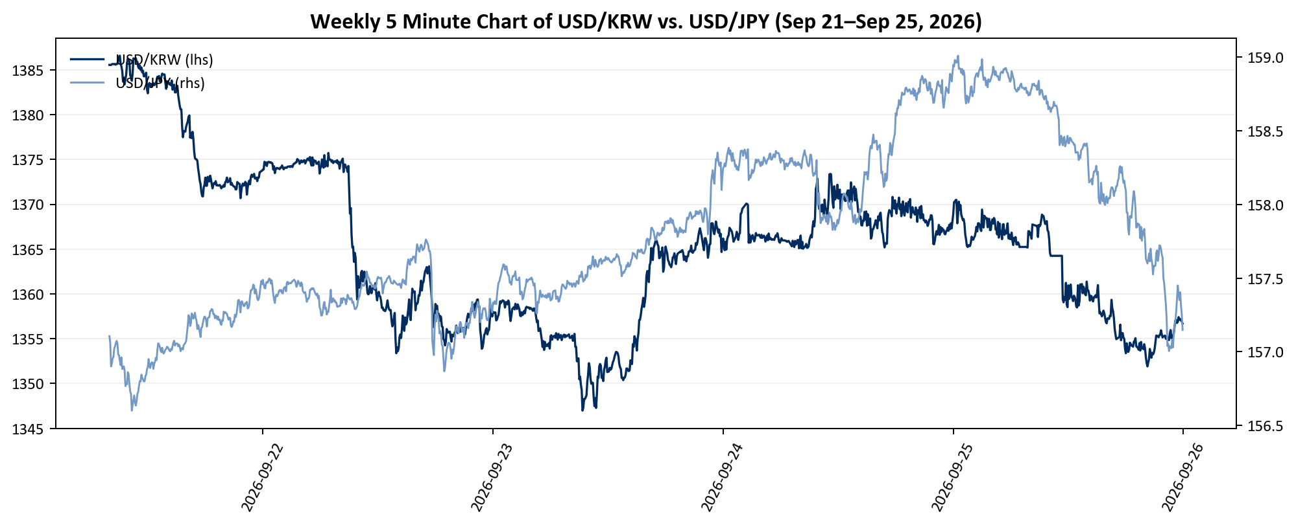
Weekly Trends
FICC-Currency
Weekly flow dynamics and issue breakdowns for the Korean Won, the Japanese Yen
Weekly 5 Minute Chart of USD/KRW vs. USD/JPY
Source: KRX, Yahoo Finance

Slide 6
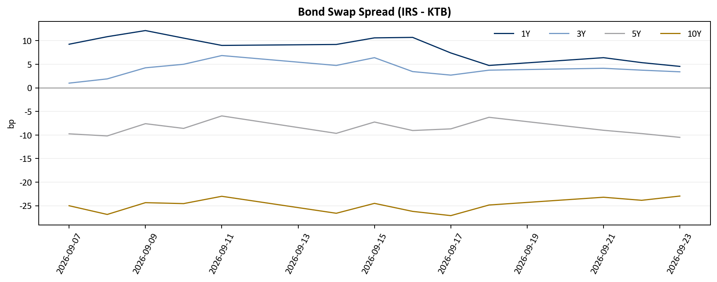
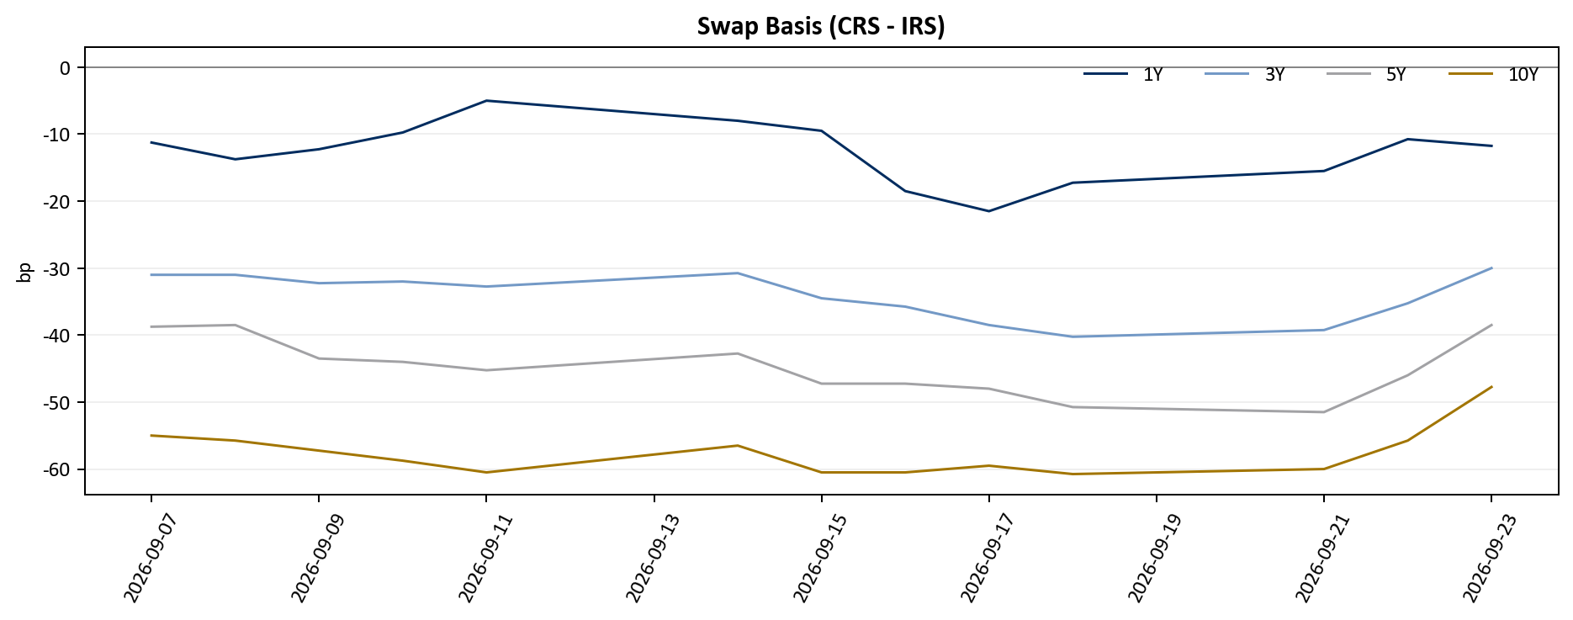
Derivatives
FICC-Currency
Swap Market Focus: Cash bonds outperformed IRS, driving the 1Y bond-swap spread wider
Bond Swap Spread(IRS rate – Bond yield)
Swap Basis (CRS-IRS rate)
Source: KMBCO

Slide 7
Regional Performance – United States & Canada
FICC-Currency
Weekly Performance Heatmap
Key Details
※ All currencies were quoted with USD as the base currency
Currency | DXY | USD/CAD
MoM(%) | 1.82% | 1.95%
YTD(%) | 2.59% | 3.14%
Deviation from 15Y High (%) | -11.52% | -3.88%
MDD(%) | -17.50% | -17.42%
RSI | 65.2 | 73.1
Vol 20 Days | 5.00% | 4.18%
Current | WoW(%)
1.4146 | 1.11%
Dollar Index (DXY)
Current | WoW(%)
100.97 | 0.75%
-3.5%
-2.0%
-1.0%
- 0.5%
0.5%
1.0%
2.0%
3.5%
Volatility Scale
Source: FRED, Yahoo Finance

Slide 8
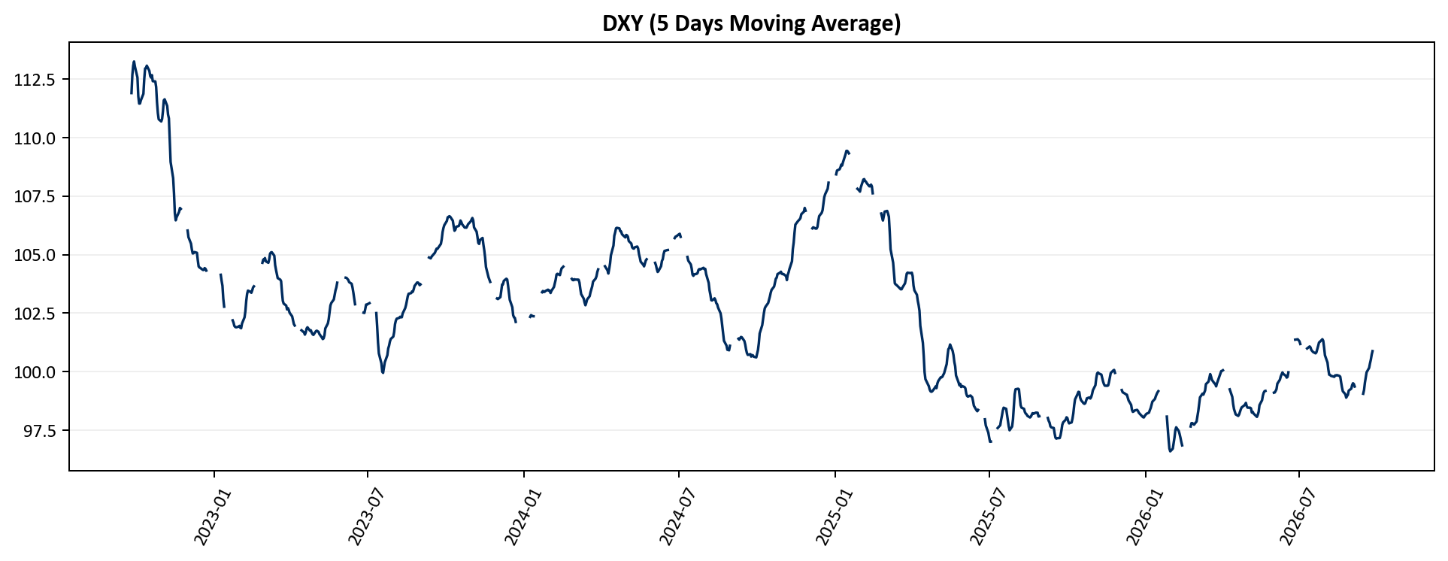
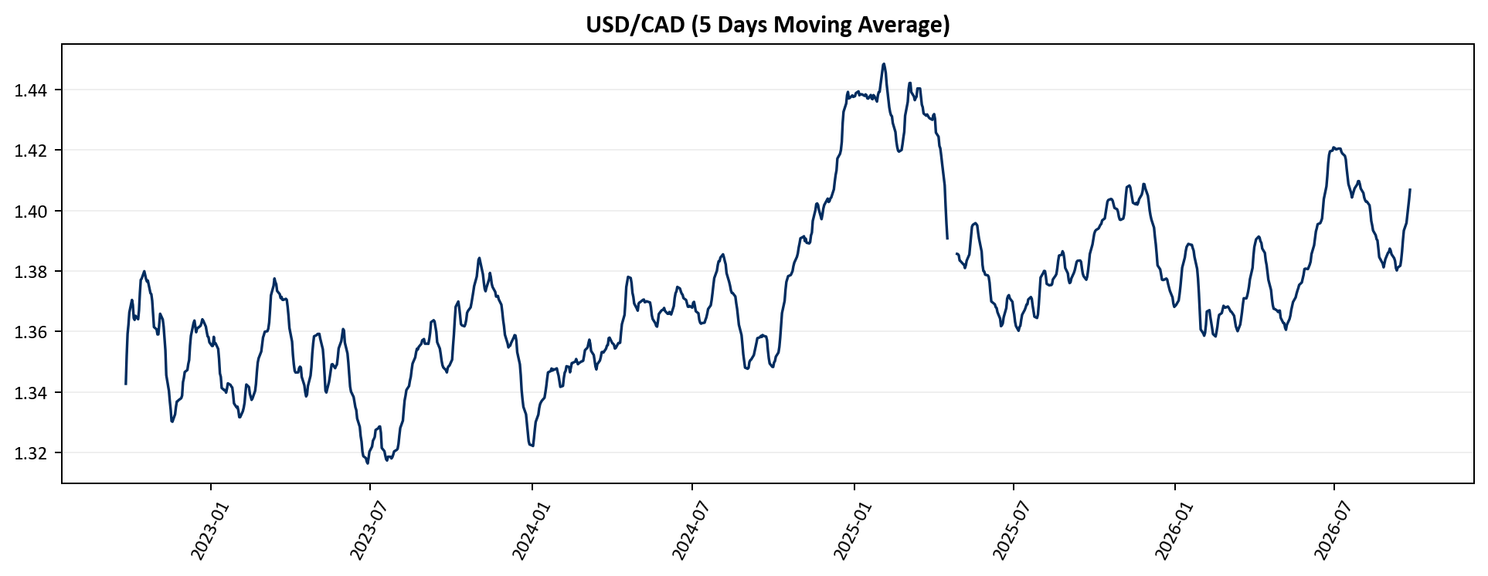
FX Historical Trends
FICC-Currency
Up-To-Date Historical Trends of Dollar Index, Canadian Dollar
DXY (5 Days Moving Average)
USD/CAD (5 Days Moving Average)
Source: Yahoo Finance

Slide 9
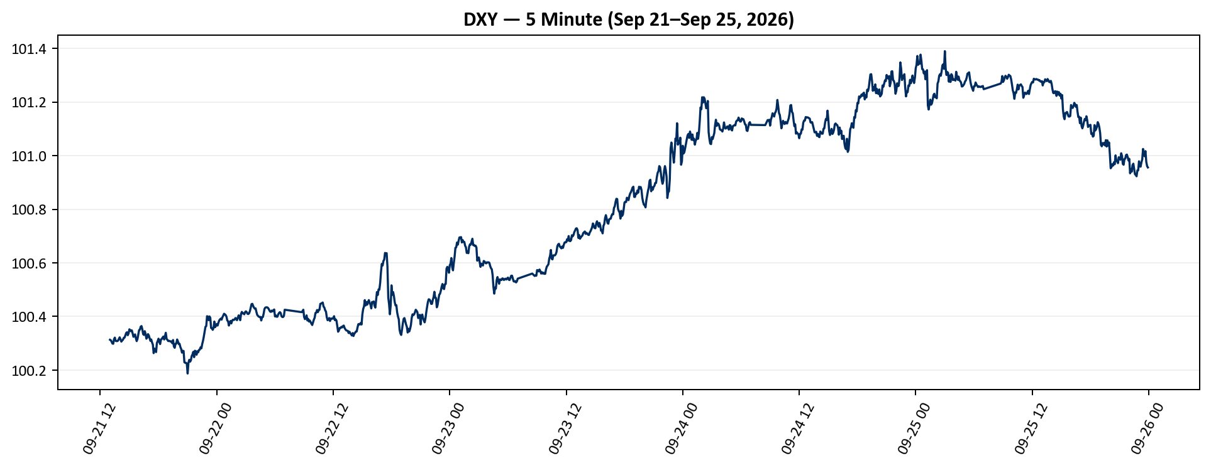
Weekly Trends
FICC-Currency
Weekly flow dynamics and issue breakdowns for the Dollar Index
Weekly 5 Minute Chart of DXY
Source: FOMC, FRED

Slide 10
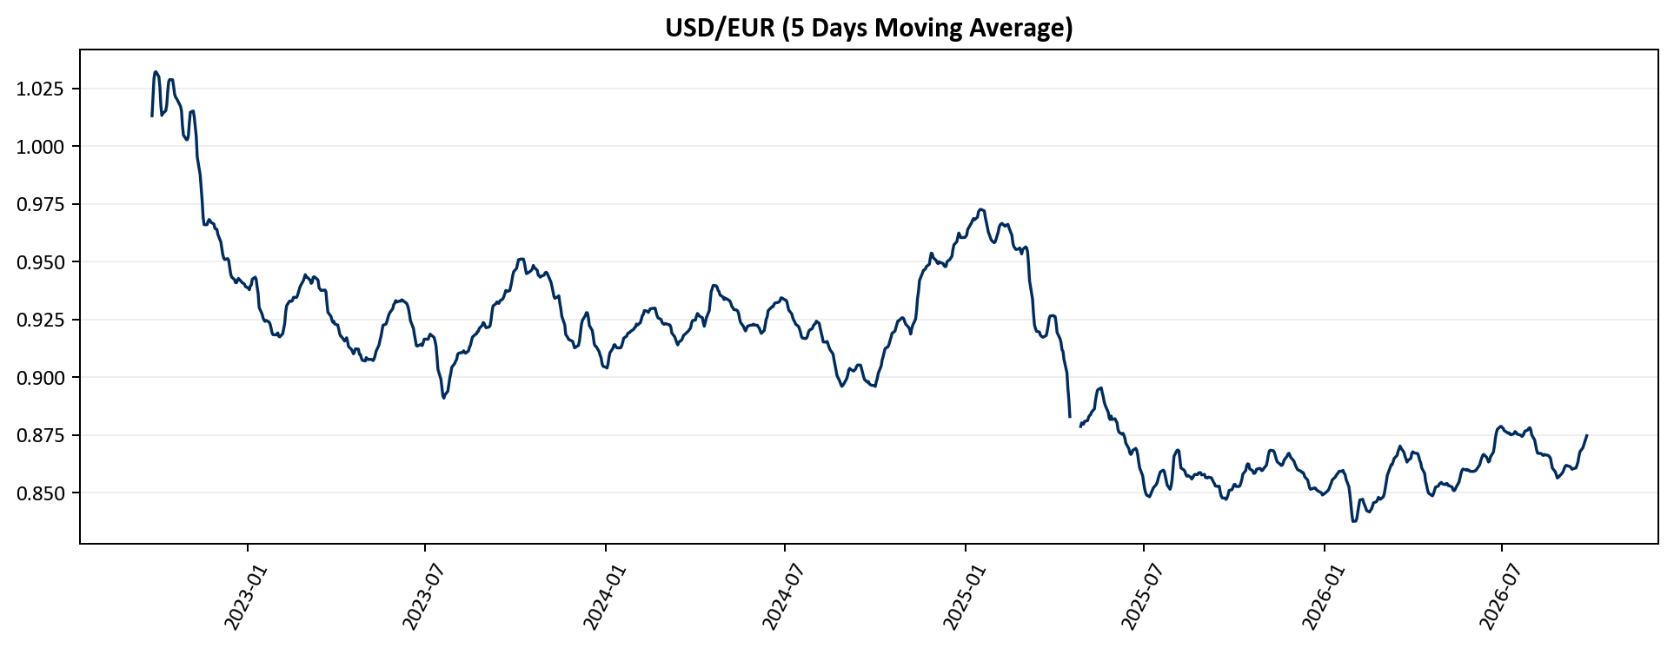
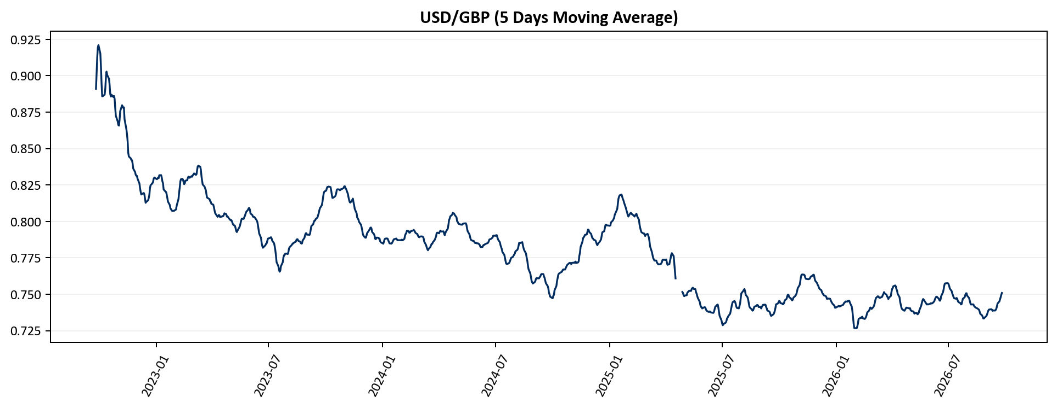
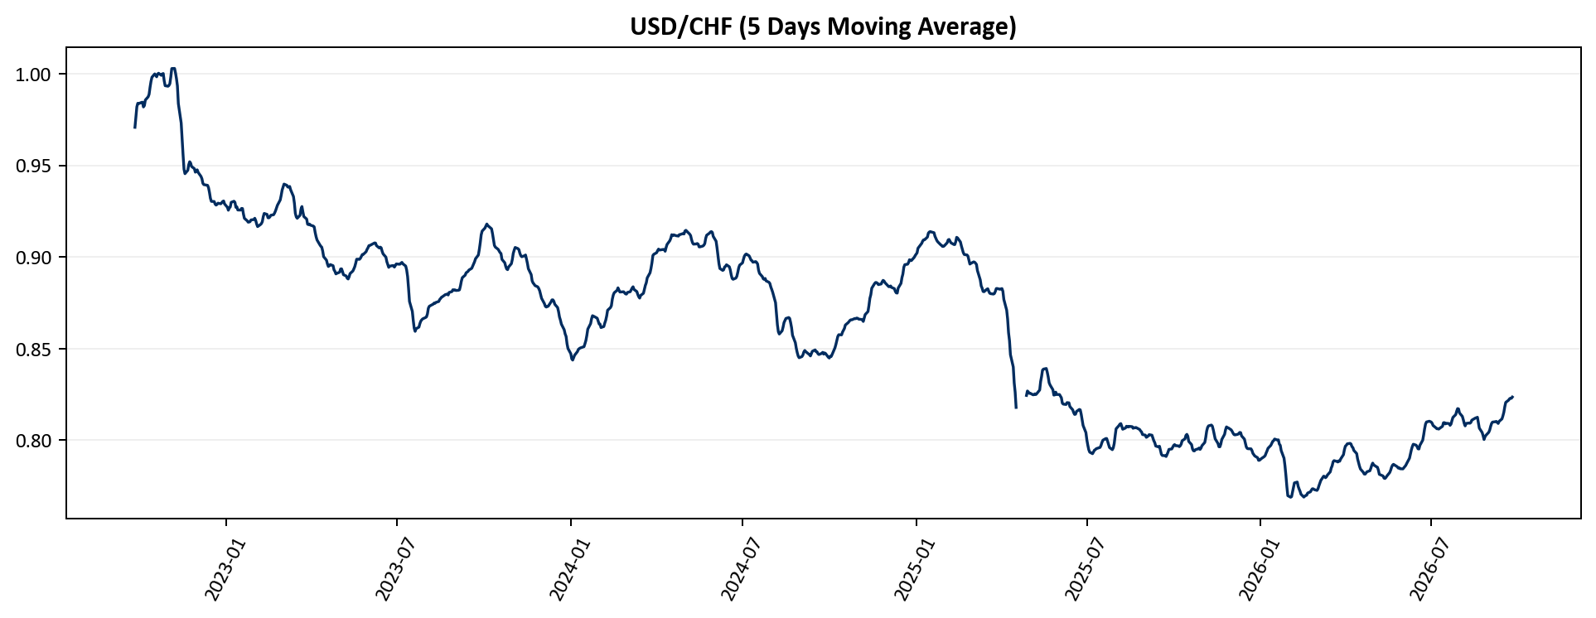
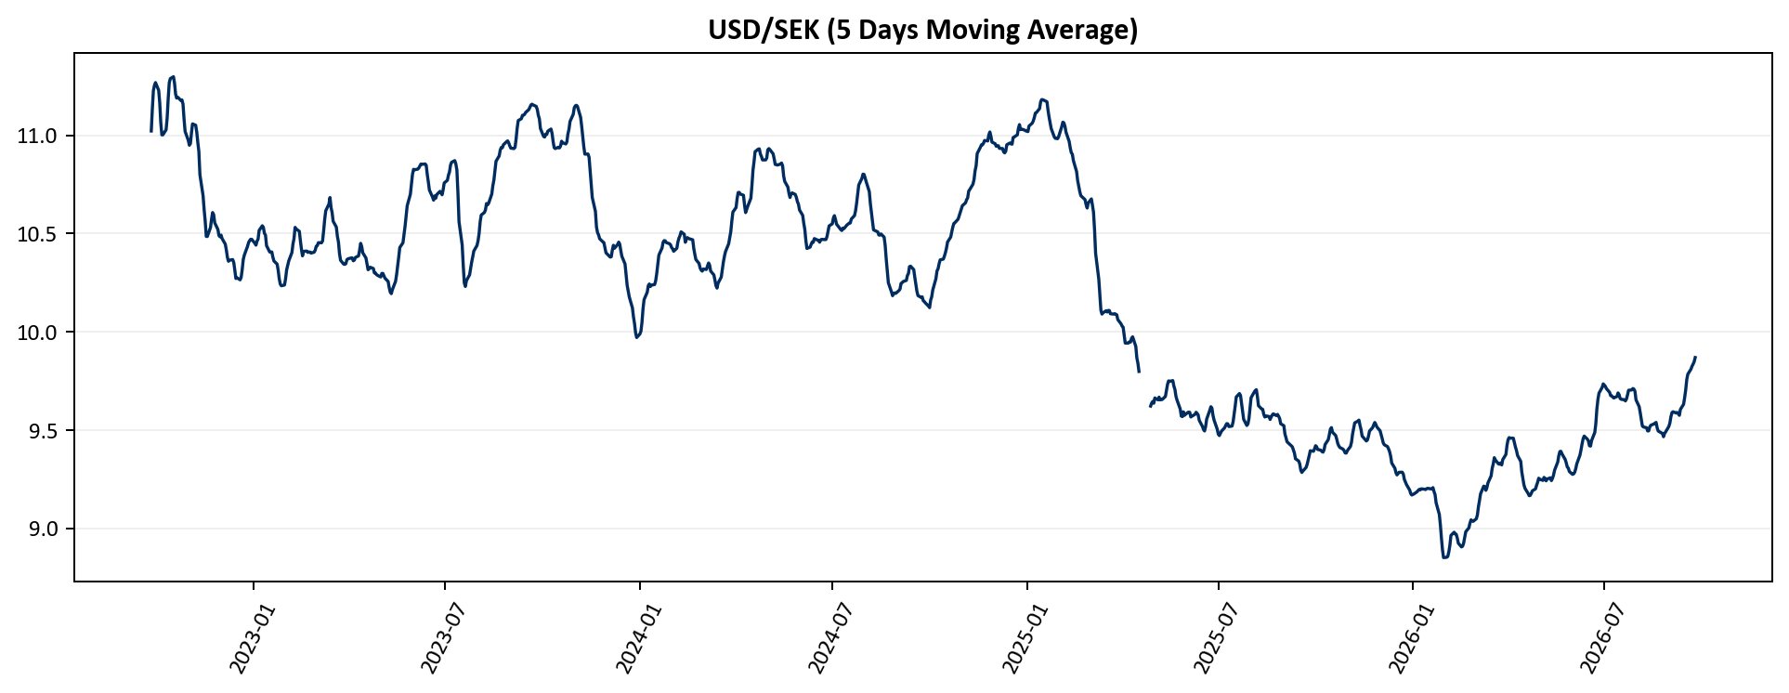
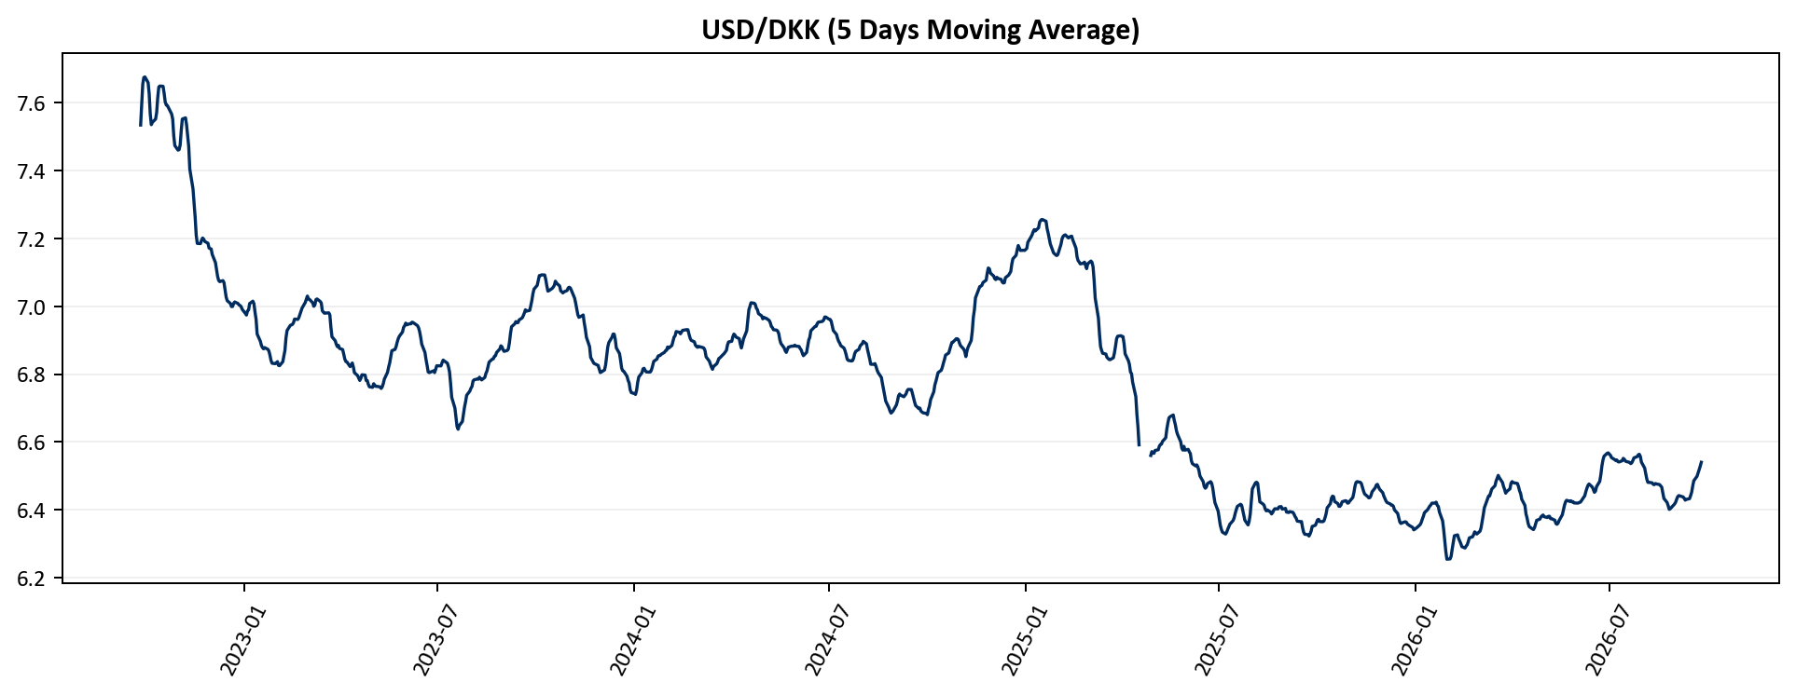
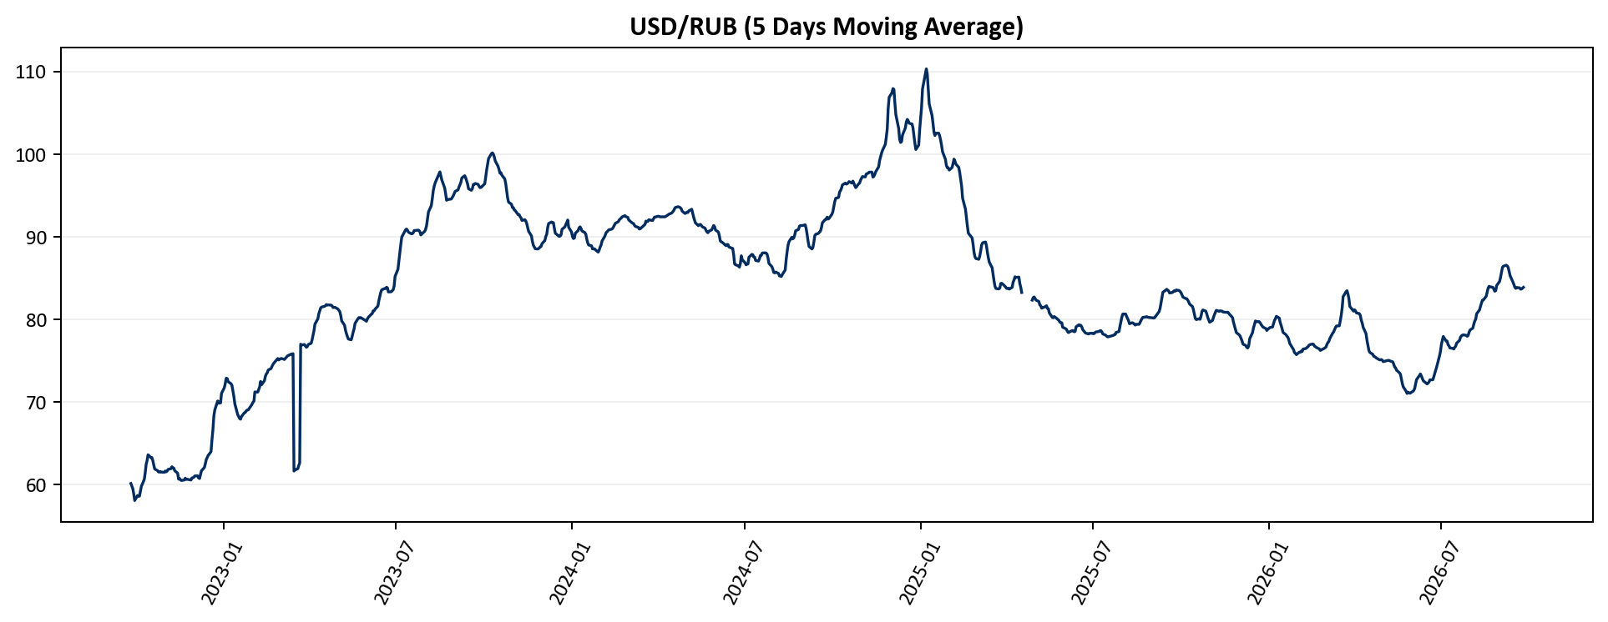
FX Historical Trends
FICC-Currency
USD/EUR (5 Days Moving Average)
USD/GBP (5 Days Moving Average)
USD/CHF (5 Days Moving Average)
USD/SEK (5 Days Moving Average)
USD/DKK (5 Days Moving Average)
USD/RUB (5 Days Moving Average)
Source: Yahoo Finance

Slide 11
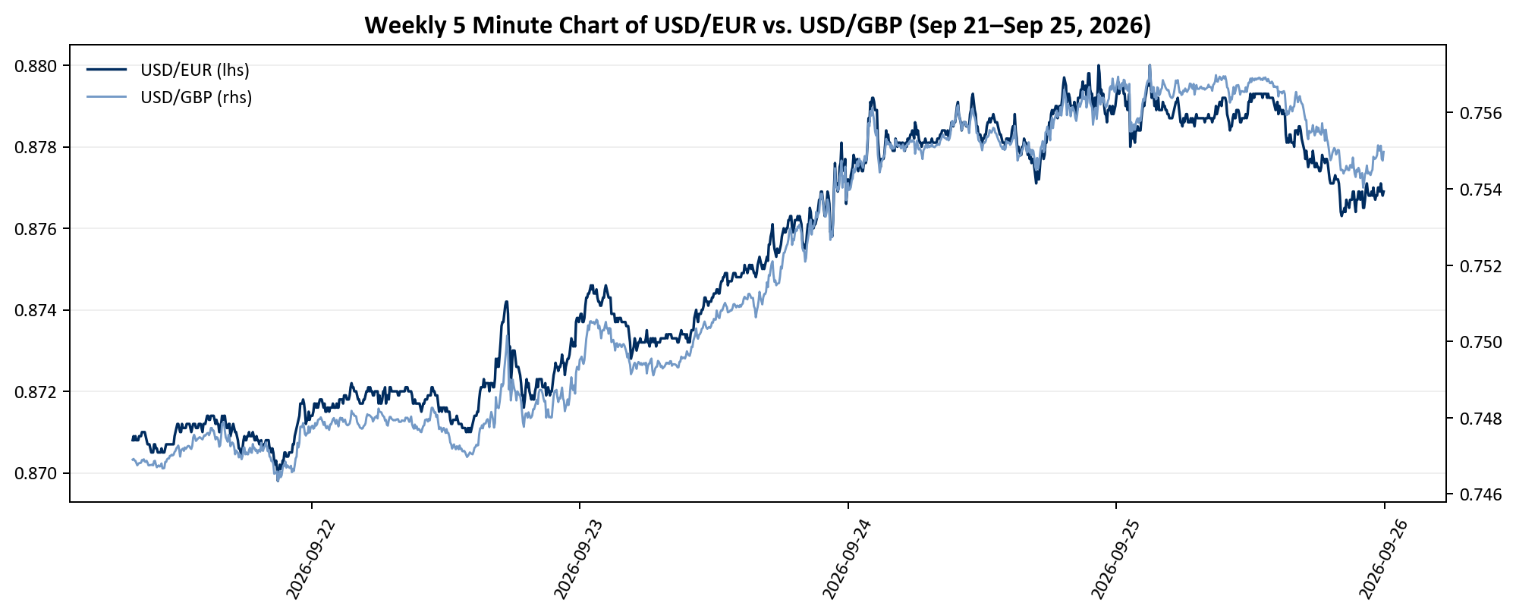
Weekly Trends
FICC-Currency
Weekly flow dynamics and issue breakdowns for the Euro, the British Pound Sterling
Weekly 5 Minute Chart of USD/EUR vs. USD/GBP
Source: Bloomberg Markets, Yahoo Finance

Slide 12
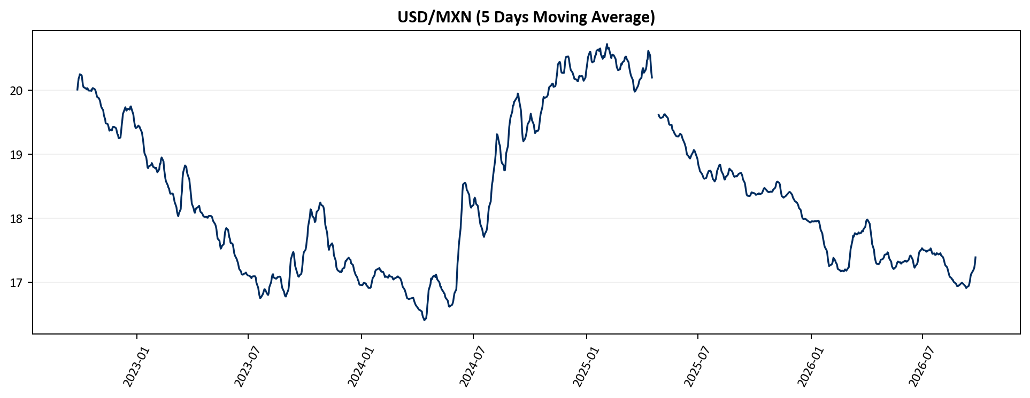
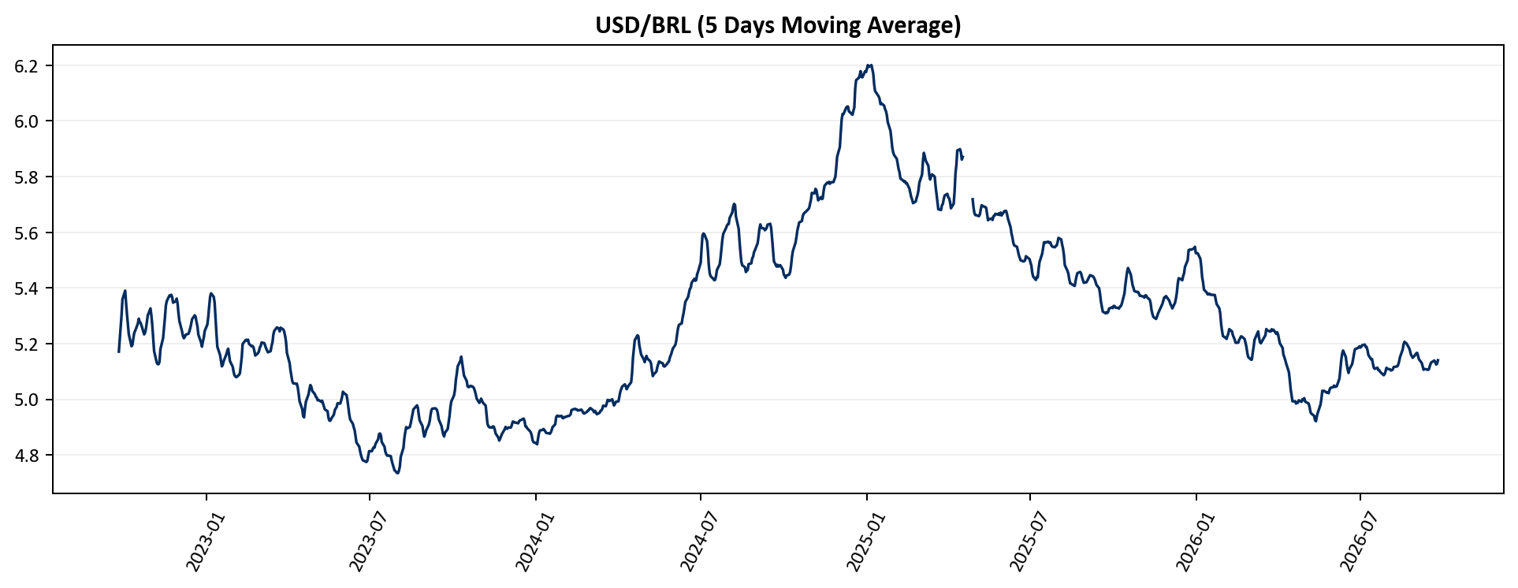
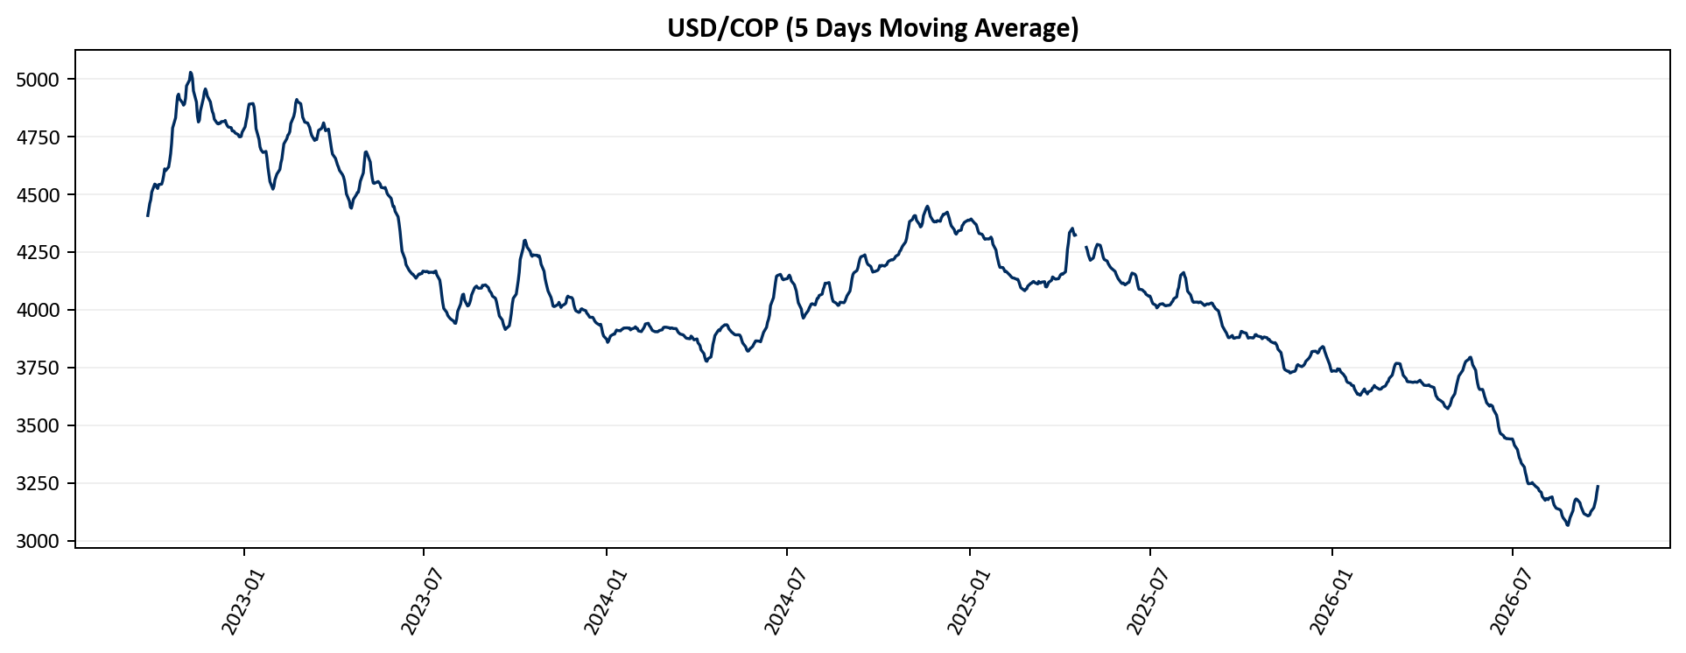
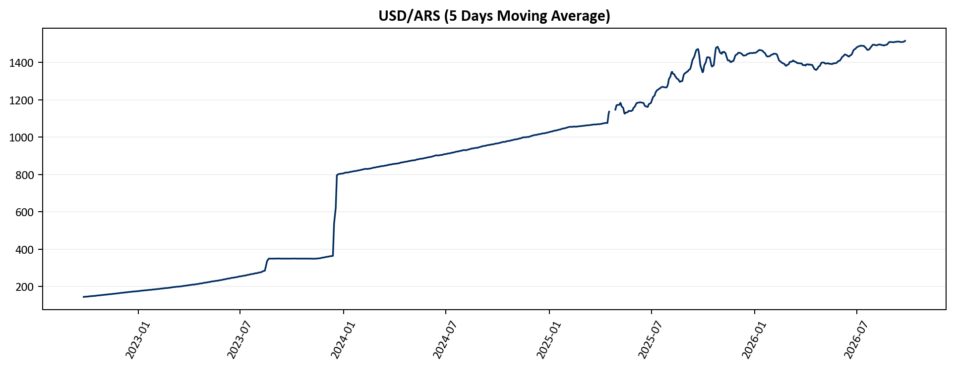
FX Historical Trends
FICC-Currency
Up-To-Date Historical Trends of notable currencies in Latin America
USD/MXN (5 Days Moving Average)
USD/BRL (5 Days Moving Average)
USD/COP (5 Days Moving Average)
USD/ARS (5 Days Moving Average)
Source: Yahoo Finance

Slide 13
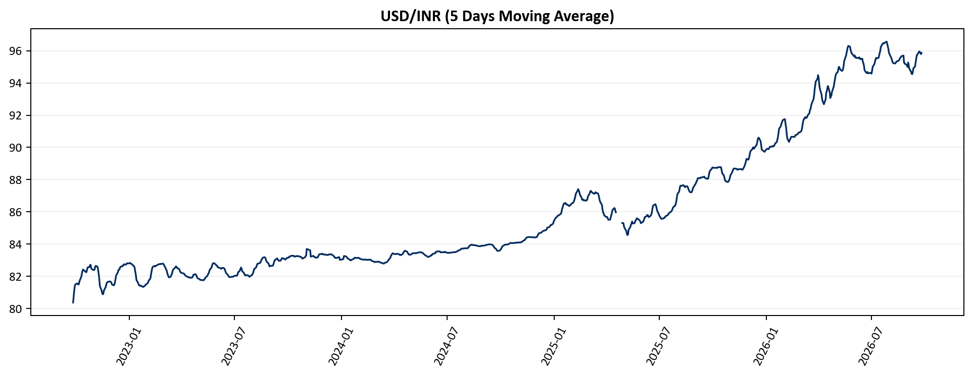
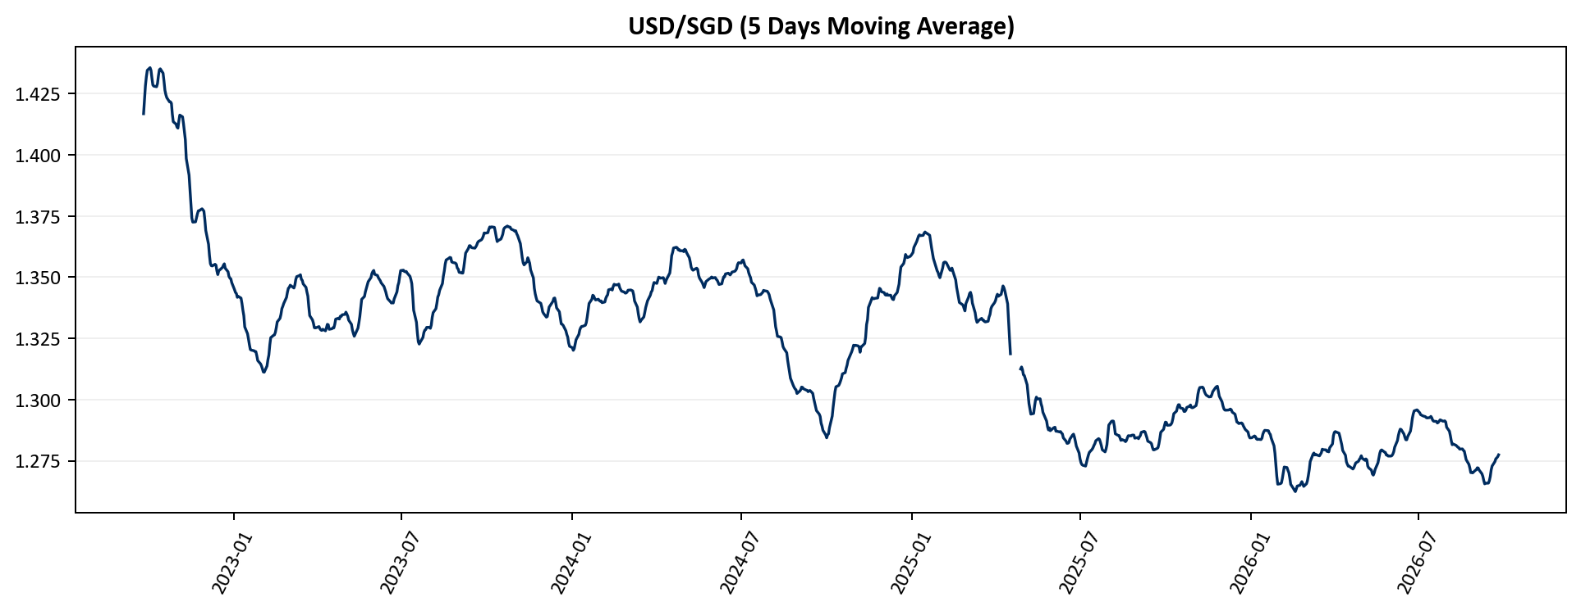
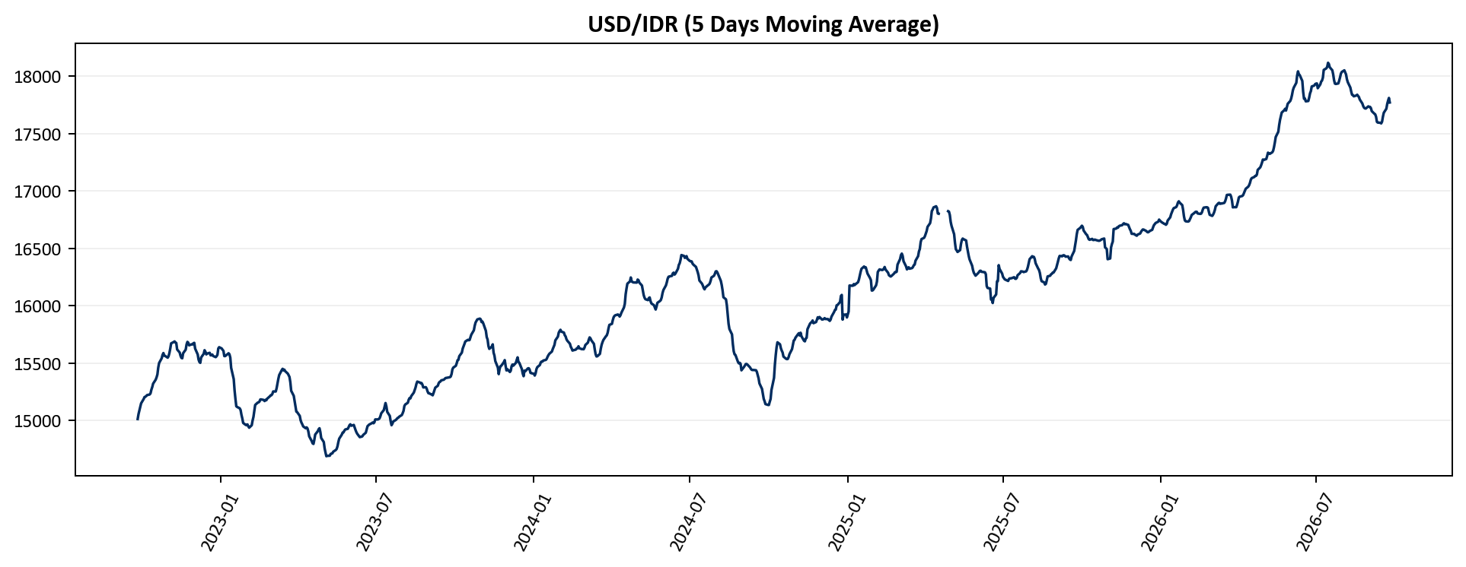
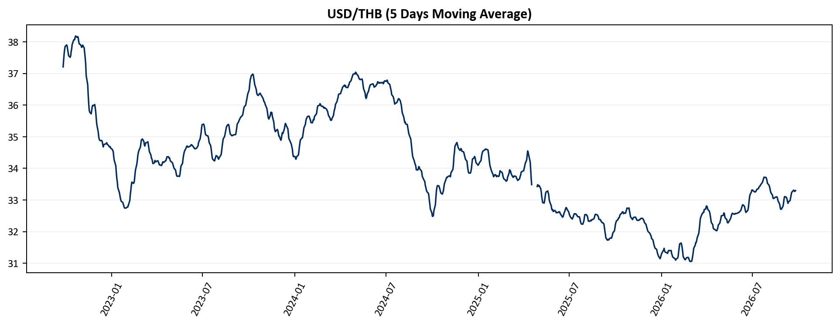
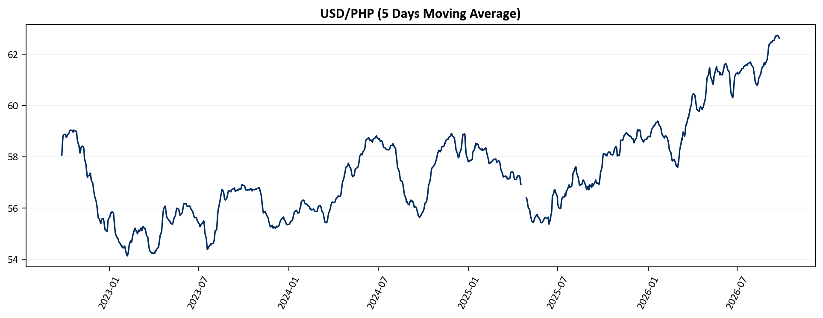
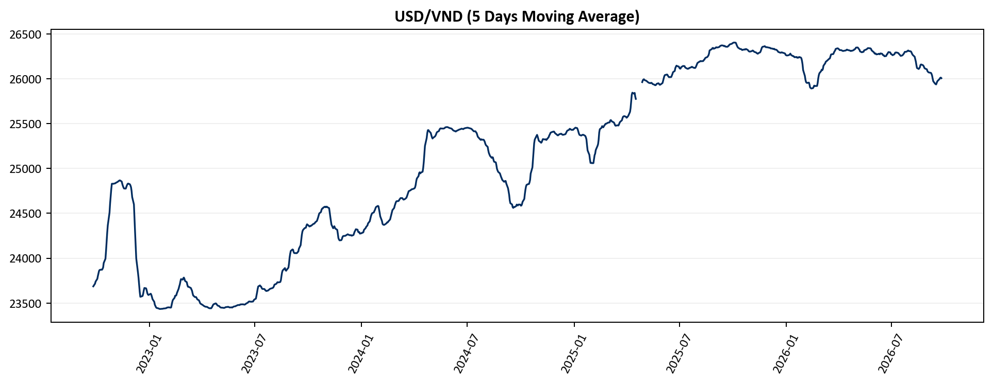
FX Historical Trends
FICC-Currency
USD/INR (5 Days Moving Average)
USD/SGD (5 Days Moving Average)
USD/IDR (5 Days Moving Average)
USD/THB (5 Days Moving Average)
USD/PHP (5 Days Moving Average)
USD/VND (5 Days Moving Average)
Source: Yahoo Finance

Slide 14
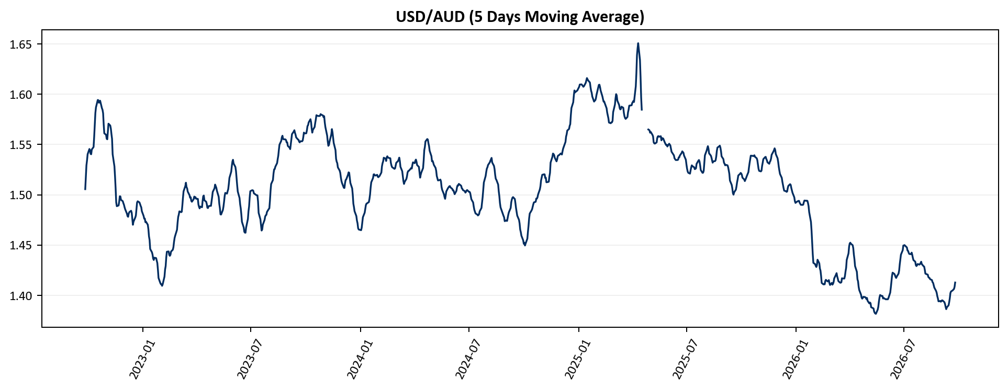
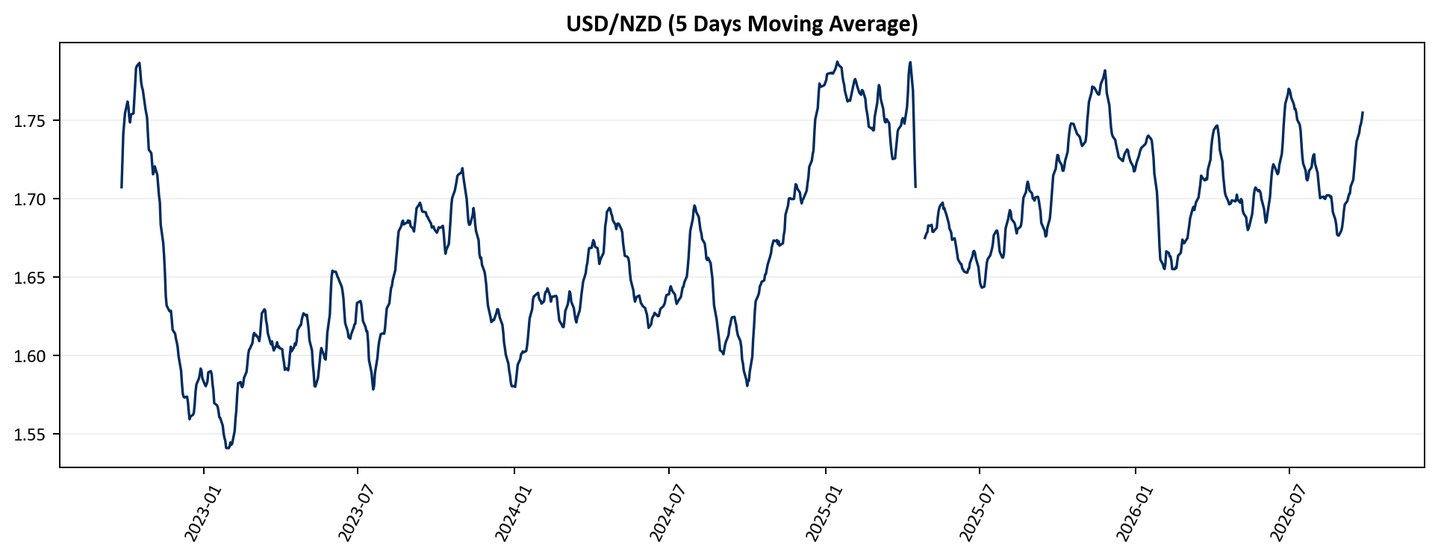
FX Historical Trends
FICC-Currency
Up-To-Date Historical Trends of Australian Dollar, New Zealand Dollar
USD/AUD (5 Days Moving Average)
USD/NZD (5 Days Moving Average)
Source: Yahoo Finance

