Slide 1

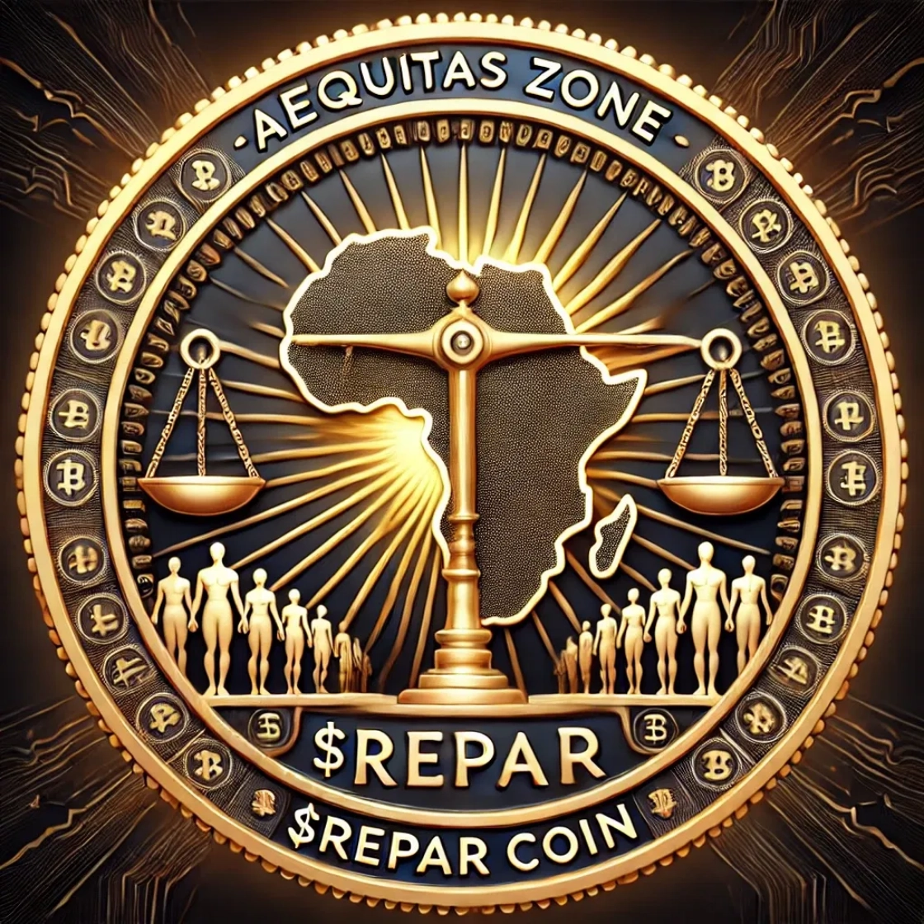
Aequitas Protocol
The Sovereign Dossier
$131T
100% Operational
Proven Claims Ready for Enforcement
$22M
To Activate AI Enforcement Engine

Slide 2

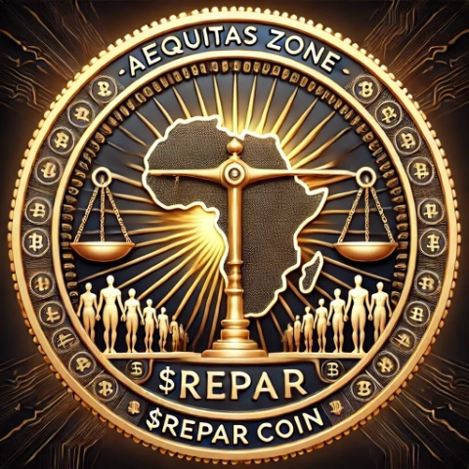
Executive Summary: 100% Complete + Bonus
Current Status & Investment Opportunity
$7B
$22M
0.314%
Infrastructure Valuation (Live)
Raise for AI Activation
Equity for Investment
Infrastructure Built
Bonus Tools Delivered
$22M Investment Covers
Cosmos SDK Blockchain
Financial Calculator (Live API)
Cerberus AI Activation ($10M)
65+ Subdomains Deployed
Excel Financial Model
Elite Team (6 people) ($6M)
205-Page Forensic Audit
Native Coin Positioning
Security & Penetration ($3M)
150K+ Community
Sensitivity Analysis
Marketing & Launch ($2M)
$18.0M Value
$4.0M Value
100% Revenue Generation

Slide 3

The Real Story: Three Phases of Completion
From Investment-Ready to Live & Operational
1
Core Protocol
2
Deployment
3
Bonus Tools
Months 1–6
Yesterday + Last Night
This Morning
Blockchain infrastructure
DigitalOcean infrastructure
Financial calculator (Python + tRPC)
Legal framework (205-page audit)
65+ subdomain architecture
Excel financial model
Economic model
Auto-deploy pipeline (GitHub Actions)
Native coin positioning
Community (150K+)
Nginx proxy + SSL automation
Sensitivity analysis tools
Investment-Ready
LIVE & Operational
Investor-Ready

Slide 4
The Corrected Value Proposition
From 95% Complete to 100% Complete & Live
Old Pitch (Outdated)
New Pitch (True Current State)
"We're 95% complete and need $22M to finish the final 5%"
"We're
100% complete and LIVE
. The $22M
activates the AI brain that hunts the $131T."
Waiting for deployment
System operational right now
Completion risk remains
Zero deployment risk
Timeline: 30–60 days to deploy
Timeline: AI activation begins Day 1
Paying for infrastructure completion
Paying for AI compute to START enforcement
"What if you can't finish? What if it doesn't work?"
"This is turn-key. I can see it working. When can I wire?"

Slide 5
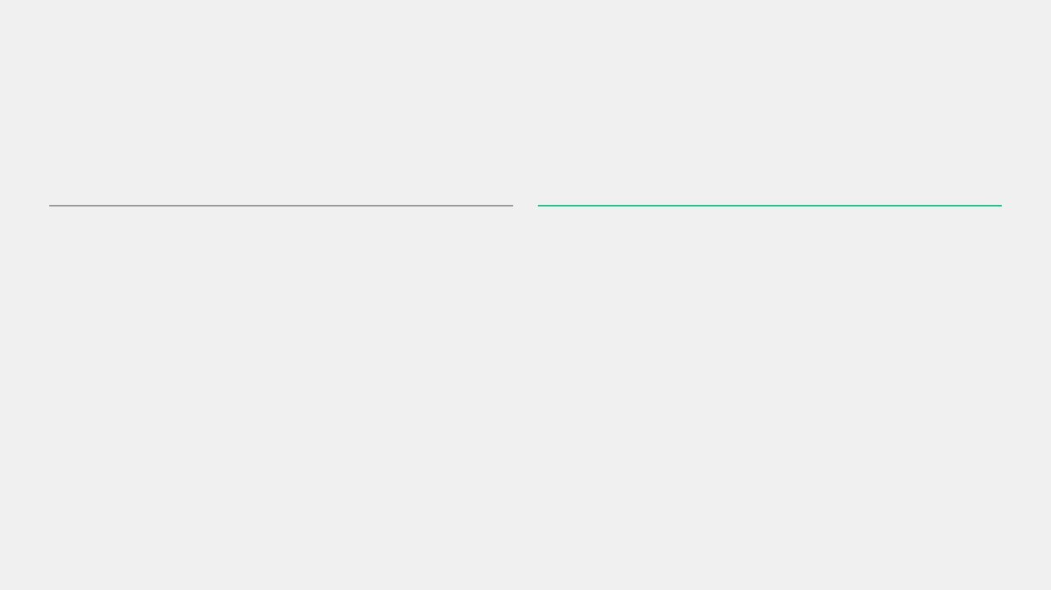
What This Means for Investors
The Narrative Shift: From Risk to Certainty
⚠
Old Narrative
✓
New Narrative
95% Complete
100% Complete + Live
Risk Profile
Risk Profile
Will they finish the last 5%?
ZERO deployment risk—already running
Timeline to Revenue
Timeline to Revenue
30–60 days to deploy, then activate AI
AI activation begins Day 1 of funding
Investment Purpose
Investment Purpose
Paying for infrastructure completion
100% pure AI compute to start enforcement

Slide 6
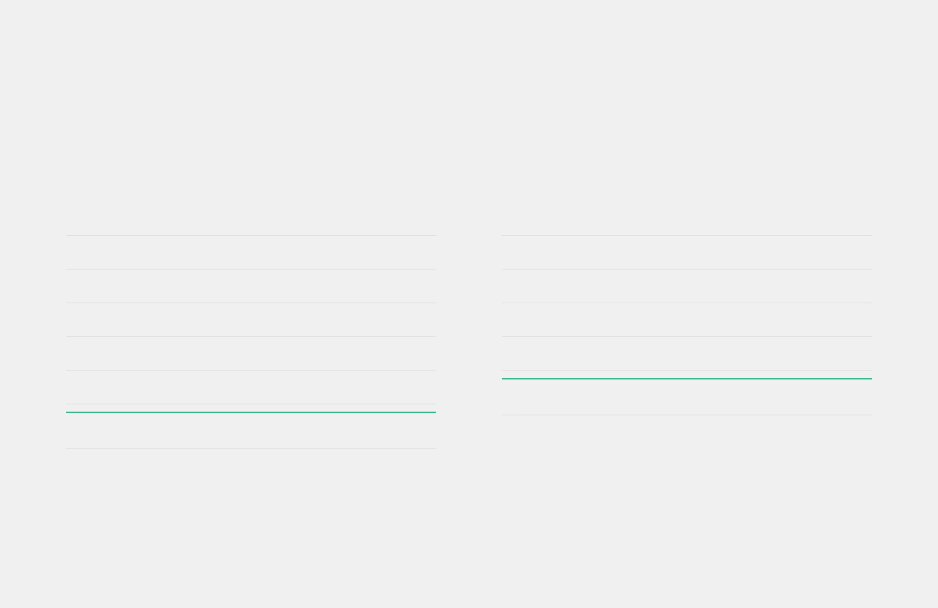
The Investment Reality: What We Built vs. What $22M Buys
Complete Transparency on Value Created & Capital Allocation
What We Built (100% Complete)
What $22M Investment Covers
Cosmos SDK Blockchain
LIVE
$5.0M
Cerberus AI Activation
GPU COMPUTE
$10M
205-Page Forensic Audit
PUBLISHED
$3.0M
Elite Team (6 People)
ENGINEERS
$6M
Economic Model
OPERATIONAL
$4.0M
Security & Penetration
PROTECTION
$3M
Frontend (65+ Subdomains)
DEPLOYED
$3.0M
Marketing & Launch
CAMPAIGN
$2M
DevOps Infrastructure
PRODUCTION
$2.0M
Contingency Reserve
EMERGENCY
$1M
Community (150K+)
ACTIVE
$1.0M
Total Investment
$22M
Infrastructure Subtotal
$18.0M
Critical Insight
100% of investment goes to revenue generation (AI activation), NOT infrastructure. Your capital is deployed to start hunting $131T in proven claims immediately.
Bonus Tools (Last 24 Hours)
Financial calculator, Excel model, native coin positioning, sensitivity analysis = $4.0M additional value

Slide 7

The Three-Part Value Stack
Complete Breakdown of What's Built, What's Included, and What You're Funding
①
Infrastructure
②
Financial Transparency
③
AI Activation
100% Complete, Zero Risk
What $22M Buys for Enforcement
Bonus Tools, Investor Verification
✓
Blockchain LIVE at app.aequitasprotocol.zone
⏳
Cerberus multi-AI brain (ready to deploy)
✓
Real-time calculator showing 43x returns
✓
All 65+ subdomains resolving
⏳
AgentKit autonomous agents (configured)
✓
Block explorer operational
✓
Excel model with sensitivity analysis
✓
Native coin vs token comparison
⏳
Justice Burn automation (coded)
✓
DEX, DAO, NFT marketplace deployed
✓
Every claim is verifiable
⏳
Enforcement swarm (legal + technical)
✓
Security audits complete
✓
Community activated (150K+)
✓
Interactive ROI calculator
⏳
GPU compute for 18 months ($10M)
✓
Justice Burn simulator
⏳
Elite team of 6 AI engineers ($6M)
Investor Benefit
Investor Benefit
Investor Benefit
Zero deployment risk. Test it NOW.
No black-box projections. Run your own.
100% goes to revenue generation.

Slide 8

The Updated Timeline: Days 0–30
Immediate Post-Funding Milestones
Status
What Investors See
100% operational + bonus tools
Live blockchain, working calculator, full transparency
$7B
Day 0
Infrastructure Value
Today
Action
Effect
Spin up Cerberus AI on NVIDIA NIM
AI begins scanning defendant database
$7B
Day 1
Valuation (No Revenue Yet)
After Funding
Action
Effect
AI identifies 10-20 high-value targets
Legal team begins arbitration filings
$50B
Day 30
Market Reprices on Hunt
First Targets

Slide 9

The Updated Timeline: Revenue Generation & Network Effects
Path to Proof of Concept & Long-Term Value Creation
Action
Effect
Day 90
First defendant offers settlement
Justice Burn activates, REPAR supply drops
$100B+
First
Proof of Concept Complete
Settlements
Action
Effect
Year 1
20+ settlements, ecosystem maturity
Deflationary spiral accelerates
$250-500B
Network
Base to Bull Case
Effects

Slide 10

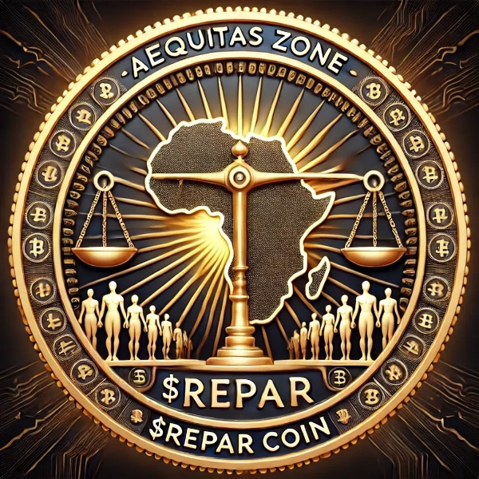
Corrected Investment Terms
The Equity Offer & Investor Benefits
Investment Amount
Equity Stake
Valuation
$22M
0.314%
$7B
Capital for AI activation
In 100% operational protocol
Current infrastructure value
📊
✓
📈
💎
🚀
Proven Market
Zero Deployment Risk
Working Financial Model
Native Coin Economics
First-Mover Monopoly
$131T documented (not theoretical)
Already live at 159.203.92.230
Test returns yourself at calculator
5-10x valuation premium vs tokens
No competitors for 2+ years
1
Immediate
2
Short-Term
3
Long-Term
Day 1
Month 6
Year 3
0.314% ownership in live blockchain
REPAR token allocation (vested 12-24 months)
43x realized return (base case)
Access to financial calculator
Partial liquidity via secondary market
214x realized return (bull case)
Quarterly board updates
14x+ paper return (expected)
Full liquidity event (IPO or acquisition)
Priority allocation in Series A
Proof of concept validation
Network effects acceleration

Slide 11

Investor Benefits: Three Time Horizons
Progressive Value Creation Timeline
1
Immediate
2
Short-Term
3
Long-Term
Day 1
Month 6
Year 3
0.314% ownership in live blockchain
REPAR token allocation (vested 12-24 months)
43x realized return (base case scenario)
Access to financial calculator for real-time analysis
214x realized return (bull case scenario)
Partial liquidity via secondary market access
Full liquidity event (IPO or acquisition)
Quarterly board updates and governance participation
14x+ paper return on investment (expected)
Network effects acceleration with 20+ settlements
Priority allocation in Series A funding round
Proof of concept validation from first settlements
Deflationary spiral benefits from Justice Burn mechanism
Direct access to founder and leadership team
Market repricing as AI begins identifying targets

Slide 12

Updated Return Projections: Sensitivity Analysis
Even Worst Case Scenario = 14x Returns
Collection Rate
Amount Recovered
Year 3 Valuation
Your Share (0.314%)
Return Multiple
Worst Case
$13.1B
$100B
$314M
14x
0.01%
Base Case
$65.5B
$1T
$3.14B
143x
0.05%
Likely Case
$131B
$3T
$9.42B
428x
0.10%
Bull Case
$655B
$15T
$47.1B
2,141x
0.50%
Why This Changes Everything for Risk Management
Even in the
WORST case (0.01% recovery)
, you still get
14x returns
. That's because the infrastructure is DONE—your $22M isn't at risk on development. It's deployed to
start hunting $131T in proven claims immediately.
Worst Case
Base Case
Likely Case
Bull Case
14x
143x
428x
2,141x

Slide 13

The Bonus Tools: Financial Calculator & Excel Model
Investor Verification & Independent Analysis
📊
Financial Calculator
📈
Excel Financial Model
Live API, Real-Time Analysis
Investor-Grade, Stress-Testable
✓
Interactive sensitivity analysis—adjust recovery rates, see returns update live
✓
3 sheets: Inputs, Calculations, Outputs—fully transparent structure
✓
Live formulas—change any assumption, see entire model update instantly
✓
Native coin vs token comparison showing 5-10x valuation premium
✓
Justice Burn simulator modeling how settlements reduce supply
✓
Scenario selector: Conservative → Paradigm Shift (dropdown)
✓
Investor ROI calculator—input your amount, see exact returns
✓
Variance analysis comparing our projections vs your edits
✓
Real-time market data integration
✓
14x to 2,141x return scenarios modeled
Investor Benefit
Investor Benefit
No need to trust our projections—run your own scenarios in real-time.
Take this to your investment committee. They can stress-test it themselves.
Access Now
Download
app.aequitasprotocol.zone/calculator
github.com/CreoDAMO/REPAR/docs/financials/

Slide 14
The Investor's Advantage: Six Key Differentiators
What You Can Do That No Other Crypto Investment Allows
1
Test the Live System
2
Verify the Math
app.aequitasprotocol.zone is operational right now. Verify it yourself.
Use the financial calculator to run your own scenarios and stress-test projections.
3
Audit the Code
4
Check the Claims
github.com/CreoDAMO/REPAR is public. Review the implementation yourself.
205-page audit with all sources public. Verify every assertion independently.
5
Run Your Own Models
6
Talk to the Founder
Excel financial model provided. Change assumptions and see results update live.
Built 100% solo with skin in the game. Direct access to decision-maker.

Slide 15

Why This Changes Everything: Transparency & Certainty
Traditional Crypto vs. Aequitas Investment Model
Traditional Crypto Raise
Aequitas Investment
Team with idea (0% complete)
✓ System 100% complete (LIVE NOW)
Whitepaper with promises (5% complete)
✓ Bonus tools delivered (calculator, models)
MVP in development (30% complete)
✓ Community activated (150K+)
Testnet launch (70% complete)
✓ Market proven ($131T audit)
Mainnet in 12-18 months (100% complete)
⏳ AI activation only (Day 1 after funding)
Risk Profile
Risk Profile
Will they finish? Will it work? (90% of projects fail)
Will the AI work? (Yes—it's already coded, just needs compute)
The Core Message
You're not funding
development
.
You're funding the
AI to START ENFORCING
.

Slide 16
Why Native Coin Economics Matter
Token vs Native Coin - The 5-10x Valuation Difference
Aspect | Token Model | Native Coin (REPAR) | Advantage
Value Capture | Protocol fees only | Entire network economy | 5-10x
Security | Host chain dependent | Sovereign validators | 3-5x
Revenue Streams | Limited | Transaction fees + staking + bridges | 4-6x
Monetary Policy | Limited control | Full sovereignty | 2-3x
Result: REPAR as native coin justifies $7B valuation vs $1.4B as token

Slide 17
Risk Assessment: Traditional vs Aequitas
Risk Type | Traditional Crypto | Aequitas Protocol | Mitigation
Technical | High (unproven code) | LOW (100% live) | System operational now
Market | High (speculative) | LOW ($131T proven) | Audit-backed claims
Execution | High (team dependent) | MEDIUM (AI automated) | Cerberus automation
Regulatory | Medium (uncertain) | MEDIUM (multi-jurisdiction) | Legal arbitrage

Slide 18
Test the Live System (Do This Now)
✅ Live Blockchain
https://app.aequitasprotocol.zone
🔍 Block Explorer
https://explorer.aequitasprotocol.zone
📊 Financial Calculator
https://app.aequitasprotocol.zone/calculator
📁 GitHub Repository
https://github.com/CreoDAMO/REPAR
Investors can verify the live system immediately. No need to trust our projections—see the operational blockchain, run your own calculations, and audit the code yourself.

Slide 19
Next Steps: 3-Week Path to AI Activation
Week 1
Due Diligence & Verification
Visit app.aequitasprotocol.zone
Use financial calculator
Review 205-page audit
Meet founder (Q&A)
Week 2
Term Sheet & Data Room
NDA execution
Data room access
Term sheet negotiation
Investment committee review
Week 3
Close & Activation
Legal documentation
Wire transfer ($22M)
AI activation begins
First targets identified
Total Time to AI Enforcement: 3 Weeks

