Slide 1


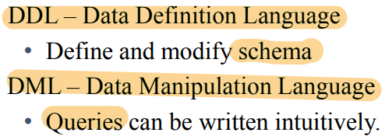
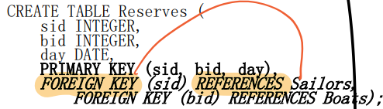
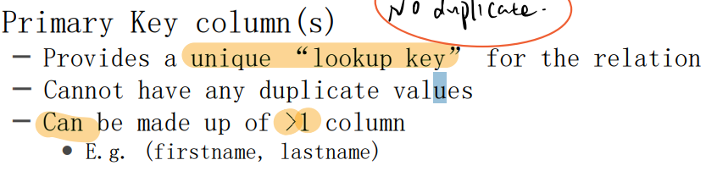
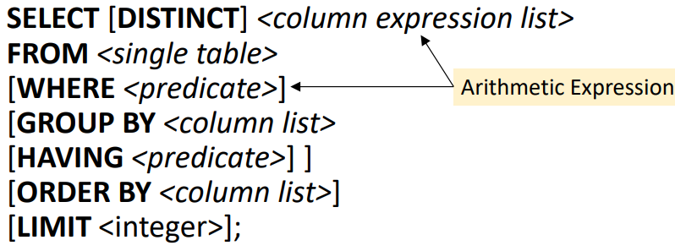
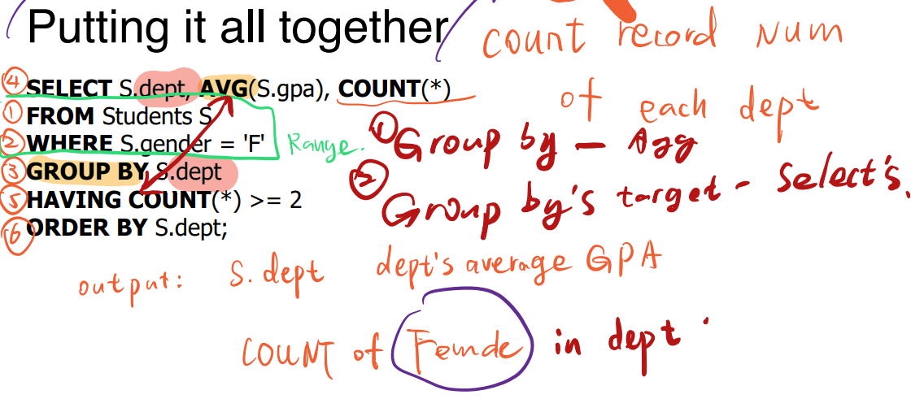
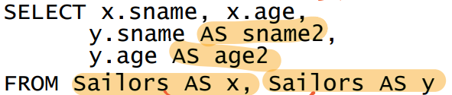


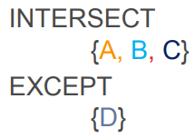
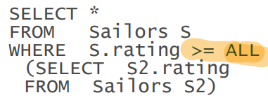
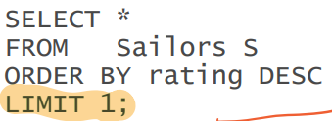
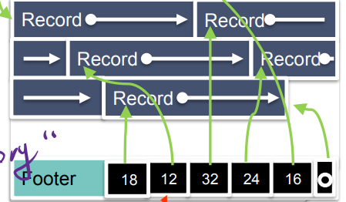
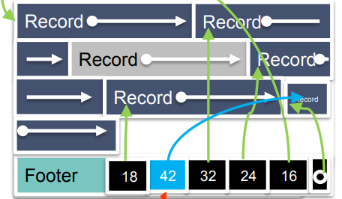
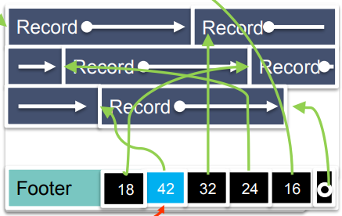
Declarative: Say what you want not how to get it
Index B+
SQL
No duplication
Atomic (not tuple in tuple)
Instance is a multiset of “rows” (“tuples”)
RDBMS responsible for efficient evaluation
SELECT DISTINCT
SELECT S.age*2 AS a2
ORDER BY S.gpa DESC, S.name
LIMIT: + ORDER BY; not pure declarative
Aggregate: AVG, SUM, COUNT, MAX, MIN
SELECT [DISTINCT] AVG(S.gpa)
GROUP BY A,B : A,B 均相同才视为一种
GROUP BY (A) SELCT 里一定有A
SELECT COUNT(DISTINCT S.name)
Find sailors whose rating is greater
than that of some sailor called Popeye
SELECT *
FROM Sailors S
WHERE S.rating > ANY
(SELECT S2.rating
FROM Sailors S2
WHERE S2.sname='Popeye')
HAVING: after group by and aggr (must)
Self Join
String Compararisons WHERE S.sname ~ 'B.*’
Find sailors who have not reserved a boat: EXCEPT
Set Semantics: UNION ALL; INTERSECT ALL; EXCEPT ALL
Nested Queries: IN (subquery); NOT IN; EXISTS;
Relational Division: “Find sailors who’ve reserved all boats.”
Said differently: “sailors with no counter example missing boats”
SELECT S.sname FROM Sailors S WHERE NOT EXISTS (SELECT B.bid FROM Boats B WHERE NOT EXISTS (SELECT R.bid FROM Reserves R WHERE R.bid=B.bid AND R.sid=S.sid ))
Max: SELECT MAX(S.rating) FROM Sailors S
legal
Not deterministic, pick arbitrary one from max
JOIN: JOIN = INNER JOIN; NATURAL JOIN equi-join for pairs of attributes with the same name
Left Outer Join: preserves all unmatched rows from the table on the left
VIEW vs sub-query (not preserved0); WITH Reds(bid, scount) AS (sub-query)
NULL not N=N; F and N=F; T and N = N; T or N = T; F or N = N
WHERE NULL: do not send to output; Aggregates ignore NULL-valued inputs
SQL Client - Query Parsing & Optimization -
Relational Operators- Files and Index Management -
Management - Disk Space Management - Database
Block = page = basic unit for IO
Disk Fire Format
Next: minimize seek and rotational delay; sequential scan: pre-fetch
Pages Files Records
Heap file: 插入快, no particular order of page/record
bitmap: each record +1 bit, 1 byte 8 bit 全化成bit算方便
Record size = slot directory pointer size per record + data size +
store field offsets for the variable-length text fields
packed: pid.rid; easy to add; delete: rearrange expensive new id
Unpacked: bitmap insert: find first empty; delete: clear bit
Slotted page: Pointer to free space + pointer to the begin of each record (reverse)
Delete: set the target to null; not effect other
Insert: reuse the slot (next open slot); Reorganize data on page
Linked-list: 一条full, 一条 with free space
每个 page 包含 records & free space tracker & 2 pointer

