Slide 1

COVID-19
Analysis & Predication
with Multiple AI Methods
CS181 Project final presentation

Slide 2

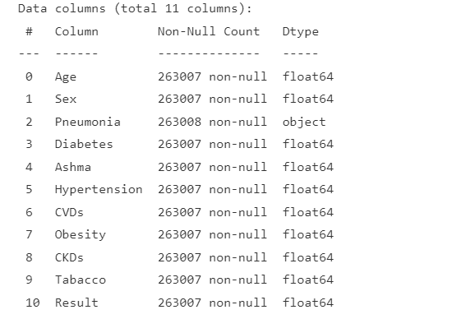
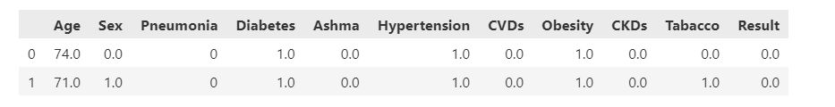
Data Pre-processing
Attributes:
Age(年龄)
Sex(性别)
Pneumonia(基础肺炎)
Diabetes(糖尿病)
Asthma(哮喘)
Hypertension(高血压）
CVDs(心脏病)
Obesity(肥胖)
CKDs(慢性肾脏病)
Tobacco(吸烟)
Result(是否患新冠)
Samples 263008 People

Slide 3
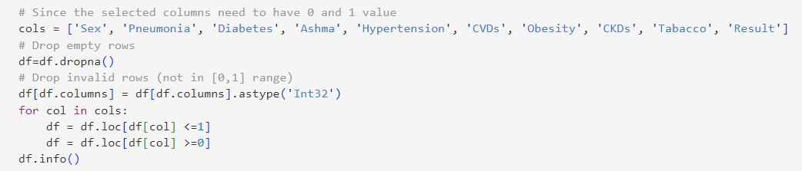
Data Processing
263008->261409

Slide 4
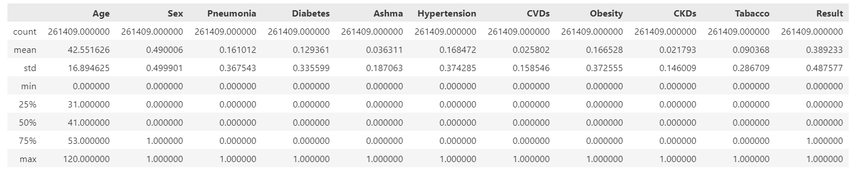
Data Processing

Slide 5
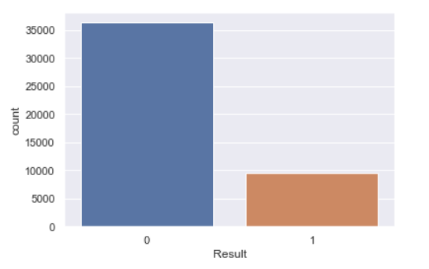
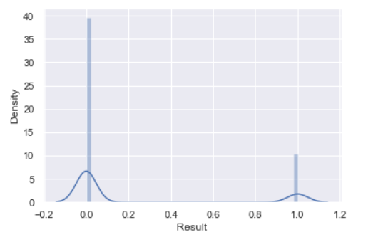
Data Processing
‘Result’ Distribution

Slide 6
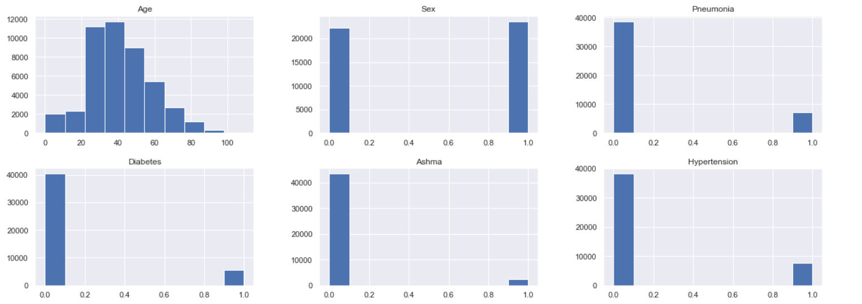
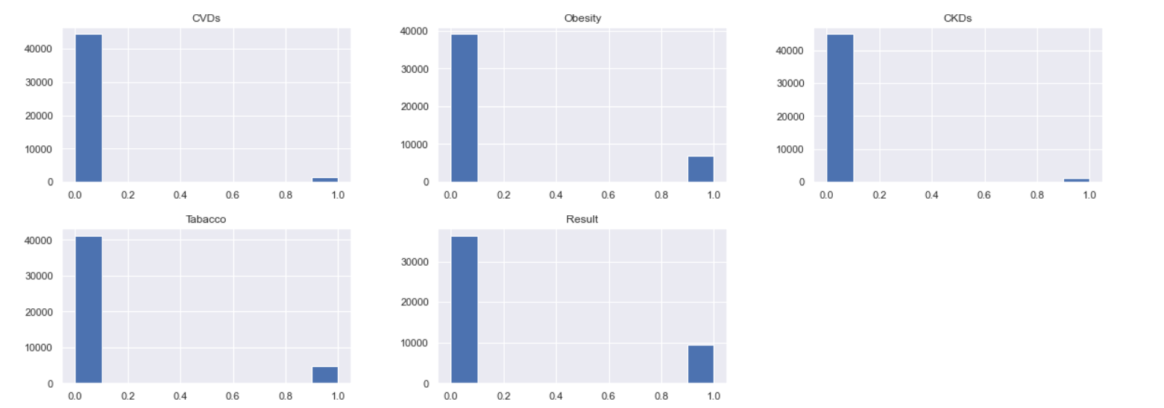
Data Processing
Features Distribution

Slide 7
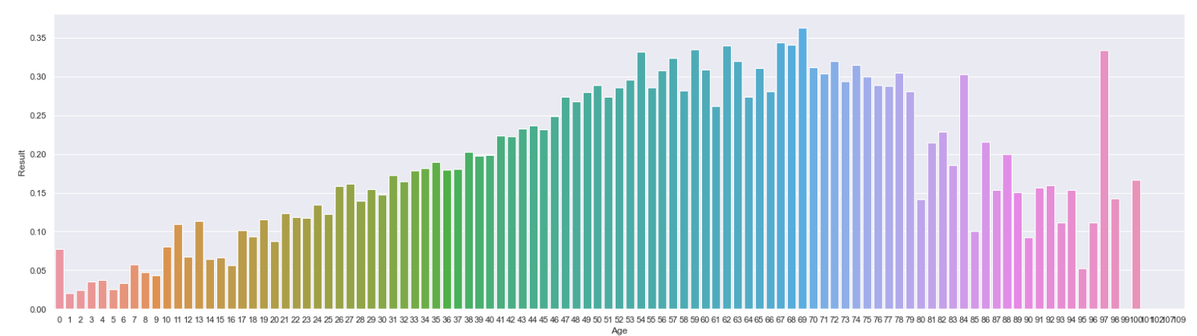
Data Processing

Slide 8
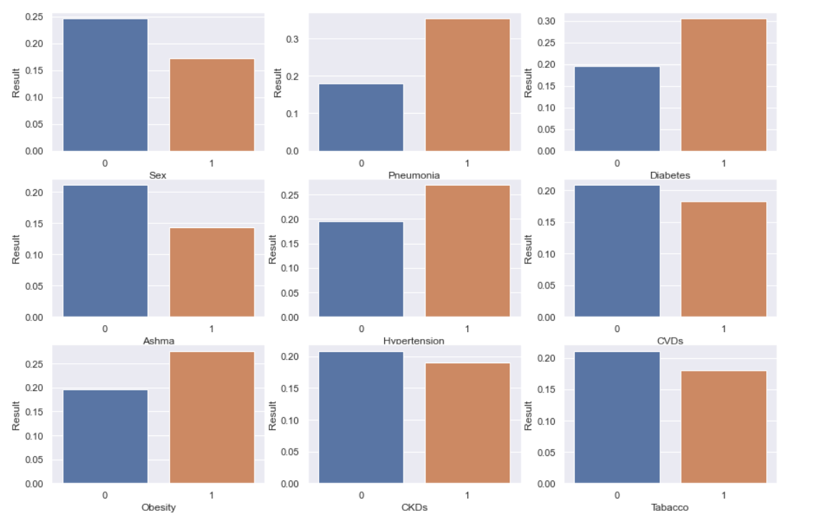
Data Processing
Features Distribution

Slide 9
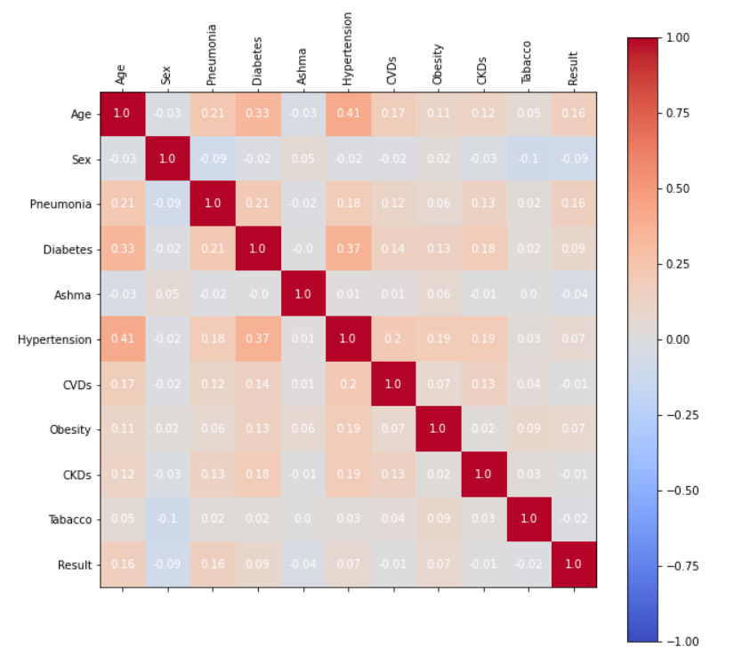
Data Processing
Age
Pneumonia
Diabetes

Slide 10
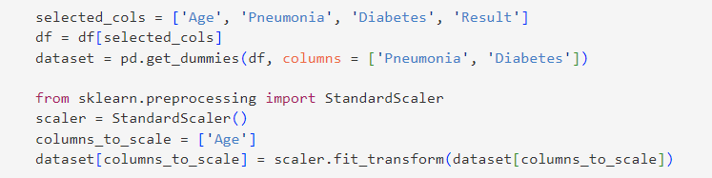
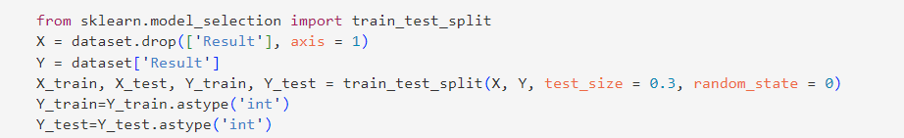
Prediction
Binarize the 0-1 factors
Standardize the continuous factor
Train-test split:
261409->182986

Slide 11
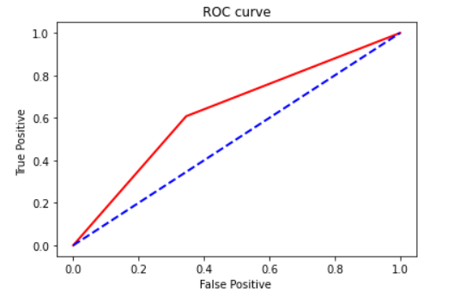
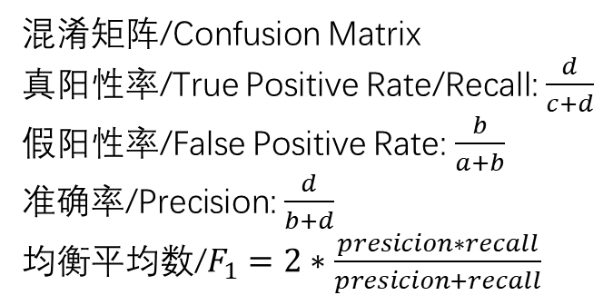
Receiver operating characteristic (ROC)
 | 0 | 1
0 | a | b
1 | c | d
混淆矩阵/Confusion Matrix
真阳性率/True Positive Rate/Recall:$\frac{d}{c+d}$
假阳性率/False Positive Rate: $\frac{b}{a+b}$
准确率/Precision: $\frac{d}{b+d}$
均衡平均数/$F_{1}=2∗\frac{presicion∗recall}{presicion+recall}$

Slide 12
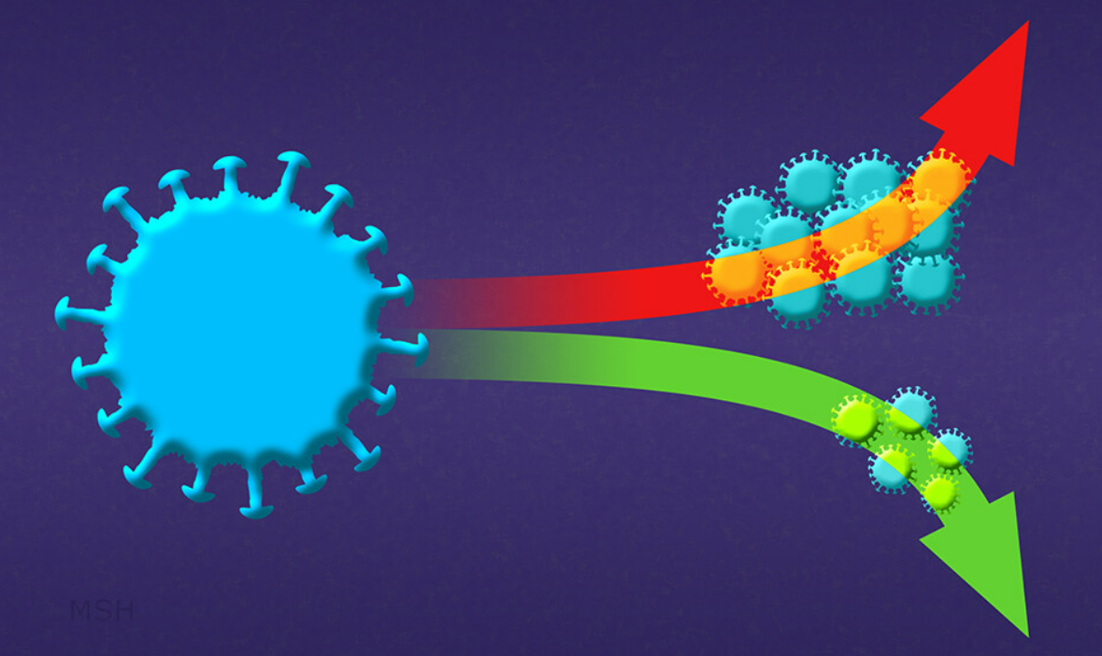
Idea
We will perform：
less neural-liked
Naïve Bayes
Decision Tree
K nearest neighbors
Logistic Regression
SVM
Neural Network (with Multilayer perceptron)
More neural-liked

Slide 13
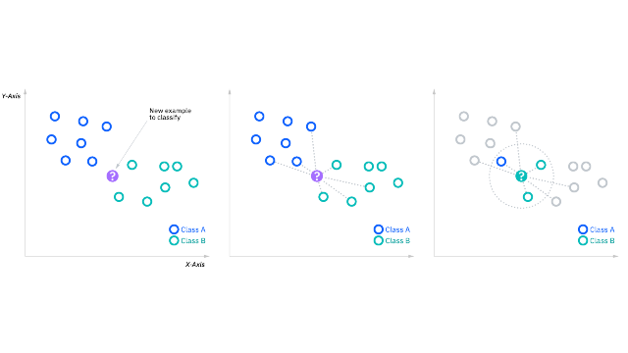
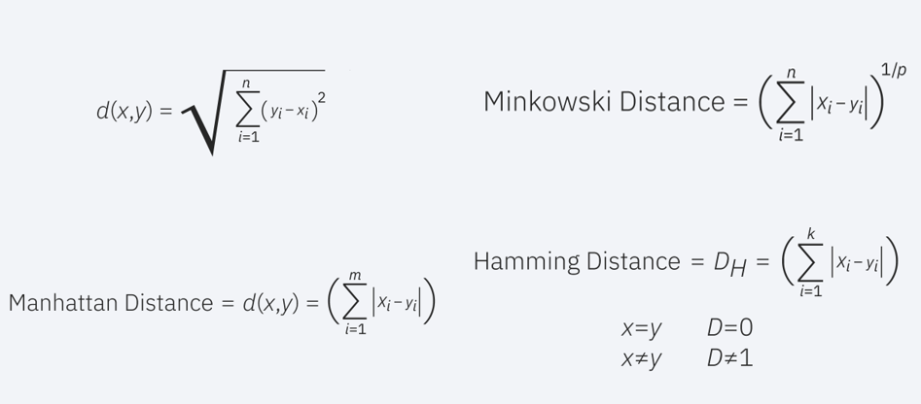
K-Nearest Neighbors

Slide 14
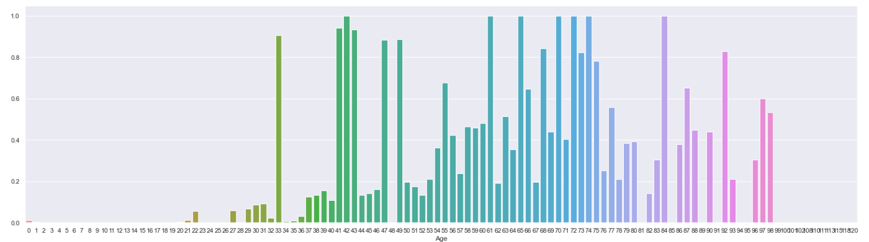
K-Nearest Neighbors

Slide 15
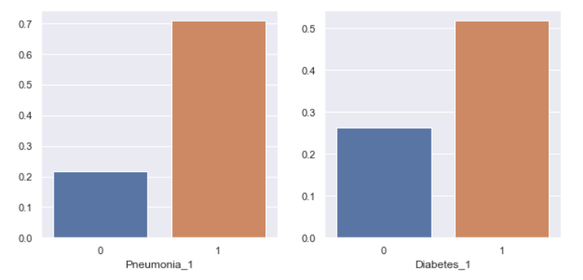
K-Nearest Neighbors

Slide 16
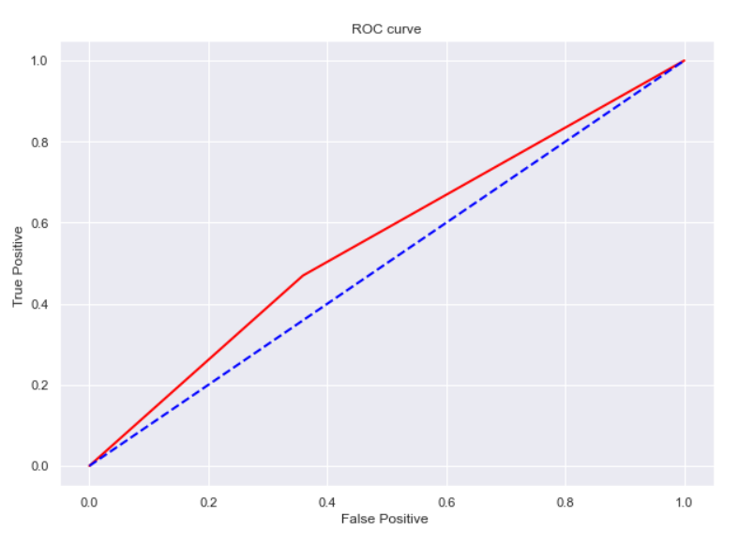
K-Nearest Neighbors
Accuracy: 0.59031
Accuracy(our):

Slide 17
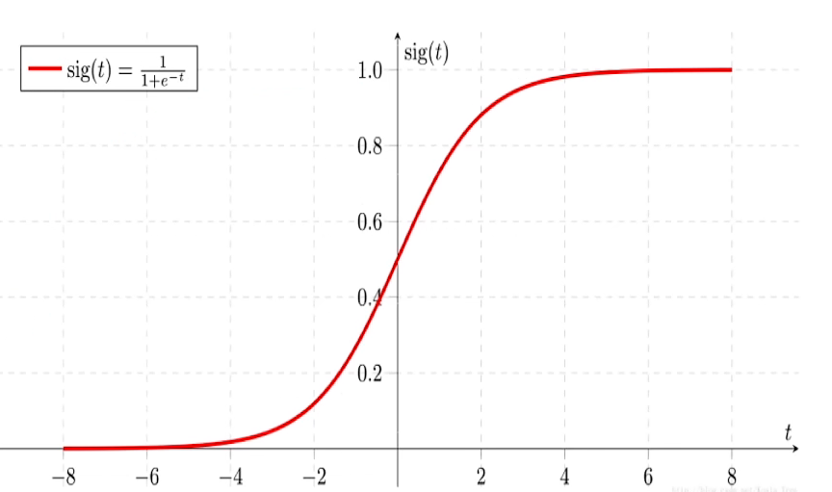
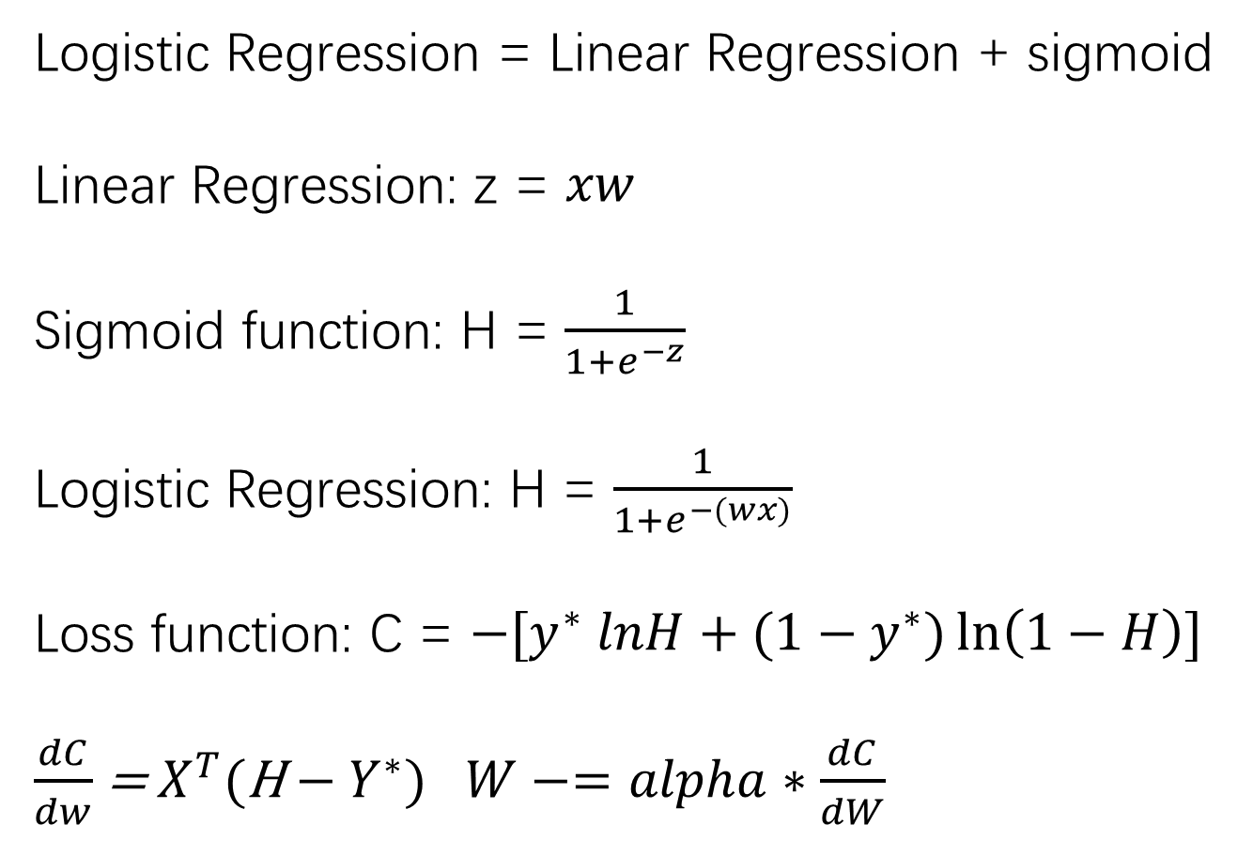
Logistic Regression
Logistic Regression = Linear Regression + sigmoid
Linear Regression: z = $xw$
Sigmoid function: H = $\frac{1}{1+e^{−z}}$
Logistic Regression: H = $\frac{1}{1+e^{−(wx)}}$
Loss function: C = $−[y^{∗} lnH+{(1−y}^{∗})\ln\left(1−H\right)]$
$\frac{dC}{dw}$ = $X^{T}$(H$−{ Y}^{∗})$ $W−=alpha∗\frac{dC}{dW}$

Slide 18
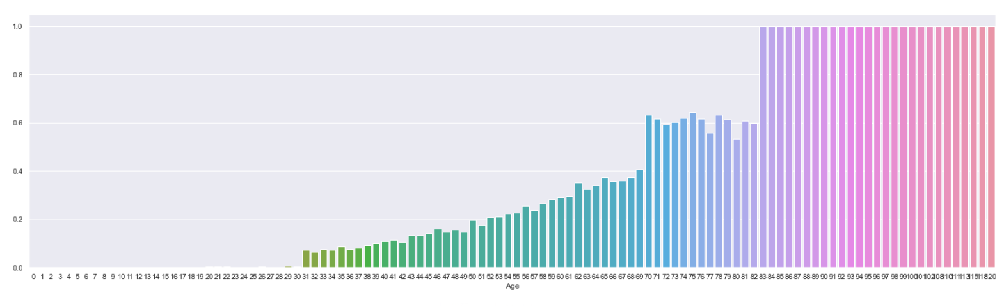
Logistic Regression

Slide 19
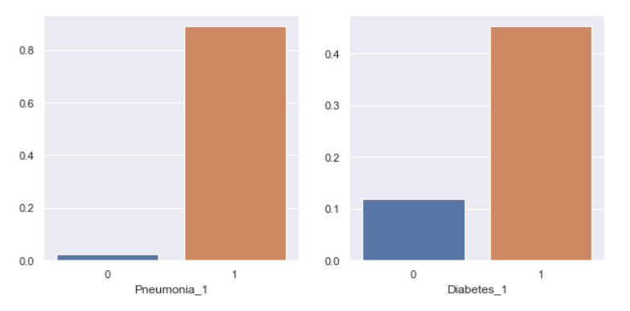
Logistic Regression

Slide 20
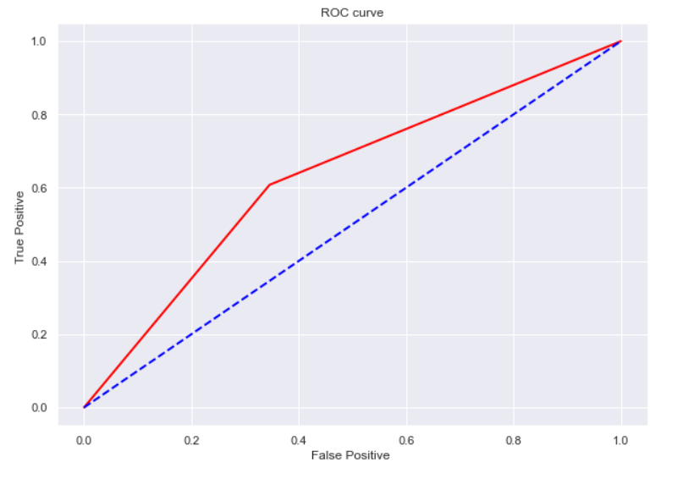
Logistic Regression
Accuracy: 0.63109

Slide 21
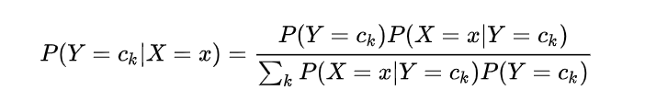
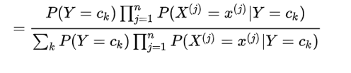
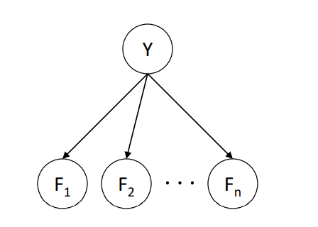
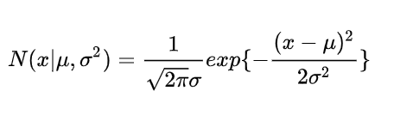
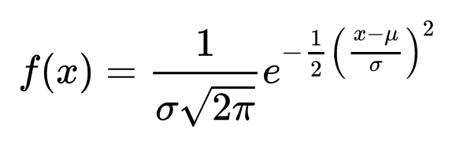
Naïve Bayes
Bayes Rule
Conditional Independence
Gaussian Naive Bayes

Slide 22
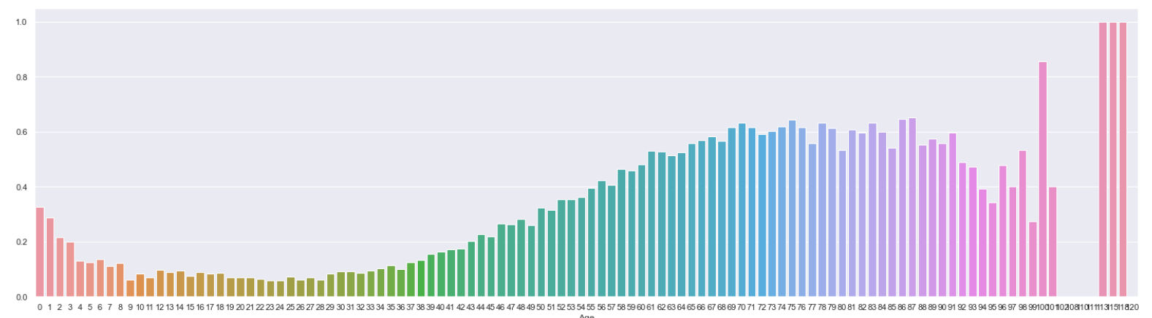
Naïve Bayes

Slide 23
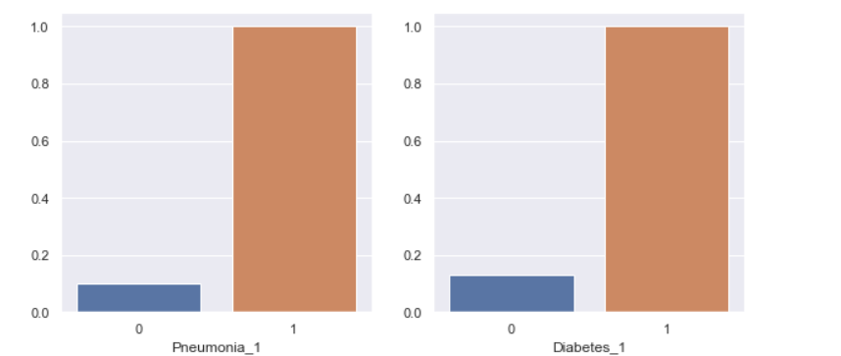
Naïve Bayes

Slide 24
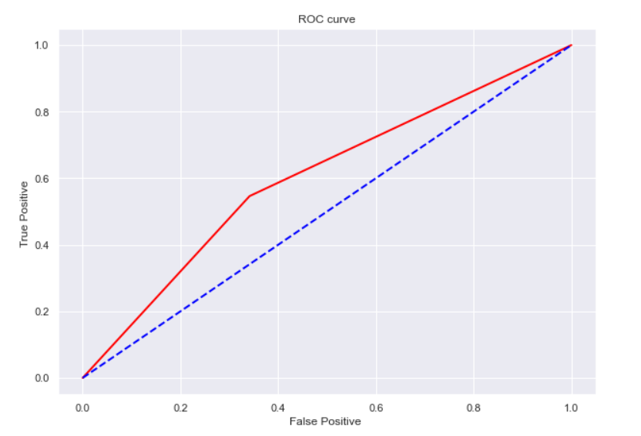
Naïve Bayes
Accuracy: 0.63097

Slide 25
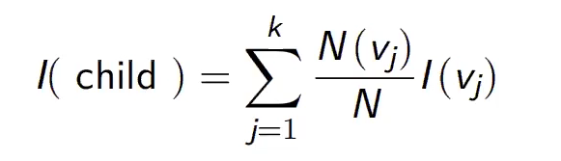


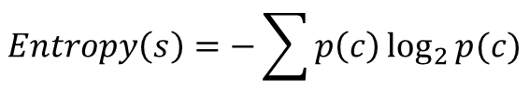
Decision Tree
ID3 & C4.5:
CART:
$$Entropy\left(s\right)=−\sum{p\left(c\right)\log_{2}{p(c)}}$$
$$Gini Impurity=1−\sum_{i}{{(p_{i})}^{2}}$$

Slide 26
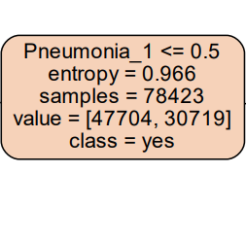
Decision Tree
Root : Pneumonia

Slide 27
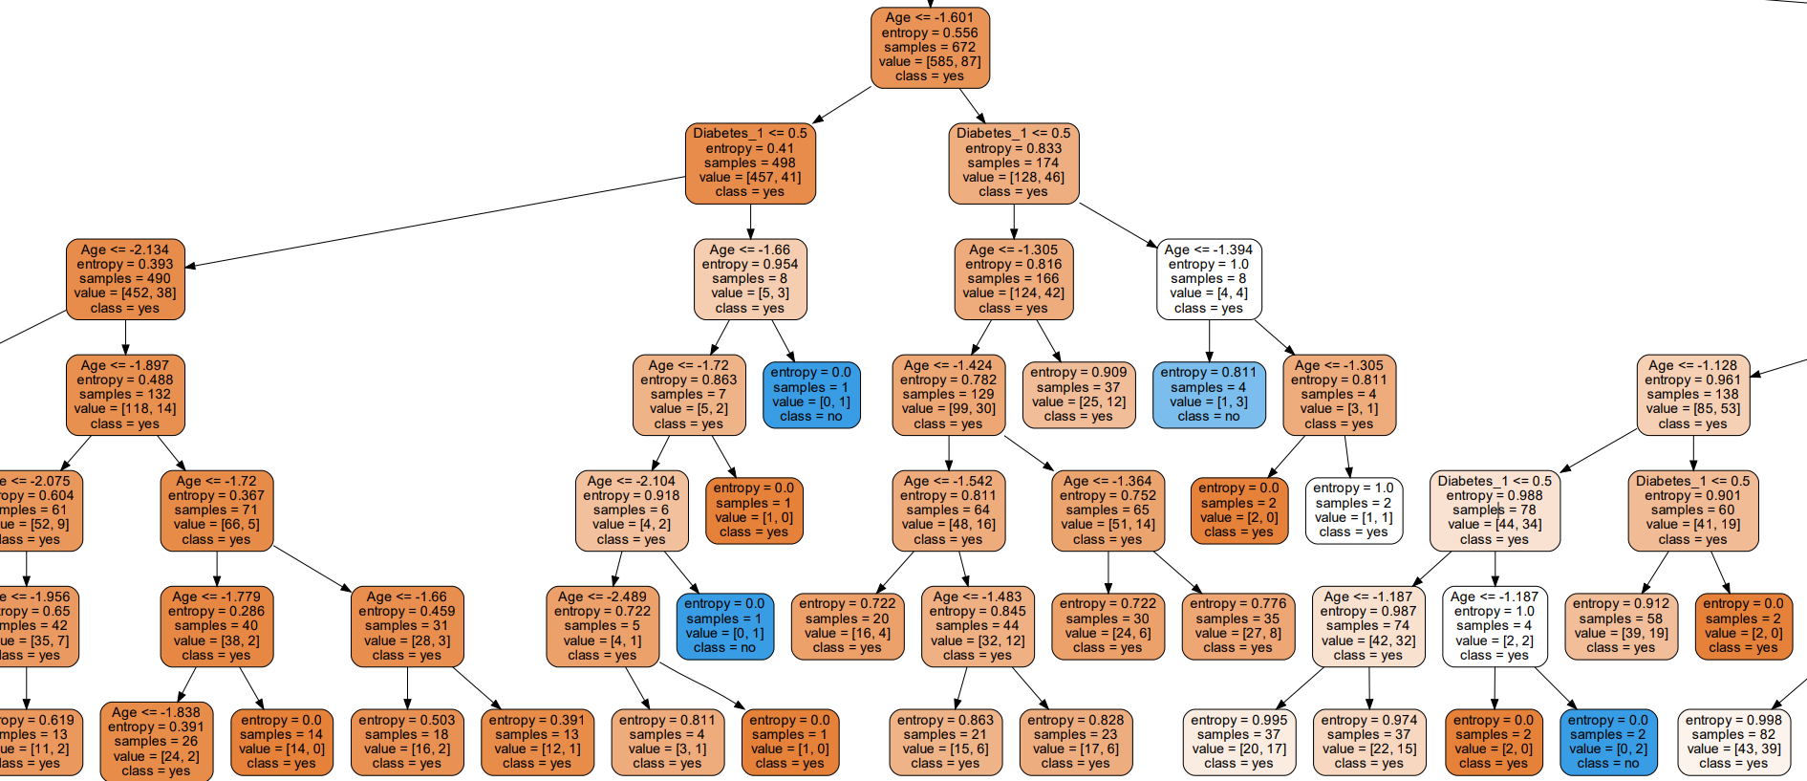
Decision Tree

Slide 28
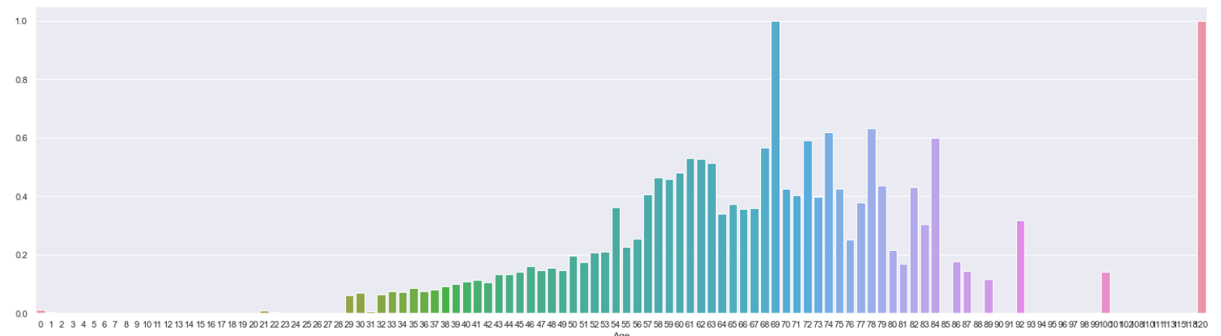
Decision Tree

Slide 29
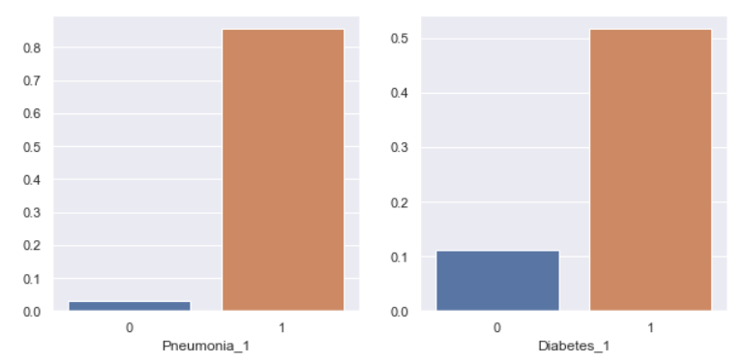
Decision Tree

Slide 30
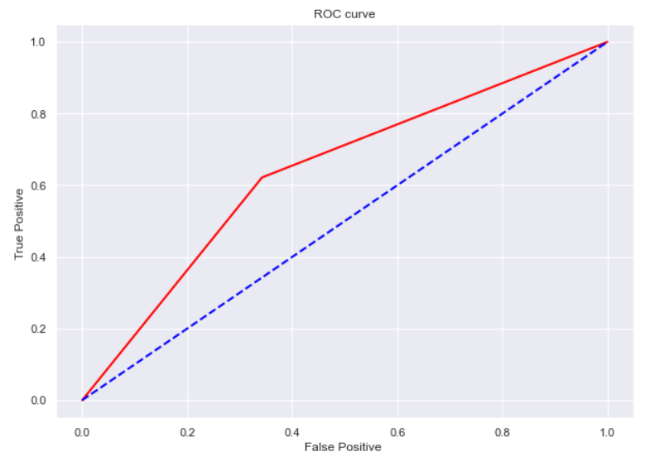
Decision Tree
Accuracy: 0.63967
Accuracy(ourself): 0.4097

Slide 31
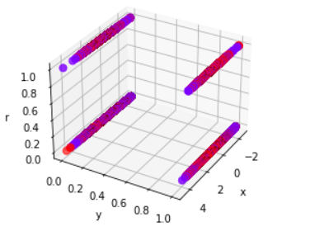
Support-vector machines

Slide 32
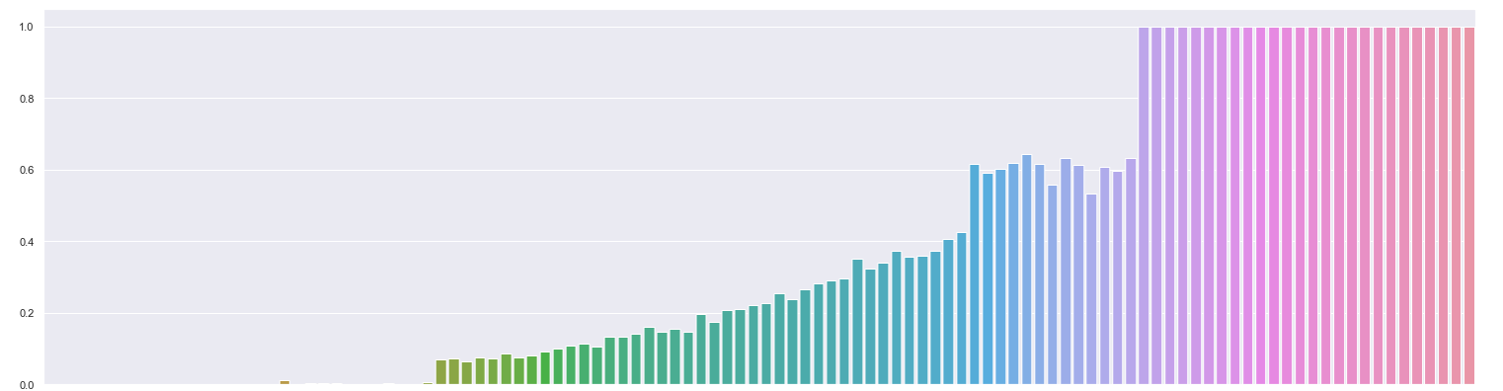
SVM

Slide 33
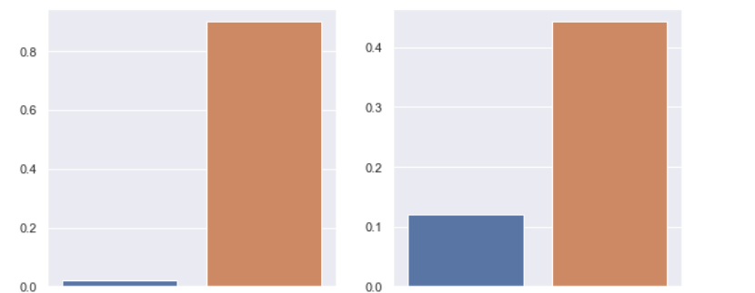
SVM

Slide 34
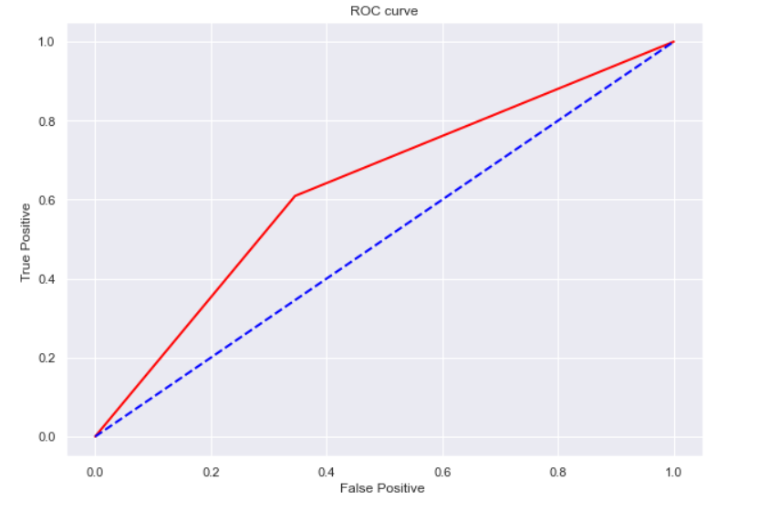
SVM
Accuracy: 0.64101

Slide 35
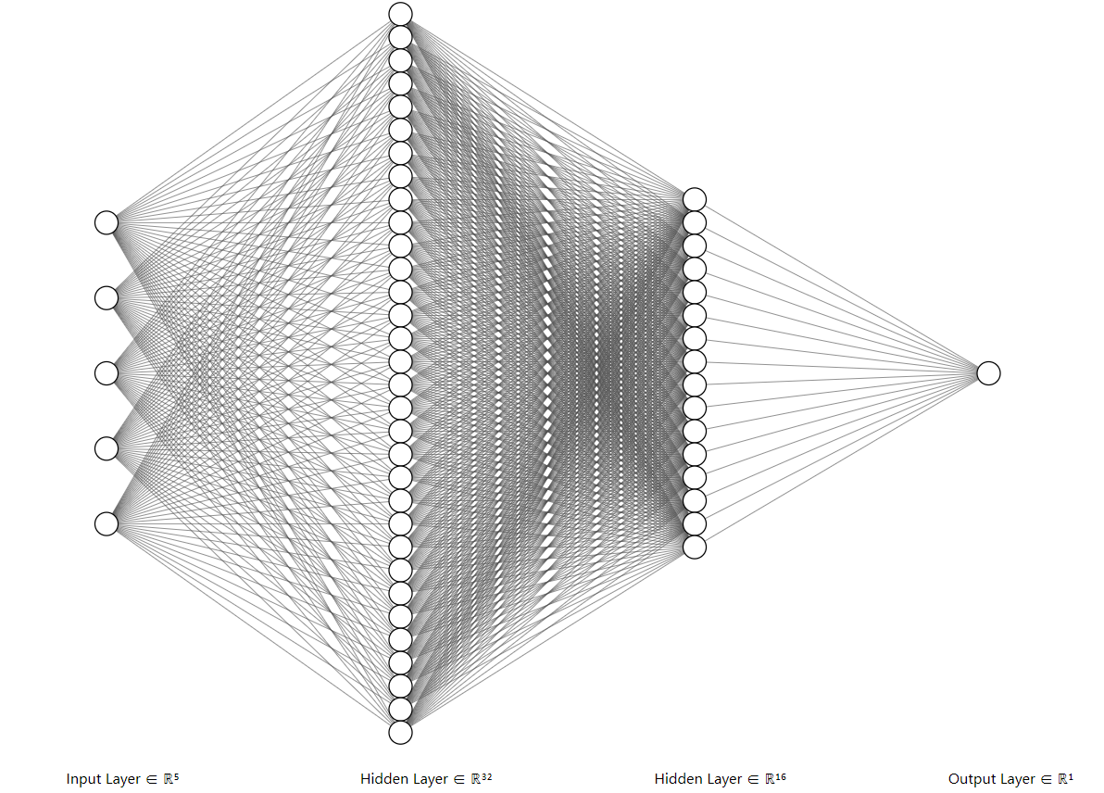
Neural Network using Multilayer Perceptron
Keras-Sequential-Dense
1 Input layer
2 Hidden layer
1 Output layer

Slide 36

NN

Slide 37
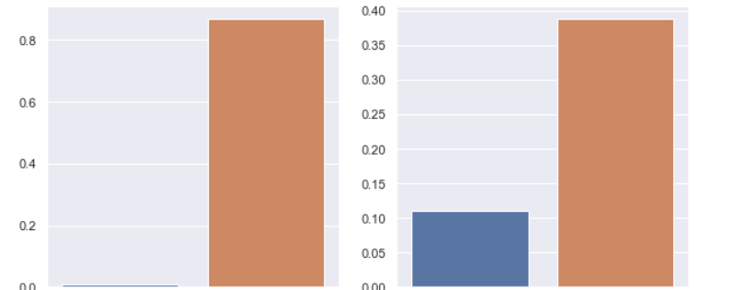
NN

Slide 38
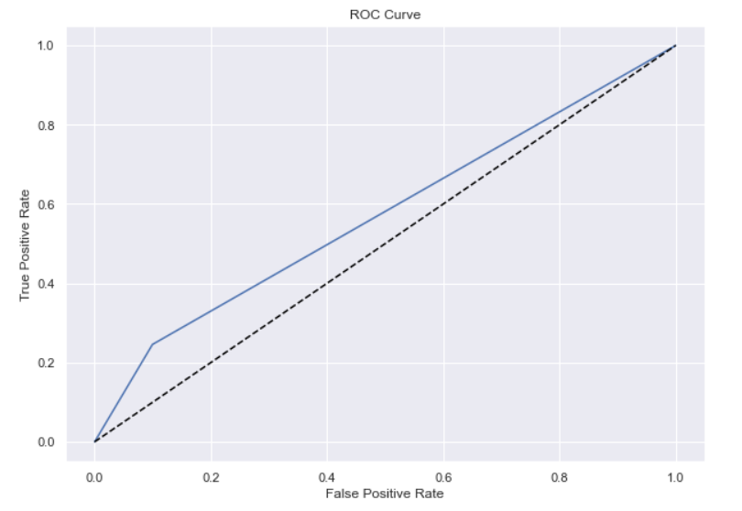
NN
Accuracy: 0.64398

Slide 39
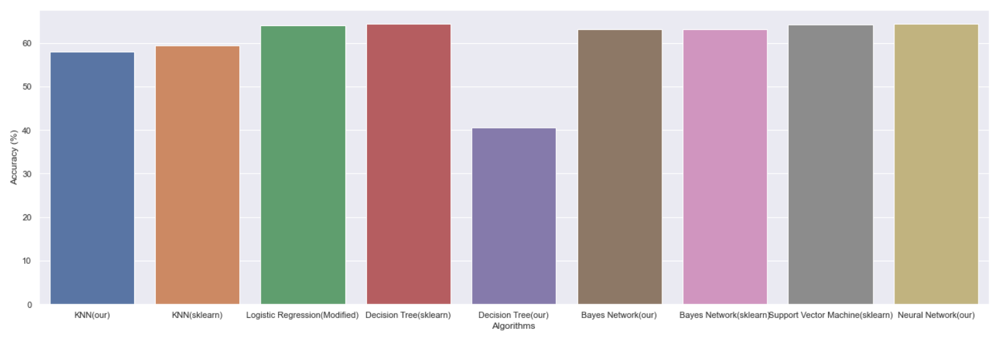
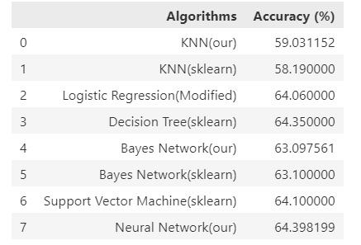
Comparison

Slide 40
THANKS!
COVID-19
Analysis & Predication
with Multiple AI Methods

