Slide 1

COVID-19
Analysis & Predication
with Multiple AI Methods
CS181 Project Proposal

Slide 2



Dataset Introduction
Basics： Age Sex
Medical record: Pneumonia Diabetes Ashma Hypertension CVDs CKDs
Other factors: Obesity Tabacco
Samples 263008 People, sex ratio = 0.4893
Age | Sex | Pneumonia(基础肺炎) | Diabetes(糖尿病) | Asthma(哮喘) | Hypertensio(高血压) | CVDs(心脏病) | Obesity(肥胖) | CKDs(慢性肾脏病) | Tabacco(吸烟) | Result(是否患新冠)
74 | 0 | 0 | 1 | 0 | 1 | 0 | 1 | 0 | 0 | 0
71 | 1 | 0 | 1 | 0 | 1 | 0 | 1 | 0 | 1 | 0
50 | 0 | 1 | 0 | 0 | 0 | 0 | 0 | 0 | 0 | 1
source:

Slide 3

Target
a. Find out the relationship between the Health Factors and Covid Infection.
b. Carry out multiple AI methods (including ones we learned in CS181)
on the dataset to do Prediction.
c. Compare the performance between traditional methods and
d. Combining and modifying to come up with Our Own Method
which perform better against others.
Deeper & Harder

Slide 4

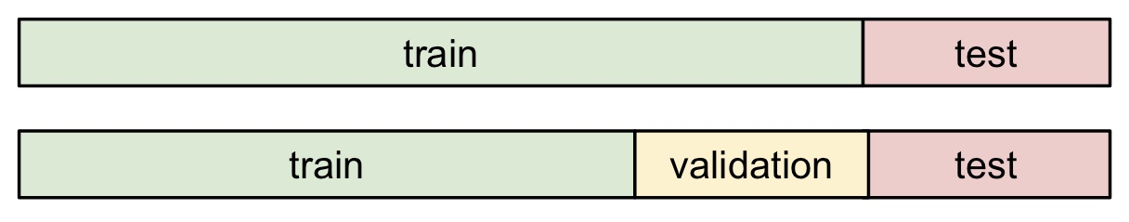
Tasks
a. Cleaning data & data processing
b. Analyzing the factors – infection relation
c. Find the adequate split of test set and training set
d. Perform both traditional & natural network based methods
e. Comparison and Evaluation, design & improve Our own method
With
Visualization
Loop back
Evaluation standard: accuracy rate, ROC curve
OR

Slide 5
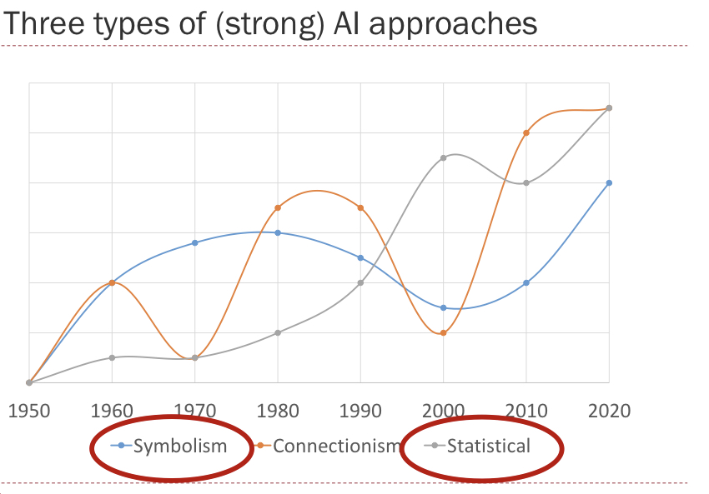
Idea
Traditional vs N-N based

Slide 6
Idea
We will perform：
less neural-liked
Naïve Bayes
Naïve Markov
Decision Tree
Random Forest
K nearest neighbors
SVM
Naïve Neural Network
Neural Network (with Multilayer perceptron)
AND…
Where’s ours?
More neural-liked

Slide 7
THANKS!
COVID-19
Analysis & Predication
with Multiple AI Methods

