Slide 1
Discussion 6
SI120 TA team

Slide 2

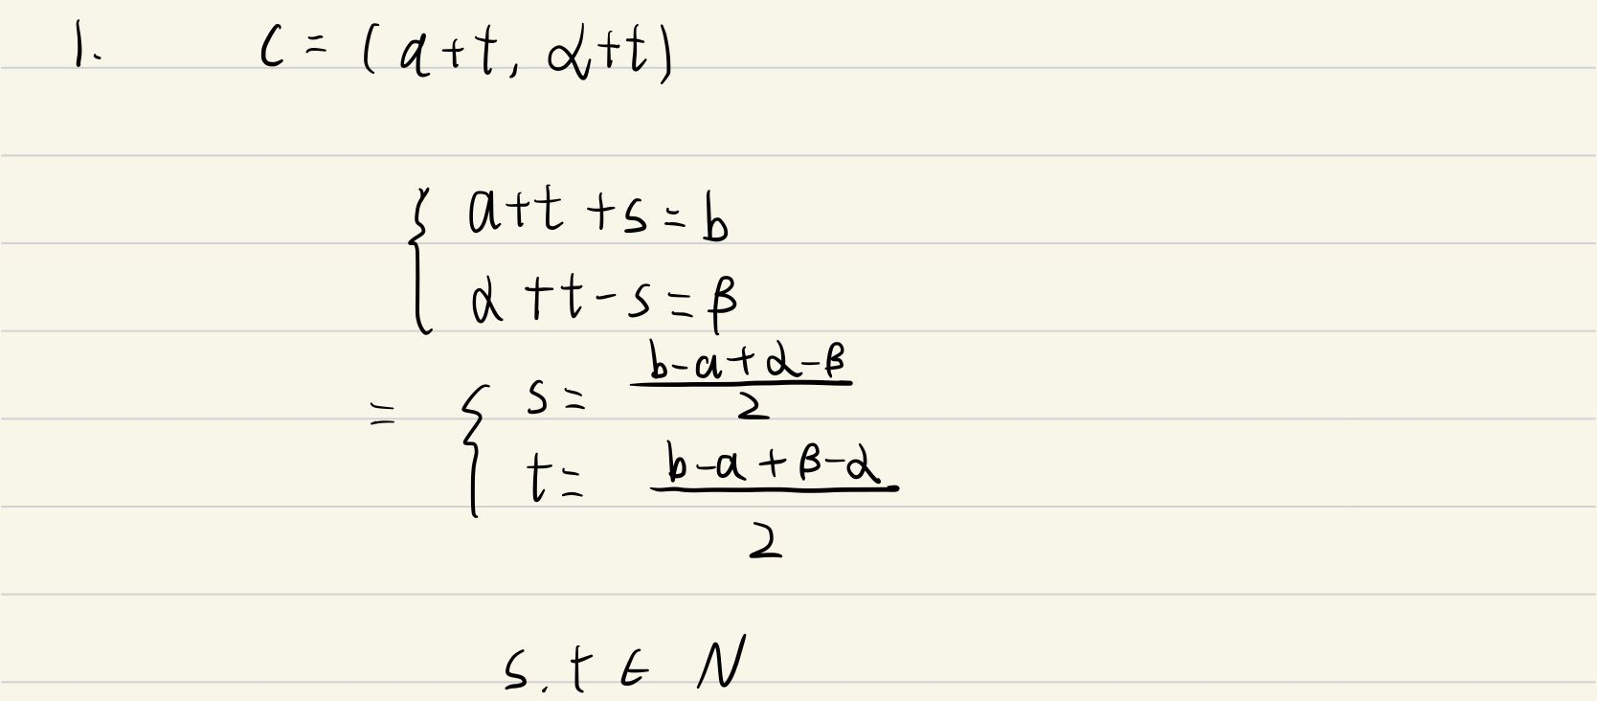

Slide 3

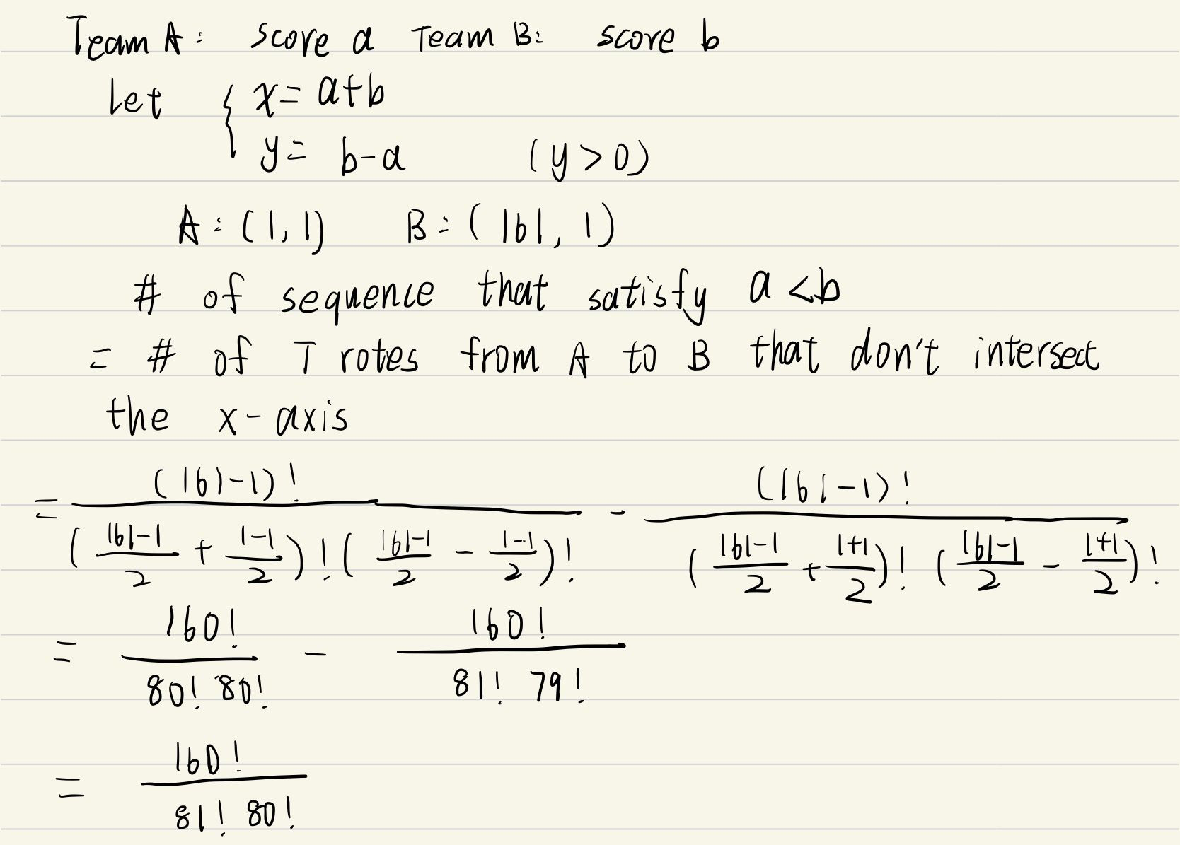

Slide 4


Slide 6


Slide 7
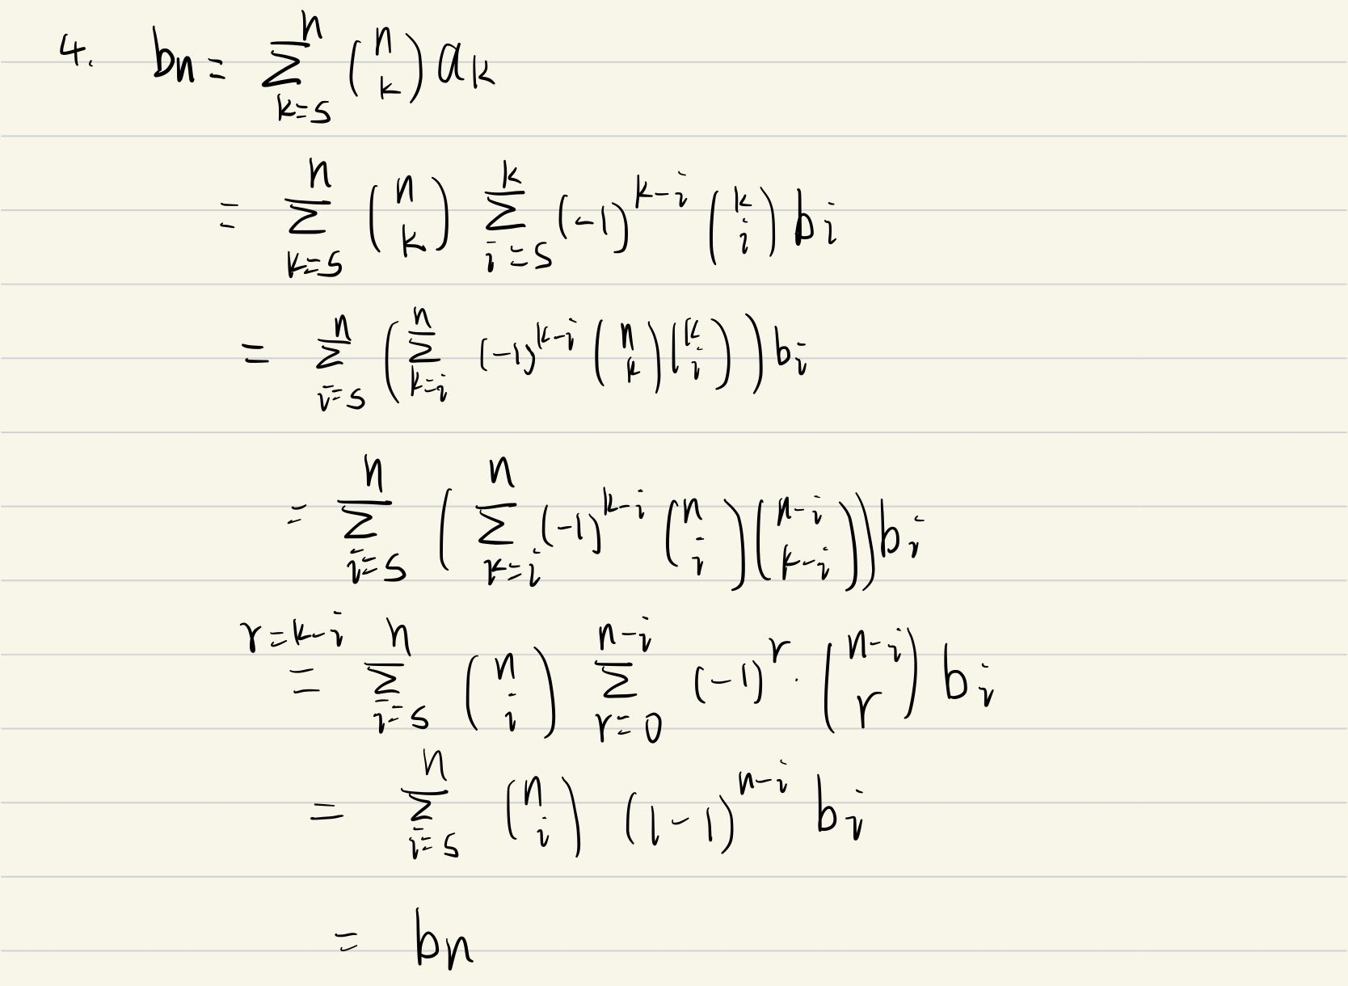

Slide 8



Slide 9
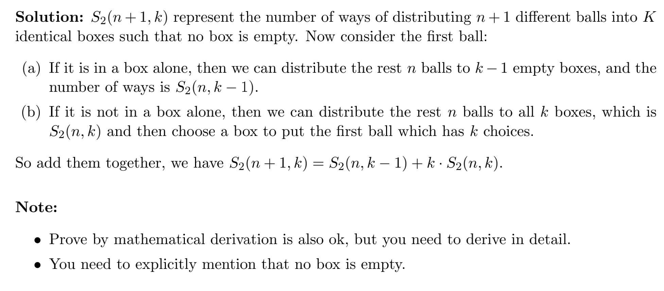

Slide 10



Slide 11
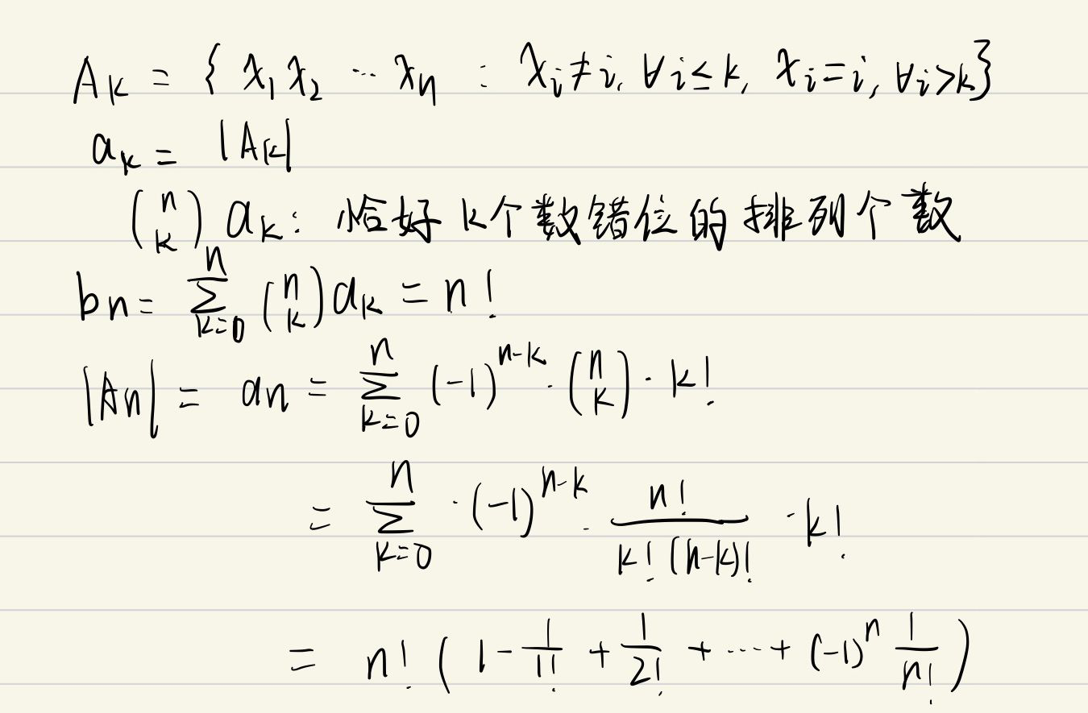

Slide 12
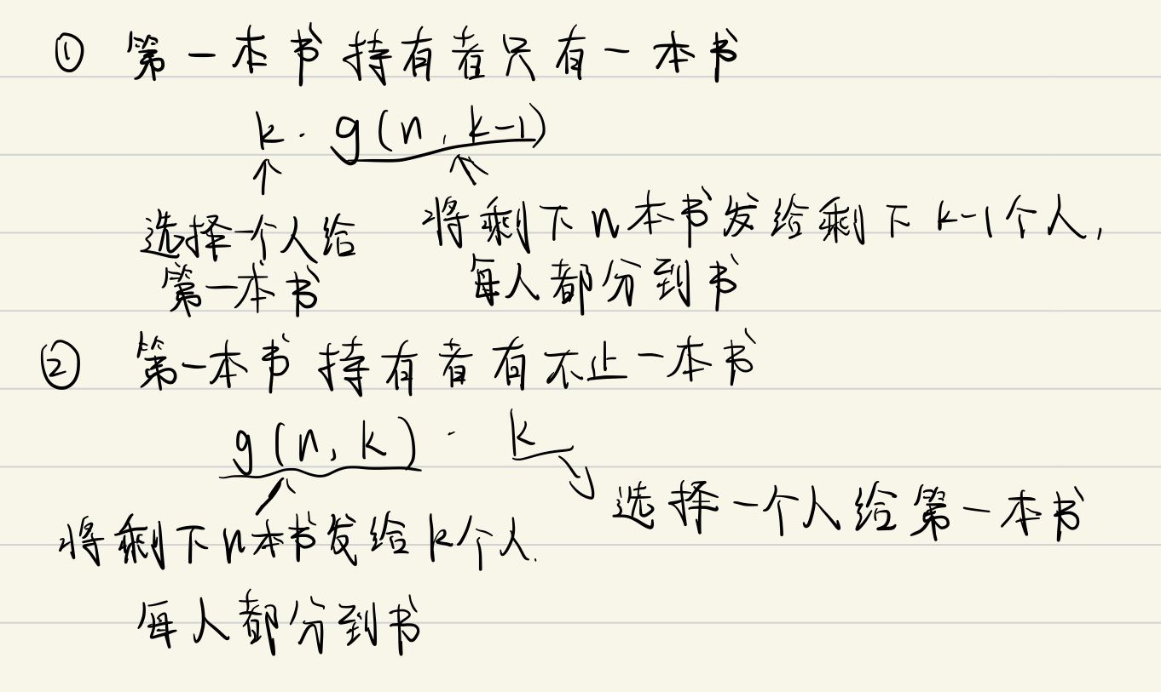

Slide 13


Slide 14
