Slide 1
CIVICEYE
making streets safer — one report at a time
A citizens’ reporting engine for potholes, broken lights, leaks & more — that routes every issue to the exact authority (or the road’s contractor!) who can fix it.
START THE STORY ▶
College presentation · 2026
Fully clickable deck
Built by students

Slide 2
THE STORY IN 8 ACTS
Use the arrows to walk through — every scene is one click away.
01 The problem
02 The toll
03 Why it happens
04 How CivicEye works
Potholes are a killer — the newspaper clips prove it
9,438 lives lost to potholes in 5 years
Warranties nobody knows about
Report → AI → verify → fix
05 The AI inside
06 Safety
07 We reach the fixer
08 Try it live
On-device + cloud vision chain
SOS for anyone in danger
Authorities & road contractors
Open the real product
NEXT ▶

Slide 3
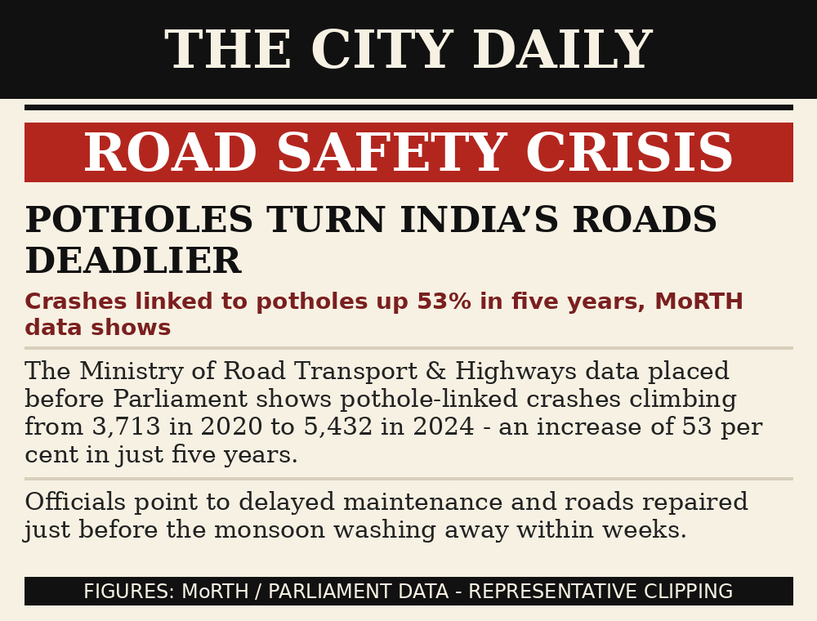
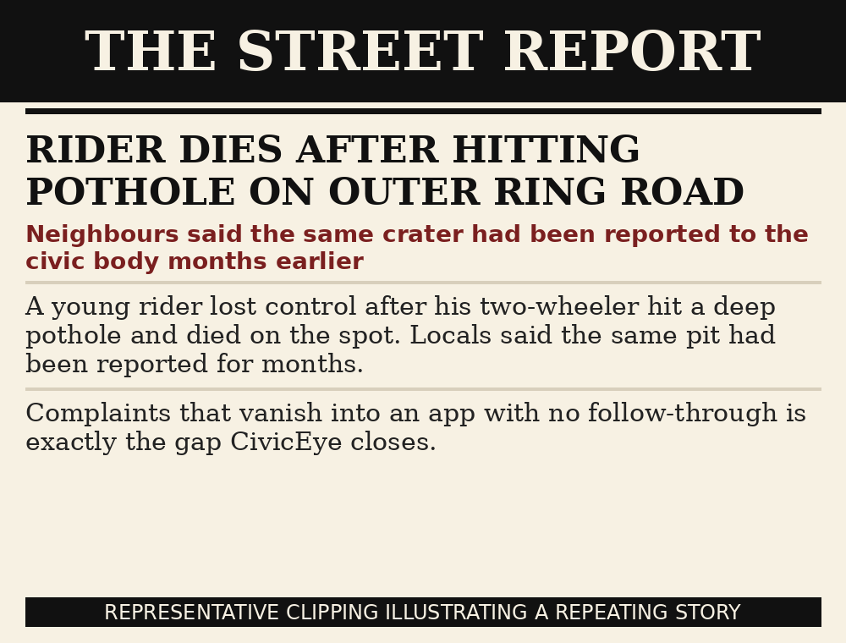
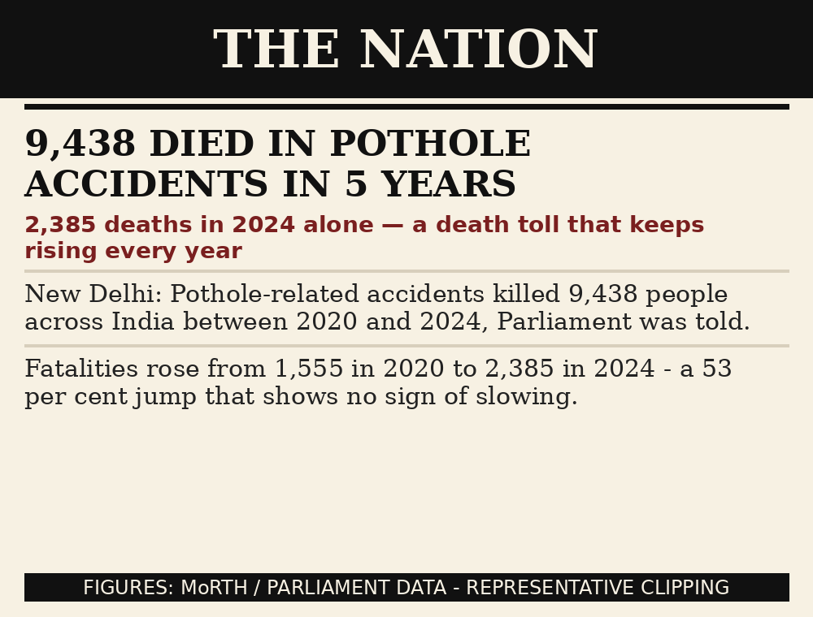
THE NEWSPAPERS ALREADY TOLD THIS STORY
These aren’t one-off tragedies — they’re a national pattern.
Every single clip describes a fixable failure — a road defect that was reported, ignored, then fatal.

Slide 4
THE TOLL IS REAL
9,438
53%
2,385
≈1.7L+
lives lost to pothole accidents in India, 2020–2024
rise in pothole-linked crashes in five years
deaths in 2024 alone — still climbing
total road deaths every single year (MoRTH)
Behind every statistic is a person — many of them young riders on their way to work or college.

Slide 5
WHY DOES THIS KEEP HAPPENING?
The broken chain
▸ 1. A citizen spots a pothole and files a complaint…
▸ 2. …to a helpline that never confirms receipt…
▸ 3. …the ward has no visibility of the backlog…
▸ 4. …and even when the road is under a contractor’s warranty, nobody checks who must pay for the fix.
Result: months of silence, then an accident — the same pothole, still unfixed.

Slide 6
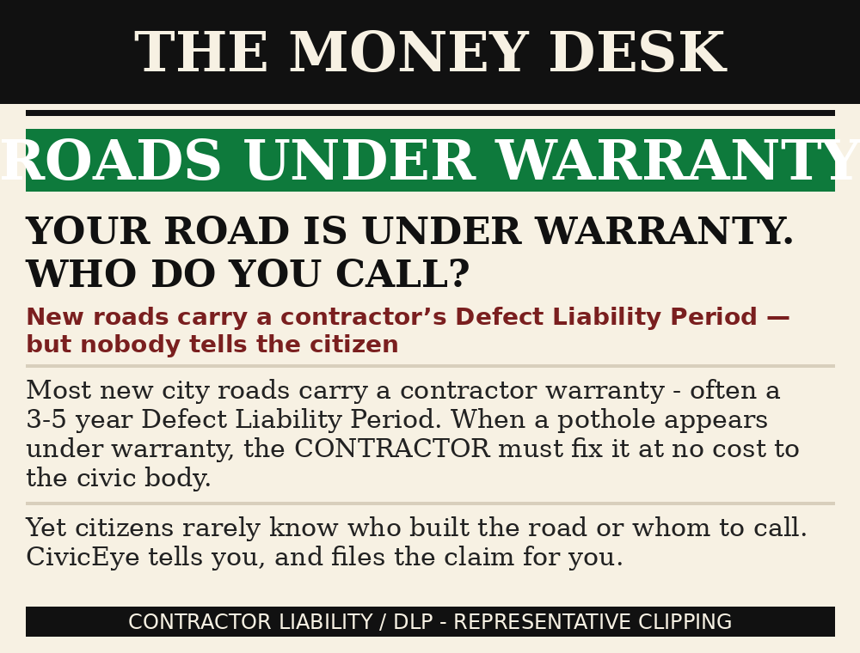
ROADS HAVE WARRANTIES. NOBODY USES THEM.
The DLP rule (real)
✔ When a road is re-laid, the contractor keeps a defect-liability warranty (often 3–5 years).
✔ If it fails in that window, the contractor — not the taxpayer — must fix it.
✔ But citizens (and even ward offices) rarely know who built the road.
✔ Inspired by Gaurav Sen’s dash-cam idea: detect potholes on video, then automatically complain to the road’s contractor.
CivicEye does exactly this — we pair every report to the contractor under warranty.

Slide 7
HOW CIVICEYE WORKS
1
2
3
4
5
Report in 60s
AI reads it
Community verifies
Auto-routed
Fixed & closed
Snap a photo & pin the spot. Works on phone, web & QR.
On-device + cloud vision detect the category & severity.
Neighbours confirm — a single fake report dies fast.
We find the owning authority AND the contractor under warranty.
Status goes pending → verified → in progress → resolved — publicly.
Every step is public — the whole street can watch a complaint get fixed.

Slide 8
THE AI ENGINE CHAIN
Real models, in order — each one is a fallback if the next isn’t available.
1
2
3
4
On-device YOLO
Roboflow cloud
Hugging Face
Smart fallback
pothole/garbage/manhole detected IN YOUR BROWSER — free & private
trained civic detector for precision (primary cloud engine)
backup vision model if the cloud is down
the app never breaks — it always answers
Blurry photo? The AI says so and asks you to retake. Wrong guess? You can edit the category — your correction trains the next model.

Slide 9
A SAFETY NET, NOT JUST COMPLAINTS
A one-tap SOS is built into the app for anyone in danger. It captures GPS and raises a CRITICAL alert that the community and staff see instantly — plus it’s clearly labelled for authorities to act on first.
⚠️ Requires a deliberate confirmation — an accidental tap can’t raise a false alarm
📍 Uses your live GPS so help knows exactly where you are
🚨 Creates a CRITICAL report visible to staff & the community in real time
📅 Never blocks the phone helplines — 112 always remains the fastest call for a live emergency

Slide 10
WE REACH THE PERSON WHO CAN FIX IT
Report type
Owner (auto-matched)
Channel that actually works
Pothole / broken road
BBMP Ward / road contractor (if under warranty)
Samparka portal + WhatsApp + email
Garbage / dumping
BBMP Solid Waste Management
Samparka portal + helpline 1533
Water leak / sewage
BWSSB
Helpline 19145 + portal
Street light down
BESCOM
Helpline 1912 + portal
Traffic signal / crash
Bengaluru Traffic Police
112 / 103 + portal
Fallen tree
BBMP Forest Cell
Helpline 1533 + portal
Contractor warranty match = the claim goes to the builder, not the taxpayer.

Slide 11
WHAT’S NEXT
Live warranty watch
map corridors → contractor + defect-liability end date; auto-claim before warranty expires
Dash-cam mode
drive the street, AI flags potholes from video (the Gaurav Sen approach), app files the complaint
Public scorecard
every ward shows open / fixed counts — citizens grade their own street
Train a sharper model
our own civic dataset — corrections from real users retrain the detector
On-ground pilot
partner a BBMP ward + one campus for a real fix-the-street month

Slide 12
QUICK QUIZ — CLICK AN ANSWER
Most new city roads carry a contractor warranty of …
1 month
3–5 years
10 years
✅ Answer: 3–5 years (the Defect Liability Period). If it fails in that window, the contractor must fix it — that’s the warranty CivicEye chases for you.
🎯 Why this matters

Slide 13
DON’T BELIEVE US — TRY IT
This deck is the story. The product is one click away:
OPEN THE LIVE CIVICEYE APP ▶
Sign in with any email — report a pothole near you and watch it route to the authority.
Try Amrita Eye (campus edition)
Email the team

Slide 14
THANK YOU!
Because a street should never decide who lives and who doesn’t.
civiceyeoffcial@gmail.com · built by students for students
← Questions?

