Slide 1
CivicEye
/ Amrita Eye
Making cities better, one report at a time.
A citizen-powered platform to report, visualise and fix civic issues
Team · Course · College
01

Slide 2
THE PROBLEM
Every city has the same story.
“Where are the potholes? Which streets go dark at night? Which junctions flood every monsoon?”
Scattered complaints
Issues reported everywhere — helplines, apps, social media — with no single trusted source.
Lost & forgotten
Complaints get duplicated, lost, or never acted on.
Newcomers in the dark
Students & new residents have no way to know what’s broken or dangerous.
No verifiable data
Authorities get noise instead of organised, trustworthy reports.
02

Slide 3
THE SOLUTION
CivicEye turns observations into verifiable, actionable data
📸
📍
🤖
✅
🏛️
Snap a photo
Pin it on the map
AI analysis
Community validates
Authorities act
→
→
→
→
Report potholes, broken lights, garbage, anything unsafe
GPS or manual pin, with campus auto-detection
CivicLENS AI detects issue, confidence & severity
Neighbours confirm; 3 confirms → Verified
Live dashboard — assign, fix, resolve, notify
One minute to report. One place for everything. Visible progress for all.
03

Slide 4
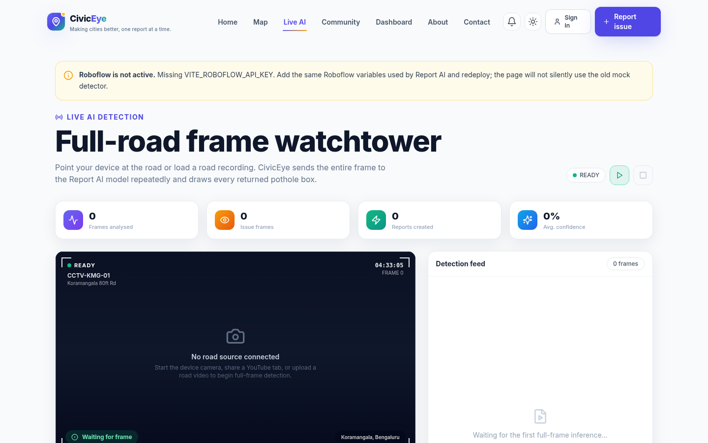
AMRITA EYE — CAMPUS MODE
Keeping our campus safe, one report at a time.
🎓 Auto-activates
for @amrita.edu students & staff — any campus.
🛡️ Campus categories
suspicious activity, water leaks, broken lights & more.
🏢 Routed to campus offices
Live AI Detection in action
Estate, Facilities, Security — the people who can act.
🎨 Campus identity
red & gold theme, campus-scoped map, dedicated favicon.
Campus reports stay on campus — city reports stay in the city.
04

Slide 5
HOW IT WORKS
From broken street to fixed — in 5 steps
1
2
3
4
5
Spot the problem
Snap a photo
Pin the location
Community verifies
Authority fixes it
Choose a category: pothole, garbage, street light, accident…
Take it on your phone (QR flow) or upload; AI analyses it.
GPS auto-detected (±30 m) or drop a pin; campus detection.
Neighbours confirm; 3 confirms → Verified.
Ward/staff dashboard → assigned → resolved → notified.
05

Slide 6
FEATURES
A complete civic toolkit
🗺️
Live Interactive Map
🤖
CivicLENS AI
📡
Live AI Detection
✅
Community Validation
Clustering, heatmap, filters, search, zoom-on-click
Real object detection — category, confidence, severity
Camera / video / screen → live detection boxes
Upvote, confirm, reject → Verified status
💬
Reviews
🏛️
Authority Dashboard
🎓
Amrita Eye
🛡️
Admin Panel
Report threads with agree / disagree
KPIs, charts, assign/resolve, ward report
Campus theme, categories & routing
Moderation, take-downs, scope control
06

Slide 7
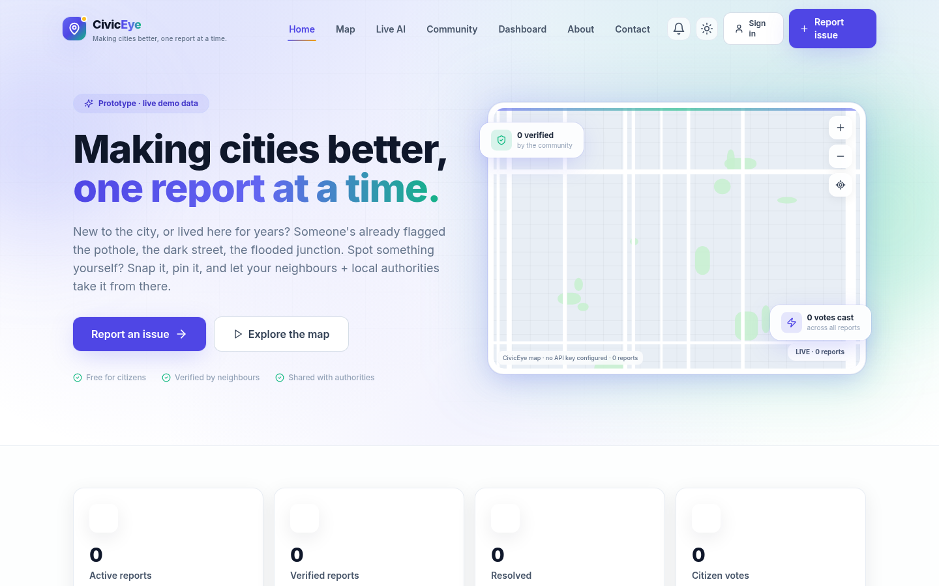
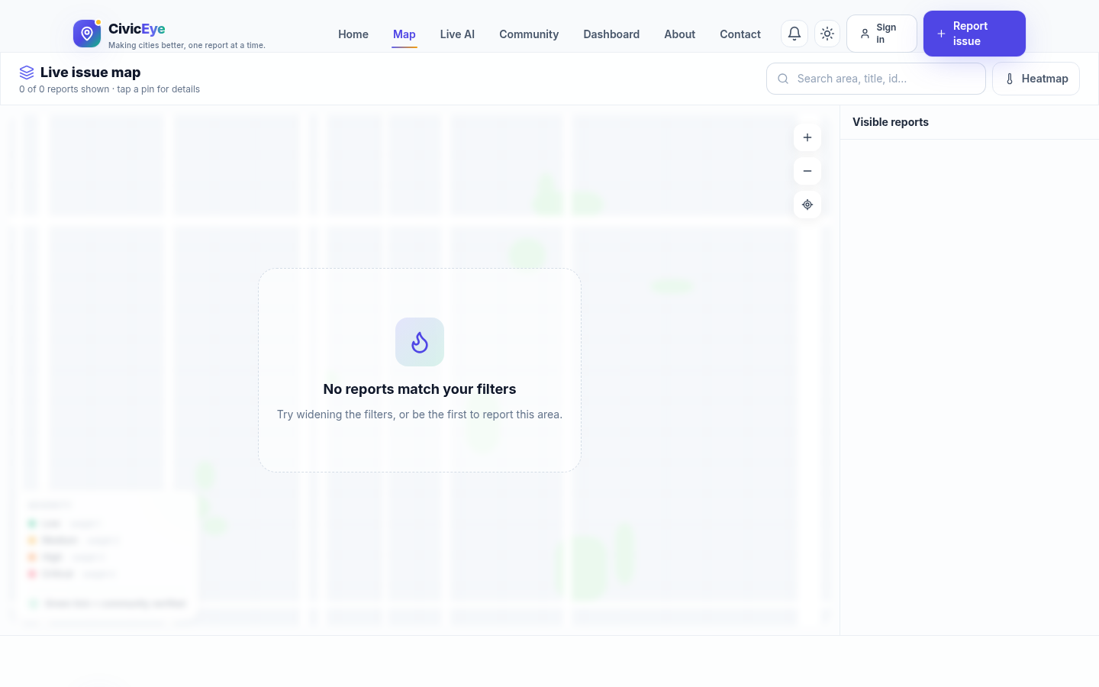
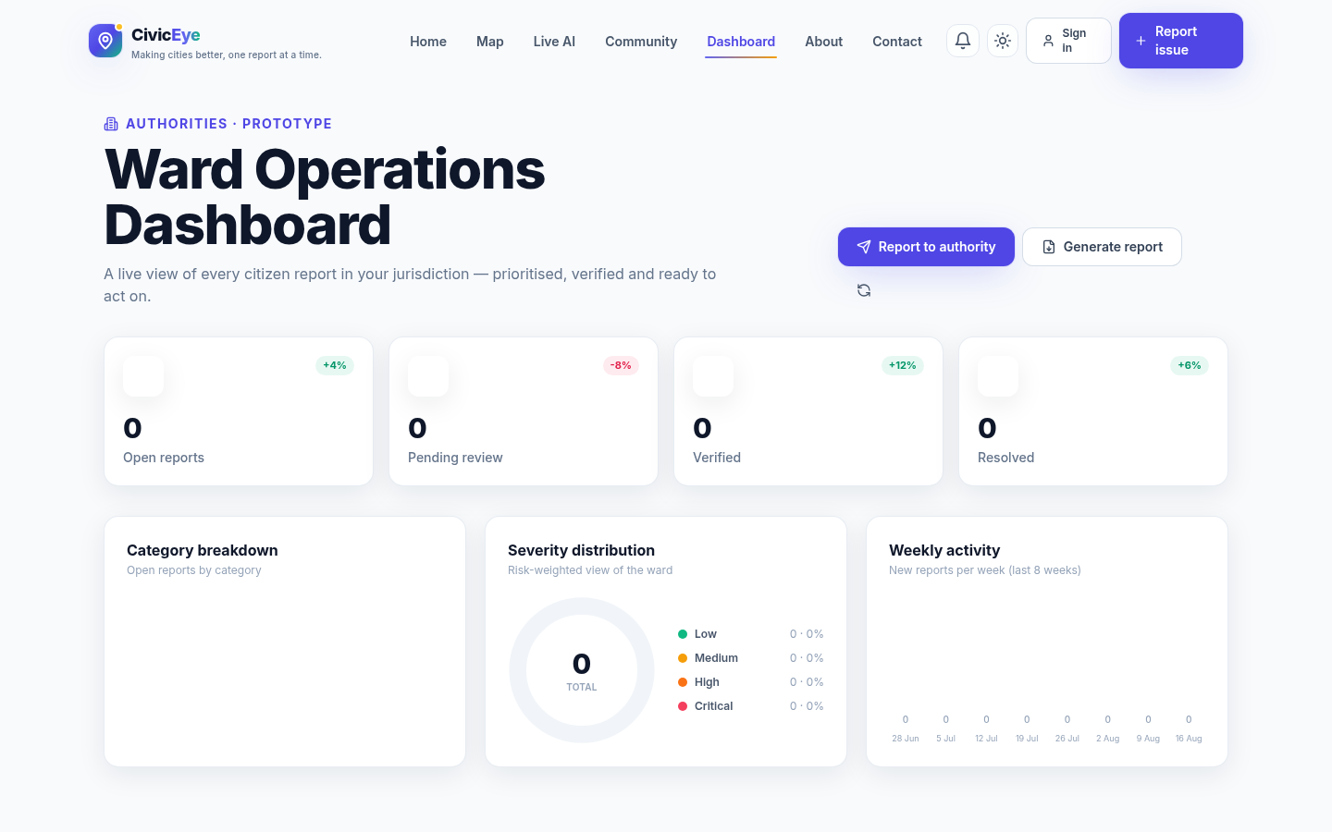
THE PRODUCT
Real screenshots of the live app
Landing
Interactive Map
Authority Dashboard
07

Slide 8
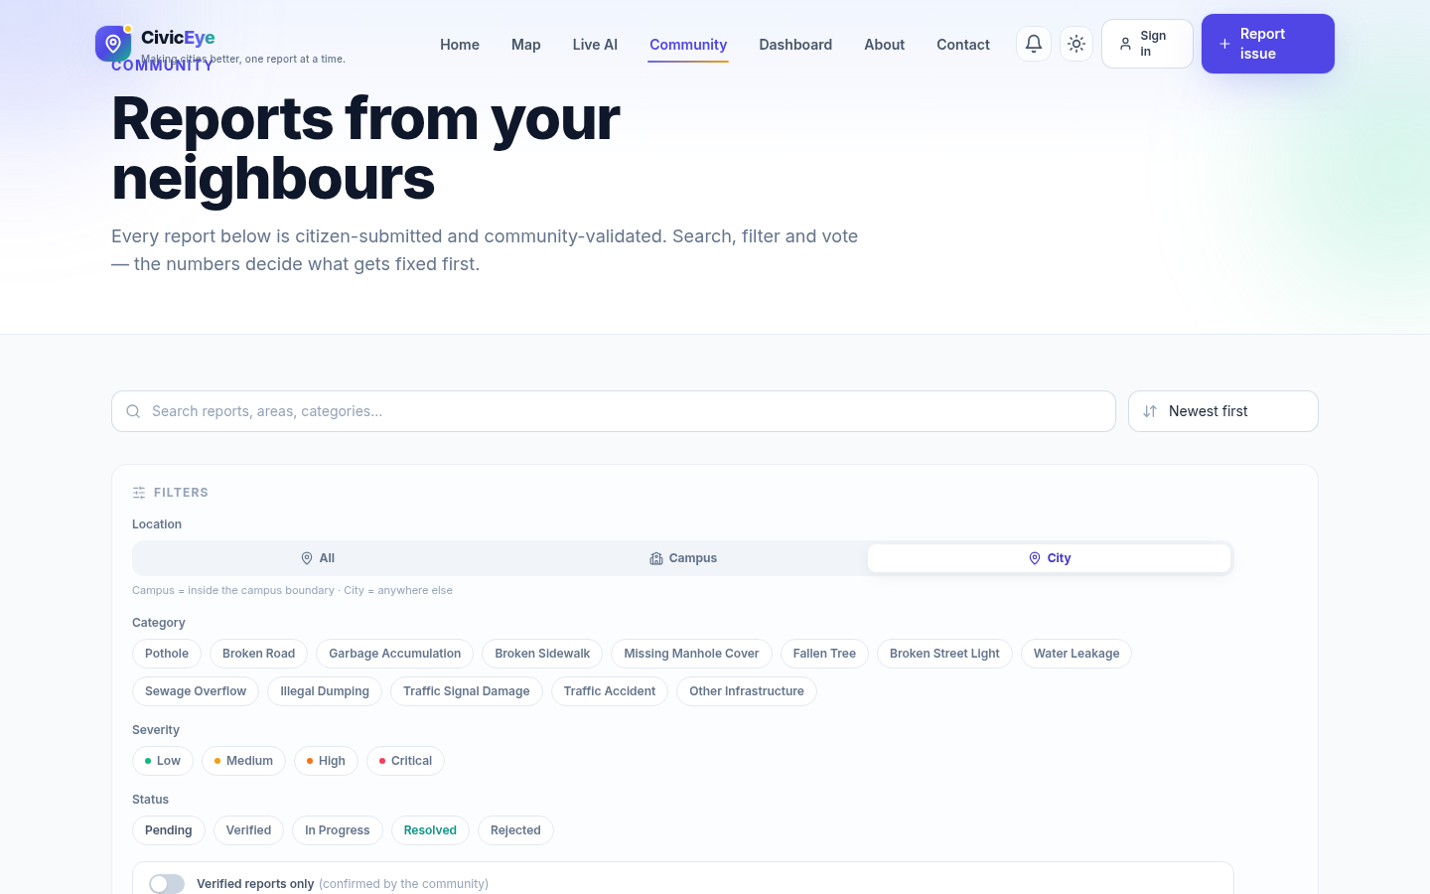
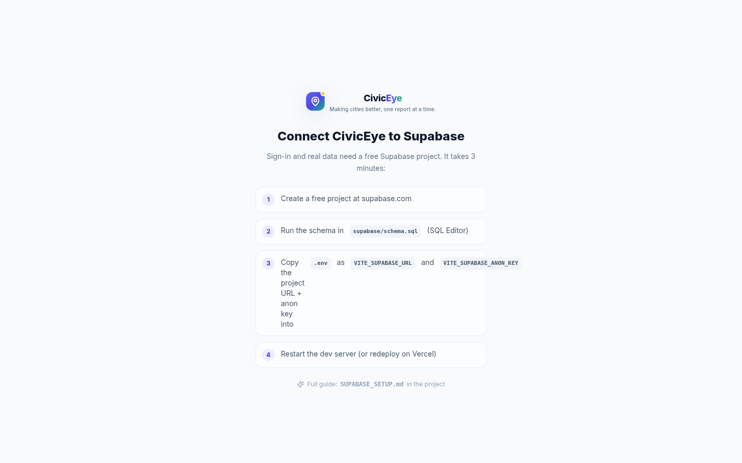
THE PRODUCT (2)
Community, Live AI & more
Community Feed
Live AI Detection
Login
08

Slide 9
TECHNOLOGY
Modern, production-grade stack
Frontend
React 18 · TypeScript · Vite · TailwindCSS · Framer Motion
Backend & Data
Supabase — Postgres, Auth, Storage, Row-Level Security
AI
CivicLENS (Roboflow) object detection · Groq vision fallback
Maps
Google Maps JS API · Marker clustering · Custom heat overlay
Serverless
Vercel functions · Cloudflare Worker proxy (30s)
Email
nodemailer SMTP gateway · EmailJS fallback · WhatsApp/SMS/mailto
09

Slide 10
HONESTY
What’s real, what’s a prototype
✅ REAL — works end-to-end
⚠️ PROTOTYPE
• Login, reports, votes, confirmations, reviews
• Authority contact data is sample (swap in real)
• Photo upload to Supabase storage
• AI free-tier quotas (~1,000 Roboflow/mo)
• AI photo analysis (real Roboflow inference)
• Report-to-authority escalation (email/WhatsApp/mailto)
• New UI coming soon
• Live AI detection (camera / video / screen)
10

Slide 11
IMPACT & LEARNINGS
Built for a real problem
Crowdsourcing works
A shared, verified map is more trusted than scattered complaints.
AI + community together
AI speeds reporting; the community keeps it honest.
Born from real life
The “new student in a new city” problem — hostelers learning the city they’ll live in for 4 years.
Visible progress
Every report shows its journey: Pending → Verified → In progress → Resolved.
11

Slide 12
WHAT’S NEXT
The roadmap ahead
Push notifications — email / WhatsApp when a report is resolved
Ward-office API integration — automatic ticket creation
Local GPU models (Ollama / fine-tuned YOLO) — unlimited live AI
City-by-city rollout with real authority contacts
Multilingual support — Hindi, Tamil, Malayalam
A brand-new UI (coming soon)
12

Slide 13
Thank you.
Making cities better, one report at a time.
Questions?
Your names · emails · college
13

