Slide 1


Multimodal Attention Network for Trauma Activity Recognition from Spoken Language and Environmental Sound
¹Rutgers, The State University of New Jersey, Piscataway, NJ, USA
²Children’s National Medical Center, Washington, DC, USA
Yue Gu¹, Ruiyu Zhang¹, Xinwei Zhao¹, Shuhong Chen¹, Jalal Abdulbaqi¹,
Ivan Marsic¹, Megan Cheng², Randall S. Burd²

Slide 2
Limitations of Previous Approaches
Activity recognition during trauma resuscitation were defined as the tracking of human movement and objects using sensor data from multiple modalities (i.e., depth image and RFID) in previous research [1-4].
Difficult to recognize those activities that typically performed by human speech or team communication.
Ignore the potential context information provide by human conversation audio streaming.
[1] X. Li, D. Yao, X. Pan, J.Johannaman, J. Yang, R. Webman, A.Sarcevic, I. Marsic and R.S. Burd, 2016, May. ``Activity recognition for medical teamwork based on passive RFID,`` In 2016 IEEE International Conference on RFID (RFID) (pp. 1-9). IEEE.
[2] X. Li, Y. Zhang, I. Marsic, A. Sarcevic and R.S. Burd, 2016, November. ``Deep learning for rfid-based activity recognition,`` In Proceedings of the 14th ACM Conference on Embedded Network Sensor Systems CD-ROM (pp. 164-175). ACM.
[3] J. E. Bardram, A. Doryab, R. M. Jensen, P. M. Lange, K. L. G. Nielsen, and S. T. Petersen, “Phase recognition during surgical procedures using embedded and body-worn sensors,” 2011 IEEE International Conference on Pervasive Computing and Communications (PerCom), 2011.
[4] X. Li, Y. Zhang, M. Li, S. Chen, F. R. Austin, I. Marsic, and R. S. Burd, “Online process phase detection using multimodal deep learning,” 2016 IEEE 7th Annual Ubiquitous Computing, Electronics & Mobile Communication Conference (UEMCON), 2016.

Slide 3
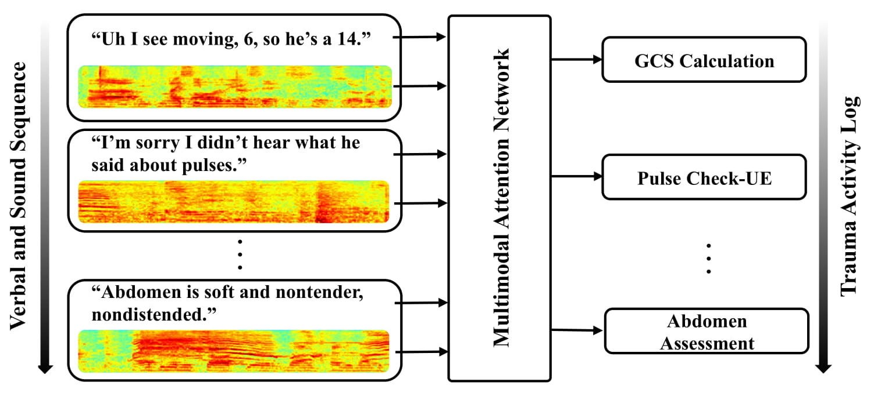
Trauma Activity Recognition from Spoken Language and Environmental Sound
Develop a model to recognize trauma resuscitation activities from verbal communication transcripts and environmental audio streams.
Specifically, given an utterance-level verbal transcript and the audio streams, our model outputs the corresponding activity label.
An end-to-end multimodal attention network that preprocesses the raw data, extracts acoustic and textual representations, and fuses the feature vectors for final classification.

Slide 4
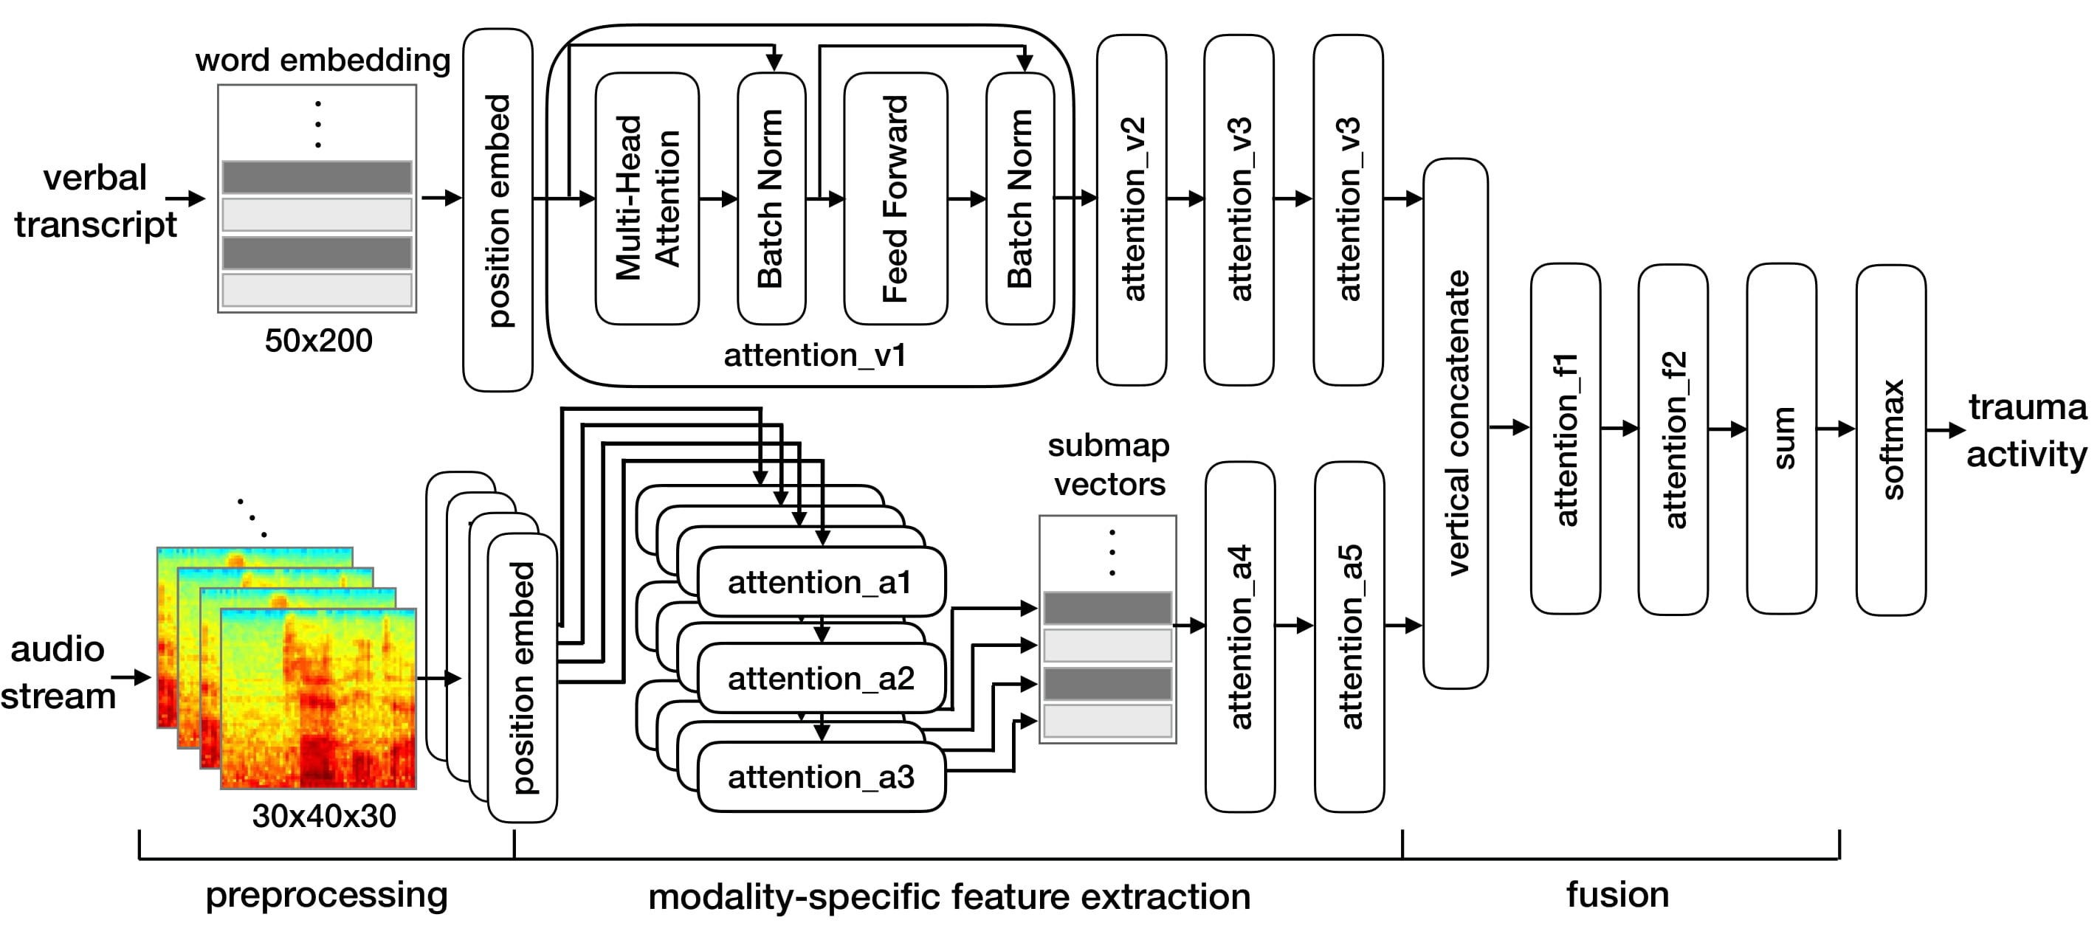
Overall Structure of Multimodal Attention Network (MAN)

Slide 5
Preprocessing
The input data includes both utterance-level verbal transcripts and audio stream.
Embed each word into a 200-dimensional vector using GloVe [5], with unknown words randomly initialized.
Represent the audio stream as a spectrogram using Mel-frequency spectral coefficients (MFSC) [6].
Segment the MFSC feature maps into several 30-frame submaps.
Verbal transcripts vector: (50, 200); audio stream vector: (30, 40, 30).
[5] Pennington, Jeffrey, Richard Socher, and Christopher Manning. "Glove: Global vectors for word representation." In Proceedings of the 2014 conference on empirical methods in natural language processing (EMNLP), pp. 1532-1543. 2014.
[6] O. Abdel-Hamid, A.R. Mohamed, H. Jiang, L. Deng, G. Penn and D. Yu, 2014. ``Convolutional neural networks for speech recognition,`` IEEE/ACM Transactions on audio, speech, and language processing, 22(10), pp.1533-1545.

Slide 6
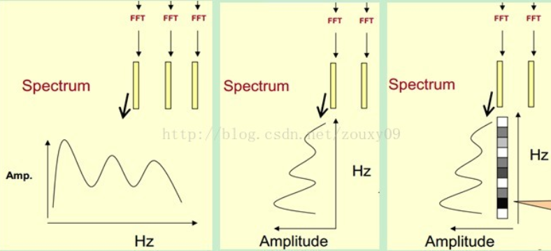
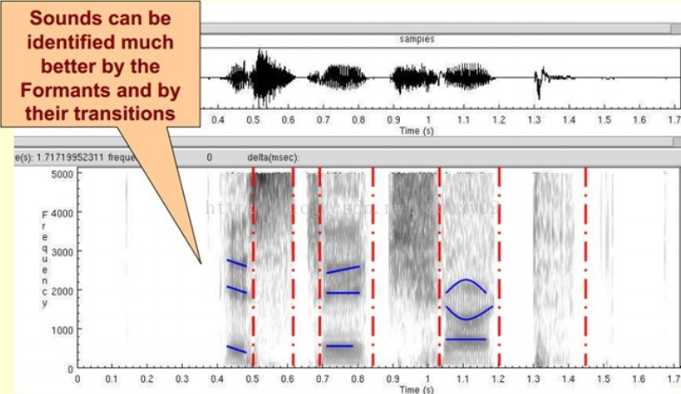
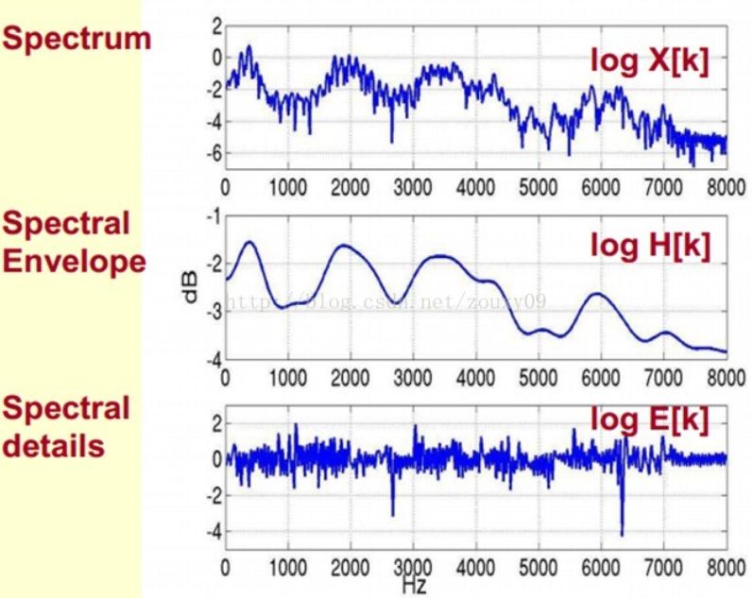

峰值
1）将原语音信号先进行预加重、分帧和加窗
2）经过傅里叶变换得到频谱：X[k]=H[k]E[k]；
只考虑幅度：|X[k] |=|H[k]||E[k] |；
3）通过Mel滤波器组得到Mel频谱
4）两边取对数：log||X[k] ||= log ||H[k] ||+ log ||E[k] ||。
5）两边取逆傅里叶变换：x[k]=h[k]+e[k]。
通过DCT离散余弦变换来实现，取DCT后的第2个到第13个系数作为MFCC系数

Slide 7
GloVe: 用于Word表示的全局向量
MFCC: 梅尔频率光谱系数（梅尔刻度的滤波器组在低频部分的分辨率高，跟人耳的听觉特性是相符的）
梅尔频率（对时域信号进行傅里叶变换转换到频域，再利用梅尔频率刻度的滤波器组对应频域信号进行切分，最后每个频率段对应一个数值）
倒谱分析（DCT去相关、压缩）
MFSC具有相关性，表现在频谱上面的较为平滑
MFSC具有更高的维度

Slide 8
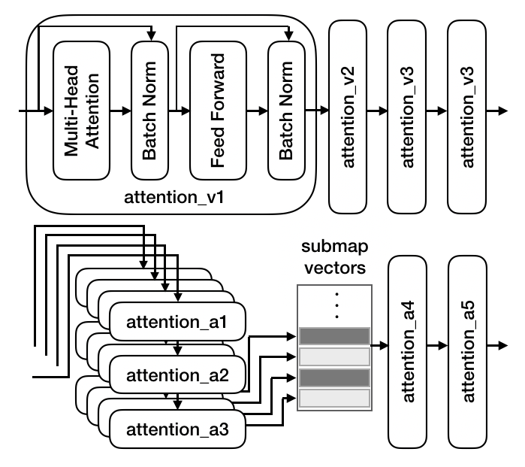
Modality-specific Feature Extraction
Two independent networks to process the verbal transcript and audio stream, respectively:
Verbal Branch
Verbal transcripts: a four-layer multi-head attention sub network.
Audio streams: a multi-level multi-head attention structure to first learn the attention distribution over adjacent audio frames, and then form the final feature vector over the entire MFSC map.
The output of each branch is the modality-specific feature representation.
Audio Branch

Slide 9
Modality Fusion
Concatenate the generated verbal and audio stream feature representations vertically to form the shared representation.
Set two attention layers over the shared representations to further fuse the features.
Take the sum over the shared representations to form the final feature vector.
A softmax classifier is used for the final classification.

Slide 10
Data Collection
Collected 75 actual trauma resuscitation cases using two fixed NTG2 Phantom Powered Condenser Shotgun microphones.
Recorded the audio stream with 16000Hz sampling rate.
The verbal transcripts were manually transcribed and segmented by the trauma experts.
All the data were collected with consent, and have been stripped of private information manually by trauma experts.
the trauma staff checked the data and manually muted the audio streams or removed the words that contain private in-formation

Slide 11
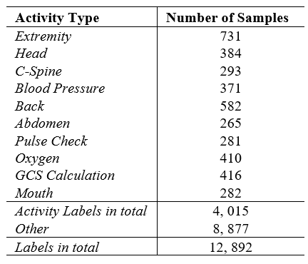
Data Annotation
Ten trauma activity labels were assigned by trauma experts for the utterance-level data and all the utterances that do not belong to the ten activities were assigned to “Other” (O) category.
12,892 utterances in total.
11 classes in total.
Ten activities: 4,015 utterances.
“Other”: 8,877 utterances.

Slide 12
Experiment
80%-20% training-testing split with 5-cross validation. Use 15% samples from training set as the validation set to tune the model.
First pre-train the audio branch for 50 epochs to facilitate model convergence. Then, we trained the entire model for 150 epochs.
Uniformly sample across classes instead of directly feeding all the training data.
Implemented the model using Keras with Tensorflow backend.
Use the dropout layer to overcome the overfitting.
Use Adam optimization with 0.001 initial learning rate and momentum parameters 0.99 and 0.999 for the first 50 epochs. Then, change to the SGD optimizer for further tuning.

Slide 13
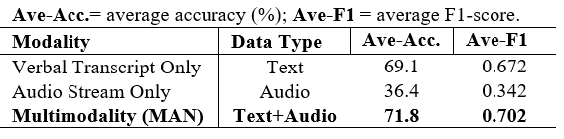
Experiment Result: Quantitative Analysis
Compare the performance of the modality-specific models and the multimodal structure.
Using verbal transcripts outperforms audio by 32.7% accuracy.
The environmental sound branch only achieved 36.4% average accuracy with 0.342 average F1-score.
The multimodal structure performs better than the transcript-only model by 2.7% accuracy.
The difference in performance demonstrates the necessity of multimodal architecture.

Slide 14
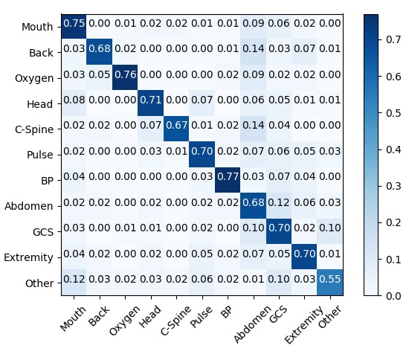
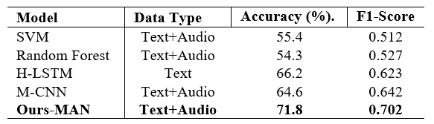
Experiment Result: Baseline Comparison
Confusion matrices of the multimodal attention network with the best performance training-testing split.
“Blood Pressure” achieves best performance.
Overall accuracy is higher than 67.0%.
Compare with baselines.
The MAN outperforms baseline models.

Slide 15
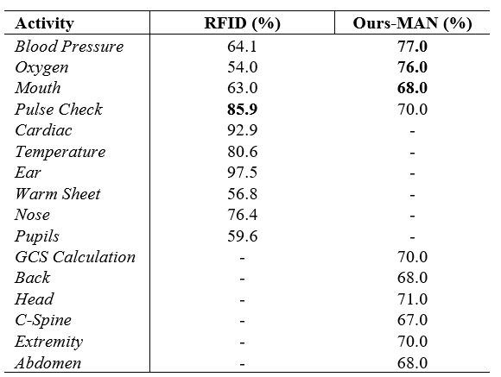
Experiment Result: Compare with RFID
Compared model performance on individual activities from [7] with the proposed MAN model.
MAN achieves better performance in three shared activities, including “Oxygen”, “Blood Pressure”, and “Mouth”.
Six activities are complementary.
The spoken language and environmental sound can be applied as a complementary resource to improve trauma activity recognition.

Slide 16
Limitation and Future Work
The MAN model uses manually transcribed text as input.
Despite the automatic speech recognition (ASR) technology allows speech-to-text without human transcripts, the quality of the audio stream extremely influence the performance of the ASR result.
The audio-only branch shows limited performance.
How to effectively extract the representative acoustic features from trauma resuscitation is still an open-end topic.
To design an applicable and scale trauma activity recognition system, it requires the combination of the RFID and the proposed MAN model.

Slide 17
Conclusion
A multimodal architecture that considers spoken language and environmental sound to detect and recognize trauma resuscitation activities.
An end-to-end multimodal attention network that preprocesses the raw data, extracts utterance-level acoustic and textual representations, fuses the feature vectors into a shared representation, and makes the final prediction.
The experiment result demonstrate the effectiveness of the network and the necessity for the multimodal structure.

Slide 18


Acknowledgement
This research was supported by the National Library Of Medicine of the National Institutes of Health under Award Number R01LM011834.

Slide 19
Thank you !
Email: yg202@scarletmail.rutgers.edu
Homepage: www.ieyuegu.com

