Slide 1
Cv1-proj1-2

Slide 2
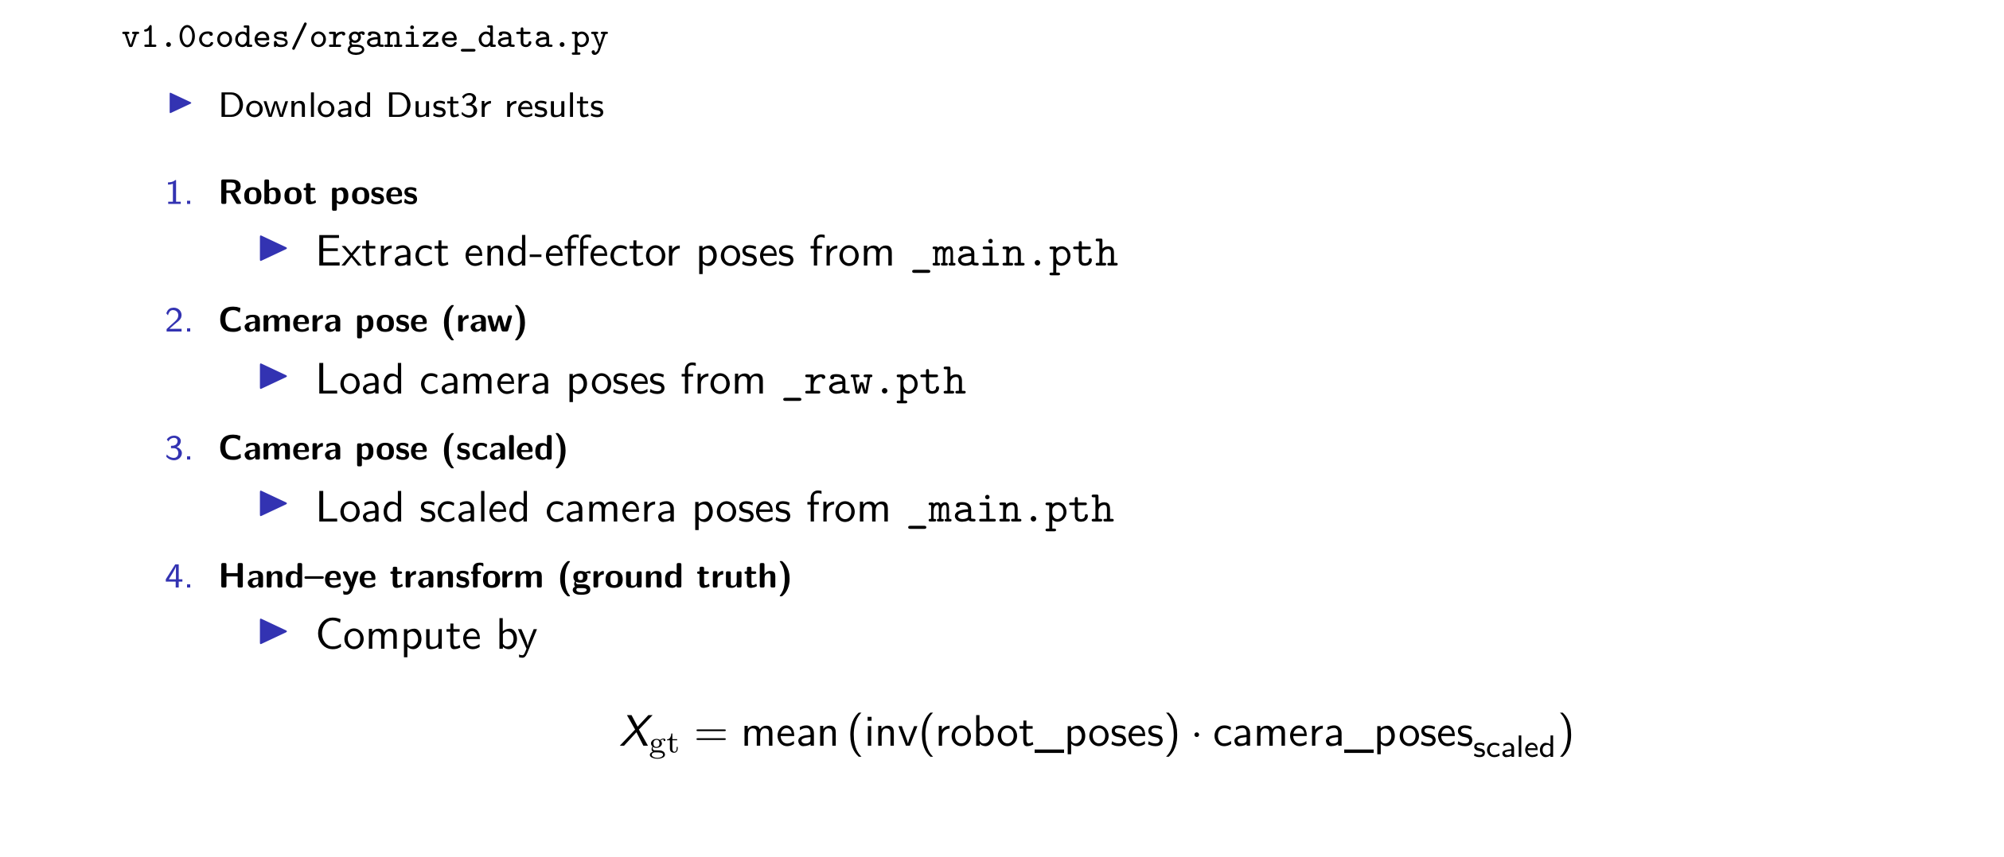
Organize data from the open source

Slide 3
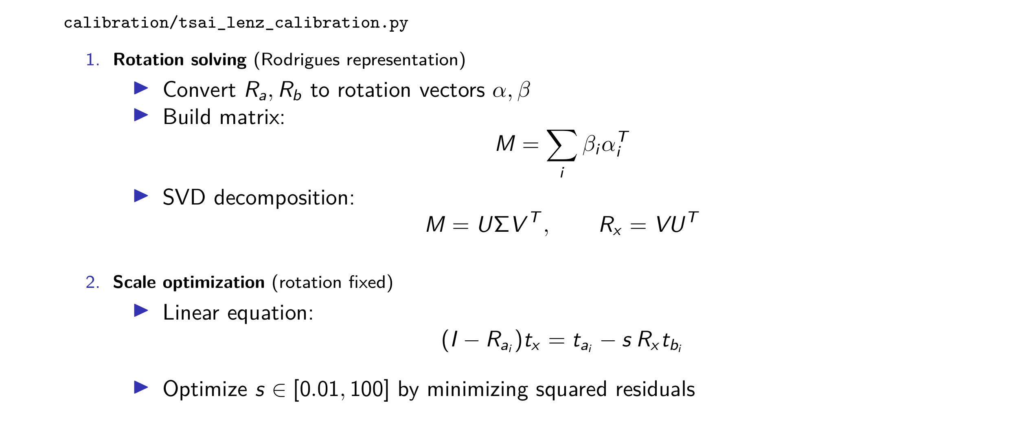
tsai_lenz_calibration

Slide 4
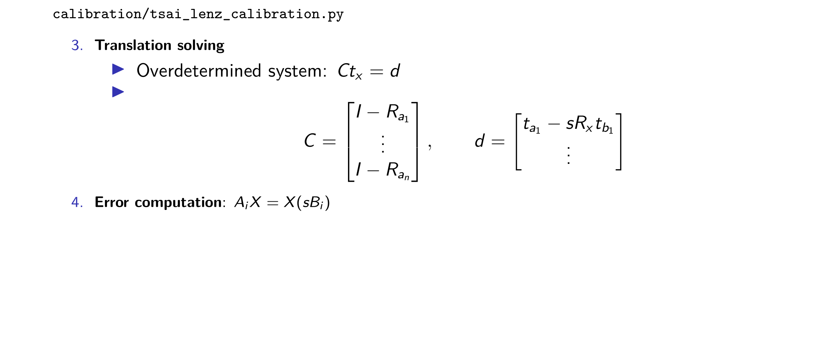
tsai_lenz_calibration

Slide 5
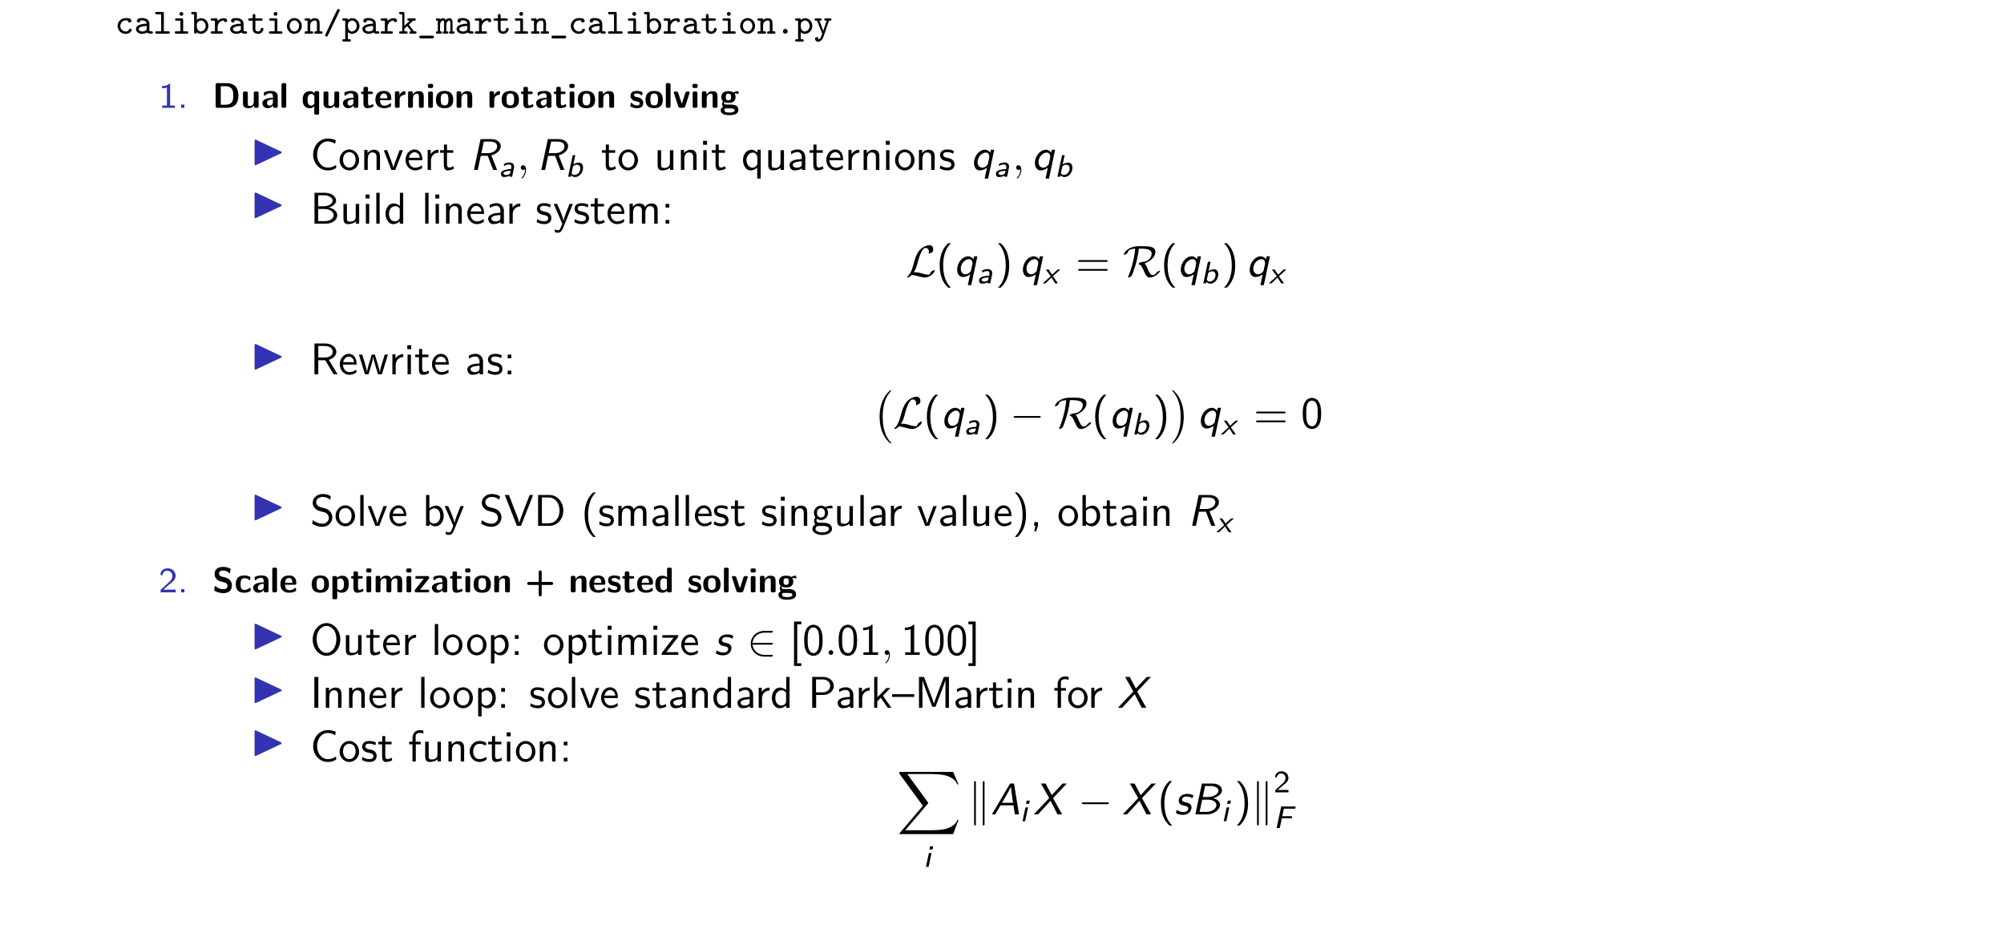
park_martin_calibration

Slide 6
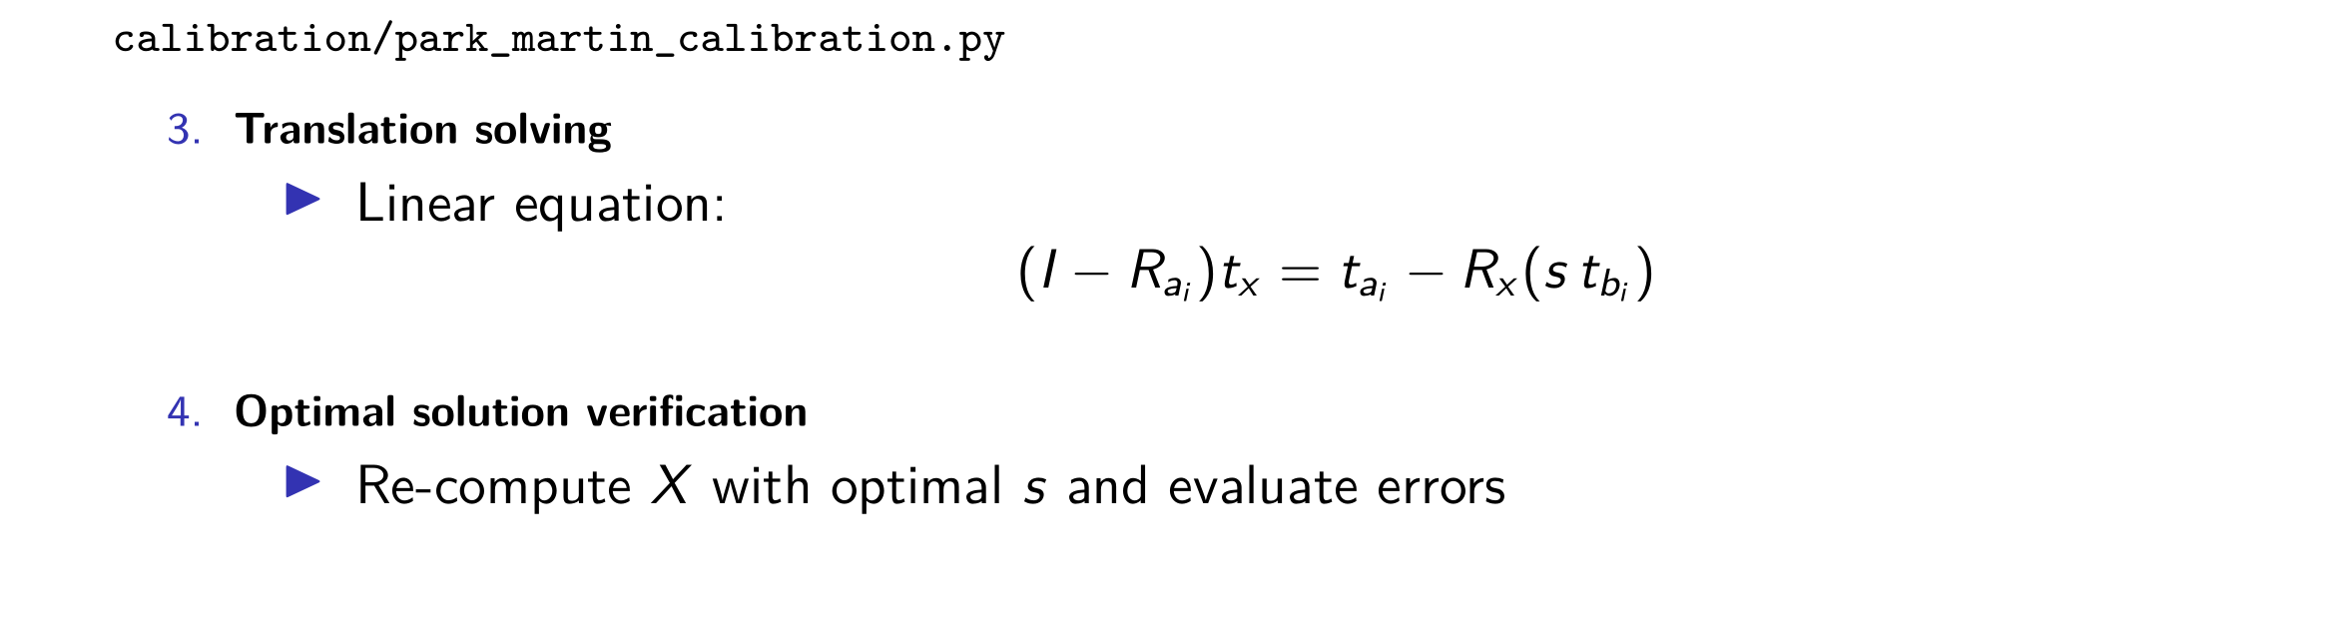
park_martin_calibration

Slide 7


Evaluation
eval\evaluate_calibration.py
compare with groud truth (Hand_eye_transform) from dataset
Metrics:
- Rotation Error: the angular difference (geodesic distance)
- Translation Error: the Euclidean distance

Slide 8
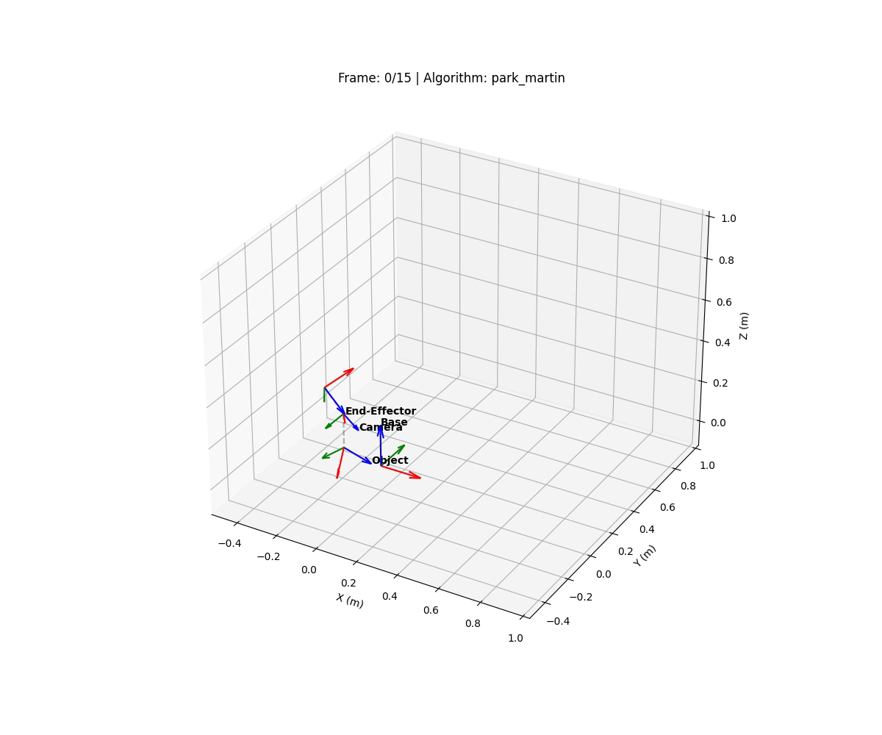
visualization
eval\visualize_coord_systems.py

Slide 9
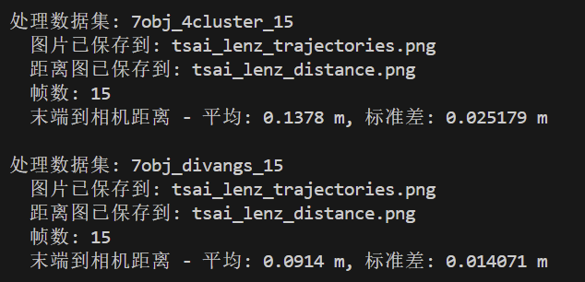
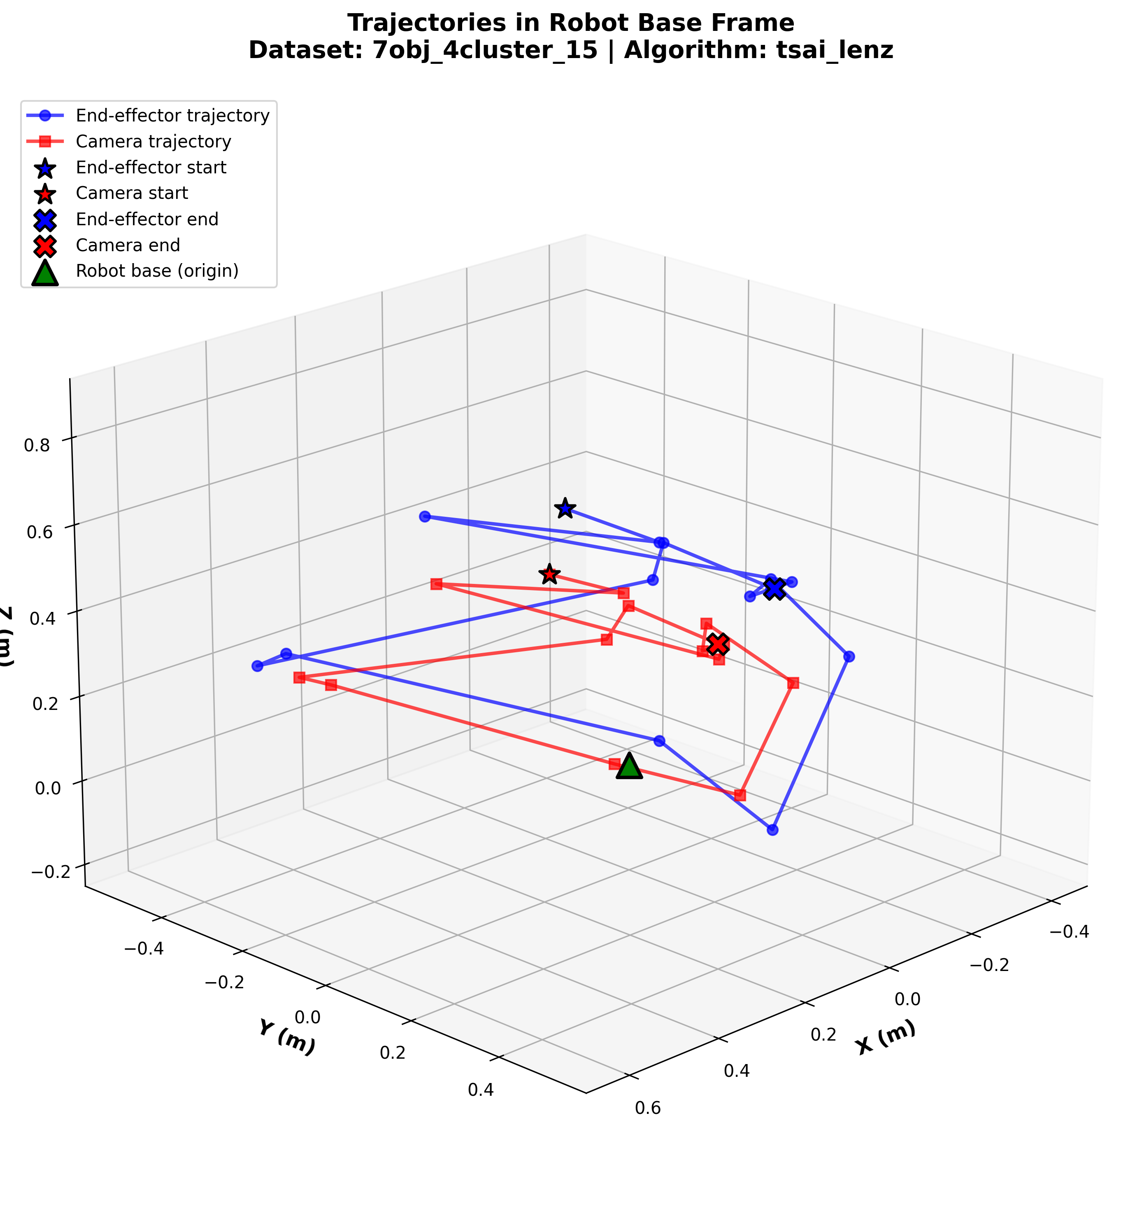
visualization
eval\visualize_trajectories.py
use the first frame to calculate
T_base_calib = T_base_end[0] @ X @ inv(camera_pose_scaled[0])
Then transform the camera to T_base by:
T_base_camera[i] = T_base_calib @ camera_pose_scaled[i]s

Slide 10
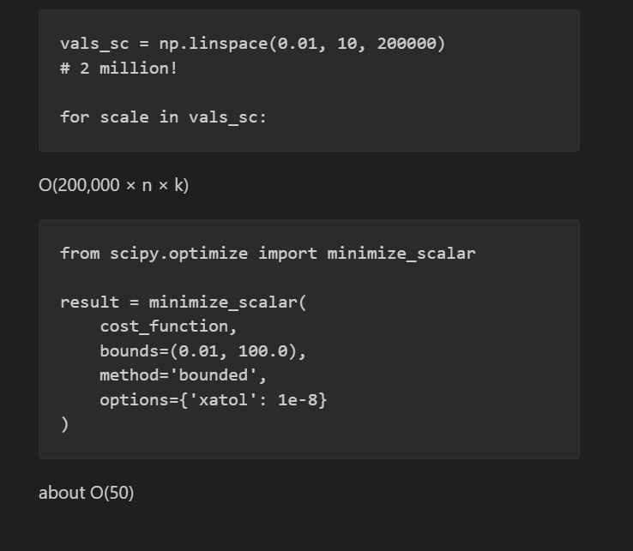
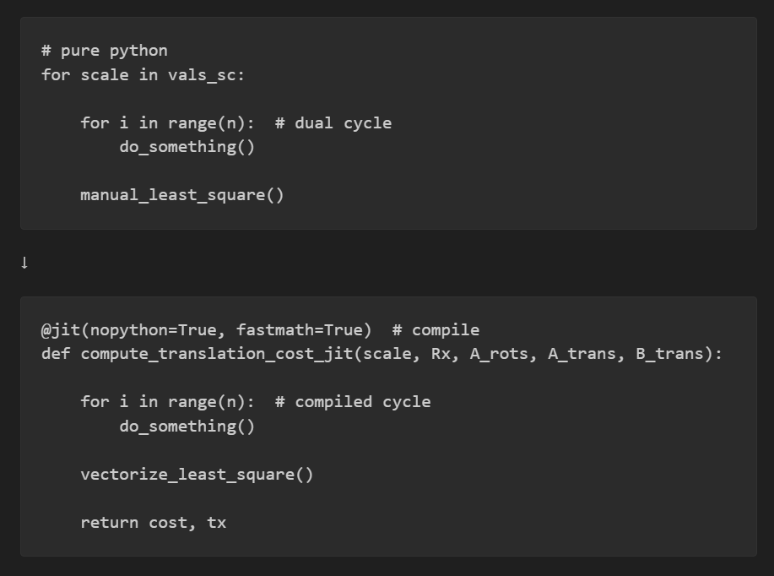
Speeding up
The original py needs 20mins to finish all 6 dataset, now 11 second

