Slide 1
Cv1-proj1-2

Slide 2
Organize data from the open source
v1.0codes\organize_data.py
Download dust3r result
Robot_poses: from _main .pth get eef_pose
Camera_pose_raw: from _raw .pth get poses
Camera_pose_scaled: from _main .pth get poses
Hand_eye_transform: from _main .pth calculate mean(inv(robot_poses) @ camera_poses_scaled)

Slide 3
tsai_lenz_calibration
calibration\tsai_lenz_calibration.py
1. **Rotation solving**: Using Rodrigues rotation vector representation
- Convert $R_a, R_b$ to rotation vectors $\alpha, \beta$
- Build matrix $M = \sum \beta \alpha^T$
- SVD decomposition: $M = U\Sigma V^T$, obtain $R_x = VU^T$
2. **Scale optimization**: Optimize scale with rotation fixed
- Linear equation: $(I - R_{a_i})t_x = t_{a_i} - s \cdot R_x \cdot t_{b_i}$
- Use `scipy.optimize.minimize_scalar` to search optimal $s$ in [0.01, 100]
- Cost function: minimize sum of squared residuals
3. **Translation solving**: Least squares at optimal scale
- Build overdetermined system $C \cdot t_x = d$
- $C = [(I-R_{a_1}); ...; (I-R_{a_n})]$, $d = [t_{a_1} - s R_x t_{b_1}; ...]$
4. **Error computation**: Verify $A_i X = X (s \cdot B_i)$

Slide 4
park_martin_calibration
calibration\park_martin_calibration.py
1. **Dual quaternion rotation solving**:
- Convert rotation matrices $R_a, R_b$ to unit quaternions $q_a, q_b$
- Build linear system: $\mathcal{L}(q_a) q_x = \mathcal{R}(q_b) q_x$
- Rewrite as $(\mathcal{L}(q_a) - \mathcal{R}(q_b)) q_x = 0$
- Stack all motions, solve via SVD for $q_x$ (smallest singular value)
- Convert back to rotation matrix $R_x$
2. **Scale optimization + nested solving**:
- Outer loop: Optimize scale $s \in [0.01, 100]$
- Inner loop: For given $s$, invoke standard Park-Martin to solve complete $X$
- Cost function: $\sum_i \|A_i X - X (s \cdot B_i)\|_F^2$ (Numba JIT accelerated)
3. **Translation solving** (inside standard Park-Martin):
- Linear equation: $(I - R_{a_i})t_x = t_{a_i} - R_x (s \cdot t_{b_i})$
- Least squares solution
4. **Optimal solution verification**: Re-compute $X$ with optimal $s$ and evaluate errors

Slide 5


Evaluation
eval\evaluate_calibration.py
compare with groud truth (Hand_eye_transform) from dataset
Metrics:
- Rotation Error: the angular difference (geodesic distance)
- Translation Error: the Euclidean distance

Slide 6
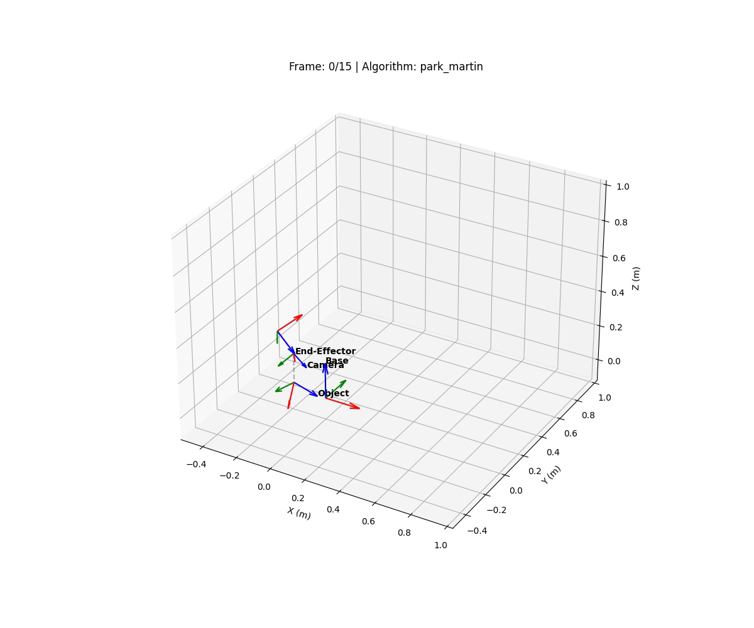
visualization
eval\visualize_coord_systems.py

Slide 7
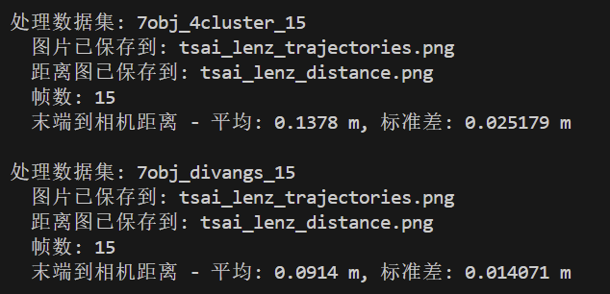
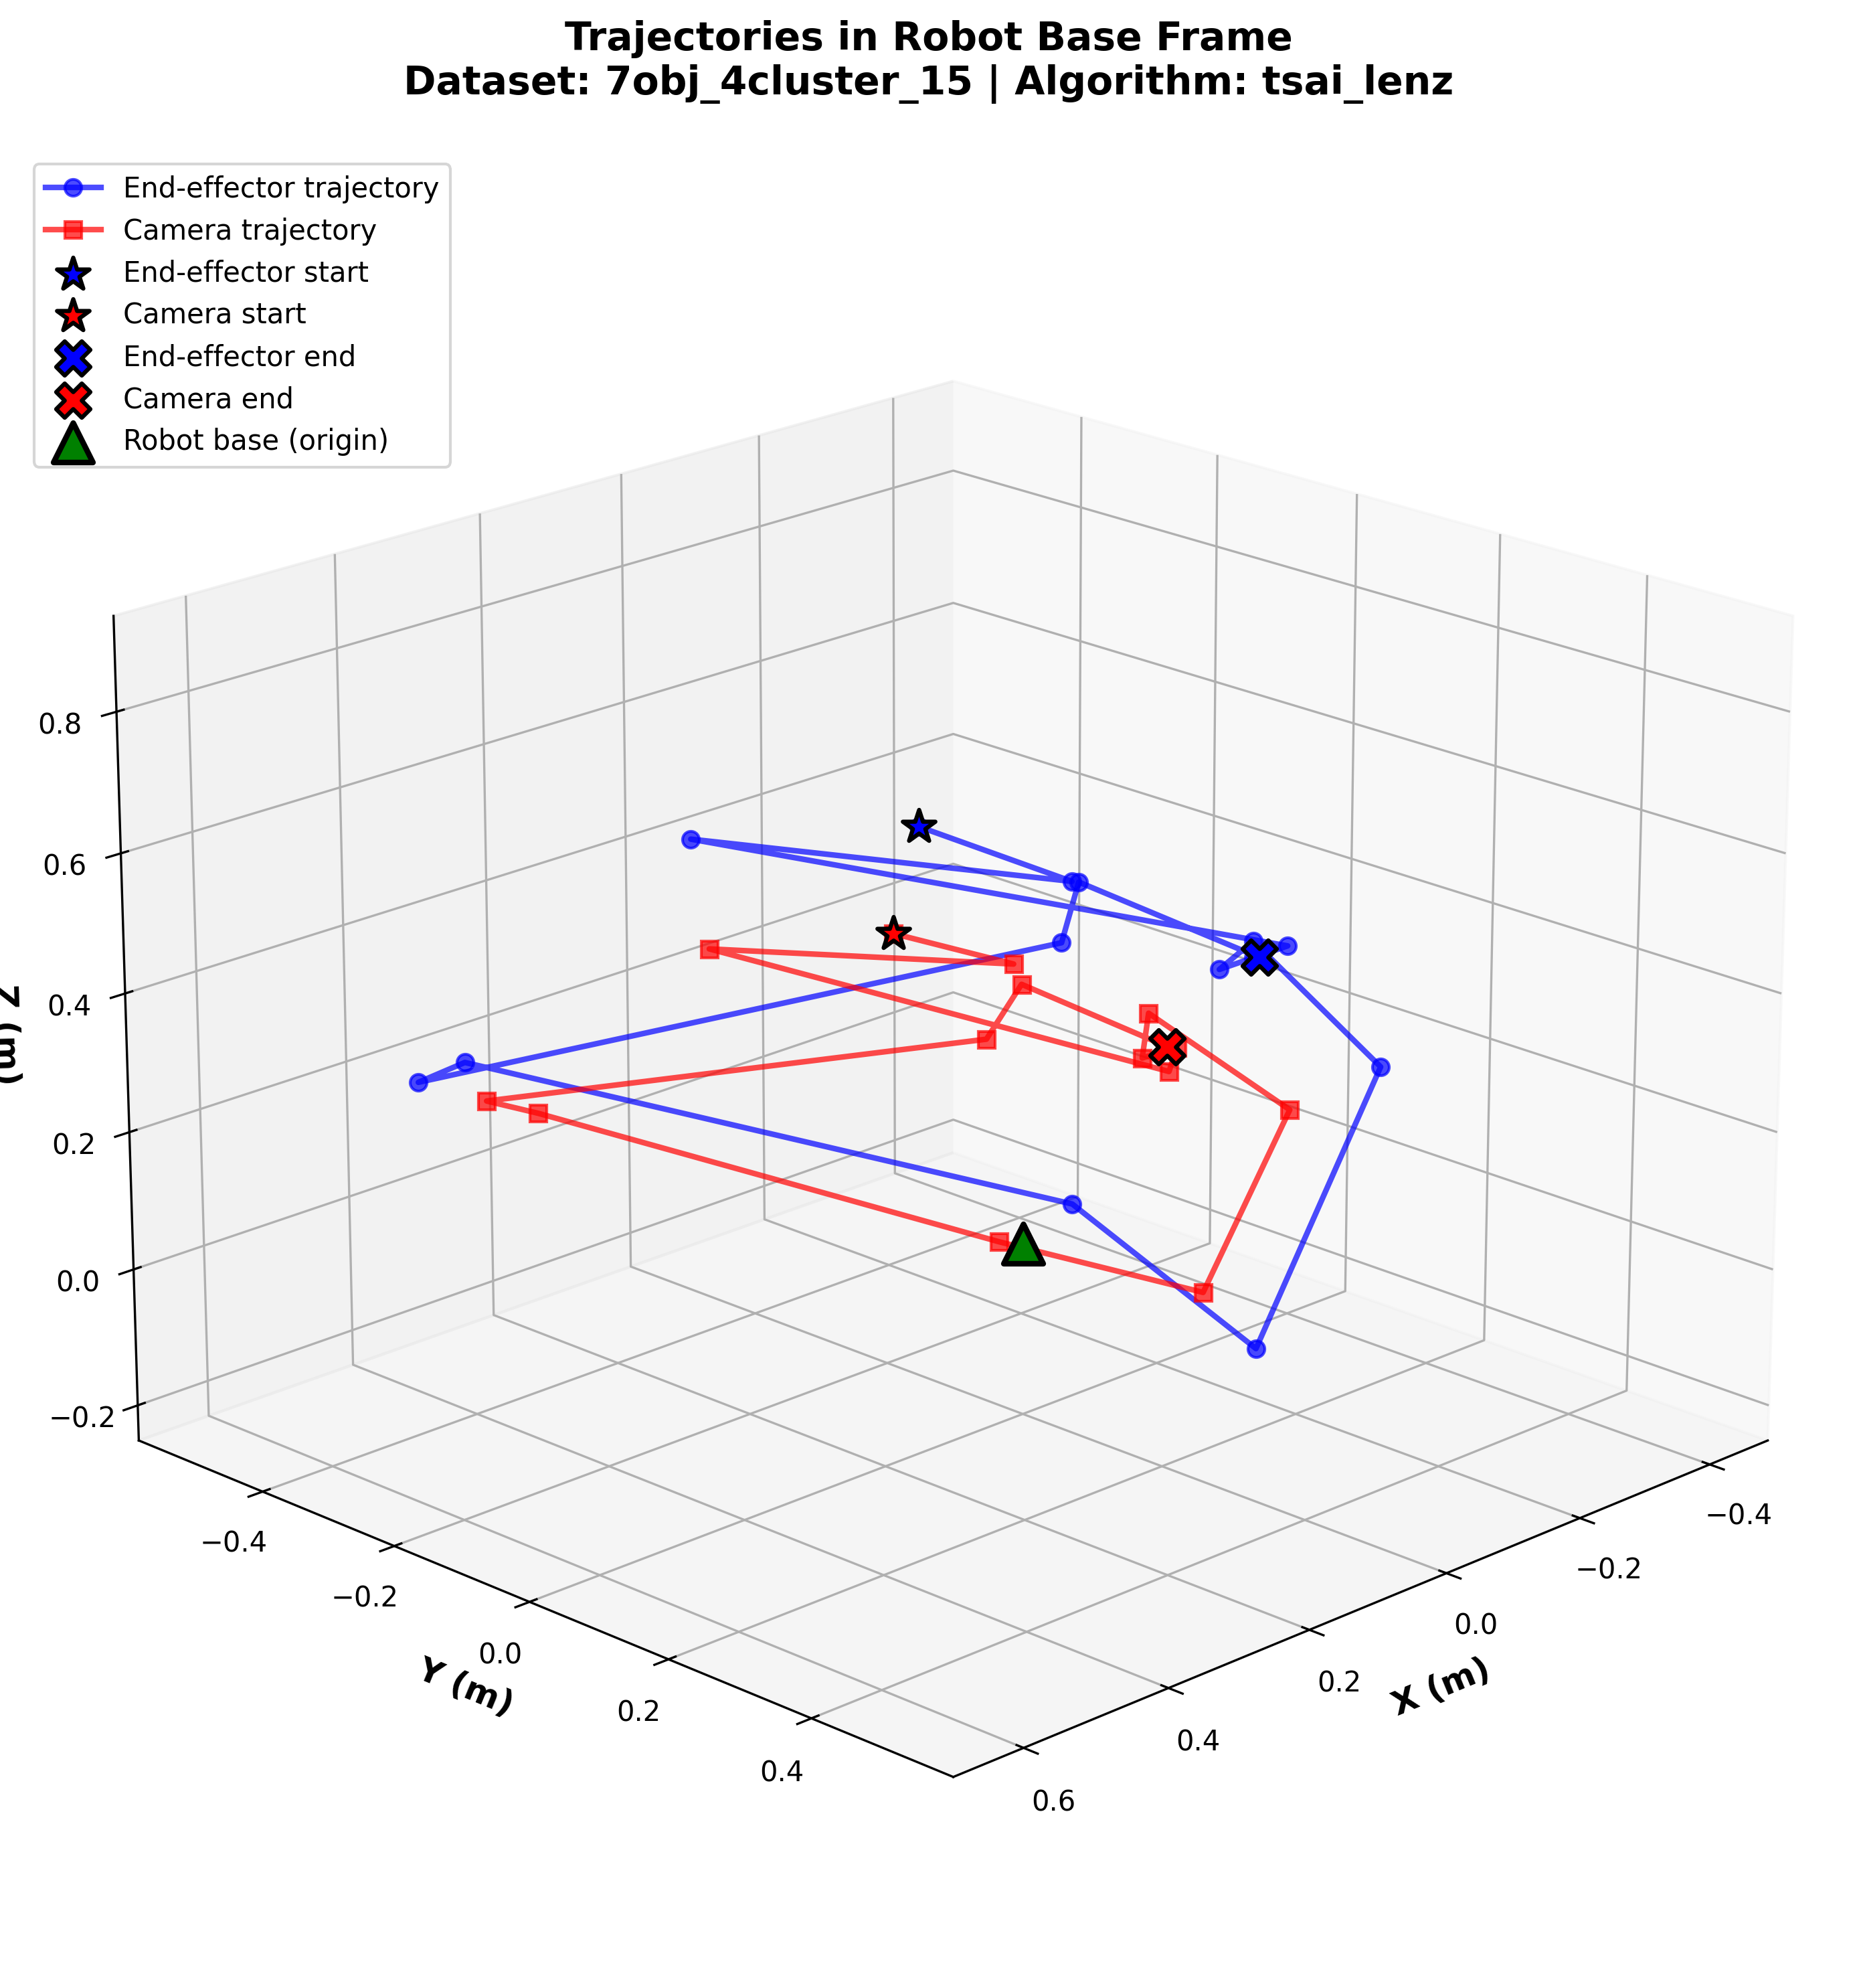
visualization
eval\visualize_trajectories.py
use the first frame to calculate
T_base_calib = T_base_end[0] @ X @ inv(camera_pose_scaled[0])
Then transform the camera to T_base by:
T_base_camera[i] = T_base_calib @ camera_pose_scaled[i]s

Slide 8
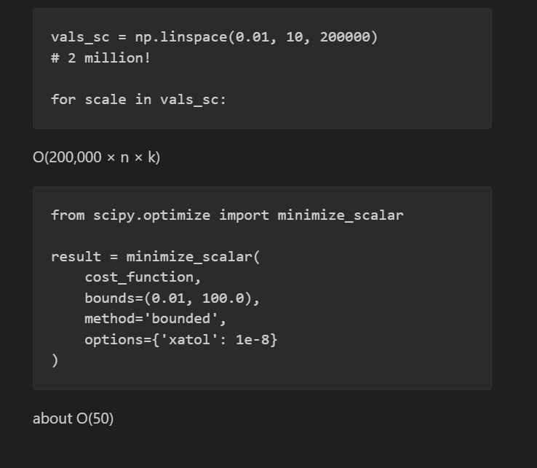
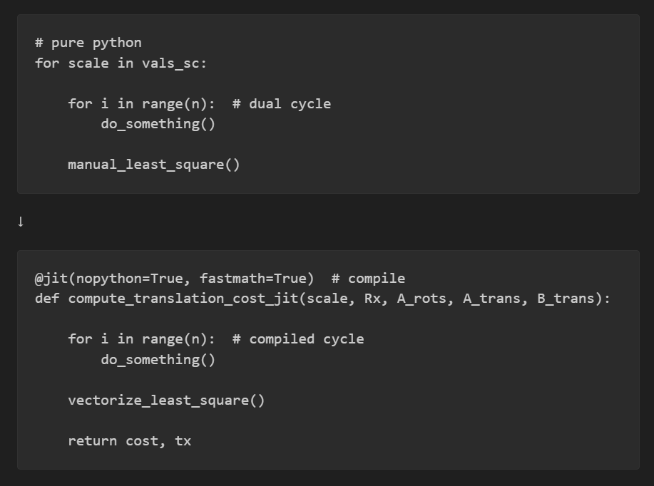
Speeding up
The original py needs 20mins to finish all 6 dataset, now 11 second

