Slide 2
Cresnet Connected Program Presenter: Ara Seferian

Slide 3
What is it?
Introduction

Slide 4
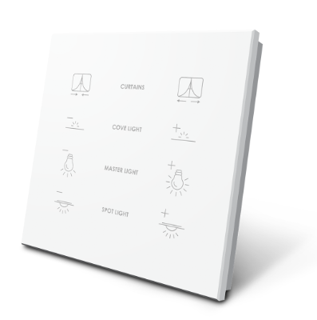
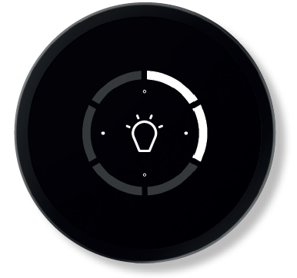
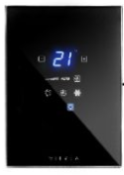
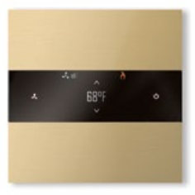
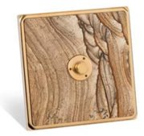
Introduction
The program allows luxury third-party keypad manufacturers to create keypads that seamlessly integrate with Crestron control systems.
Crestron provides a Cresnet chip that manufacturers use in their devices.
Key benefits:
Keypads are native Cresnet devices
Supports Toolbox auto-discovery
Supports standard keypad features
Supports custom features
Keypads are certified by Crestron

Slide 5





Information
Crestron provides a micro-site dedicated to each of our luxury keypad partners.
https://crestron.com/Partners/Integrated-Partners -> Residential -> Luxury Keypads
Click “Learn More” for each manufacturer’s micro-site.

Slide 7
Thank you!

