Slide 1
Use Case Presentation
Team Blue Steel

Slide 2
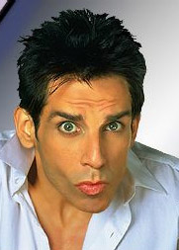
Team introduction

Slide 3

Chip keyes
I’m currently a research technician at Fred Hutchinson Cancer Research doing primarily molecular biology and animal surgery. I was initially premed through college, which is why my background is in life sciences. I was exposed more and more frequently to computer programming via data analysis, which ignited an interest to know more about such an interesting and versatile field. I have 6 courses left in my MS in Computer Science degree and am focusing on a mix between software engineering and data science courses. Personal - My wife and I are expecting our first baby in august, which we’re pumped/nervous about. I also enjoy homebrewing in what little spare time I have left.

Slide 4
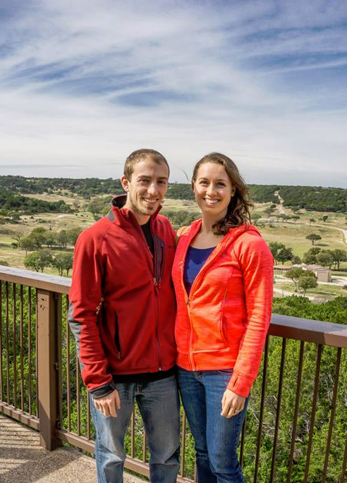
Dan LAGRECA
I’m an embedded systems developer, originally from Michigan. I’m more than half way done with my CS degree from JHU. I’m on the tail end of being a millennial (depending on your definition) - though I do remember life before the internet!

Slide 5

Dave Cain
I have over 15 years of experience in software quality assurance much of which was in testing computer games. Currently I work at G2 Web Services where I validate software used by the financial services industry. I anticipate earning my Masters in Information Systems Engineering after this semester.

Slide 6
Assumptions and constraints
Kiosks will have power
A method for transporting audiobooks between branches will be available
Kiosk hardware will be in good repair and function as expected
Credit Card data will not be hosted internally

Slide 7
Key stakeholders
Customers
Library branch staff
Library admins

Slide 8
Use case overview
Title | Goal | Primary Actor
Customer Starts a New Kiosk Session | Initiate kiosk transaction | Customer
Customer Browses Audiobook Collection | Browse available audiobooks | Customer
Customer Checks Out | Check out an audiobook | Customer
Customer Picks up Reserved Audiobook | Pick up reserved audiobook | Customer
Customer Returns Audiobook | Return audiobook to kiosk | Customer
Customer Reserves Audiobook | Reserver audiobook using internet | Customer
Library Staff Restocks Kiosk | To restock kiosk with returned audiobooks | Staff
Library Staff Registers new Customer | To register new customer in the system | Staff
Admin runs report | To see system wide activity | Admin
Admin modifies inventory | To change inventory levels | Admin

Slide 9
Actor definitions
Customer – Persons borrowing audiobooks
Library staff – Local branch staff responsible for stocking audiobooks and registering new users
Library admins – Organizational staff responsible for system wide maintenance

Slide 10
The end

