Slide 1
“The Modern Shellhouse” hackathon project BoatTracker - Fleet management system for rowing & paddling clubs
Goals
Replace paper-based systems for reserving & checking out equipment
Provide rich information about equipment usage
Maximize utilization & participation with online reservation management
Enhance security & safety with better tracking of equipment & users
How we achieved this
Leverage an existing open-source booking system (BookedScheduler)
Build a conversational interface for fast, easy use
Kiosk-style status view for use in the boathouse
Daily report of usage & policy violations sent to boathouse manager
RFID system for improved tracking & security (coming soon)

Slide 2
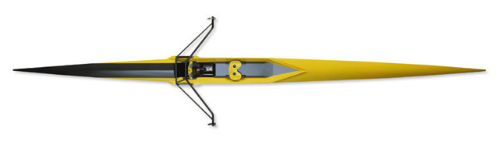

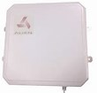


BoatTracker Architecture
Booked
Scheduler
(PHP)
Browser
Reactive UI
REST API
Skype
MS Bot
Framework
BoatTracker
ingress/egress
events
SMS
RFID tracking for security and analytics
FB
LUIS
Browser
Current status page
replaces boathouse
logbook
Triggers
User-customizable
notifications & actions
IFTTT

Slide 3
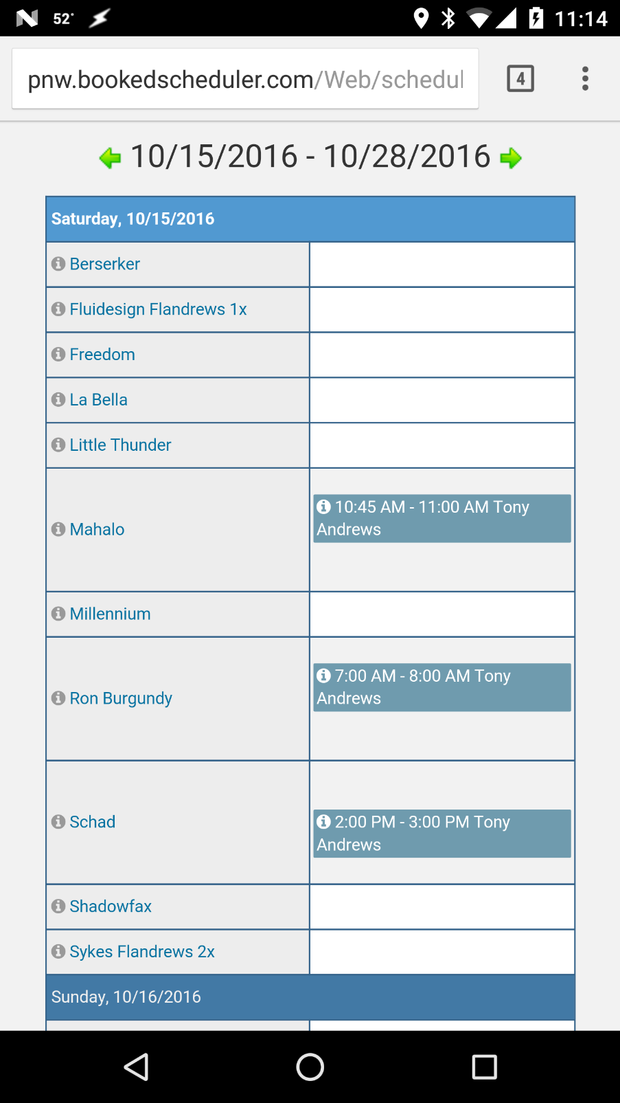
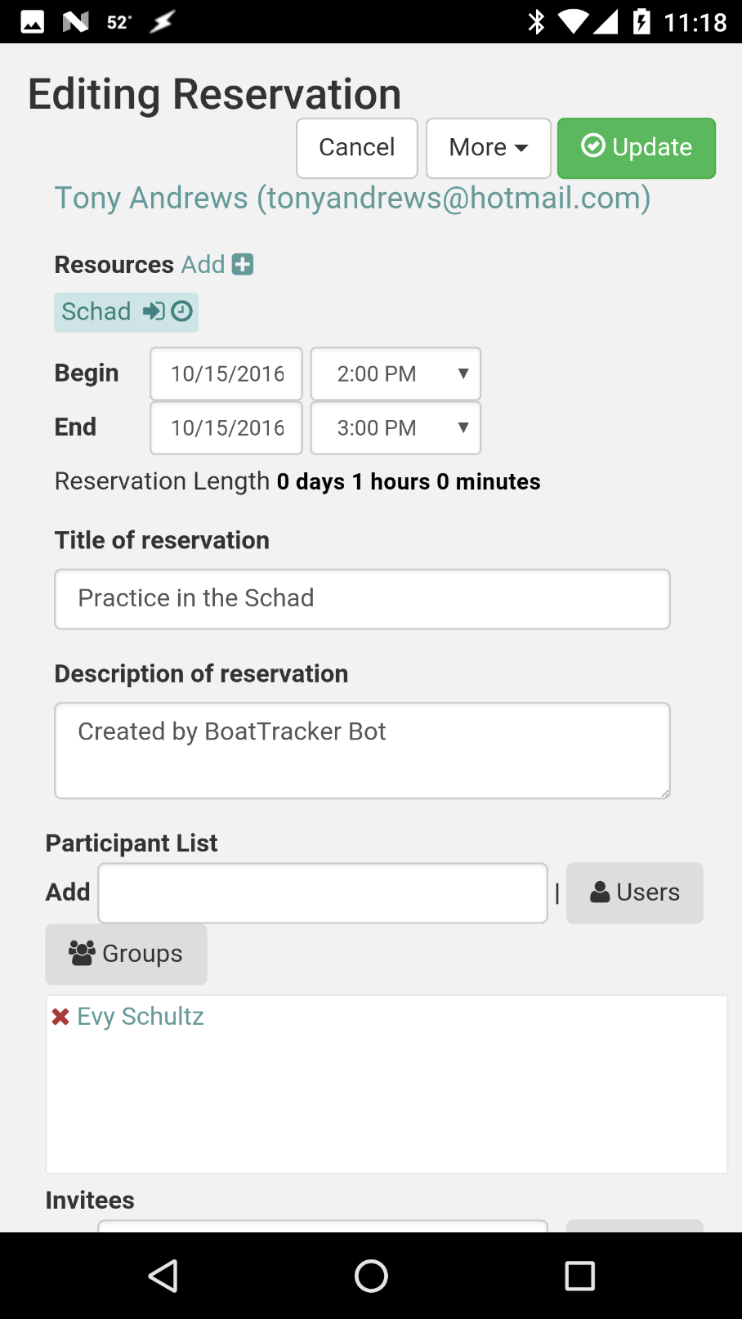
BookedScheduler Mobile UI
Reactive UI for desktop or mobile use
Customized for rowing/paddling scenarios
Provides the most complete access to the reservation system
Access to individual boats can be restricted by skill level, weight class, membership level, etc.

Slide 4
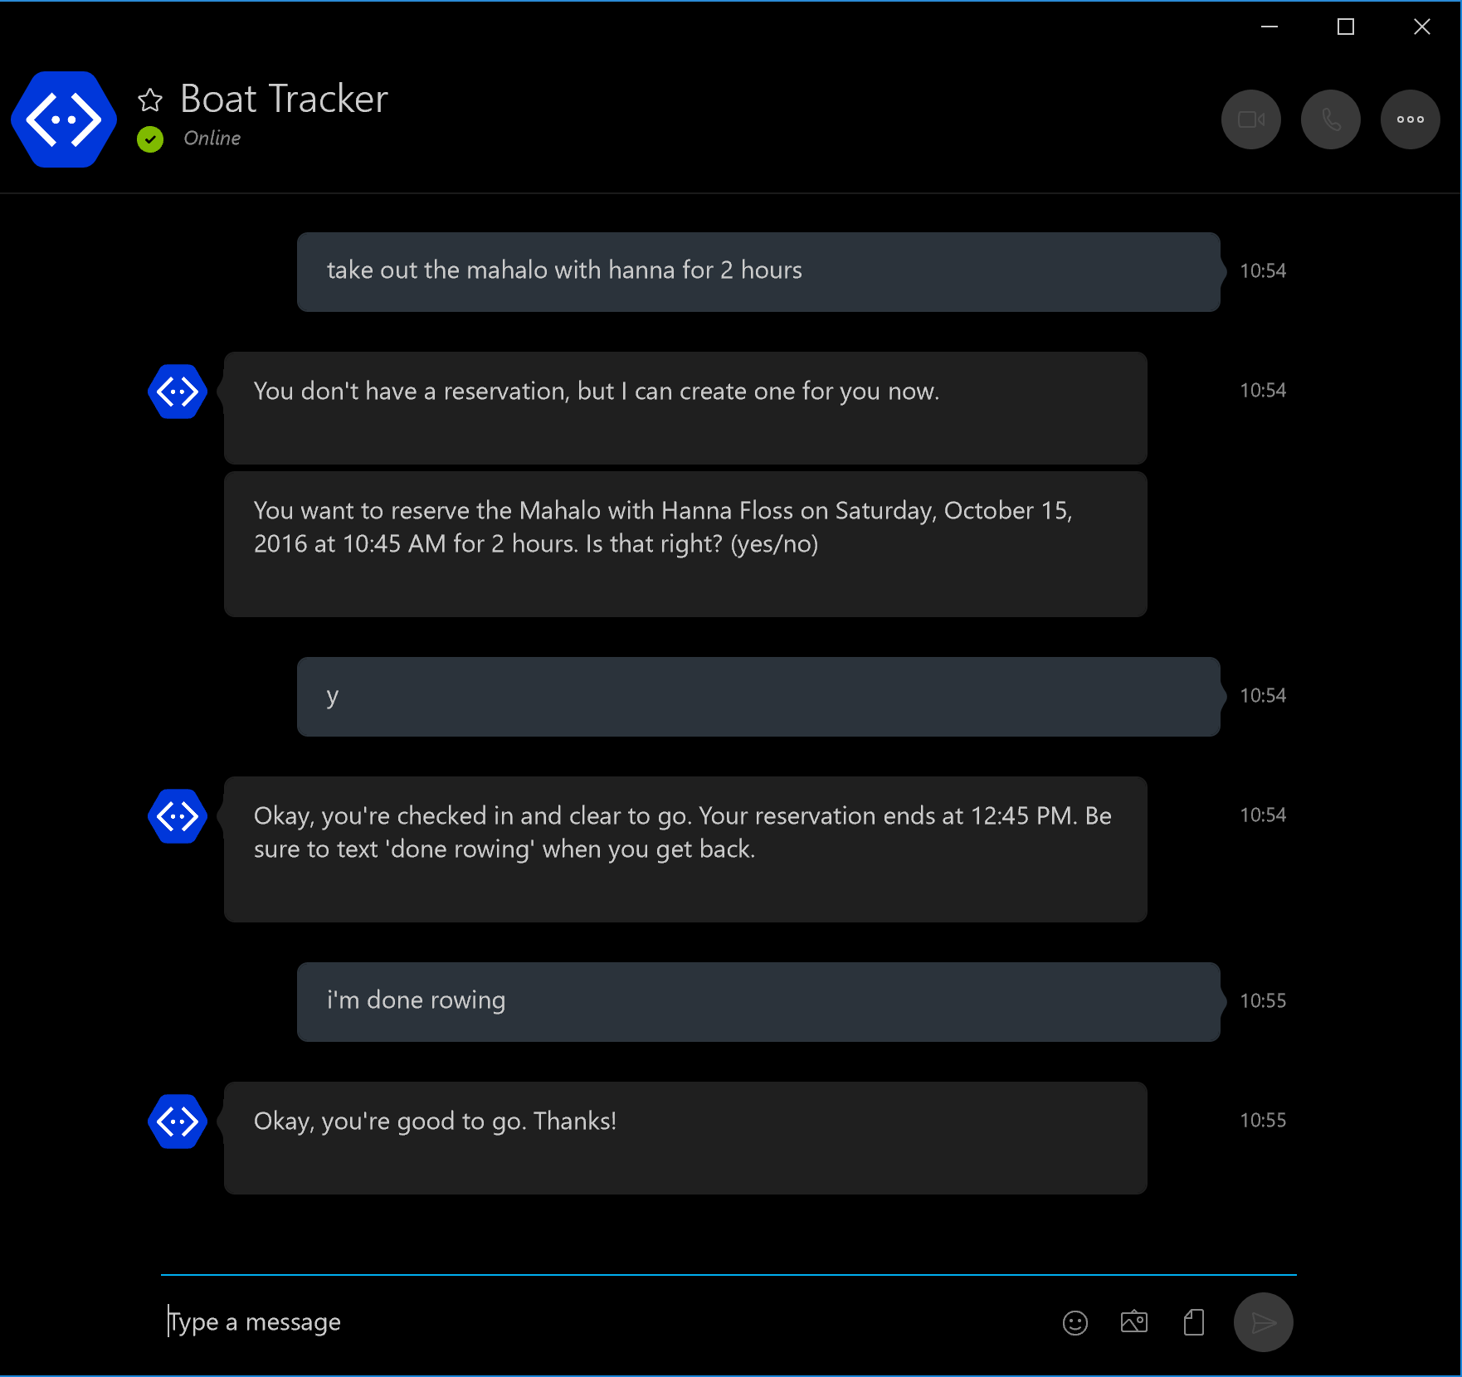
Conversational UI
Fast, easy access to most features
Use with Skype or SMS
Supported commands:
Reserve a boat
Take out a boat with or without a prior reservation
Return a boat when done
Check the availability of a boat on given day
Cancel a reservation
View reservations by boat and/or day

Slide 5
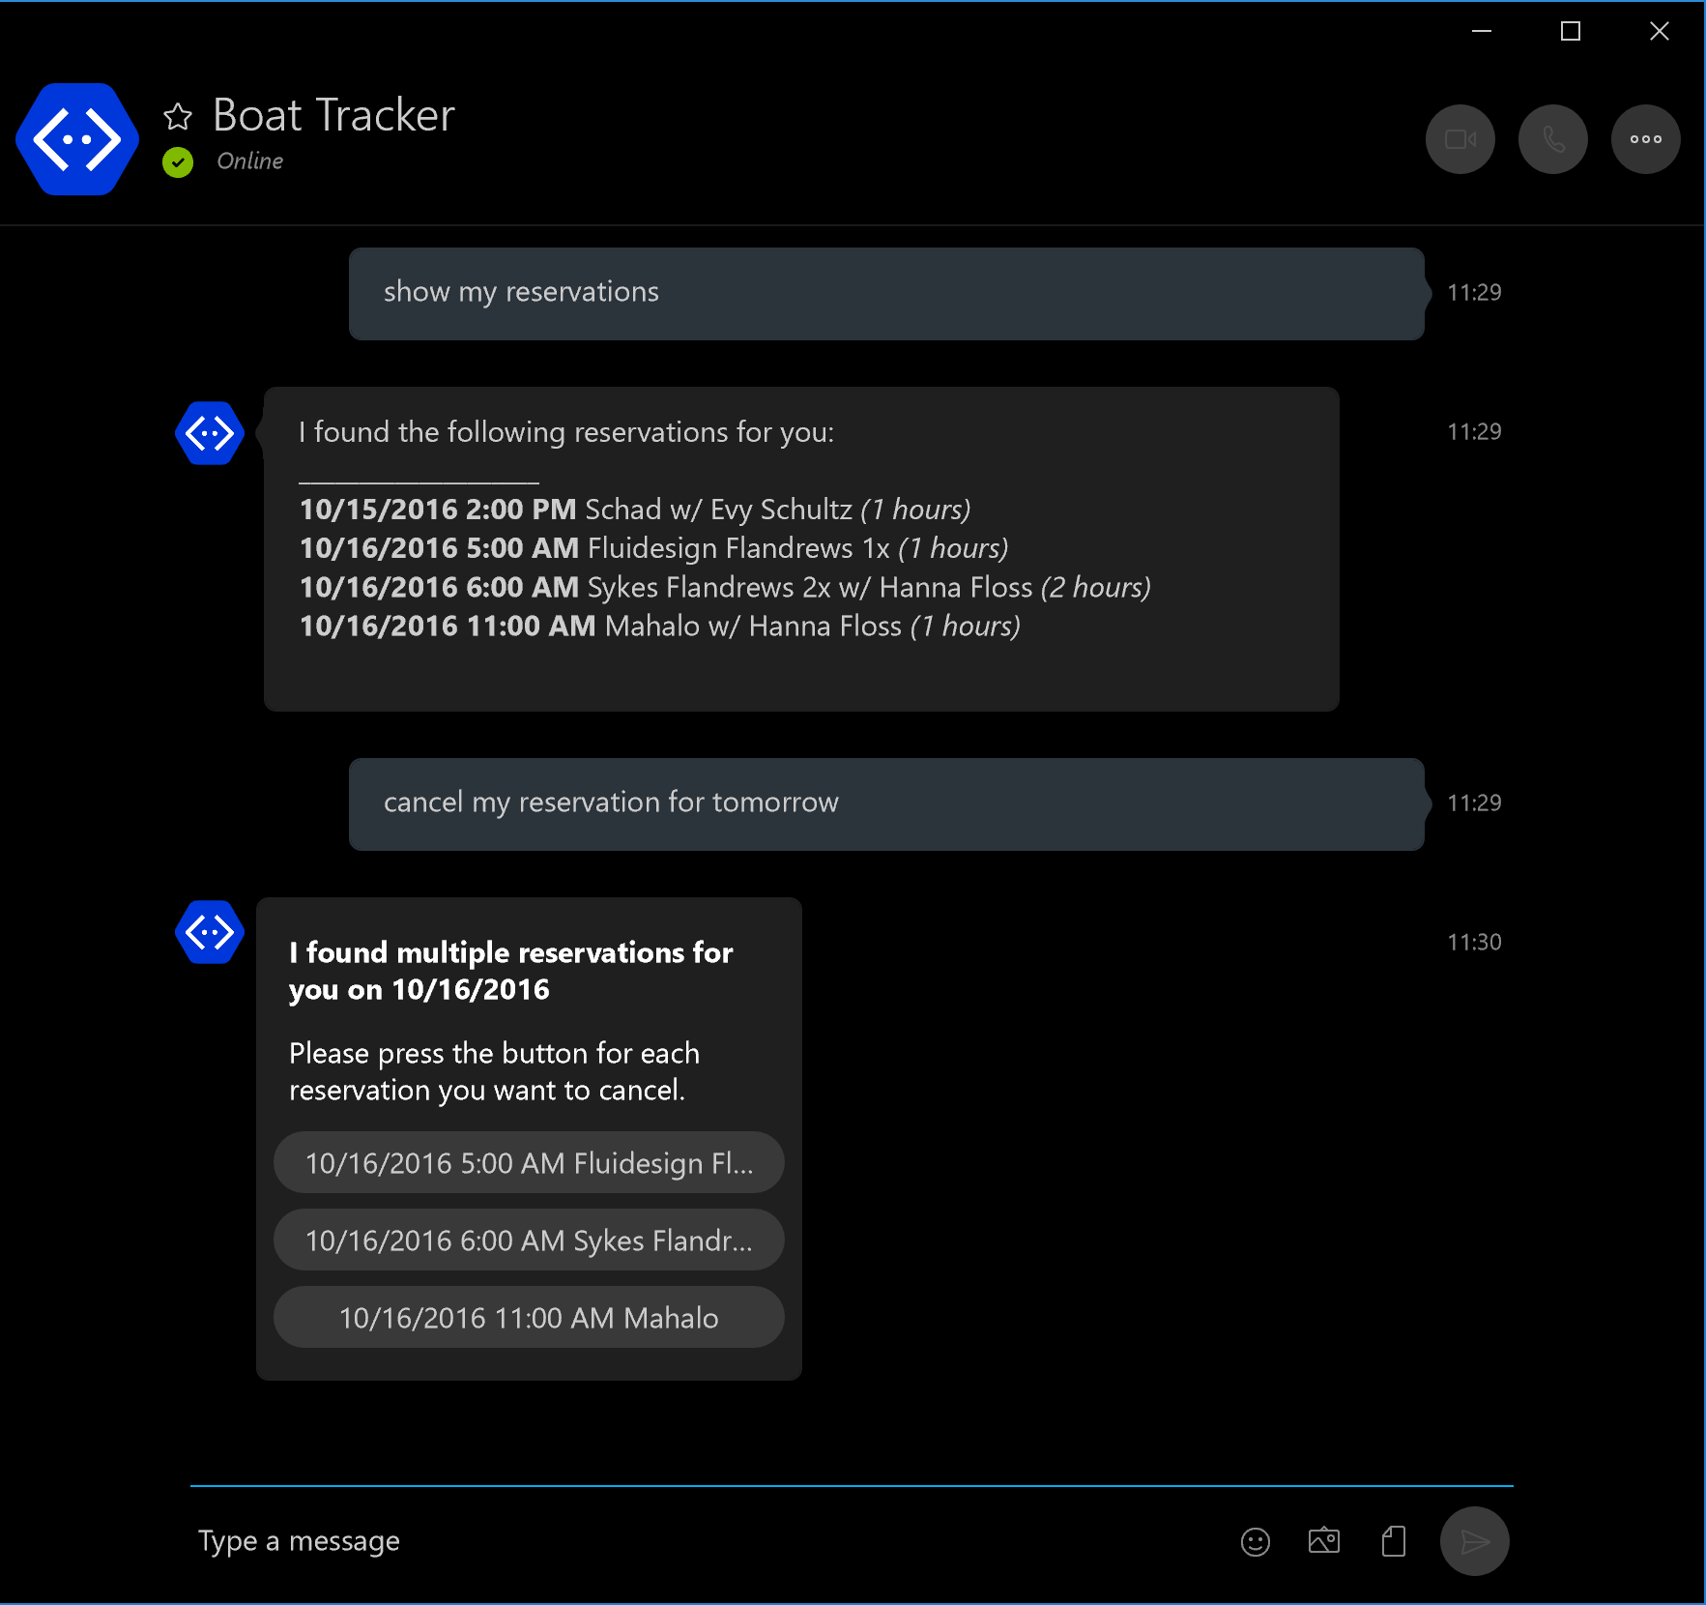
Conversational UI
Fast, easy access to most features
Use with Skype or SMS
Supported commands:
Reserve a boat
Take out a boat with or without a prior reservation
Return a boat when done
Check the availability of a boat on given day
Cancel a reservation
View reservations by boat and/or day

Slide 6
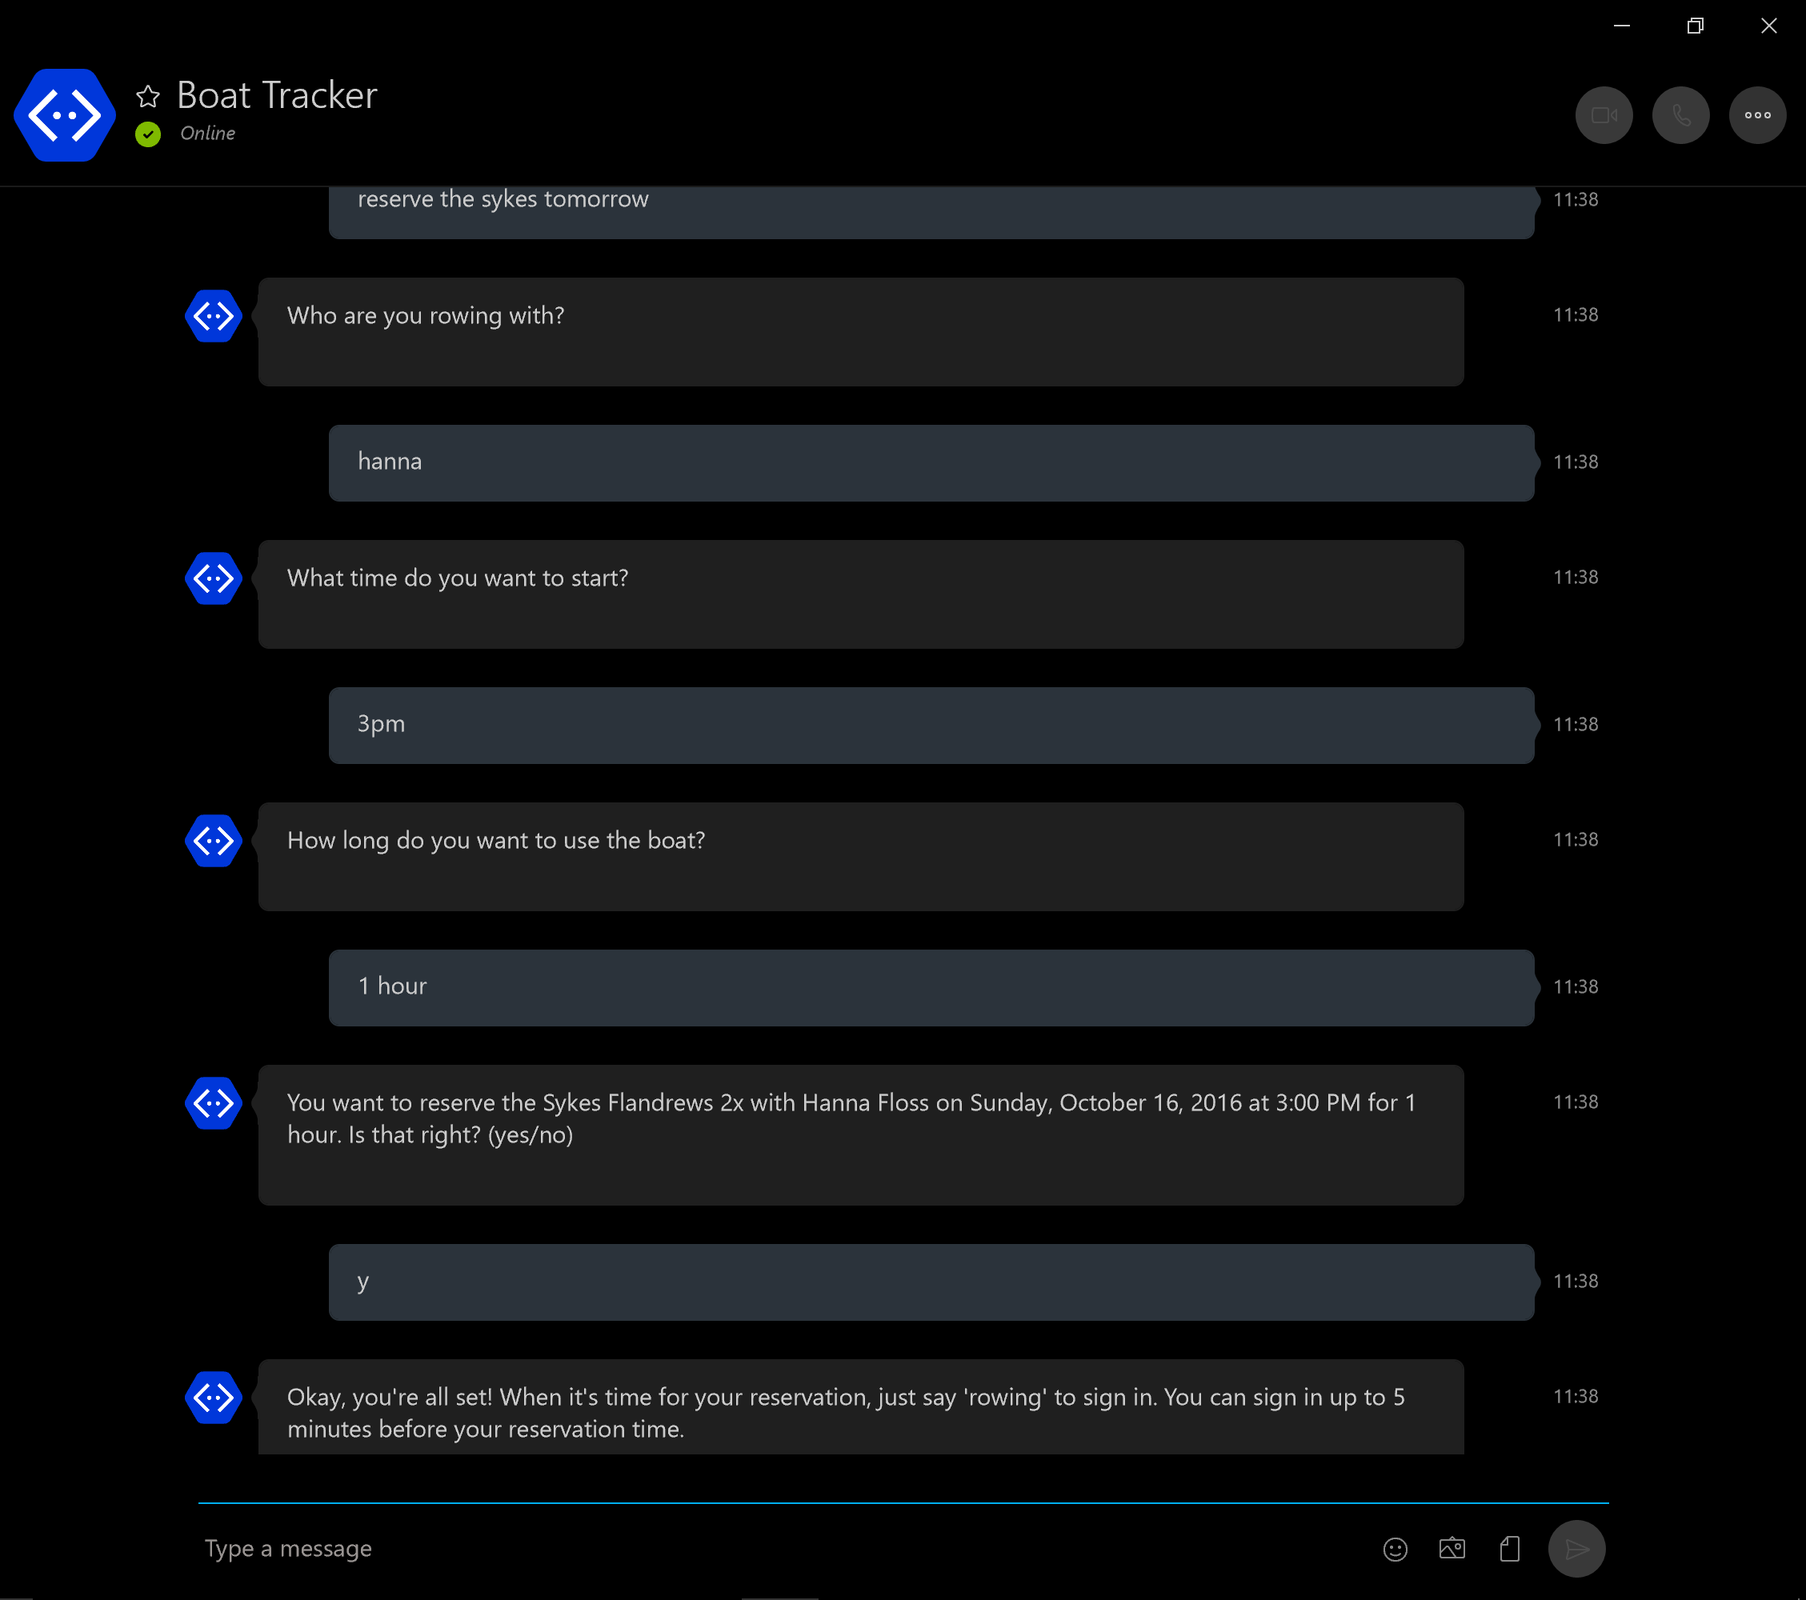
Conversational UI
Fast, easy access to most features
Use with Skype or SMS
Supported commands:
Reserve a boat
Take out a boat with or without a prior reservation
Return a boat when done
Check the availability of a boat on given day
Cancel a reservation
View reservations by boat and/or day

Slide 7
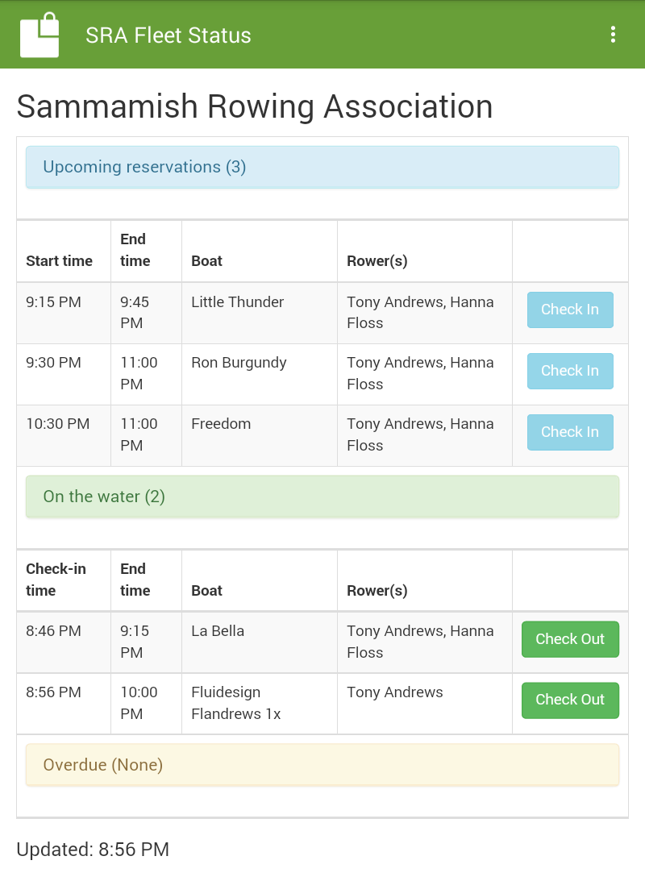
Kiosk web view replaces existing paper logbook
One-touch access to check-in & check-out
Shows boats currently on the water and those that are overdue to return
Designed for use on a cheap tablet in “locked down” mode

Slide 8
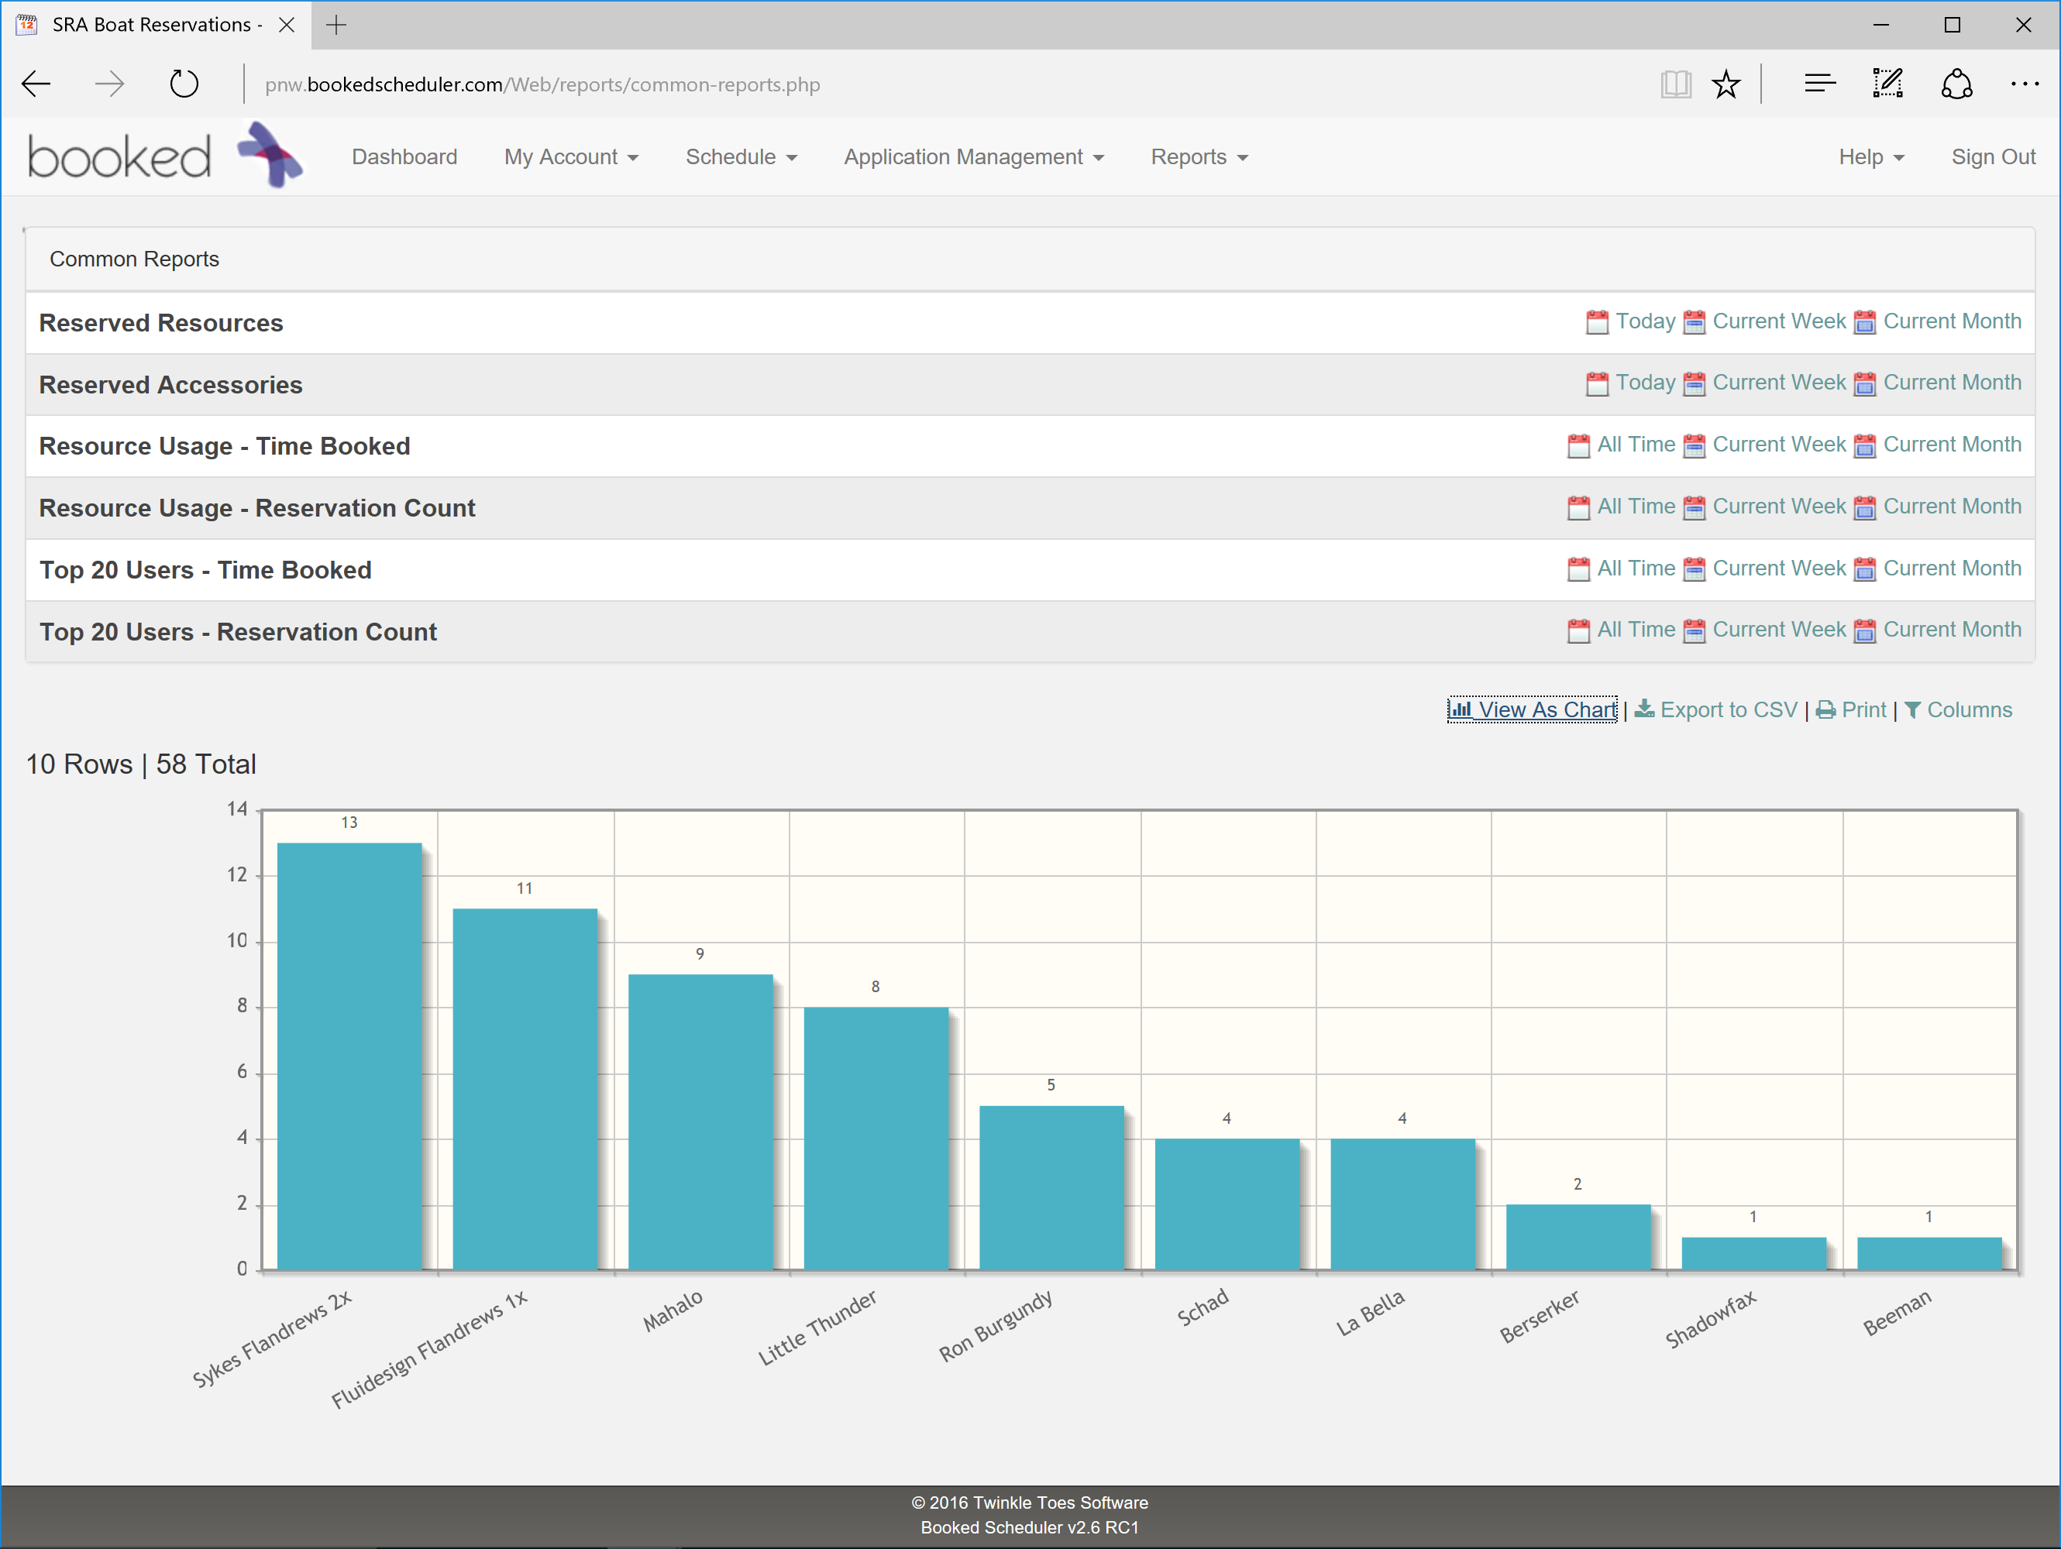
Reporting
Variety of standard & custom reports available via BookedScheduler
Usage by boat
Usage by user
Many more…
BoatTracker daily report email includes:
Total # of reservations
“Unclaimed” reservations
“Unclosed” reservations
Reservations with an incomplete roster

Slide 9
Next steps…
Pilot deployment planned for January
Sammamish Rowing Association (Redmond, WA)
~150 adult rowers
Interest from the Pocock Rowing Foundation
Can help evangelize with other Northwest rowing clubs
RFID tracking system in development
Boat-friendly RFID tags identified and tested
Typical cost for RFID reader and antennas < $2,000
Great for use on larger boats that aren’t typically “reserved”
Valuable security feature for private boat owners
Get a text message whenever your boat leaves or enters the boathouse

