Slide 1


Matlab Tutorial
Fundamentals of programming Using Matlab
By: IEEE Student Branch
Lakehead University, Thunder Bay

Slide 2
Tutorial Plan
1. MATLAB Basics
2. Plotting
3. Continuous Time System Analysis
4. Discrete-Time System Analysis
5. Loading and Saving Data
6. Introduction to Simulink

Slide 3
1. MATLAB Basics
A. Definition of Variables
- Variables are assigned numerical values by typing the expression directly, for example: a = 1+2
yields: a = 3
- The answer will not be displayed when a semicolon is put at the end of an expression, for example type a = 1+2;
Predefined variables which can be used at any time:
i: sqrt(-1), j: sqrt(-1), pi: 3.1416...
complex number example:
y= 2*(1+4*j)
yields: y = 2.0000 + 8.0000i

Slide 4

B. Definition of Matrices
MATLAB is based on matrix and vector algebra; even scalars are treated as 1x1 matrices
Lets creates a 1x4 vector with elements 1, 3, 5 and 7
v = [1 3 5 7];
twoXthree= [1 2 4; 3 6 8];
[M,N] = size(twoXthree) returns the number of rows (2) and columns (3) in separate output variables.
Lets creates the matrices: t = 0:10; x = cos(t*pi);
x with elements equal to cos(t*pi) for t = 0, 1,..., 10.
X➔ [cos(0) cos(pi) cos(2*pi)…..cos(10*pi)]

Slide 5
Matrix
Solve the following equation:
X+Y=5; 2X+Y=7; %use CAP
Cramers Rule to solve a 2x2 matrix:
A=[1 1;2 1]; C=[5; 7];
Solution [X Y] ➔ inv(A)*C’
[X Y]=[2 3]

Slide 6
C. General Information
Matlab is case sensitive so "a" and "A" are two different names.
Comment statements are preceded by a “%”
help for MATLAB can be reached by typing help
format of the display:
- format short e; Floating point format with 5 digits.
- format long e; Floating point format with 15 digits.
The commands who and whos give the names of the variables that have been defined in the workspace.
The command length(x) returns the length of a vector x and size(x) returns the dimension of the matrix x.
- length(x): 11
- size(x): 1 11

Slide 7
D. M-files
M-files are macros of MATLAB commands that are stored as ordinary text files with the extension "m", that is filename.m
example of an M-file that defines a function, create a file in your working directory named yplusx.m that contains the following commands:
Write this file:
function z = yplusx(y,x)
z = y + x;
-save the above file(2lines) as yplusx.m
x = 2; y = 3;
z = yplusx(y,x) → 5
Get input by prompting on m-file:
T = input('Input the value of T: ')

Slide 8
2. Plotting
Commands covered: plot, xlabel, ylabel, title grid, axis, stem, subplot
xlabel('time (sec)'); ylabel('step response'); title('My Plot');
Eg:To plot more than one graph on the screen, use the command subplot(mnp) which partitions the screen into an mxn grid where p determines the position of the particular graph counting the upper left corner as p=1. For example,
subplot(211),semilogx(w,magdb);
subplot(212),semilogx(w,phase);

Slide 9
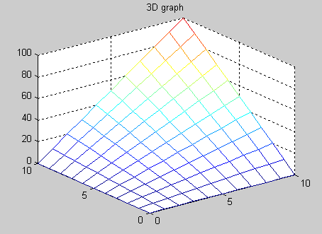
3D - Plotting example
x=[0:10]; y=[0:10]; z=x’*y;
mesh(x,y,z); title(‘3-D Graph’);

Slide 10

3. Continuous Time System Analysis
A. Transfer Function Representation
Comments: tf2zp, zp2tf, cloop, feedback
Eg: num = [2 3];
        den = [1 4 0 5];
        TF2ZP Transfer function to zero-pole conversion
        - zeros, poles and gain of a transfer function from the vectors num and den
        [z,p,k]=tf2zp(num,den)
        z = -1.5000 p = -4.2737, 0.1369 + 1.0729i, 0.1369 - 1.0729i k = 2
        [num,den] = zp2tf(z,p,k)
        From zeros, poles and gain, we can get the TF using zp2tf

Slide 11

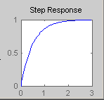
B. Time Simulations
Commands covered: residue, step, impulse, lsim
Eg: num = 1; den = [1/2 1];
t = 0:3/300:3; % for a time constant of 1/2
y = step(num,den,t);
plot(t,y) OR step(tf(num,den));

Slide 12
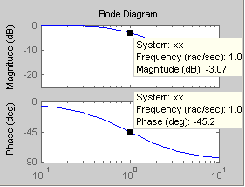
Continuous Time System Analysis continue
C. Frequency Response Plots
Commands covered: bode, Freqs, logspace, log10, semilogx, unwrap
Eg: bode(tf([1],[1 1])); →1/s+1
D. Analog Filter Design
Commands covered: butter,cheby, zp2tf

Slide 13

4. Discrete-Time System Analysis
A. Convolution
Commands covered: conv, deconv
- The behavior of a linear, continuous-time, time-invariant system with input signal x(t) and output signal y(t) is described by the convolution integral
- h(t), assumed known, the response of the system to a unit impulse input
To perform discrete time convolution, x[n]*h[n]
define x[n] and h[n]
y = conv(x,h) - This command assumes that the first element in x and the first element in h correspond to n=0, so that the first element in the resulting output vector corresponds to n=0. If this is not the case, then the output vector will be computed correctly, but the index will have to be adjusted.

Slide 14
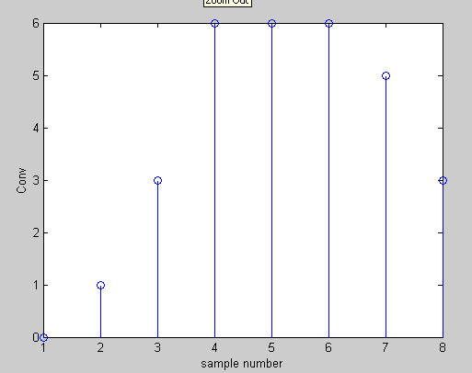
Convolution
For example,
x = [1 1 1 1 1]; → [1 1 1 1 1]
h = [0 1 2 3]; → [3 2 1 0]
conv(x,h) yields y = [0 1 3 6 6 6 5 3].
stem(y);
ylabel(‘Conv');
xlabel(‘sample number’);

Slide 15
5. Loading and Saving Data
When using MATLAB, you may wish to leave the program but save the vectors and matrices you have defined. To save the file to the working directory, type
save filename
where "filename" is a name of your choice. To retrieve the data later, type
load “filename”

Slide 16
6. Introduction to Simulink
Simulink is a software package for modeling, simulating, and analyzing dynamic systems. It supports linear and nonlinear systems, modeled in continuous time,
sampled time, or a hybrid of the two. Systems can also be multirate, i.e., have different
parts that are sampled or updated at different rates.

Slide 17
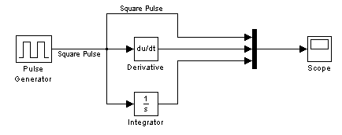
Simulink Example
Differential block & Integral block

Slide 18
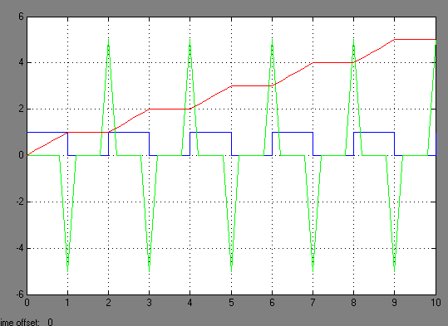
Example results
Integral
Pulse
Differential
End of presentation. Thanks for your participation!!!

