Slide 1
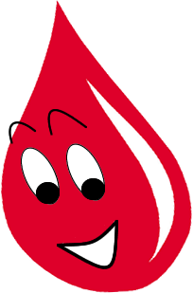
HEMO-CHAIN
Made by shooting stars (Paytm build for india)
Geeta Rawat
Rahul Prasad
Shivam Bhardwaj
Vishal Bhardwaj

Slide 2

Problems w it h existing blockchains
Slow Transaction Confirmations
No Settlement Finality
Limited Throughput
Anonymous Processors
Designed for Cryptocurrency
Poor Governance
No Privacy

Slide 3

What is Hyperledger? What Makes it Unique?
Open Source not-for-profit accelerating the development and adoption of business blockchain technologies. Businesses with the most stringent blockchain requirements Trust Hyperledger because:
Neutral and collaborative, Hyperledger will always:
Industry-standard blockchains
by business for business
Hyperledger blockchain technologies emphasize key enterprise requirements:
Hosted by The Linux Foundation, the experts at accelerating open technology development and commercial adoption
be open to all who wish to participate
produce open source technologies
remain immune to the commercial interests of any single company
Support for differing levels of access
Sub-universal validation
Cross-chain transactions
Modularity
14

Slide 4





Hyperledger Goals
Where open source teams build diverse approaches for business blockchain technology systems
Create enterprise grade, open source, distributed ledger frameworks &
code bases
to support business transactions
Provide neutral, open, & community- driven infrastructures
supported by technical and business governance
Build technical communities
to develop blockchain and shared ledger POCs, use cases, field trials and deployments
Educate the public
about the market opportunity for blockchain technology
Promote our community of communities
taking a toolkit approach with many platforms and frameworks
18

Slide 5



Use Case: Clearing and Settlement
Today’s post trade clearing and settlement system’s involved numerous parties, each keeping a copy of the same pieces of data.
Blockchain enables this process to be simplified so that every participant can be confident they are seeing what their counterparties are seeing.
Today’s Process: Blockchain Process:
8

Slide 6
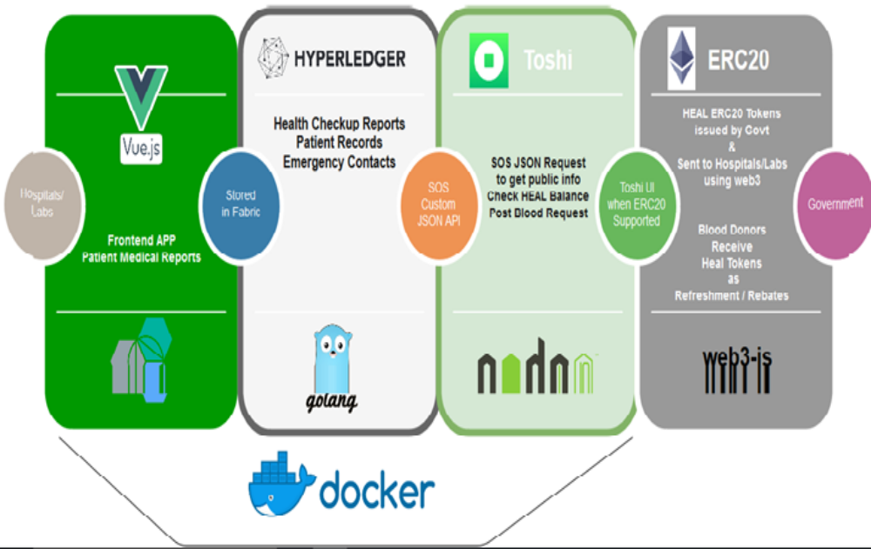
TECHONOLGY INVOLVED

Slide 7
HEMO-CHAIN
Its is a chain which make ledger connection between user ,blood donators and hospitals.

Slide 8
DID YOU KNOW?
450ml of blood can save as many as three lives.
Every two seconds, someone in India needs blood.
One out of every three of us will need blood in our life time.
Even with all of today’s technology, there is no substitute for blood.
Someone has to give blood
  in order for someone to receive blood.

Slide 9
FACT SHEET -1
Hospitals predict that the need for blood will increase 5% each year.
Approximately only 4% of the eligible population in India donates blood.
75% of donors donate only ONCE per year.
If they donated just two times per year there would
  never be any shortages.

Slide 10
FACT SHEET -2
A person has 5 - 6 litres of blood in their body.
A person can donate blood after every 90 days (3 months).
Body recovers the Blood very quickly:
  Blood plasma volume– within 24 - 48 hours
  Red Blood Cells – in about 3 weeks
  Platelets & White Blood Cells – within minutes

Slide 11
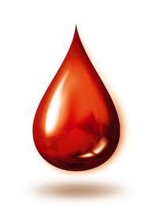
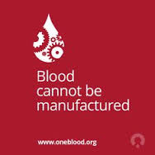
WHY SHOULD WE DONATE

Slide 12
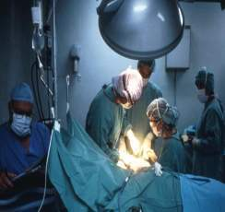
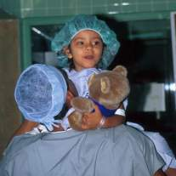
Blood is always needed for,
  Accident victims
  Cancer patients
  Blood disorder patients
  Surgery patients
  Pre-mature, pre term babies
  and many other…….
1 of out 10 hospital patients needs a blood transfusion
4.5 million Indians lives are saved by blood transfusions each year

Slide 13
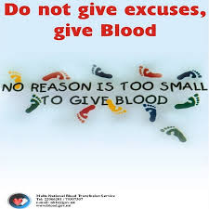
IMPORTANCE OF BLOOD DONATION
    Some of the reasons people need blood transfusions are:
Accidents
Cancer
Sickle Cell
Premature birth
Surgery

Slide 14
WHO CAN DONATE THE BLOOD?
Donor should be between 18-65 years of age with a weight of 45 kg or above with pulse rate, body temperature and blood pressure should be normal.
Both men and women can donate.
There are only few conditions in which donors are permanently excluded. The donor with history of epilepsy, psychotic disorders, abnormal bleeding tendencies, severe asthma, cardiovascular disorders, malignancy are permanently unfit for blood donation.
Donors suffering from disease like hepatitis, malaria, measles, mumps, and syphilis may donate blood after full recovery with 3-6 months gap. Also people who have undergone surgery, blood transfusion may safely donate blood after 6-12.

Slide 15

BENEFITS OF BLOOD DONATION
Tests on:
hemoglobin level
blood pressure
body weight
hepatitis B
hepatitis C
Syphilis
HIV

Slide 16
PROCEDURE FOR
VOLUNTARY BLOOD DONATION
Pre-Donation:
Donor Screening
Donor Eligibility criteria
Deferral Criteria (Donor Consent Form)
Medical examination
Blood Donation:
Blood donation procedure
Post donation:
Rest, advice & refreshment
Donor Certificate, Donor ID card

Slide 17
WHO CANNOT DONATE?
Life long | 1 year | 6 Months
Abnormal bleeding disorder Heart,Kidney,Liver Disorder Thyroid disorder Epilepsy, Mental disorders Tuberculosis, Leprosy, Asthma Cancer Insulin dependent diabetics Uncontrolled High BP | Surgery Typhoid Dog bite Unexplained weight loss Continuous low grade fever | Tattooing or body piercing Dental extraction Root canal treatment Malaria Vaccination

Slide 18
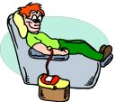
BLOOD DONATION PROCEDURE
REMEMBER!
The Donor Must ….
have had good rest / sleep
have had light meal
be mentally prepared

Slide 19
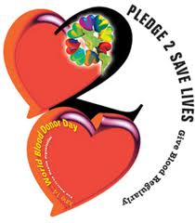
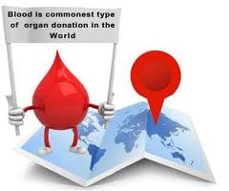
WHAT CAN YOU DO?
Make Blood Donation a HABIT
Donate regularly – after every 3 months to commemorate special days like birthdays, anniversaries ….
Motivate others to donate
Refer your friends and relatives

Slide 20
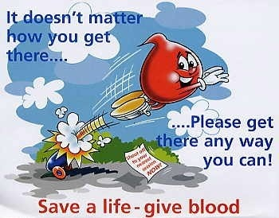

Slide 21
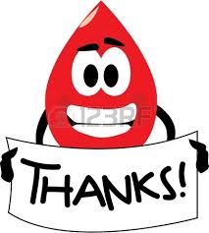
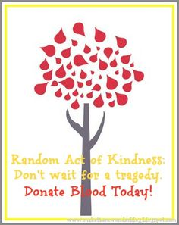
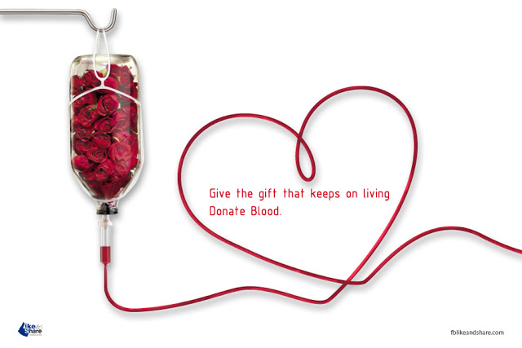
THANK YOU…

