Slide 1
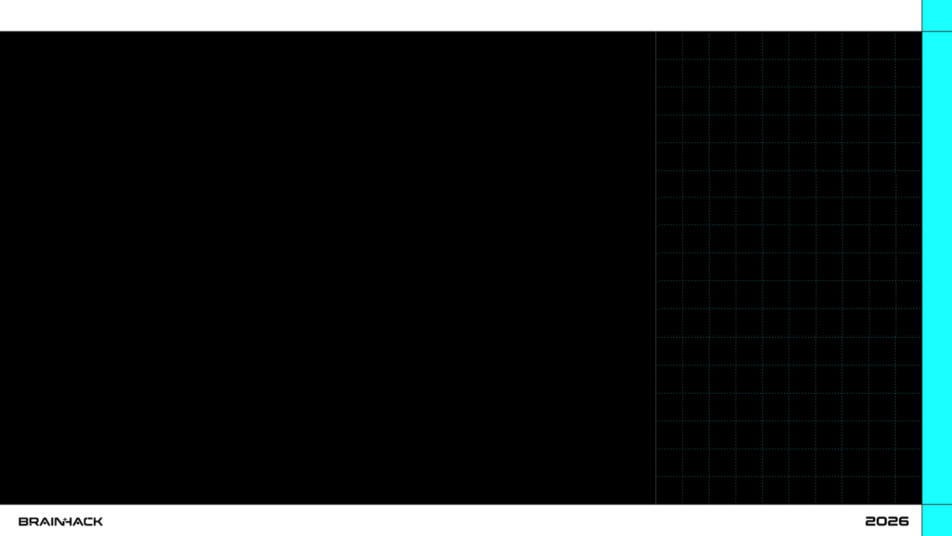

UPDATES FOR ROBOVERSE DRONE CHALLENGE

Slide 2
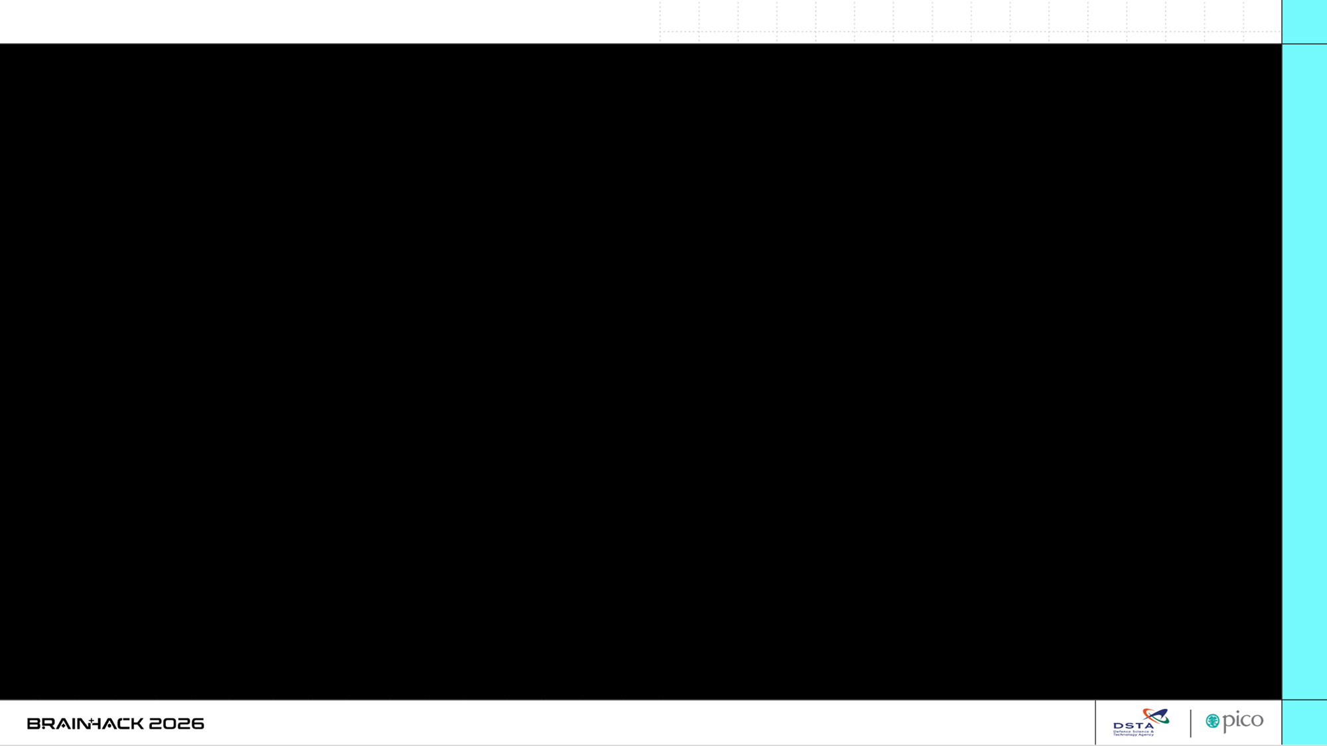
Final Competition
Scenario
Your team receives intelligence of the enemy’s transport convoy travelling routes. Your mission is to gather information on the convoy.
Objective
To gather intelligence on all targets of the convoy.
Challenge
The challenge will be carried out in 2 stages:
Reconnaissance (University teams only)
Deployment & Ambush

Slide 3
Competition Prize Awards
Pre-University Category
1st Place: $1800
2nd Place: $1300
3rd Place: $900
University Category
1st Place: $1800
2nd Place: $1300
3rd Place: $900

Slide 4
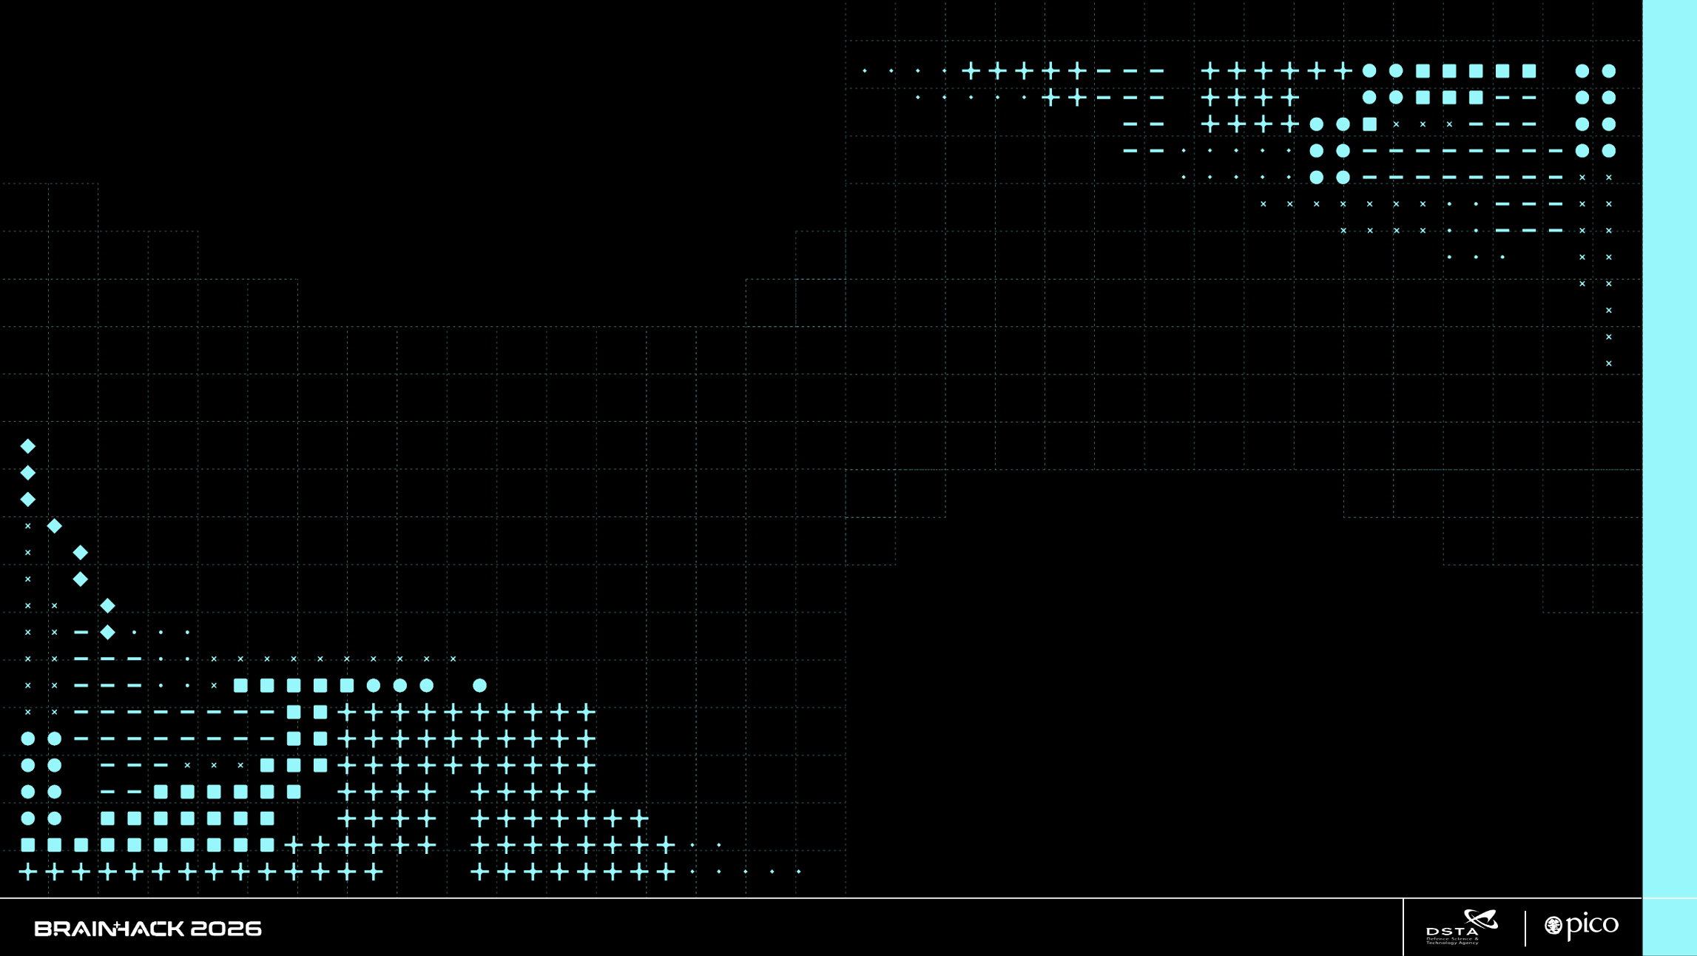
CHALLENGE STAGES

Slide 5
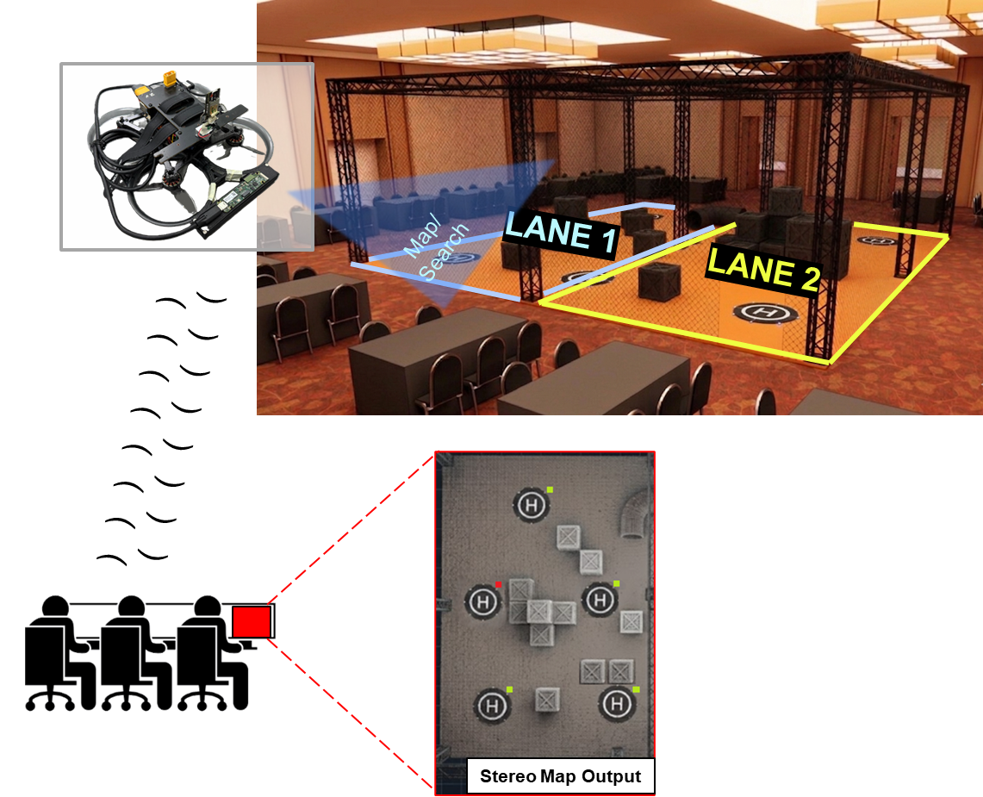
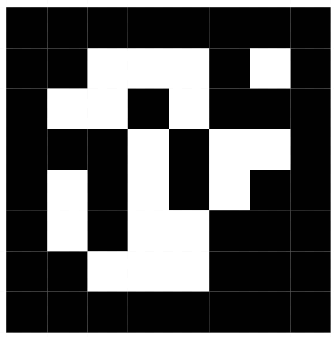
Challenge One (University teams Only)
Gameplay
A Mapping Drone with Stereo Camera will be deployed to map the arena.
The arena comprises obstacles and a number of Drone Landing Pads, each attached with an Aruco Marker.
The Mapping Drone will return a top-down depth map, and images of the Aruco Marker. Teams are expected to decipher the Aruco Marker to check if each landing site is valid for landing.
Evaluation Criteria
Teams will be awarded points based on their understanding of the concept, mapping speed, and the accuracy of identifying landing sites as valid or invalid.
1x Mapping Drone
(Intel Realsense Stereo Camera)
5.88Ghz Control +
Footage
Participants’ C2 Terminal
Aruco Marker Placed Beside Landing Pad

Slide 6
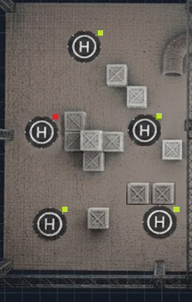
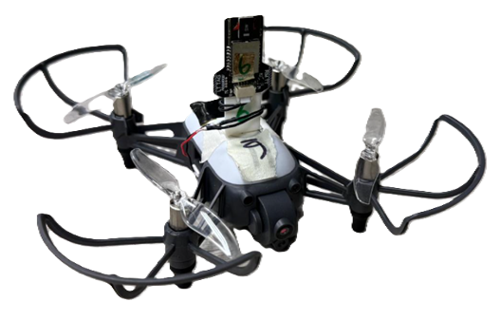

Challenge Two
Gameplay
Based on the mapping information (will be provided), the team can strategize and select 3 of the available landing zones.
The team will then launch 3 HULA drones from the C2 to land on the designated landing areas to prepare for ambush.
Evaluation Criteria
Points will be awarded for successful and accurate landings on the designated zones, in the least amount of time.
Land
3 x Highgreat HULA Drones
Land
) ) ) ) ) ) ) )
) ) ) ) ) ) ) )
Land
Participants’ C2 Terminal
Invalid Landing Zones
Valid Landing Zones

Slide 7
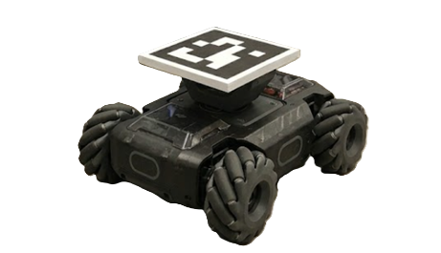
Challenge Two (cont’d)
Gameplay
The convoy will be launched into the drone cage and these robots will loiter for a period of time.
During this time, the team will launch the 3 HULA drones to search for these ground robots.
Evaluation Criteria
Points will be awarded for successful and accurate snapshots of the ground robots. Teams that complete the task in less time will earn more points.
) ) ) ) ) ) )
) ) )
Participants’ C2 Terminal
Convoy
5 x RoboMaster Ground Robots Programmed By 65Drones As Targets
) ) )
Enter

Slide 8
TECHNICAL INFORMATION

Slide 9
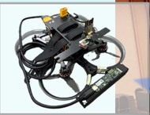
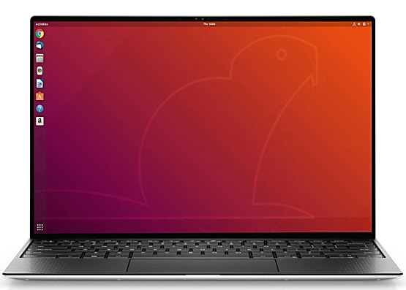
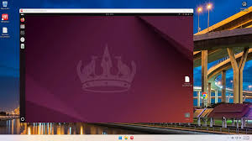
Mapping Drone
Mapping Drone Control and Data Access
The mapping drone's onboard computer runs the codes to control its movement and capture video from the depth camera (Realsense).
The mapping drone's onboard computer runs Ubuntu 22.04, with ROS2 and OpenCV installed.
Remote Access
Teams will remotely access the mapping drone's computer through the C2 Terminal using NoMachine to execute codes and control the drone.
Programming Options
Teams can utilize Python or C++ code on the mapping drone to access:
Depth Camera images: using pyrealsense2 or ROS2
Drone's data: using MAVSDK Python or ROS2
UWB data: using the provided Python class or ROS2
UWB data provides north-east position of the drone in the Arena.
Keyboard / Mouse
Desktop Screen

Slide 10
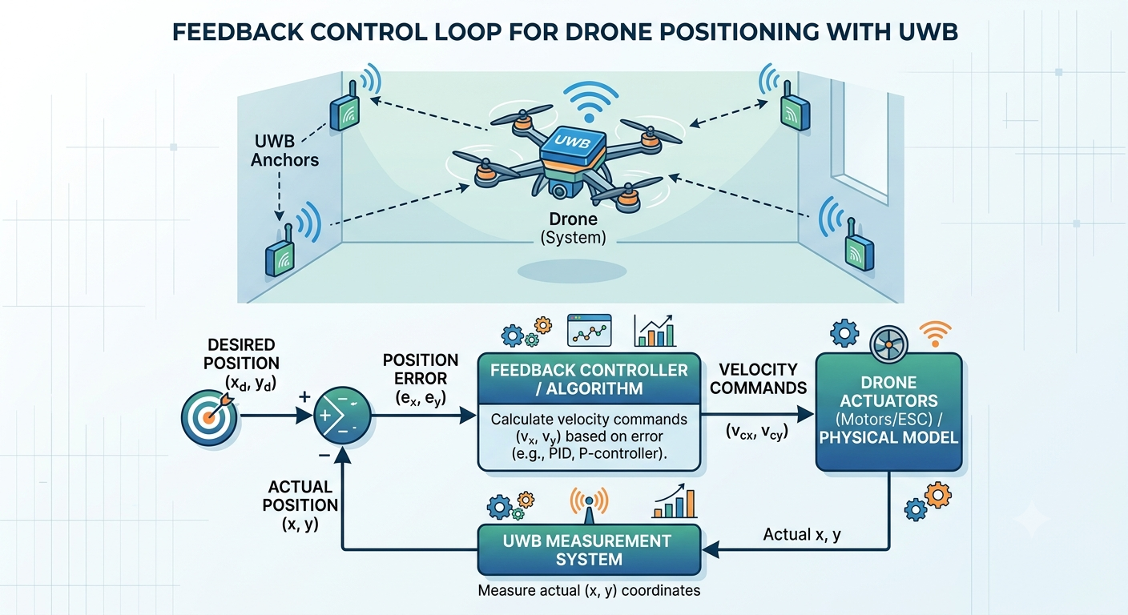
Coding the Mapping Drone Navigation
Controlling the Mapping Drone
To control the mapping drone, your code must use the offboard mode, as per the Qualifiers.
You can use MAVSDK Python, which you should be familiar with.
Alternatively, you can use ROS2, and the necessary files are available on the C2 terminal.
Recommended Approach
We strongly recommend controlling the drone's movement using NED position commands. However, using velocity commands with UWB is more efficient.
Utilizing UWB Data
The Mapping Drone is equipped with a UWB tag that provides its location. Your code can access the UWB topic to obtain the drone's x-y coordinates without using ROS2.
Implementation
Your code should:
Poll the UWB position
Calculate the error between the desired position and the current position
Send velocity commands to correct the error
Reference Code
For guidance, refer to kolomee.py available on the Discord channel.

Slide 11
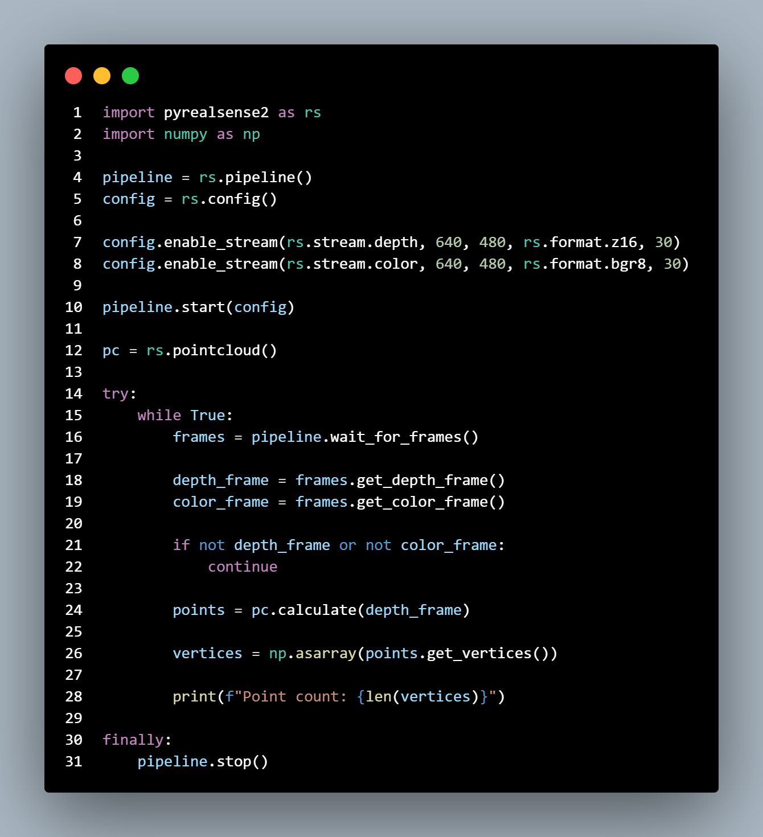
Using Realsense in your python code
Mapping and Detection with Pyrealsense2
As your drone flies to a location, perform mapping and detection using the pyrealsense2 Python library to capture RGB, depth, and point cloud data in your Python code.
Image Acquisition
Unlike Gazebo, which streams images to your code, pyrealsense2 requires your code to actively call and retrieve images (see lines 17 and 18).
For guidance, refer to the following example codes available on the Discord channel:
generateTopDown.py: sample code for generating a top-down occupancy grid
getDepth.py: example code for capturing depth images and calculating actual pixel distances
getRGB.py: example code for capturing RGB images
getInfra.py: useful for cameras without RGB but with infrared left and right lenses
getSyncDepthColor.py: example code for synchronized depth and color images

Slide 12
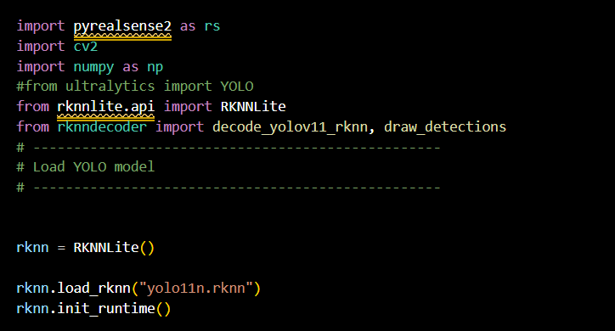
Object Detection using NPU on Mapping Drone
YOLO Object Detection with NPU Acceleration
The mapping drone's compute module supports YOLO object detection, which can be accelerated by the Neural Processing Unit (NPU) to achieve speeds of approximately 50fps.
Exporting Custom Models to RKNN Format
To utilize the NPU for YOLO object detection, you need to export your custom model to RKNN format. Follow these steps:
Export your model to ONNX format using convertyolotoonnx.py.
Convert the ONNX file to RKNN format using converttorknn.py.
These files are available on the Discord channel.
Refer to the following example codes to learn how to perform object detection using the RKNN model:
getDepthAndDetect.py
rknndecoder.py

Slide 13
Swarm Drone
Controlling the Swarm of Hula Drones
The codes to control the swarm of Hula drones run on the C2 Terminal, a Windows laptop with an Ubuntu 22.04 Virtual Machine.
Programming Environment
Your codes can run on the Windows environment of the C2 Terminal and utilize the following libraries:
pyhulax for controlling the Hula drones and accessing their camera images.
Accessing UWB Position
Teams can access the UWB position of the drones using the provided UWB Python library.
Your mission code runs here: Data processing, command control, visualization.
Drone Telemetry Data
UWB data
Navigation Setpoints, Commands

Slide 14
THANK YOU

