Slide 1

Managing a Service with Cricket
Jeff Allen
WebTV Networks, Inc.

Slide 2
Agenda
First, a word about my employer…
The Cricket Talk
Deploying Cricket
Some other asides along the way…

Slide 3
What’s a Microsoft employee doing here?
WebTV Networks, Inc. is a wholly owned subsidiary of Microsoft.
I work in the group that operates the WebTV Service, which is the server-side piece of the WebTV product.
The WebTV Service consists of hundreds of machines running Solaris, and a bit of Windows NT where it makes sense to use it.

Slide 4
Open Source at WebTV
We depend on open-source tools to operate the service: ssh, top, postfix, INN, etc.
We write tools when we can’t download what we need.
We released Cricket under the GPL because it was the right thing to do.
No, the lawyers don’t know about Cricket!

Slide 5
The Cricket Talk

Slide 6
The Problem
Monitoring a huge system of components is hard:
Short-term issues make us act reactively
We need data that we often don’t have available to make good long-term decisions
Lots of types of devices, operating at all levels of the protocol stack

Slide 7
Common Questions:
Short term:
Is the link to North America up?
Long term:
Do we need more bandwidth to North America?

Slide 8
Better Questions:
What is the current state of the link?
What has it been recently?
Is it what we expect it to be?
What long-term trends can we discern?
Answering questions like these requires a good data collection and graphing system.
Notes:
These questions relate to a network, but the same kind of analytical questions can help administrators run all kinds of other systems, including hosts and applications.
To be useful, the system has to have these properties:
Be storing data before you know you need it
Present legible graphs that give you enough information to answer the questions you are going to be asking.

Slide 9

The System: Cricket!
Cricket is a tool for storing and viewing
time-series data.
Very flexible
Extremely Legible Graphs
Space and Time efficient
Platform Independent

Slide 10
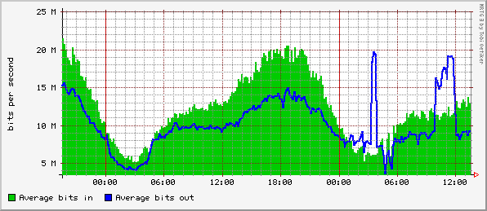
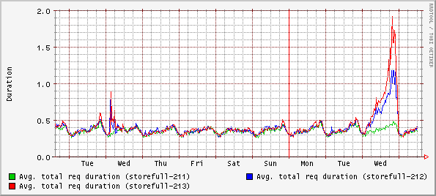
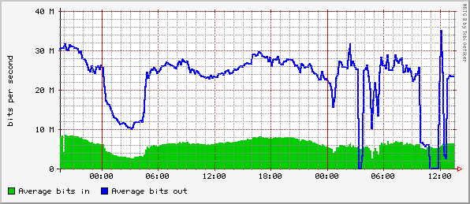
Example Graphs

Slide 11
How it works
Cricket’s collector runs from cron every 5 minutes and polls devices.
Data is stored in the RRD files.
Cricket’s grapher CGI script is used interactively to browse the data.
Both the collector and the grapher rely on a hierarchical configuration system called a Config Tree.

Slide 12
Collection
Cricket gathers data from:
SNMP
Shell Scripts
Files
URL’s
Perl Procedures
Notes:
Cricket’s SNMP is implemented by SNMP_Session.pm. It works everywhere Cricket does, since it’s 100% Pure Perl™.
When using Cricket to read files, it’s a good idea to run another process of some sort to update the contents of the files… otherwise the graphs will be fairly uninteresting.
HTTP transactions are currently done via an external script. Eventually, the Perl libraries for HTTP will be integrated into Cricket to avoid the costs of the external script.

Slide 13
Storing Data
Data lives in Round Robin Database (RRD) files.
Automatically discards old data, maintaining constant size database.
Automatically rolls-up data into summaries on various time scales.
Uses binary format on disk for speed.
Notes:
RRD came from work Tobias did to overcome MRTG 2.x’s shortcomings. Without RRD, Cricket would be useless. RRD does all the hard work for Cricket -- the rest of the job is simply configuration management and putting a CGI interface on RRD.
Without Cricket, RRD can still be used, though it’s harder, since you need to call it with the right options. There are other frontends for RRD. More info about RRD itself and other front ends is available from the RRD homepage, at: http://ee-staff.ethz.ch/~oetiker/webtools/rrdtool.

Slide 14
Graphing the Data
Graphing is actually done by RRD – thus the very close resemblance to MRTG graphs.
The graphs are useful because they have:
  Enforced data density
  Enough info to tell the whole story
  The Right Scale
Notes:
Enforced Data Density is a term Arnold de Leon coined. Compare Cricket graphs to the ones that come out of traditional network management systems, or even Microsoft Excel. By presenting the data as a sequence of bars or line segments on a very rigid time scale, Cricket communicates the true character of the data. Or at least it convinces Arnold that it’s got something interesting to say.
The time periods on the graphs are carefully chosen to go back far enough to always show you the current data in the context of past data. For instance, this hour’s data is shown next to both data from the last hour, and data from the same hour in the previous day. Even if your traffic is not constant during the day, you can look at a Cricket graph and say “It looks right, based on previous data.”

Slide 15
The Config Tree
Hierarchical structure for config files:
Uses inheritance to avoid repeated configuration info.
Easy to add new targets.
Easy to parallelize collector (and administrators).
Could be used by other apps in the future

Slide 16
Making Sense of the Data
Looking at a handful of graphs in response to an external stimulus seems to work well for troubleshooting.
However, the capacity to draw 10000 graphs hardly qualifies as a proactive monitoring tool!
A human cannot comprehend that much raw data.
Notes:
Harvey Mudd students are working on solving this problem. More information about their project is available from http://www.cs.hmc.edu/clinic and http://www.cs.hmc.edu/clinic/projects98/WebTV.html.

Slide 17
Monitors
Cricket can monitor targets or sets of targets for certain types of behavior
A message is sent when a threshold is violated, and again when things are back to normal.
Cricket is designed to talk to an Alert Manager

Slide 18
Aside: What’s an Alert Manager?
The part of a management infrastructure where you gather and filter its of data about the state of your service.
For more information on the approach we use for Network Management see:
http://www.gnac.com/four-star
Notes:
This is a bit of an aside, and a plug for another talk I gave.

Slide 19
Types of Monitors
Value
  An absolute limit
  Example: tell me when this link is over 80 mbit/sec
Hunt
  Watch for rollover characteristics
  Example: tell me if the modem banks are not behaving correctly

Slide 20
Types of Monitors (cont.)
Relation
  Compare two measurements
  Example: tell me when today’s traffic at this time is more than 20% different from yesterday’s
  Example: tell me when the traffic on link 1 is more than 5% different than the traffic on link 2.
Other types may be added…

Slide 21
Setting Thresholds
It is a pain to set hard-coded thresholds and then change them over time as usage increases.
A static threshold might not make sense for cyclic data.
Wouldn’t be nice if Cricket could check the graphs itself?

Slide 22
Towards adaptive thresholds
Humans only really get interested in a graph when it “doesn’t look right”.
How would a computer know if a graph “doesn’t look right”?
Simple real-time predictive statistical techniques seem to be working for us in prototypes.
Notes:
More information available in the future. Hopefully a paper at LISA 2000, definitely on the Cricket website.

Slide 23
Deploying Cricket

Slide 24
The Goal
Whether you know it or not, your ultimate goal is to monitor absolutely everything in Cricket.
Experience shows that almost any time-varying data is useful in Cricket.
You have to collect data before you need it, or it won’t be there when you ask “how was it before we noticed it was broken?”

Slide 25
Getting there:
Get started, learn to configure it, join the Cricket community
Extend Cricket’s reach into all parts of your system, one piece at a time.
Configure monitors
Add features!

Slide 26
First Steps…
Fetch it from here:
http://cricket.sourceforge.net
Read the beginner’s guide
Get it to monitor a few things using the sample config tree.
Join the mailing list, listen in.

Slide 27
Configure mod_perl
Cricket runs much faster under mod_perl.
As long as you have only one installation and you are not hacking on the source code, it works right.
When in doubt, restart Apache.
There is room for a lot of improvement here…

Slide 28
Play around a bit
Have a separate Cricket instance where you are not afraid to play:
  You will be reinitializing your data from time to time.
  You will be collecting very wrong data by mistake.
  You will have ugly spikes in your data, until you learn how to avoid them.
It would be nice to not have all that bad stuff happen to your production system!

Slide 29
Finding things to monitor
Collect data from all layers of the system, not just the network.
Application
OS
Network
Physical

Slide 30
Fetching data
Various methods: SNMP, exec, file, func.
The “clean” way to get it is with SNMP.
The “easy” way to get it is by executing an external program, or reading from a file.
The “efficient” way to do it is with a function.
Sometimes you must speak SNMP – i.e. network devices. For applications, external programs are better.

Slide 31
SNMP for Cavemen
SNMP is not simple. Do not feel bad if you are confused by it.
I don’t know the SNMP book market very well – no recommendations. Marshall Rose’s book at least has soapboxes.

Slide 32
Two SNMP tools
Empire (now Concord) SystemEDGE is the best SNMP agent for Unix and it’s very useful under NT as well:
http://www.empiretech.com
SNMX lets you walk a MIB just like walking a filesystem. It’s payware from here:
http://www.ddri.com

Slide 33
Running an external command
Some data available via SNMP needs post-processing.
BIND can be configured to write stats to syslog. Syslog forwards the stats to the Cricket host, and Cricket spawns a script to read the info from syslog.
Cricket can talk HTTP by running GET, curl, or wget.

Slide 34
Reading from a file
Think of it as a dropbox model for IPC.
Applications (like the WebTV Service)
  Creates the data asynchronously.
  A “bridge tool” knows how to talk to the application, and also knows what files to put it into.
  Cricket wakes up and picks up the data from the file.

Slide 35
Reading from a file (more)
Existing SNMP polling tools
  The router guys don’t want you to double-poll.
  Solution: the existing tool can hand over the data to Cricket via files.

Slide 36
Don’t be afraid of a hack
Oracle DBA’s are a wacky creature…
They needed Cricket, but they don’t want anyone talking to their precious database.
I asked them to show me what they had already. I was looking for a non-threatening way to get the performance data out.

Slide 37
The Hack
Machine with
Oracle
Performance log, collected by cron
Cricket
Rcp, scheduled by cron
Admin machine,
Owned by DBA’s
HTTP to CGI script
Notes:
Clearly, the right answer would be to have Cricket talking SNMP to the Oracle SNMP agent.

Slide 38
The Social Effect
The result was ugly, but now the DBA’s are addicted to Cricket.
They assigned a junior DBA to add more measurements. His first job was to clean up the hack.
Mission Accomplished!
On to the next application…time to get someone else addicted!

Slide 39
Configuring monitors
By now, you have been running Cricket for some time.
Look at your historical data to decide on some rules that show Bad Things™ happening.
Set monitors in your test tree, and arrange to have the monitors come to you in e-mail.
Relation monitors are very useful when your traffic is cyclical.

Slide 40
Cyclic Data

Slide 41
Hunt Groups
Telephone companies are notoriously bad at following directions related to hunt groups.
Terminal servers usually have weird failure modes that can ruin the best laid plans.
Cricket can alert you when there is traffic on the second PRI even though the first one only has 5 modems off-hook.

Slide 42
Tips
Compiling the config tree goes faster when it is smaller. Make your test tree small, even if your production tree is big.
The GET program that comes with LWP is a lightweight HTTP client. Use it to fetch data when other techniques might not be available.

Slide 43
Questions?
Contact Info:
Jeff Allen
jeff.allen@acm.org
http://cricket.sourceforge.net

