Slide 1
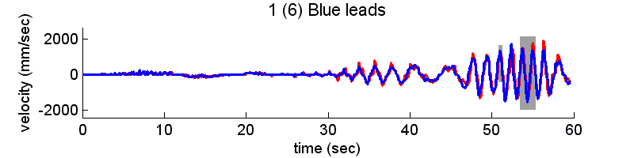
Welcome to Mirror-Game!
We will now present you to some graphs. You should divide each graph into segments, such that each segment represents something “interesting” in the graph, according to your opinion. For example, in the following graph, a possible segmentation might be -
and the proper choose of cut-points is done by clicking the proper points (the yellow ones) on the graph.
Note: there is not “right” or “wrong” labeling, you should label the graph as you see it.

Slide 2








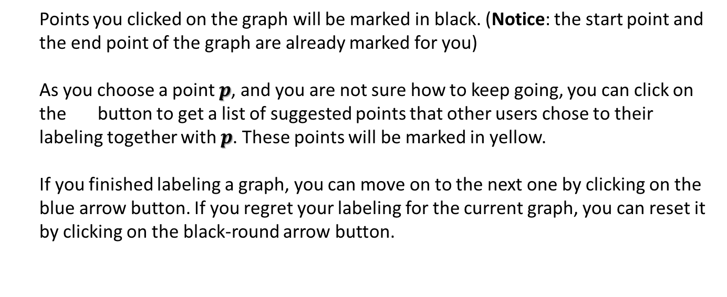
Points you clicked on the graph will be marked in black. (Notice: the start point and
the end point of the graph are already marked for you)
As you choose a point $p$, and you are not sure how to keep going, you can click on
the button to get a list of suggested points that other users chose to their
labeling together with $p$. These points will be marked in yellow.
If you finished labeling a graph, you can move on to the next one by clicking on the
blue arrow button. If you regret your labeling for the current graph, you can reset it
by clicking on the black-round arrow button.
At the bottom of each graph, you will find the following buttons:
resets to original view (after zooming)
toggling between zoom reviews
pan axes with left mouse, zoom with right (not recommended)
zoom to rectangle
GOOD LUCK!
Notes:
For your convenience, as you choose a point in the graph, that point will be shown in black, and in relevance to that point we will suggest you others (according to previous users labeling) which will be shown in yellow. Notice: the start point and the end point of the graph are already marked for you.

