Slide 1

Asking Clarifying Questions for Conversational Search
Machine Learning for Conversational AI
Coursework 2 SET10120
Notes:
Andy
Welcome – quick intro to project
Our project investigates the development of a conversational search system which retrieves documents for the user. It further asks clarifying questions to resolve ambiguity in user queries. Traditional search systems often struggle with underspecified or ambiguous queries and can lead to irrelevant or broad results.

Slide 2
System requirements
RQ1: When to ask clarifying questions during conversations?
RQ2: How to select or generate the clarifying questions?
RQ3: How to evaluate a clarifying question-answering systems?
Notes:
Andy
What project set out to do.
Our project set out to develop a system in relation to three main research questions: RQ1 – When to ask clarifying questions during conversations? Our system initially attempts to retrieve documents for the user and assesses its confidence on the relevance to the current conversation context. When our system is unable to find a document confidently in relation to a user query, a clarifying question is asked. For example the user asks: “Climate change impacts” and the system can clarify by asking: “Are you referring to climate change in specific regions?”.
RQ2 – How to select or generate the clarifying questions? To select the most appropriate question, our system uses SBERT to rank questions from the Qulac dataset.
RQ3 – How to evaluate a clarifying questions-answering system? To evaluate our system we fed 75 dummy queries in and evaluated the cosine similarities to the top ranked questions. Further to this, the document retrieval module was compared to ground truths.

Slide 3
Overall Concept and AIMS
Build a system which can identify, and ask clarifying questions based on the Qulac dataset. System Features:
Returns relevant Wikipedia Summaries if user query is clear.
Utilises RASA to tie together other system modules – SBERT and BM25
BM25 – Match Wikipedia Summaries with user queries
SBERT – Rank Results
Notes:
Jordan
We developed a conversational system which retrieves Wikipedia summary documents for the user.
Our main aims were to have the system have basic dialogue flow with the additional feature for refining intent to help return more relevant results when the users query was ambiguous or underspecified.
Our system was a modular setup comprising of the following: Rasa – for dialogue conversational flow.
BM25 for document retrieval and confidence evaluation.
And SBERT for ranking clarifying questions.

Slide 4

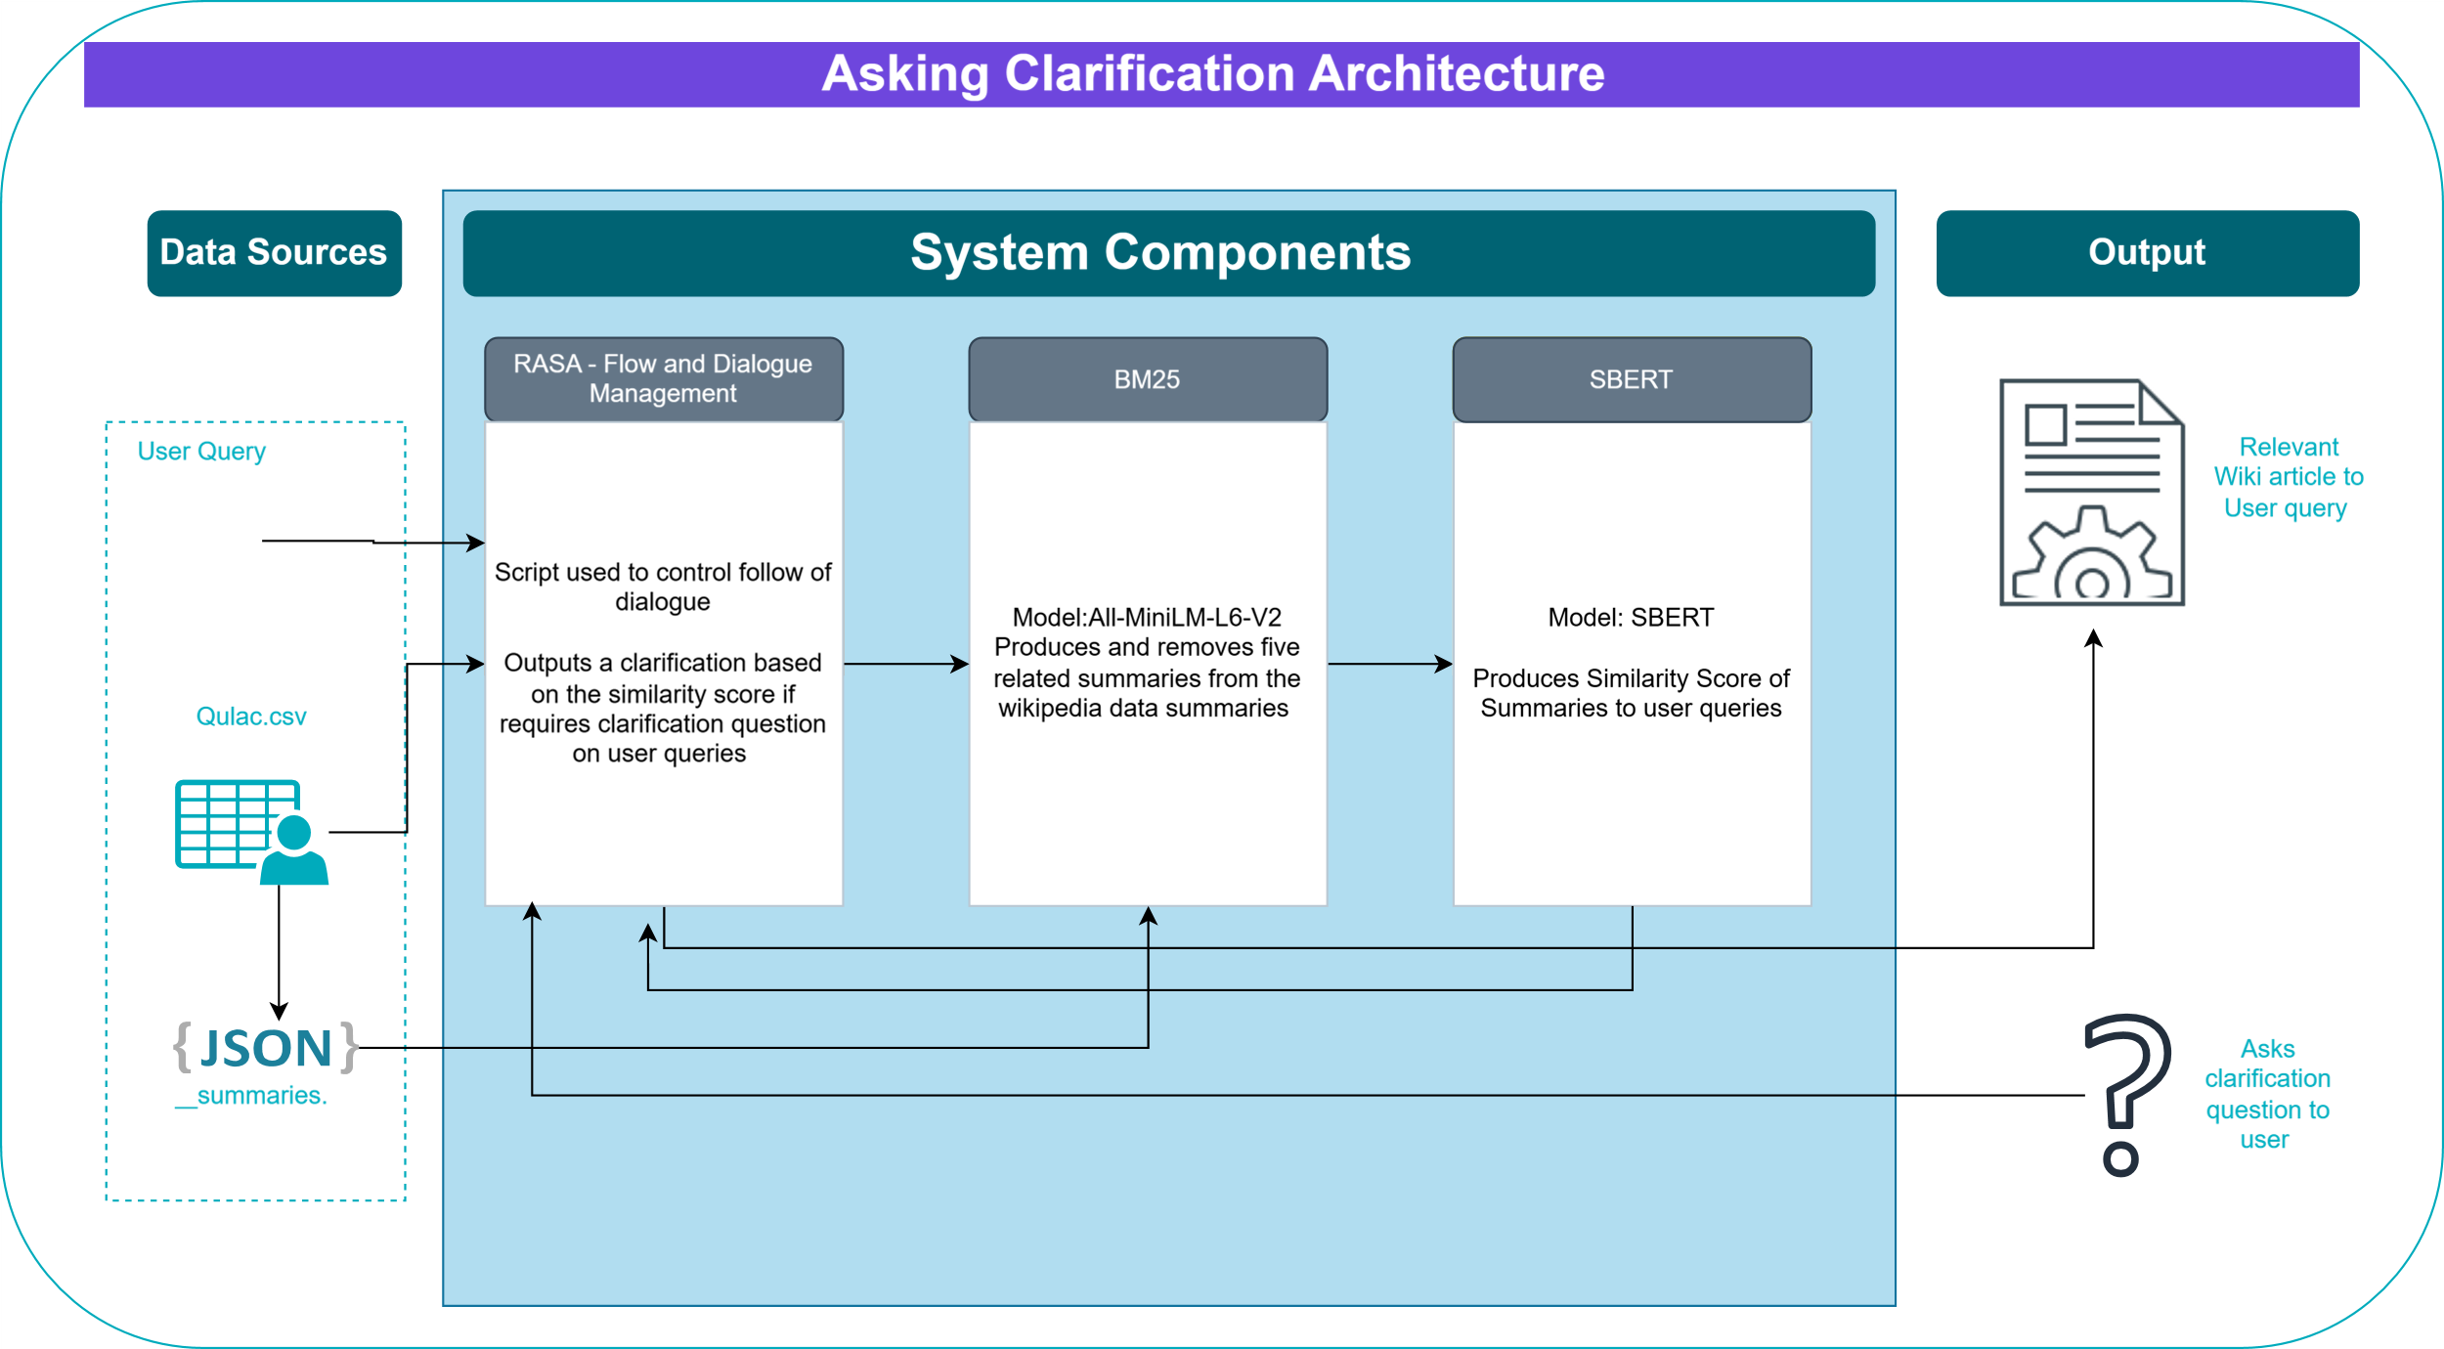

System Architecture
Notes:
Jordan
Rasa was the main module controller with everything being directed though it.
Rasa is responsible for identifying initial intent and handling change in intent as queries and responses evolved the conversation context.
When basic intent is not clear, Rasa calls BM25 via one of its actions python script.
If BM25 is confident, then it sends the top ranked Wikipedia summary to Rasa to return to the user.
When it is not confident, system flow is directed to SBERT for ranking the most appropriate clarifying question.
The top ranked question is then passed back to the user for response.

Slide 5
Team Roles
SBERT Clarifying Questions Retrieval Specialist:
Ansh Bisht
Project Manager:
Jordan Dickson
Lead Developer & System Integrator:
Jack Harrison
Information Retrieval Engineer:
Ruben Lazell
Scrum Master & System Designer:
Andrew Taison
Set up the SBERT model for sentence similarity.
Supported tuning and evaluation of the question ranking module.
Managed project tools including Kanban board and GitHub.
Organised team meetings.
Sourced Wikipedia summaries for retrieval.
Led implementation and integration of system modules.
Set up Rasa and handled communication between components.
Produced the system demonstration video.
Developed and tested the BM25 retrieval module.
Supported module integration and retrieval tuning.
Led team meetings and tracked weekly progress.
Designed the initial system structure.
Sourced and pre-processed the Qulac dataset.
Created templates for the report and presentation.
Responsibilities
Notes:
Andy
We approached the structuring of our team by first identifying the key implementation areas required for development as already outlined.
Following this, we each decided which area we wanted to work on based on our current experience and knowledge.
We also had two team members fall into management and documentation roles to assist in a smooth delivery of the project. Our implementation team comprised of:
Ansh, who was our clarifying question retrieval specialist responsible for setting up SBERT.
Jack took the role of lead developer and system integrator, handling much of Rasa and module communication.
Ruban was our corpus and information retrieval engineer who setup BM25.
Our management team consisted of:
Jordan, who took the role of project manager dealing with project tools and also sourced our Wikipedia summary documents,
and myself as scrum master and system designer, whilst I also preprocessed the Qulac dataset to be used as our questions and as part of our training data.

Slide 6
BM25 - Retrieval pipeline
Uses BM25
Reranked using all-MiniLM-L6-v2
Outputs the most relevant wiki-style summary
Returns “not confident” if top score is not relevant enough
Qulac → Query → BM25 → Top 5 → MiniLM Reranker → Top Summary → Confidence Check
Notes:
Ruben

Slide 7
BM25
Uses Bag-of-Words and term frequency to rank summaries
Each summary is assigned a BM25 relevance score
Retrieves the top 5 most lexically relevant summaries
“President” and “Leader” are considered completely different
Scores are not comparable across different queries
Notes:
Ruben

Slide 8
all-MiniLM-L6-v2
Reranks the top 5 summaries from BM25 using semantic similarity
Converts queries and summaries into vector embeddings and compares them using cosine similarity
Can identify relevance even if the wording is different
Lightweight transformer model from SentenceTransformers - fast and efficient for reranking
Cosine similarity higher or lower than 0.4
Notes:
Ruben

Slide 9
Evaluation of Retrieval Pipeline
Tested with 150 GPT-4-generated queries
50 matching, 50 ambiguous, 50 non-matching
Matching queries, 92% accuracy, 100% precision, 95.56% F1 score, avg cosine similarity: 0.5882
Ambiguous queries: 42% confident predictions, avg cosine similarity: 0.3584
Non-matching queries: 80% correctly flagged as not confident, avg cosine similarity: 0.2839
Notes:
Ruben

Slide 10
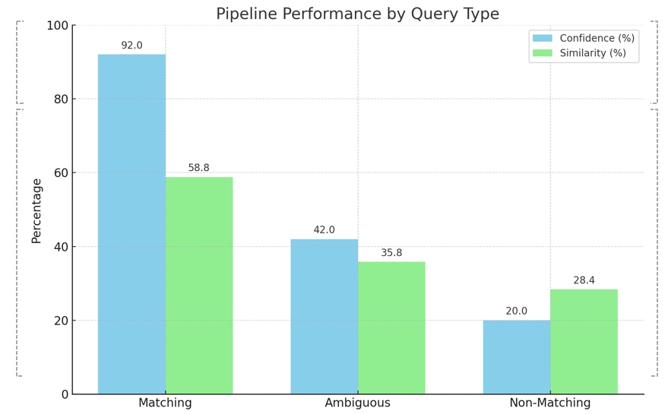
Notes:
Ruben

Slide 11
SBERT Clarification Ranking Model
Purpose: Designed to handle ambiguous queries in the conversation system by suggesting a relevant clarifying question
Model used: all-MiniLM-L6-v2- A compact, efficient sentence embedding model.
Features
The Model has high inference and semantic accuracy, making it ideal for clarifying question tasks.
Compatible with a retrieval-based ranking system like RASA
Notes:
Ansh

Slide 12
Main Objective
To enable semantic clarification in the dialogue system. It also prevents misinterpretation of the user’s intent
Integration with the system
This connects directly to RASA as a fallback module.
IT gets triggered when the main BM25 fails to produce a confidence score.
And sends the top-ranking clarifying question back to the conversational flow.
Training
Fine-tuned on 196 query-clarification pairs for QULAC dataset using MultipleNegativeRankingLoss for effective semantic learning.
Notes:
Ansh

Slide 13
📊Evaluation
Dataset used
The model is evaluated with 75 ambiguous queries across diverse domains such as tech, medical, education, etc.
Each query/intent contains 4 clarifying questions.
This evaluation is designed to test the model’s generalization
beyond the initial dataset of 196(ambiguous pairs).
Process
The SBERT model ranks the clarification by the cosine similarity.
The top clarification is selected for each query and,
The prediction is considered confident if the similarity ≥ 0.40
Notes:
Ansh

Slide 14
Results
Confident Prediction: 63/75(84%)
Average confidence similarity score: 0.563
Percent of non-confident prediction:16%(avg 0.38)
The threshold was set at 0.4
Key insight:
The model achieves a high semantic score across various topics. Showing a strong semantic match across unseen and ambiguous inputs.
Showed appropriate uncertainty near threshold(0.4). Overall, it demonstrates a robust understanding of the query intent pair.
Notes:
Ansh

Slide 15
Demo showcase
Demo will showcase system mean features:
Bm25: working independently with RASA
SBERT: working alongside bm25 and RASA
Will contain a brief explanation of how each part works
Notes:
Jack
List all the main features that will be presented in the demo video

Slide 16
Demo
Demo Video
Notes:
Jack
Once sharing via teams, hover over share at the top of the screen, and click on share audio.

Slide 17
FUTURE WORKS
Investigate and implement methods for generating clarifying questions for the system.
Replace the Wikipedia summaries with a system that directly responds to users’ queries.
Conduct significantly more extensive research into other systems.
Notes:
Jordan
The future work for this project would be based on the limitations for the current system. Some of the major limitations include: * that the system ranks predefined questions rather than generates them. A system that generates questions would provide more flexibility and generalisation to a range of user scenarios. A further point would be incorporating user patience and tolerance to bad questions to ensure the system doesn’t continually ask questions. * A further limitation is that our system currently only returns Wikipedia summaries and may not meet the user requirements. A future project could incorporate a search engine to provide access to more varied responses.
* The third point to raise is to conduct more research as to if there are more efficient ways to build system. Work in this field moves very fast and so it is important to keep up to date with new methods and approaches.
Currently I believe with the work we have demonstrated, this is the best system we could have achieved given the complexity , time frame available and project requirements. Q&A

