Slide 1

Asking Clarifying Questions for Conversational Search
Machine Learning for Conversational AI
Coursework 2 SET10120

Slide 2
Overall concept & aims of the system

Slide 3
Main problems to be solved in creating the system

Slide 4
Retrieval pipeline
Uses BM25
Reranked using all-MiniLM-L6-v2
Outputs the most relevant wiki-style summary
Returns “not confident” if top score is not relevant enough
Qulac → Query → BM25 → Top 5 → MiniLM Reranker → Top Summary → Confidence Check

Slide 5
BM25
Uses Bag-of-Words and term frequency to rank summaries
Each summary is assigned a BM25 relevance score
Retrieves the top 5 most lexically relevant summaries
“President” and “Leader” are considered completely different
Scores are not comparable across different queries

Slide 6
all-MiniLM-L6-v2
Reranks the top 5 summaries from BM25 using semantic similarity
Converts queries and summaries into vector embeddings and compares them using cosine similarity
Can identify relevance even if the wording is different
Lightweight transformer model from SentenceTransformers - fast and efficient for reranking
Cosine similarity higher or lower than 0.4

Slide 7
Evaluation of Retrieval Pipeline
Tested with 150 GPT-4-generated queries
50 matching, 50 ambiguous, 50 non-matching
Matching queries, 92% accuracy, 100% precision, 95.56% F1 score, avg cosine similarity: 0.5882
Ambiguous queries: 42% confident predictions, avg cosine similarity: 0.3584
Non-matching queries: 80% correctly flagged as not confident, avg cosine similarity: 0.2839

Slide 8
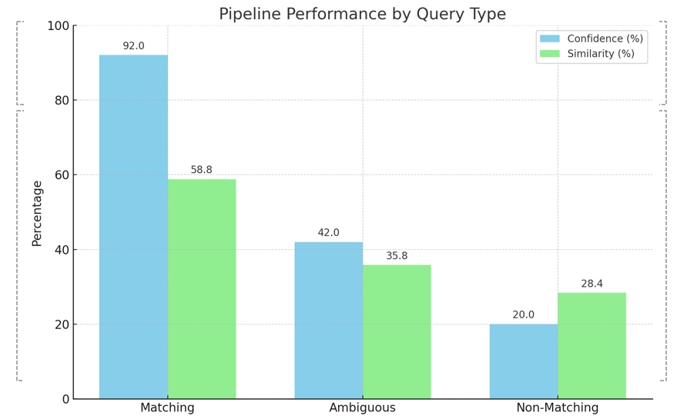

Slide 9
Demo showcase
Demo will Showcase:
Bm25: working independently with RASA
SBERT: working alongside bm25 and RASA
Will contain a brief explanation of how each part works

Slide 10
Demo

Slide 11
How it could be improved /ideas for future work

Slide 12
Team Roles
SBERT Clarifying Questions Retrieval Specialist:
Ansh Bisht
Project Manager:
Jordan Dickson
Lead Developer & System Integrator:
Jack Harrison
Information Retrieval Engineer:
Ruben Lazell
Scrum Master & System Designer:
Andrew Taison
Set up the SBERT model for sentence similarity.
Supported tuning and evaluation of the question ranking module.
Managed project tools including Kanban board and GitHub.
Organised team meetings.
Sourced Wikipedia summaries for retrieval.
Led implementation and integration of system modules.
Set up Rasa and handled communication between components.
Produced the system demonstration video.
Developed and tested the BM25 retrieval module.
Supported module integration and retrieval tuning.
Led team meetings and tracked weekly progress.
Designed the initial system structure.
Sourced and pre-processed the Qulac dataset.
Created templates for the report and presentation.
Responsibilities

