Slide 1


Fatal or Non-fatal: Comparative Study of Classification Algorithms for Cardiac Arrhythmias Discrimination
Alëna Rodionova, Haochen Han, Haotian Zhu and Po-Yuan Wang
CIS 520: Spring 2019
University of Pennsylvania

Slide 2

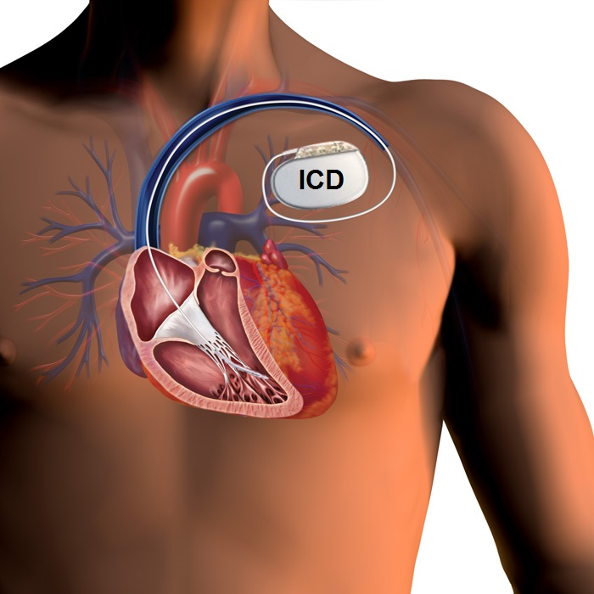
Real-Life Problem: VT/SVT Discrimination
Heart disease is the leading cause of death around the world.
More than 1000 Americans died each day in 2016 from heart attacks.
Ventricular Tachycardia (VT) is a potentially fatal arrhythmia.
Supraventricular Tachycardia (SVT) is not considered to be dangerous.
ICD shock to the heart to stop a fatal arrhythmia
Project goal: analyze cardiac arrhythmia discrimination algorithms
Notes:
40J shock. SCD is death that occurs within one hour of onset of symptoms in witnessed cases.
SCD starts with VT

Slide 3
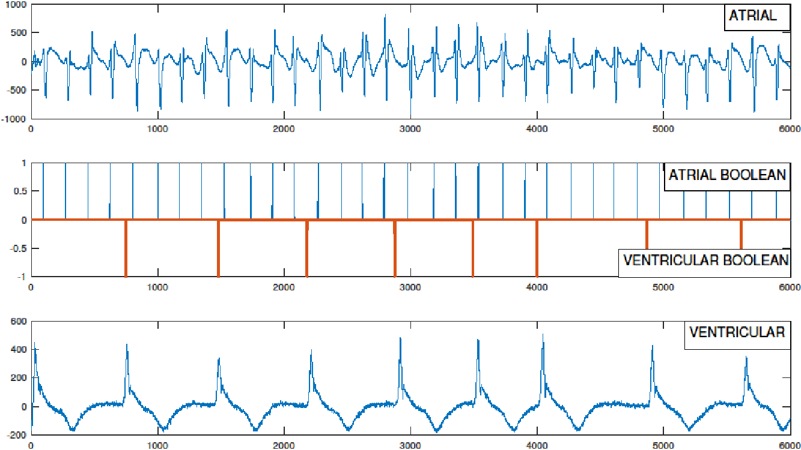
Datasets and performance measures
Ann Arbor Electrogram Libraries
89 EGM signals: 62 VT, 27 SVT
Cardiac model EGM database
1920 EGM signals: 960 VTs, 960 SVTs
FP (misclassifying SVT as VT) might lead to a process of further examination and treatment episodes
FN (misclassifying VT as SVT) might put the patient in the risk of death.
Complex performance measures:
TPR (# correctly detected VT/# true VTs)
TNT (# correctly detected SVT/# true SVTs)
Precision
[1] AAEL (http://electrogram.com/)
[2] Jiang et al. In-silico pre-clinical trials for implantable cardioverter defibrillators, 2016
Notes:
*The EGMs were generated by the heart model that has been validated for realism by cardiologists

Slide 4
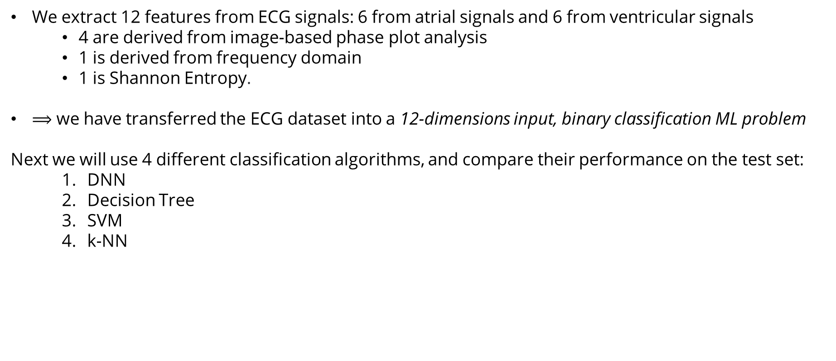
ML formulation

Slide 5
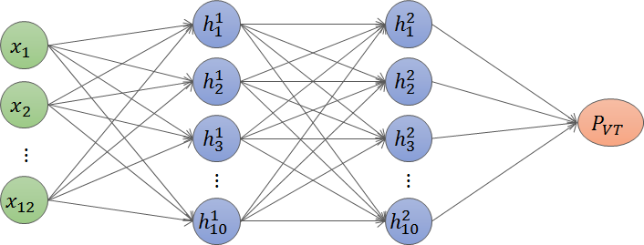
Approach 1: DNN
Data: 12-features representation.
Train: 800 VT, 800 SVT
Test: 160VT, 160 SVT
Feed-forward fully-connected neural network
12 input neurons, 2 hidden layers (10 neurons each, Relu), 1 output neuron (Logistic sigmoid)
Implementation: Python, Keras 2.2.4
Loss function: Cross entropy (log-loss)
Epochs: 3000
Mini-batch gradient descent: 128, learning rate: 0.01
FN, misclassifying VT as SVT: 14/160
FP, misclassifying SVT as VT: 7/160
Accuracy 0-1 | 0.9344
Sensitivity (TPR) | 0.9125
Specificity (TNR) | 0.9563
Precision | 0.9542
F1 | 0.933

Slide 6
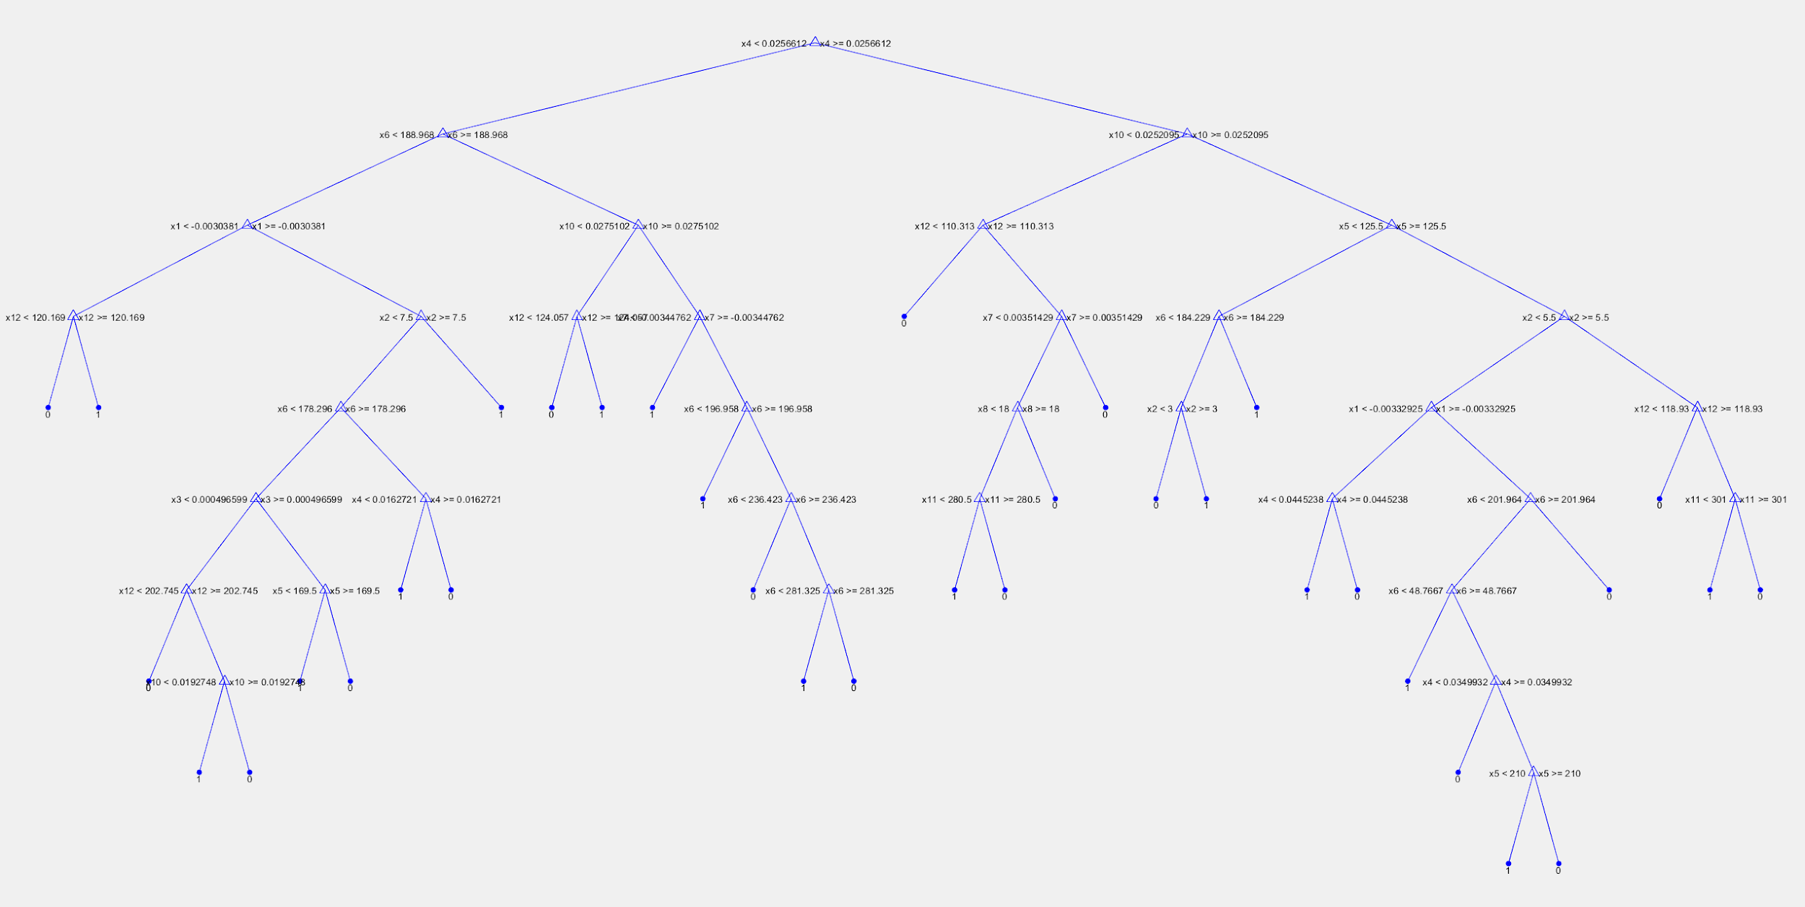
Approach 2: Decision Tree
Simple decision tree
Input 12 features
Accuracy: 93.13%
Sensitivity: 94.38%
Specificity: 91.88%
9 of the VT patient is marked as SVT
13 of the SVT patient is marked as VT

Slide 7
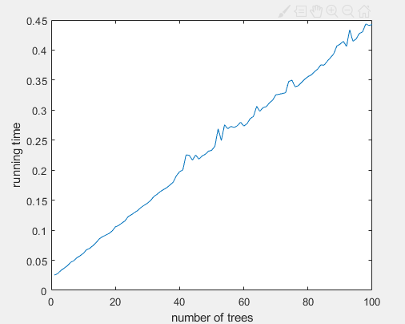
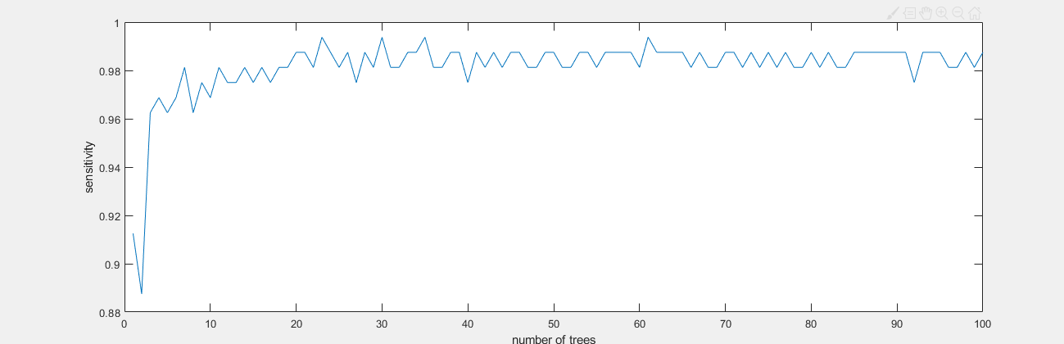
Approach 2: Decision Tree

Slide 8
Approach 3: SVM
Step1
Model: kernel SVM
Instance X: Artificial Dataset - Heart beat frequency (n * 1)
Label Y: {SVT, VT}
Accuracy (1-Test Error): 96%
Step 2
Input data: 12 features
Instance X : 12 features that have physiological meaning (n * 12)
Too few features, training/test time acceptable, no need for PCA
Accuracy: Artificial Dataset - 98%; Real Dataset – Ongoing
Step 3
Use Fourier transformation to extract k major waves (k frequencies with highest energy), record their frequencies, amplitudes, phases.
Instance X : n * (3 * k)
Accuracy: Real Dataset - >90-95% (small dataset)
Step 4 (Ongoing)
Use PCA on frequency spectrum after FFT (So that we can handle a shorter period of EGM)
Apply different cost on false positive and false negative.

Slide 9
Approach 4: k-NN
k-NN method
Distance: Euclidean distance
Data: 12-features representation.
Loss function: Logarithmic Loss
Accuracy on the test set: 94.37%

Slide 10
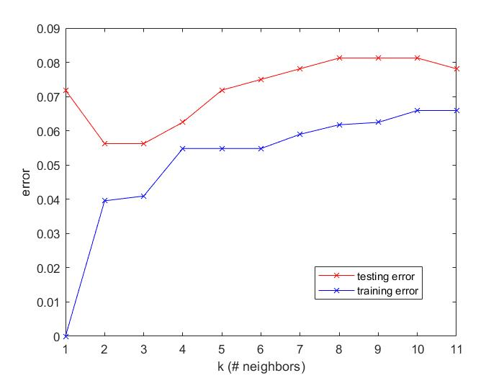
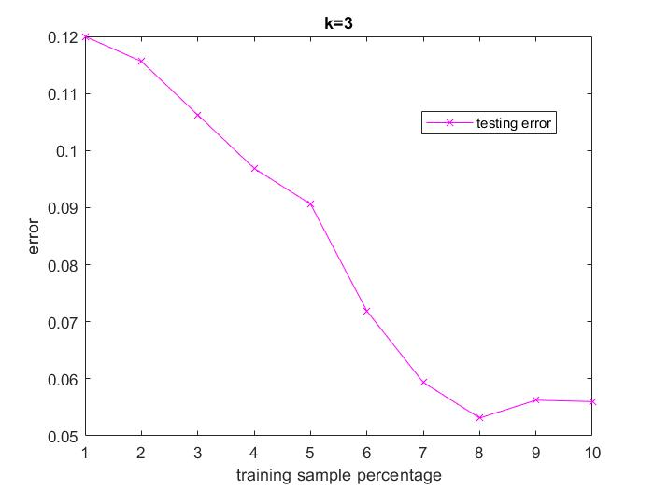
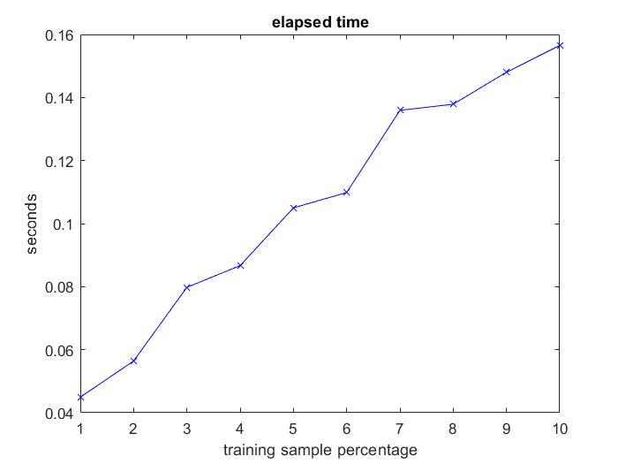
Approach 4: k-NN
k-NN error plot
computation time
Testing error has the smallest value (0.0563) when k=3.
Accuracy = 94.37%
Testing error decreases as training subsets become larger
Computation time in testing phase increases as data points increases

Slide 11
Approach 4: k-NN
when k=3
sensitivity (true positive) =90.625%
specificity (true negative)=94.375%
Result Analysis
As k grow larger, the error increase, possibly because data of same label is separated into different small groups, therefore, selecting too much neighbors might lead to selecting wrong label points.
As the training sets become larger, testing error decrease due to the voting system may be more accurate when more data are scatter in the space.
The computation time increase as the data set becomes larger because k-NN calculate the distance between every training points and testing points in the testing phase.
Reduced computation time by modifying distance calculation procedure.
Notes:
minkowski distance
chi square
correlation
validate point

Slide 12
Backup slides

Slide 14
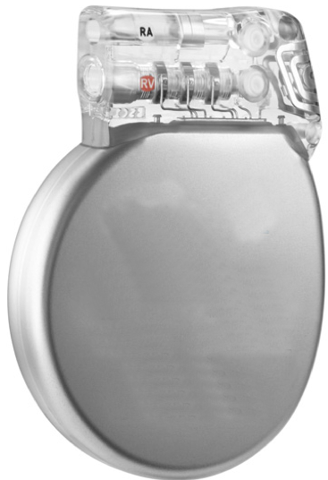
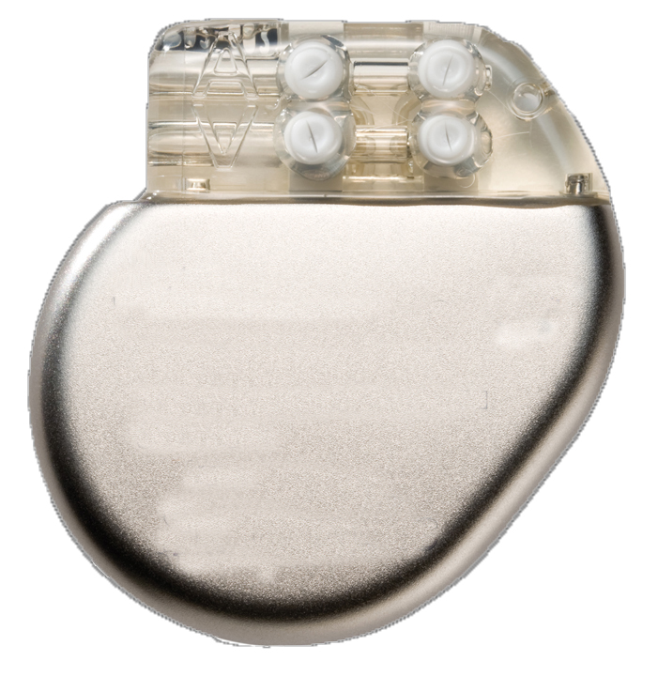
Life-Critical Autonomous Medical devices
Implantable Defibrillator
Stop a fatal arrhythmia by delivering a 40J shock to the heart
10,000 new patients every month
Implantable Pacemaker
Maintain a minimum appropriate heart rate
3 million patients worldwide
300,000 every year
Notes:
I will be talkin about QREs for arrhythmia detection algorithms. In particular, we consider algorithms that are implemented in ICDs and Pacemakers. Life-critical medical devices, that we, CC team, all know about.

Slide 15
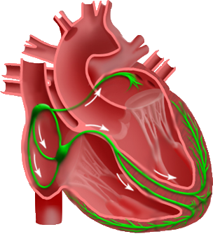

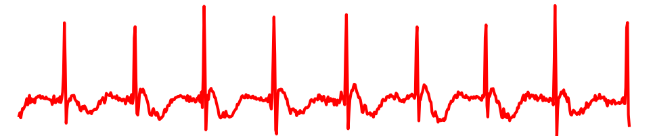
Therapy decision pipeline
Step 1
Step 2
Sensing
(Peak Detection)
VT/SVT Discrimination
Therapy decision
Discriminator #1
Discriminator #2
…
Discriminator #n
Notes:
Let’s consider the pipeline of how these devices operate.

Slide 16
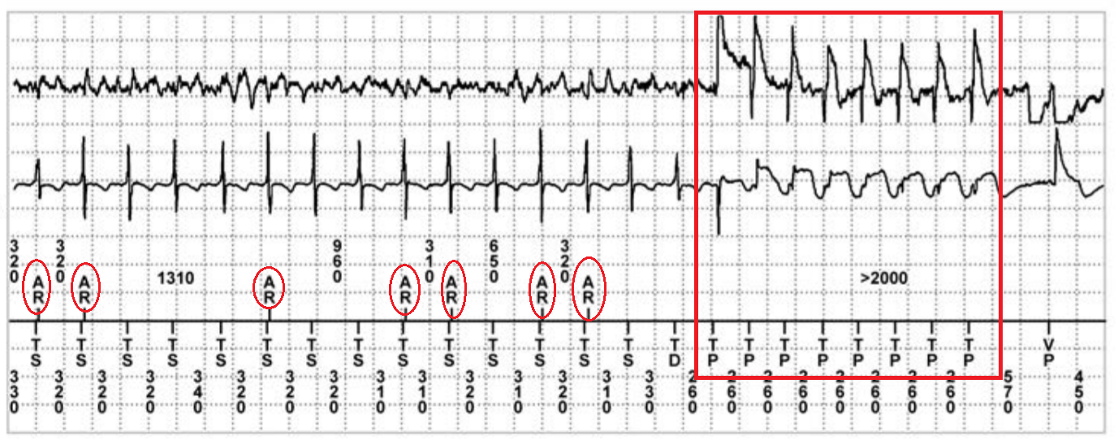
Life-Critical Autonomous Medical devices
Peak detection errors can be responsible for up to 10% of decision errors (mistake a fatal arrhythmia for non-fatal or vice-versa)
Atrial EGM:
Ventricular EGM:
A sensed:
V sensed:
Notes:
In the same paper he shows lots of examples of when this might happen. And this particular example presents how the undersensing in Atrial channel, might affect the final decision and lead to an inappropriate therapy

