Slide 1


Fatal or Non-fatal: Comparative Study of Classification Algorithms for Cardiac Arrhythmias Discrimination
Alëna Rodionova, Haochen Han, Haotian Zhu and Po-Yuan Wang
CIS 520: Spring 2019
University of Pennsylvania

Slide 2

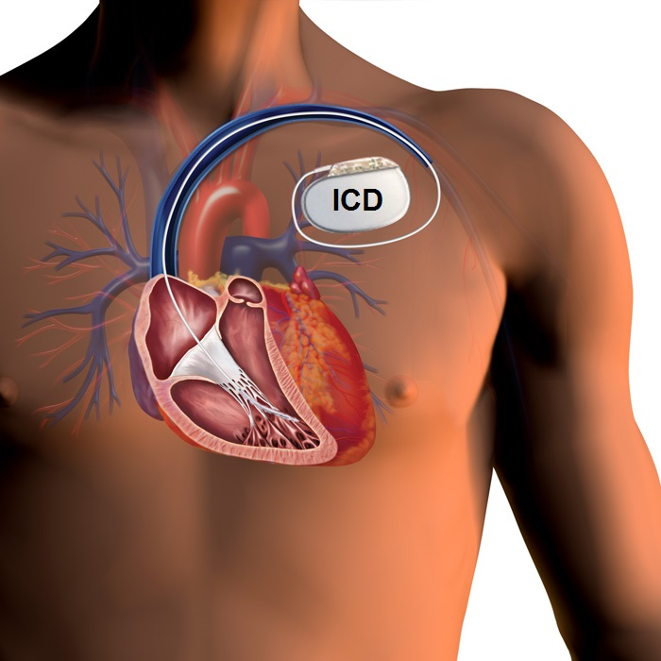
Real-Life Problem: VT/SVT Discrimination
Heart disease is the leading cause of death around the world.
More than 1000 Americans died each day in 2016 from heart attacks.
Ventricular Tachycardia (VT) is a potentially fatal arrhythmia.
Supraventricular Tachycardia (SVT) is not considered to be dangerous.
ICD shock to the heart to stop a fatal arrhythmia
Project goal: analyze cardiac arrhythmia discrimination algorithms
Notes:
40J shock. SCD is death that occurs within one hour of onset of symptoms in witnessed cases.
SCD starts with VT

Slide 3
Datasets and performance measures
[1-2] Jiang et al. In-silico pre-clinical trials for implantable cardioverter defibrillators, 2016
EGM database
Cardiac model EGM database
1920 EGM signals:
960 VTs
960 SVTs
FP (misclassifying SVT as VT) might lead to a process of further examination and treatment episodes
FN (misclassifying VT as SVT) might put the patient in the risk of death.
Complex performance measures:
TPR (# correctly detected VT/# true VTs)
TNT (# correctly detected SVT/# true SVTs)
Precision
Notes:
*The EGMs were generated by the heart model that has been validated for realism by cardiologists

Slide 4
ML formulation

Slide 5
Approach 1: DNN
Feed-forward fully-connected neural network
Relu activation functions with a sigmoid at the output layer
Data: 12-features representation.
Train:
Test:
2 hidden layers (BLA neurons), 12 input neurons, 2 output neurons
Loss function:
Epochs:
Implementation: Python, Keras 2.2.0
Accuracy on the test set:

Slide 6
Approach 2: Decision Tree (details & results)

Slide 7
Approach 3: SVM (details & results)
Step1
Model: kernel SVM
Instance X: Artificial Dataset - Heart beat frequency (n * 1)
Label Y: {SVT, VT}
Performance: 96%
Step 2
Input data: 12 features
Instance X : 12 features that have physiological meaning (n * 12)
Too few features, training/test time acceptable, no need for PCA
Performance: Artificial Dataset - 98%; Real Dataset – Ongoing
Step 3
Use Fourier transformation to extract k major waves (k frequencies with highest energy), record their frequencies, amplitudes, phases.
Instance X : n * (3 * k)
Performance: Real Dataset - >99% (small dataset)
Step 4 (Ongoing)
Use PCA on frequency spectrum after FFT (So that we can handle a shorter period of EGM)
Apply different cost on false positive and false negative.

Slide 8
Approach 4: k-NN (details & results)
k-NN method
Distance: euclidean distance
Data: 12-features representation.
Loss function: Logarithmic Loss
Accuracy on the test set: 94.37%

Slide 9
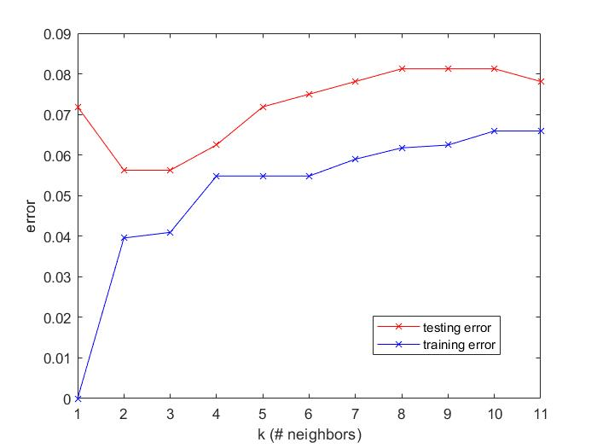
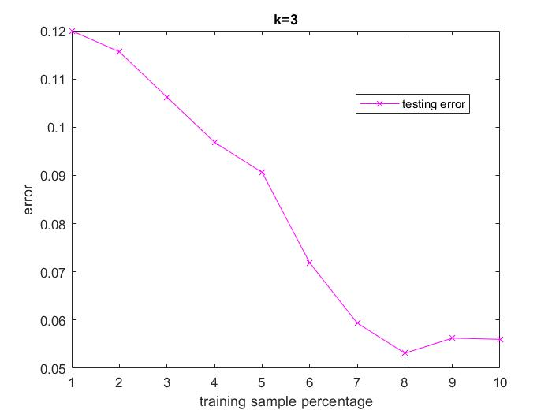
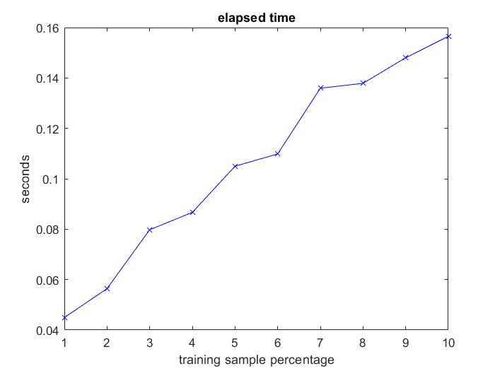
Approach 4: k-NN (details & results)
k-NN error plot
computation time
Testing error has the smallest value (0.0563) when k=3.
Accuracy = 94.37%
Testing error decreases as training subsets become larger
Computation time in testing phase increases as data points increases

Slide 10
Backup slides

Slide 12
Our contribution
Use Quantitative Regular Expressions[*] to describe the operations of an ICD: peak detection and discrimination
A quantitative extension of regular expressions: compute arbitrary functions on segments of input signal that match a symbolic regular expression
ICD algorithms in Temporal Logic | ICD algorithms in QRE
Different tasks require different logics. Some tasks not expressible in any logic today | One formalism for all tasks
Must learn different logics, many tasks awkward to express or not succinct | Declarative language that makes programming in it simpler
Guarantees vary according to the logic | Guarantees bounded time and memory consumption per data item that is independent of the input signal length
Many logics are undecidable | Potential for formal analysis of resulting programs

Slide 13
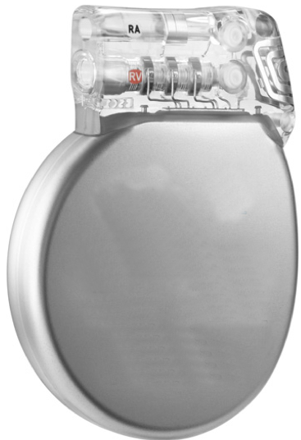
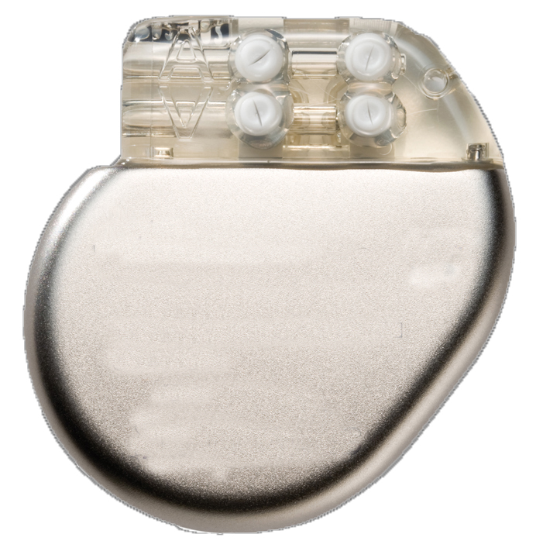
Life-Critical Autonomous Medical devices
Implantable Defibrillator
Stop a fatal arrhythmia by delivering a 40J shock to the heart
10,000 new patients every month
Implantable Pacemaker
Maintain a minimum appropriate heart rate
3 million patients worldwide
300,000 every year
Notes:
I will be talkin about QREs for arrhythmia detection algorithms. In particular, we consider algorithms that are implemented in ICDs and Pacemakers. Life-critical medical devices, that we, CC team, all know about.

Slide 14
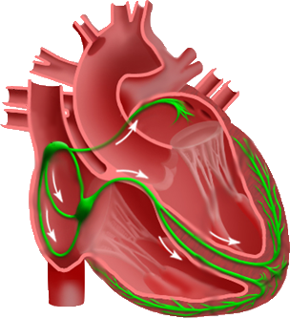
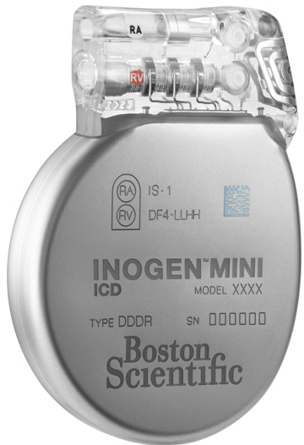
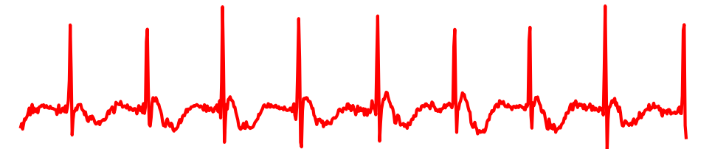
Therapy decision pipeline
Step 1
Step 2
Sensing
(Peak Detection)
VT/SVT Discrimination
Therapy decision
Discriminator #1
Discriminator #2
…
Discriminator #n
Notes:
Let’s consider the pipeline of how these devices operate.

Slide 15
Therapy decision pipeline
Step 1
Step 2
Sensing
(Peak Detection)
VT/SVT Discrimination
Therapy decision
Discriminator #1
Discriminator #2
…
Discriminator #n
Notes:
ICD or a pacemaker records a real-valued electrogram signals coming directly from the heart. It might be a ventricual signal, or atrial signal or both.

Slide 16
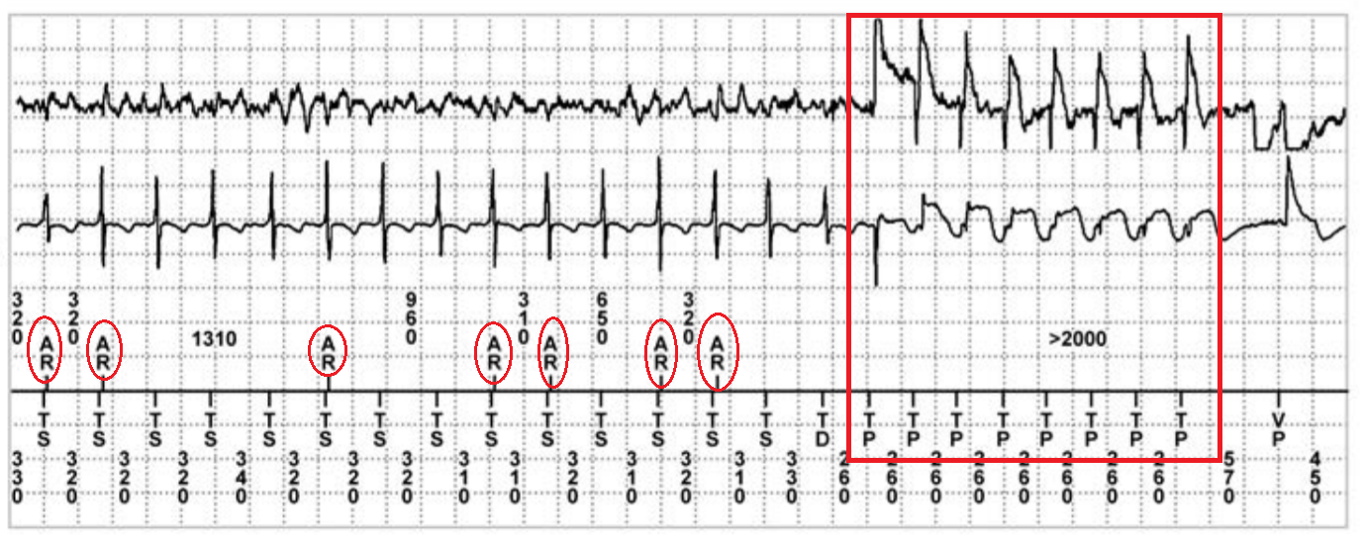
Life-Critical Autonomous Medical devices
Peak detection errors can be responsible for up to 10% of decision errors (mistake a fatal arrhythmia for non-fatal or vice-versa)
Atrial EGM:
Ventricular EGM:
A sensed:
V sensed:
Notes:
In the same paper he shows lots of examples of when this might happen. And this particular example presents how the undersensing in Atrial channel, might affect the final decision and lead to an inappropriate therapy

