Slide 1
Authentication and Authorization
UT CS361S
Spring 2021
Lecture Notes

Slide 2
Authentication/Authorization
Validating Identity
Permissions Assigned to a Validated Identity

Slide 3
The Authentication Process
CLAIM: Identity X
CHALLENGE: Prove it
AUTHENTICATOR
PROOF: Credential 1
PROOF: Credential 2
PROOF: Credential n

Slide 4
Authentication Mechanism
VERIFIER
COMPUTATION & ALGORITHMIC COMPONENTS
INPUT
TRANSPORT
DATABASE

Slide 5
The Big Three
Something you KNOW
Something you HAVE
Something you ARE

Slide 6

KNOW: Passwords
Security Requirements
The password is ONLY known by the party seeking authentication
The password cannot be easily guessed by human or computer
The password will not be forgotten by the party seeking authentication

Slide 7
Sidebar: Hashing
F(x)
ARBITRARY DATA
FIXED SIZE “HASH”
THIS IS CALLED THE “PRE-IMAGE”

Slide 8
Required Properties
“Compression”: The size of x is unbounded; the size of f(x) is fixed
“Ease of Computation”: f(x) is “easy” to compute
“Preimage Resistance”: Given y, it is “hard” to find x
“2nd Preimage Resistance”: Given x and f(x)=y, “hard” to find f(x’)=y
“Collision Resistance”: It is hard to find (x, x’) where f(x) = f(x’)

Slide 9
Simple Intuition
A hash is a small, fixed size mathematical fingerprint of data
You cannot recover or predict the data given the fingerprint
Any change in the data results in a complete change of the fingerprint

Slide 10
Common Hash Algorithms
MD5 – DEPRECATED, DON’T USE
SHA1 – DEPRECATED, DON’T USE
SHA256 – Currently Recommended
EXAMPLES:
sha256(“hello”)
2cf24dba5fb0a30e26e83b2ac5b9e29e
1b161e5c1fa7425e73043362938b9824

Slide 11
Salted Hashes
Google “5e884898da28047151d0e56f8dc6292773603d0d6aabbdd62a11ef721d1542d8”
The SHA256 hash of something will be the same until the end of time
If we want the output to be unrecognizable, we can add a “salt”
A salt is just some random data. It can be publicly known
SHA256(“hello”+32 bytes of random) = a random value

Slide 12
Password Registration
COMPUTATION & ALGORITHMIC COMPONENTS
TERMINAL
NETWORK
Compute
D = HASH(Y, salt k)
Transport
Identity X
Password Y
Input
Identity X
Password Y
DATABASE
ID X: k, D
Store identity, Salt, Hash

Slide 13
Password Verification
COMPUTATION & ALGORITHMIC COMPONENTS
TERMINAL
NETWORK
Verify
D’ = HASH(Y, salt k)
Load D
Compare D == D’?
Transport
Identity X
Password Y
Input
Identity X
Password Y
DATABASE
ID X: k, D

Slide 14
Common Problems
Interception
COMPUTATION & ALGORITHMIC COMPONENTS
TERMINAL
NETWORK
Forgot PW
Shared PW
Easily Guessed PW
DATABASE
ID X: k, D
Trojans
Insiders
WeakHash
Key Logers

Slide 15

Something you Have
Security Assumptions
The “token” is ONLY possessed by the party seeking authentication
The token cannot be easily forged or duplicated
The authentication protocol is secure

Slide 16
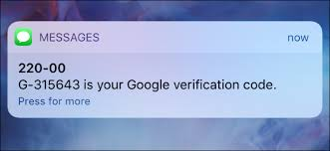
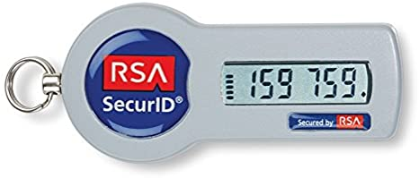
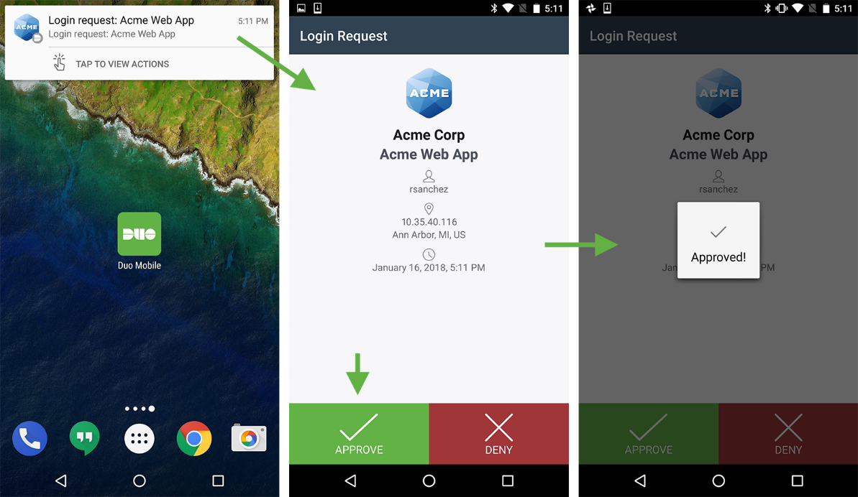
Something you Have Examples

Slide 17

Problems with “Tokens”
Is it REALLY something you have?
Is sending a code by email 2-factor?
What about phone cloning?
What about network interception?
Is an RSA Token’s seed just something you know?
“Something you can respond with”

Slide 18
Something you Are
Security Assumptions
The “characteristic” is effectively unique
Can effectively measure, record, or detect the characteristic
Characteristic cannot be forged, replicated, or otherwise “lost”
Characteristic will not change (too much) over time
Characteristic will never need to be revoked
The Authentication Protocol is Secure!

Slide 19
False Positives vs False Negatives
False Negative – Do not authorize party with valid characteristic
False Positive – Authorize party with invalid characteristic

Slide 20

Receiver Operating Characteristic
The trade off between FP and FN
Decreasing one typically increases the other
Equal Error Rate is when FP approximately equals FN
In most biometrics, False Negatives are worse

Slide 21
Problems with Biometrics
Fingerprinting has been *seriously* misused in Courts (see Anderson at pp. 469-470)
Interpretation of results and understanding of statistics
Variable accuracy in scanning mechanism
“Freshness”
Belief in infallibility leads to security culture problems
Biometrics exclude a *lot* of people (e.g., differently abled)
Cvil Rights and Privacy issues
Injury that alter the characteristic (e.g., fingerprint)

Slide 22
Access Controls
The mechanism by which authorization permissions are managed
Within most information systems, the most common controls:
(C)reate
(R)ead
(U)pdate
(D)elete
Most other controls can be thought of as a form of one of these
(But “Execute” is often listed separately)

Slide 23
Every-day Approaches
Access Control Lists
Capabilities

Slide 24
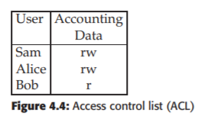
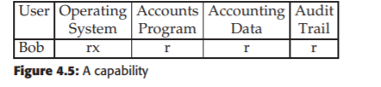
One View of ACL/Capabilities

Slide 25
Broader Concept
A capability is an enabling technology for access
An access control list is a filtering technology for access

Slide 26
Opponents of capabilities argue that you cannot change a file’s status
They just don’t understand capabilities
System Disable
Capability
Façade to File A
File A

Slide 27
MAC vs DAC
Mandatory Access Controls – what is permitted is determined by policy
Discretionary Access Controls – what is permitted is determined by user

Slide 28
Multi-Level Security (MLS)
Often seen as synonymous with MAC
Users and data are assigned classifications
What users are permitted to do with data depends on both labels

Slide 29
Bell Lapadula Model
Design emerged from military document classification
Enforces two properties
Simple Security Property: No Read Up (NRU)
*-Property: No Write Down (NWD)
The *-property was the big innovation of BLP. It assumed trojans and buggy code!
This is a well defined security policy
It is relatively easy to determine if the mechanisms enforce the policy
If it’s the right policy it works great!

Slide 30
Problems of BLP
If the security officer can “temporarily declassify” all of the protections go away
Strong tranquility: security labels never change during operation
Weak tranquility: labels never change in a way that violates security policy
The idea here is “least privilege”. Even if you have TS, start at unclassified
As you access info that is higher, your level increases
The system can get fragmented into pieces that can’t communicate
Also, what do you do with an App that has to straddle?
A document editor used to redact a TS document to Classified
Doesn’t deal with creation of subjects or objects

Slide 31
Biba model
Upside-down BLP
You can only read up and write down
The goal is integrity not confidentiality
Partially used in Vista. Uses the NoWriteUp.
Most files are “medium” or higher. IE is “low”
So, things downloaded can read most files, but not write to them!
This was the first formal model of integrity
Struggled in real-world because of the exceptions and straddling issues

Slide 32
Inference
Information sharing often involves some kind of “scrubbing”
In MLS, a report is redacted before moving down a security layer
In privacy-preserving systems, data is often anonymized
The problem, of course, is inference
People can often be identified by their medical records even with names removed
And, of course, we’ve seen this with AOL and Google

Slide 33
Inference Control
Characteristic formula – the query instructions to get some set
Query set – the set produced by a characteristic formula
Sensitive Statistics – stats that deanonymize information:
For example, if the set is too small, than we’ve identified an individual by attributes

Slide 34
Query Size
You can limit how small a result is from a query
But you also have to worry about returning N-1!!
Also, you have to deal with using multiple queries to get a smaller than N intersection

Slide 35
Role Based Access Control
RBAC
Users assigned roles, permissions based on roles
Is this MAC or DAC?
Lessons from the field: what goes wrong in RBAC?

Slide 36
Authorization Principles
Least Privilege
Separation of Duties

