Slide 1
World Wide Web Design, Security,& Threats
Law 379M – Technology of Cybersecurity
Fall 2021
Lecture Notes

Slide 2

What is the World Wide Web?
Internet - globally interconnected network system
World Wide Web - HTTP-based content, apps, “ecosystem”
WORLD WIDE WEB
Website
Browser
HTTP
INTERNET

Slide 3
Key Tech: Domain Name System (DNS)
IPv4 addresses were hard to remember/use
IPv6 are worse
Humans need semantically meaningful addresses
DNS maps IP addresses to domain names

Slide 4
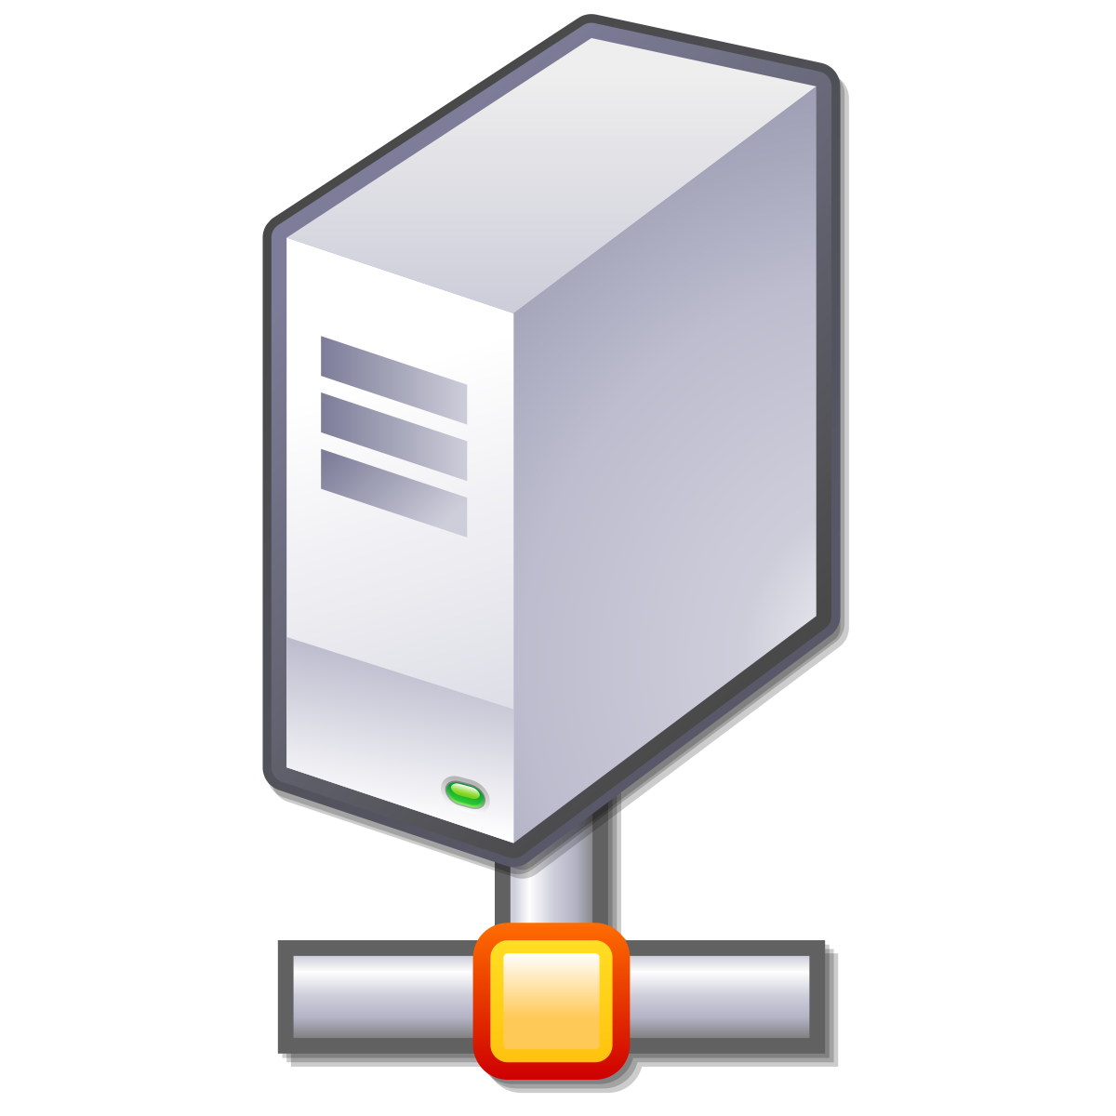
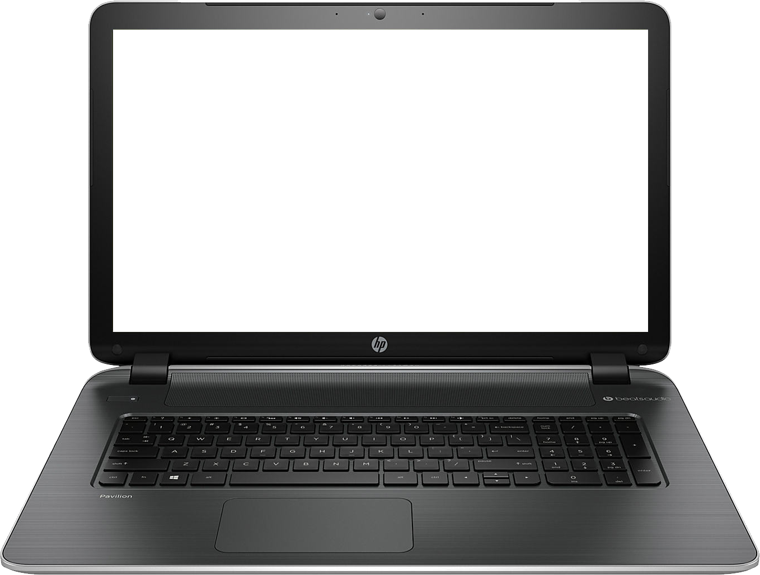

Basic Idea
Where is “google.com?”
142.250.138.138
DNS SERVER
http://google.com
GET / HTTP/1.1
142.250.138.138
(google.com)

Slide 5
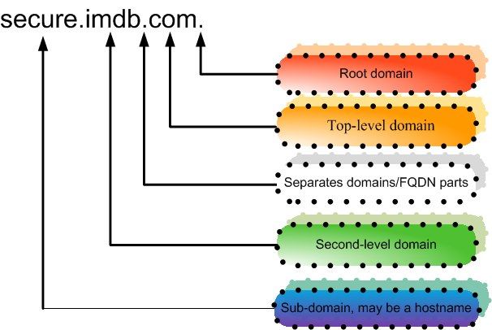

Slide 6
Top Level Domains (TLDs)
Generic Top Level Domain (gTLD) - .com, .net, et
Country code Top Level Domain (ccTLD) - .uk

Slide 7
TLD Name Management
Registrars administer TLDs
For gTLDs, this is a business with pros and cons
Registrars authorize “domain name registrars”

Slide 8
Domain Name Registration
Party requests SLD + TLD from domain name reseller
Party submits “whois” information (contact info)
Registrar verifies that name is available
Registrar stores relevant data in registry and DNS servers

Slide 9
DNS and Address Resolution
DNS is a recursive and hierarchical process
Recursive – DNS server searches another DNS server
Hierarchical –
Root Domain to TLD
TLD to Subdomain

Slide 10
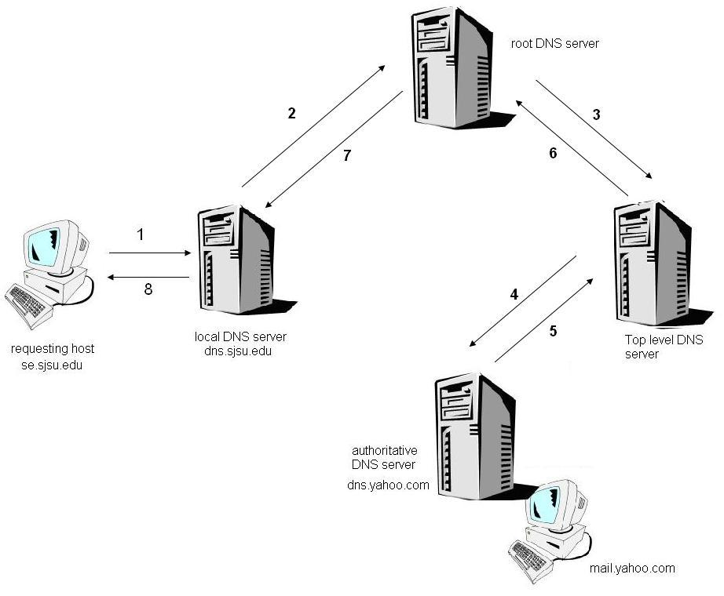

Slide 11
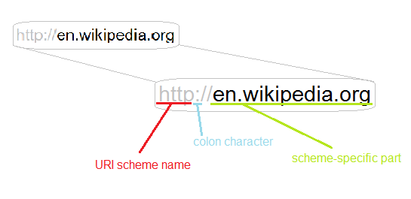
Uniform Resource Identifiers (URIs)

Slide 12
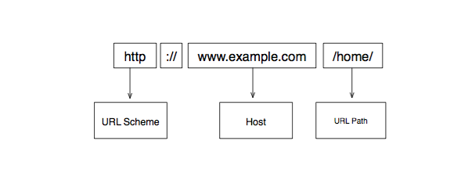

Slide 13
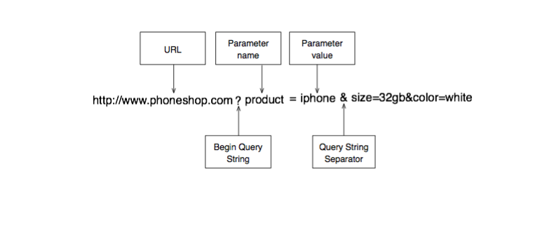

Slide 14
Absolute vs Relative URI
Absolute paths begin with <scheme>://host/
e.g., http://www.google.com/
Everything else is relative
e.g., /not/an/absolute/path
The scheme and host are determined by context

Slide 15
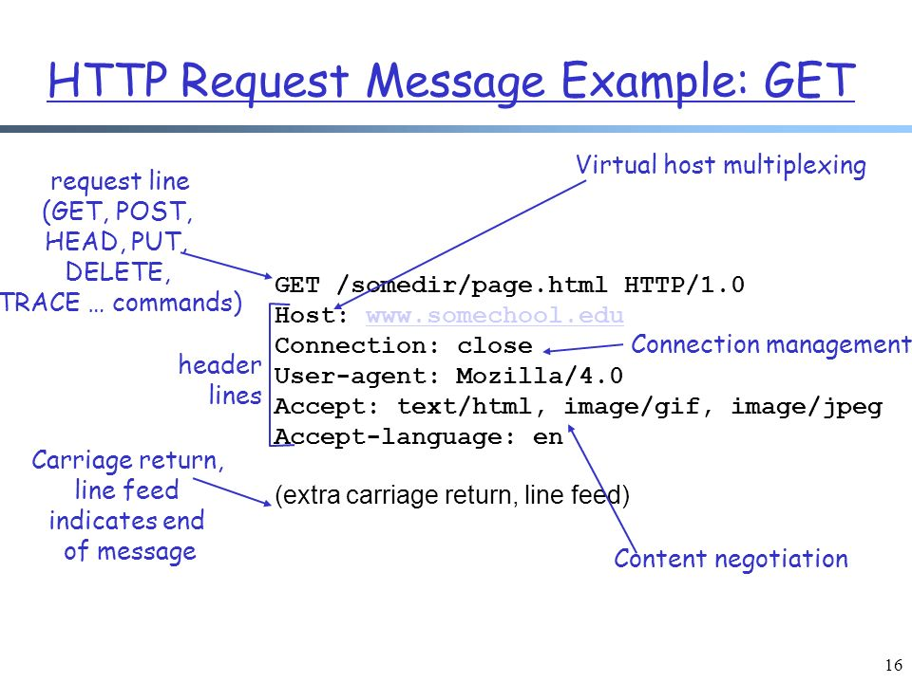
HTTP Request

Slide 16
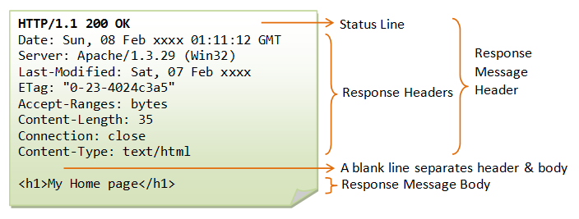
HTTP Response

Slide 17
Static Web Page Example
<HTML>
<BODY>
<H1>Simple Web Page</H1>
<IMG SRC=“/images/image1.jpg”>
</BODY>
</HTML>

Slide 18
Rendering a Web Page
Browser requests HTML “root” page
Root page has links for images, etc
Browser requests embedded objects
Browser integrates and renders objects

Slide 19
Web Root
/
someserver.com/a/b/c.html
images
a
image1.jpg
z
b
c.html
HTTP GET
/a/b/c.html
Browser
(Google Chrome)
WEB SERVER
(http://someserver.com)

Slide 20
<HTML>
<BODY>
<H1>Simple Web Page</H1>
<IMG SRC=“/images/image1.jpg”>
</BODY>
</HTML>
c.html
someserver.com/a/b/c.html
Simple Web Page
?
HTTP RESPONSE
c.html
Browser
(Google Chrome)
WEB SERVER
(http://someserver.com)

Slide 21
Web Root
/
someserver.com/a/b/c.html
Simple Web Page
images
a
?
z
b
image1.jpg
c.html
HTTP GET
/images/image1.jpg
Browser
(Google Chrome)
WEB SERVER
(http://someserver.com)

Slide 22


image.jpg
someserver.com/a/b/c.html
Simple Web Page
HTTP RESPONSE
Image.jpg
Browser
(Google Chrome)
WEB SERVER
(http://someserver.com)

Slide 23
Let’s try it again… look for the change…
Web Root
/
someserver.com/a/b/c.html
a
z
b
c.html
HTTP GET
/a/b/c.html
Browser
(Google Chrome)
WEB SERVER
(http://someserver.com)

Slide 24
<HTML>
<BODY>
<H1>Simple Web Page</H1>
<IMG SRC= “http://google.com/images/image1.jpg”>
</BODY>
</HTML>
c.html
someserver.com/a/b/c.html
Simple Web Page
?
HTTP RESPONSE
c.html
Browser
(Google Chrome)
WEB SERVER
(http://someserver.com)

Slide 25


someserver.com/a/b/c.html
Simple Web Page
?
HTTP GET
/images/image1.jpg
images
image1.jpg
Browser
(Google Chrome)

Slide 26
image.jpg
someserver.com/a/b/c.html
Simple Web Page
HTTP RESPONSE
Image.jpg
Browser
(Google Chrome)

Slide 27
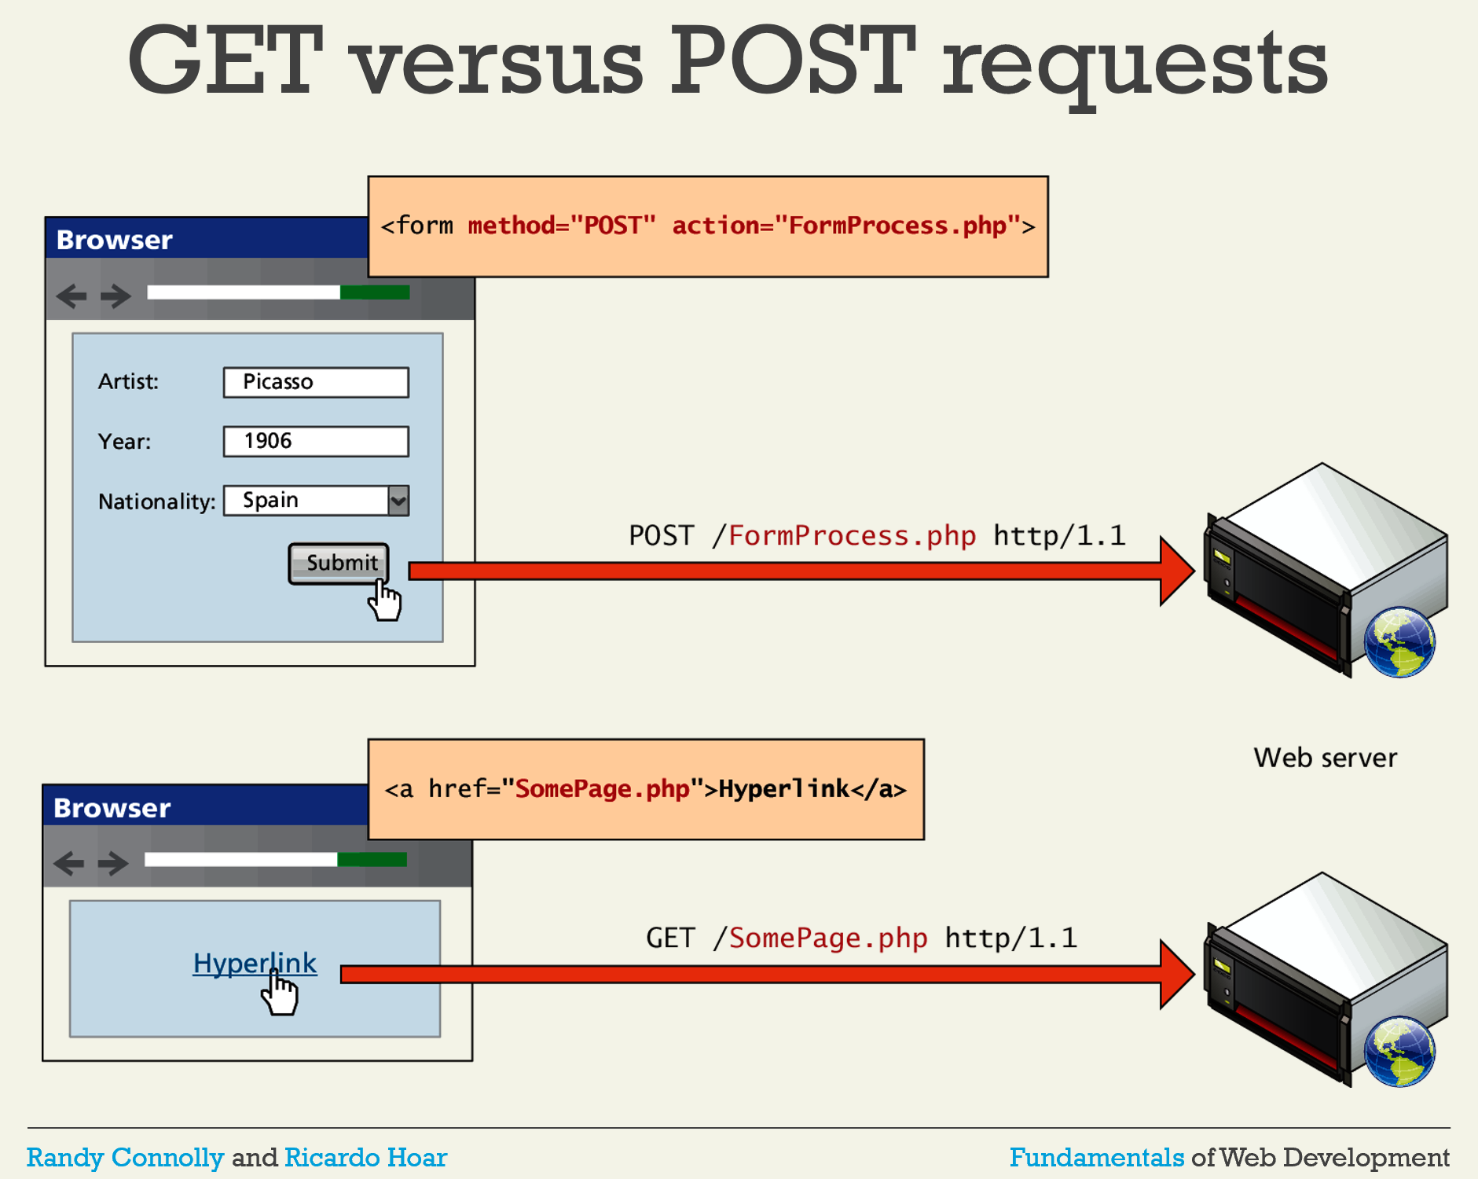

Slide 28
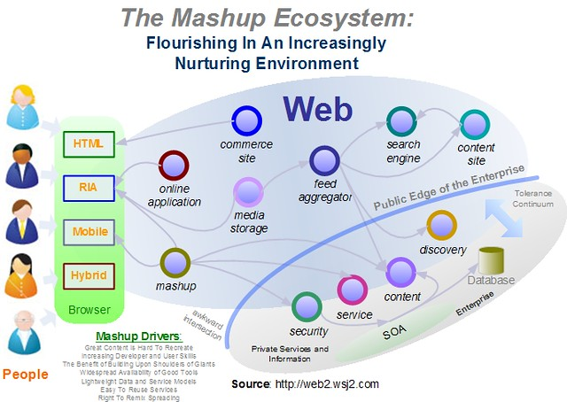
Web 2.0 and Beyond

Slide 29
Cookies
HTTP is STATELESS
A webserver doesn’t “connect” requests
To simulate a “session”, use cookies
Put “cookie: <session id>” in request/response header

Slide 30
Basic Idea
GET \ HTTP/1.1
Cookie: ac39f210ef120
Browser 1: google
Browser 2: google
Page 1
Page 2
GET \ HTTP/1.1
Cookie: 9b8dde1783ff3e

Slide 31
Cookies and Domains
Cookies are most assigned by domain
For example, “google.com” cookies
This is important for security and privacy

Slide 32
Cookies Demo

Slide 33
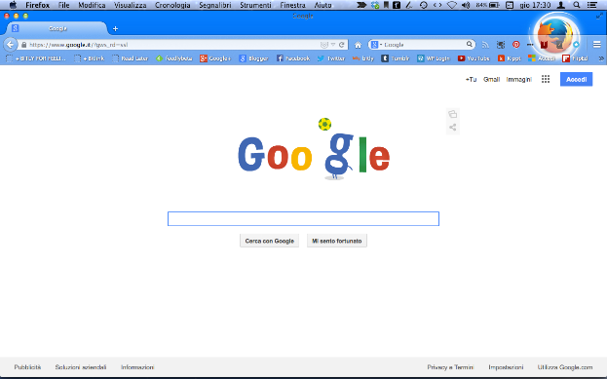

Browser to Website Security
TLS provides end-to-end security
What are the “ends”?
SECURE TLS CHANNEL
This Photo by Unknown Author is licensed under CC BY-SA
This Photo by Unknown Author is licensed under CC BY-SA
BROWSER
SERVER

Slide 34



Trusting the Server (Backend)
TLS doesn’t prevent the server
from sharing with 3rd parties…
Sharing with Government
Sharing with Criminals
This Photo by Unknown Author is licensed under CC BY-SA
SERVER
This Photo by Unknown Author is licensed under CC BY-SA

Slide 35

Trusting the Server (Frontend)
TLS doesn’t prevent the server
from directing your browser
to a third party server
This Photo by Unknown Author is licensed under CC BY-SA
SECURE TLS CHANNEL
This Photo by Unknown Author is licensed under CC BY-SA
This Photo by Unknown Author is licensed under CC BY-SA
BROWSER
SERVER

Slide 36
Security Concerns
Protecting user privacy
Protecting cookies
Protecting multi-source webpage from “bleeding” info
Protecting dynamic webpages from corruption

Slide 37
User Privacy
Communications with a website are not shared
Cannot be tracked without permission

Slide 38
Cookies Again
Not just used for login
Store info about user’s session
ONLY SENT BY BROWSER TO SAME DOMAIN
Cookies for google.com never sent to amazon.com
BUT WHAT ABOUT MULTI-SOURCE WEBPAGES?!

Slide 39
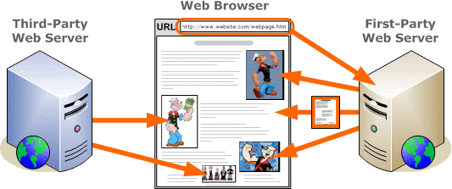
First-Party, Third Party

Slide 40
Problem of 3rd Party Cookies
3rd-party cookies can be spread across many sites
Example: ad server serving ads on many webpages
Ad server tracks you across all the pages it serves
Thus most browsers not block 3rd party cookies

Slide 41
Bypassing Blocked 3rd Party Cookies
First-party façade: advertising_company.amazon.com
Collusion: first-party, third-party share data
First-party can send data to third-party in URL
<IMG src=“http://third-party?cookie=stolen”>

Slide 42
Conspiracy How-To
The main website creates an agreement with the 3rd party. “I’ll send you X data for Y dollars.” 3rd party provides a communication protocol.
Typically, a URL with the transmitted info
included as part of the URL!
1X1 tracking pixels, for example:
3rd Party
Main Website
<IMG SRC=“http://third-party.com/shared-info>

Slide 43
Broader Conspiracy
Normally, one 3rd party can’t share data with another. (Same origin policy). But, when they all work with one ad delivery platform, that platform coordinates sharing.
3rd Party 1
Website 1
Ad Delivery Platform
3rd Party 2
Website 2
Website 3
3rd Party 3

Slide 44
Dynamic webpage can READ itself!
Downloaded content is not just “static”
Dynamic webpage can ask the browser about itself
“Browser, what is displayed on the webpage?”

Slide 45
A VERY Brief Intro to JavaScript
Web pages don’t just have text
Include mini-programs called scripts
Typically written in a language called JavaScript
EXECUTES IN THE BROWSER (not on the server)

Slide 46
<HTML>
<BODY>
<H1>Simple Web Page</H1>
<script>
(javascript goes here)
</script
</BODY>
</HTML>
dynamic.html
someserver.com/a/b/c.html
Simple Web Page
HTTP RESPONSE
dynamic.html
Browser
(Google Chrome)
WEB SERVER
(http://someserver.com)
Javascript runs when the page loads

Slide 47
What can JavaScript Do?
It can read the contents of the page
It can change the contents of the page
It can send/receive data over the network

Slide 48
PROBLEM: Javascript from 3rd Party
The following is NOT allowed:
GET webpage
Website
HTML with <IFRAME>
from adserver
Browser
GET ads IFRAME
EVIL IFRAME!!!
3rd Party Server (like ads)
Evil IFRAME could ask the
Browser for the contents
of the website, seeing/changing
Sensitive data

Slide 49
Preventing 3rd Party Attacks
IFRAMES are isolated. Cannot ask about the rest of the page
SAME ORIGIN POLICY:
Data from a website can only be sent back to that website
Example: Javascript only talks to server it came from
Example: cookies only sent to server it came from

Slide 50
Dynamically Generated Pages
Most webpages are not files these days
Instead, they are created on-the-fly

Slide 51
<HTML>
<BODY>
<H1>Weclome Seth/H1>
User since 02/01/2013
</BODY>
</HTML>
Server creates “c” when after it receives the request
HTTP GET
/a/b/c
Cookie: XYZ
DATABASE
WEB SERVER
(http://someserver.com)
Cookie | User | Join Date
XYZ | Seth | 02/01/2013

Slide 52
Cross-Site Scripting (XSS)
Attacker tries to insert their own JavaScript
Some XSS worked by exploiting bugs in browsers
Most often inserted into dynamically created page

Slide 53
The Attacker gets Evils JavaScript inserted either through a “reflection” attack or “storage” attack. Once operational, it can impersonate the user, including all of their cookies and settings. Moreover, the Evil JS can communicate with the attacker for data exfiltration or ongoing real-time control.
XSS Visualization
WEB SERVER
HTTP Request w/ Cookie
HTTP Response
AUTHORIZED WEBPAGE
ATTACKER
Command and Control
EVIL JS
Exfiltrated:
Web server response
Cookies including session auth
User Browser

Slide 54
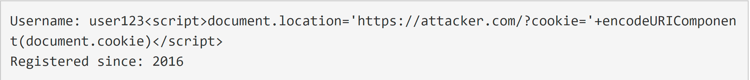
Example:
The User’s “name” has been corrupted to include a “script” that will run every time it is displayed
This is the Database
The script connects to the attacker’s website with the user’s cookie encoded as a parameter to the URL. This bypasses the Same Origin Policy (any URL is allowed)

Slide 55
The primary defense against XSS attacks is filtering inputs and escaping outputs. These defenses actually stop and eliminate the XSS attack altogether.
Secondary defenses mitigate XSS attacks by preventing XSS JS from exfiltrating some kinds of data. For example, cookies marked “HttpOnly” cannot be read by JavaScript in most modern browsers.
XSS Visualization
WEB SERVER
HTTP Request w/ Cookie
HTTP Response
AUTHORIZED WEBPAGE
ATTACKER
Command and Control
EVIL JS
Exfiltrated:
Web server response
Cookies including session auth
User Browser

Slide 56
CSRF Visualization
WEB SERVER
Cross-Site Request Forgery is simpler than XSS. There is typically no JS and it is not typically two-way communication with the Attacker.
The idea is simply getting the victim to click on a link or otherwise transmit an HTTP request that causes an unauthorized transaction.
HTTP Request w/ Cookie
HTTP Response
AUTHORIZED WEBPAGE
EVIL LINK
User Browser

Slide 57
CSRF Visualization
WEB SERVER
A CSRF-Token is some unpredictable value embedded in the webpage that is used for identifying authorized requests. If done right, prevents the CSRF attack.
HTTP Request w/ Cookie
HTTP Response
AUTHORIZED WEBPAGE
(with CSRF Token)
EVIL LINK
User Browser

Slide 58
XSS and CSRF Demo

