Slide 1
Overlay Network Threats (eg Social Media)
LAW 379M
Fall 2021
Lecture Notes

Slide 2
Overlay Networks
Any network overlaid on top of another
Network Requirements:
1. Bootstrap (initial access)
2. Addressable
3. Routable
4. Data Transfer
Example: Social Media Networks (including Email)

Slide 3
The Power of Socially Connected Networks
Social networks are semantic
Networking is tied to human psychology
1. Bootstrap – friends, company, identity
2. Addressable – social connections
3. Routable – social graph (e.g., friends of friends)
4. Data Transfer – psychological investment

Slide 4
Social Network Vulnerabilities
Users import emotions/beliefs into the network
Users traffic in vitally important information
None of our “perimeter defense” applies
Attackers can directly attack the psychology surface
Attackers have valuable data

Slide 5
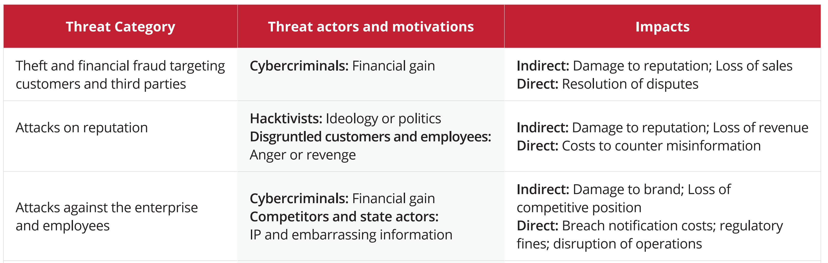
Common Attack Types:
Personal Theft or Fraud
Organization Theft or Fraud
Destruction of Reputation
Source: “A Taxonomy of Digital Threats”
Zero Fox Corporation

Slide 6
Email Threat: SPAM
You know what it is.
Why does it work?
Advertising
Pump and Dump
Malicious Payload/Malicious Links
Unregulated/Illegal Traffic

Slide 7
Spam Incentives
It costs virtually nothing to send emails
It costs the same to send 1 message vs 1 million
Many spam messages are sent by botnet
BULK messages: Less than 1% response rate is great

Slide 8
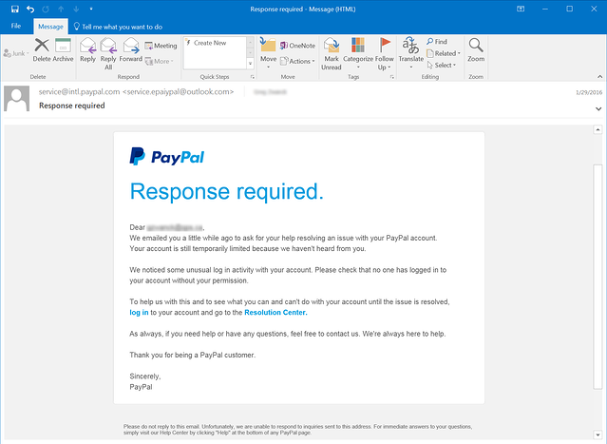
Email Threat: Phishing

Slide 9
Bulk Phishing Concepts
Psychology
Visually, looks authoritative
Urgency drives immediate behavior
Some phishing is very emotional
“Call to Action”
Typically, email response not desired
Includes either a bad link or malicious attachment
Bad link goes to fake website that looks real
BULK messages: Less than 1% response rate is great

Slide 10
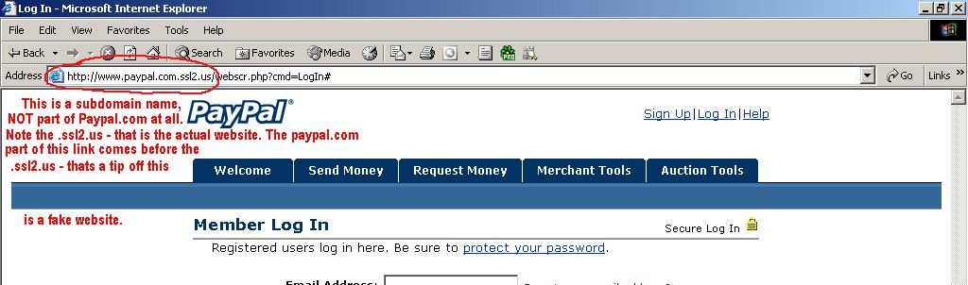
Phishing Links
Why do they need a fake URL?

Slide 11
Cloud Services as Links
Many phishing emails now use cloud service links
Amazon, Azure, etc. links are not blocked
Also, seem authoritative

Slide 12
Note About Phishing Training
I’ve yet to see it work.
Lots of companies try. Lots of products.
Word on the street is the users don’t learn

Slide 13
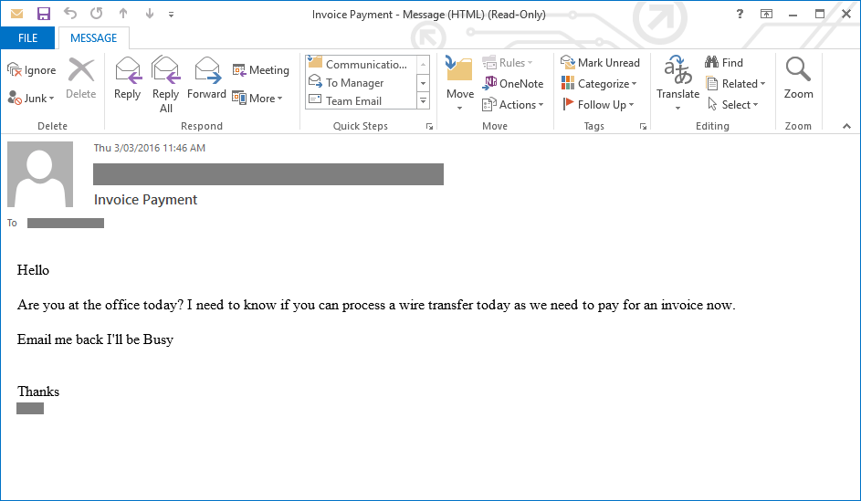
Spear Phishing Example 1

Slide 14
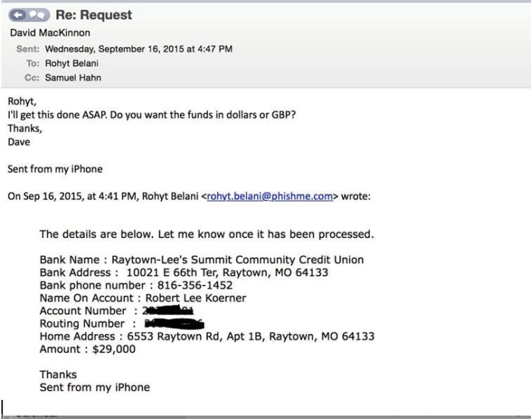
Spear Phishing Example 2

Slide 15
Spear Phishing Breakdown
Two major components:
Sender impersonation
Call to Action

Slide 16
Sender Impersonation
Approach #1: CLOSE email address:
REAL: seth.nielson@company.com
FAKE: seth.nielson@c0mpany.com
Approach #2: replace DISPLAY NAME:
REAL: Seth Nielson <seth.nielson@company.com>
FAKE: Seth Nielson <seth.nielson@not_even_close.com>
Approach #3: ignore email (get response via link)

Slide 17
Call to Action Psychology
Different than Bulk Phishing
Requires higher success rate
Targets are carefully chosen
Busy people are great targets
Urgency is still stressed

Slide 18
Personal Spear Phishing

Slide 19
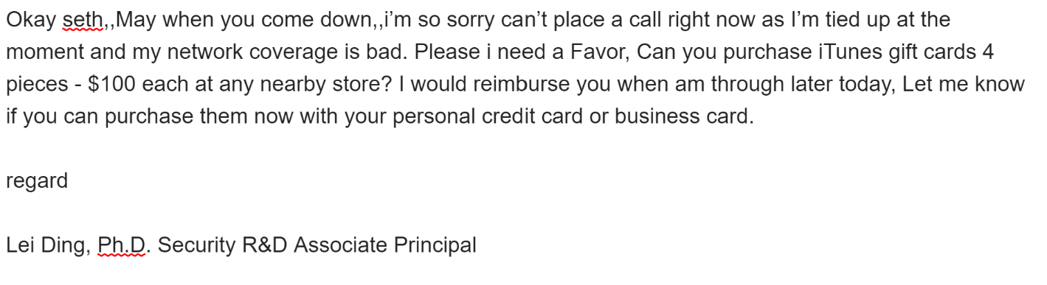
Spear Phishing Exchange

Slide 20
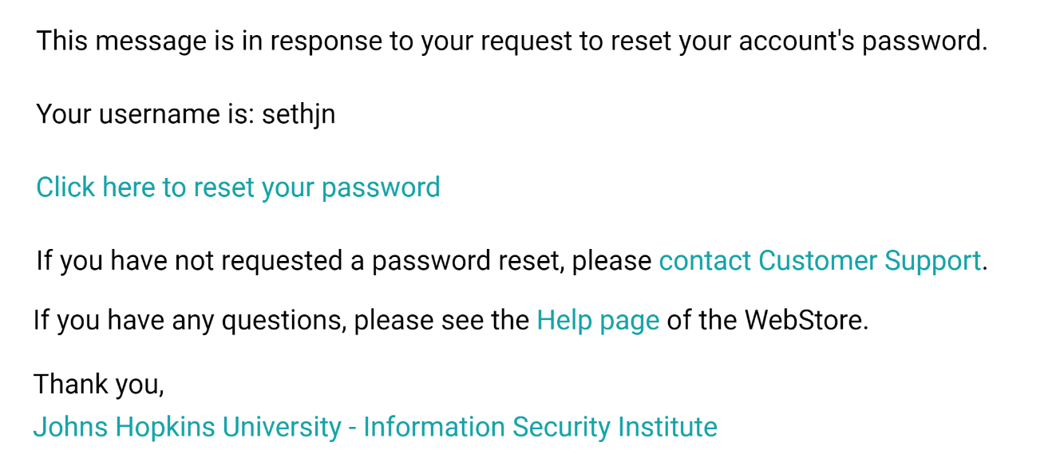
Spear Phishing False Positive?

Slide 21
Whaling
Specifically targets big catches (e.g., CEO)
CEO-like individuals can be vulnerable via assistants
Have a great deal of power that is not questioned

Slide 22
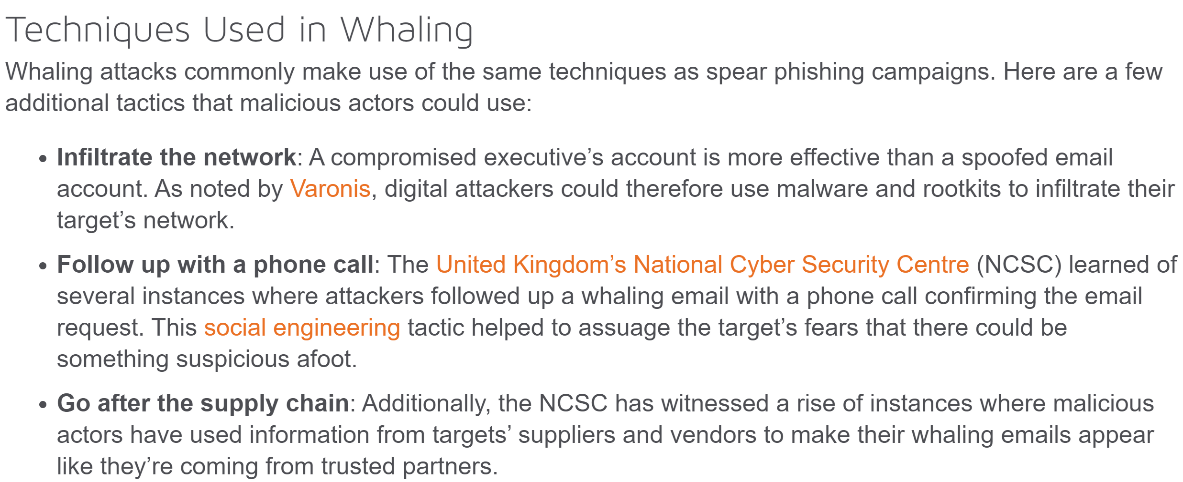
Whaling Techniques
Source:
https://www.tripwire.com/state-of-security/security-awareness/6-common-phishing-attacks-and-how-to-protect-against-them/

Slide 23
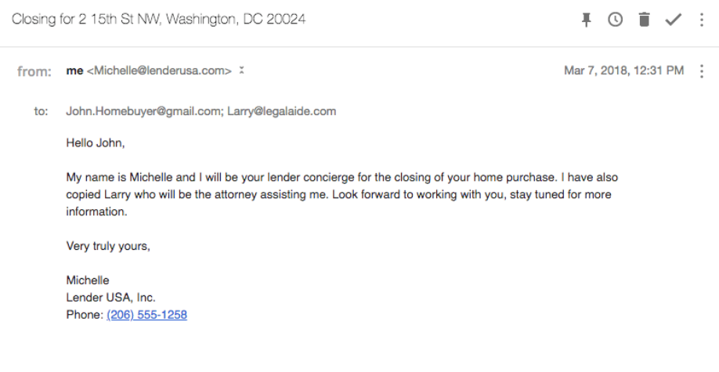
Real Estate Scams

Slide 24
Malicious Email and Psychology
Psychological Manipulation
Similar to Anderson’s example about pretexting
Emotional impulses drive the reactions
WE ARE ALL VULNERABLE TO THIS

Slide 25
Dealing with Phishing Risk
Don’t click on links is best
If you click a link, make sure it is HTTPS
Make sure the URL is correct
Find a phone number via HTTPS website
SLOW DOWN! Send it to an expert for review

Slide 26
Social Media Threats
Includes all the threats from email:
Spam
Phishing
Spear Phishing
Additional Threats
Attacks on reputation
Harassment/Bullying
False information
False popularity

Slide 27
Social Media Spam/Phishing
Can be used as recon for email-based spear phishing
Spam exists in Facebook, etc
(Spear) Phishing with links for call-to-action

Slide 28
Psychology of Disinformation
People tend to believe popular ideas
This is not necessarily a weakness
None of us can investigate everything
The “wisdom of crowds” is real

Slide 29
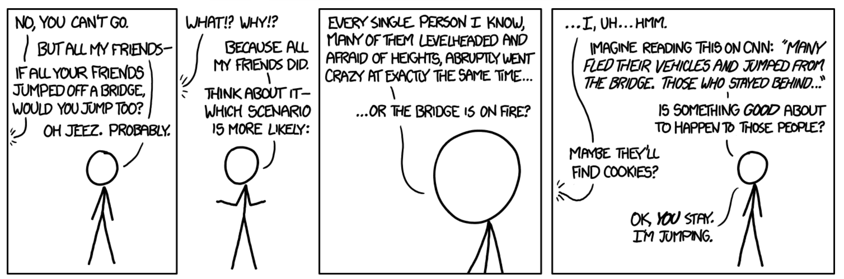

Slide 30
Social Media Bots
Bots are automated social media accounts
Simple uses include increasing “friends” count
Can also spread information
Programming is simple: retweet or share

Slide 31
Psychology of Sharing
Bots not always required
Identify something people want to believe
Media consultants test most persuasive formulations
Release into “the wild” and evaluate the spread
Political operatives monitor effectiveness

Slide 32
Political/Social Media Circle
Political machine identifies a target topic
Multiple allied outlets release variable formulations
Track statistics carefully (e.g., Twitter “ratio”)
Anything with backlash can be disavowed easily
Anything that grows popular will be adopted
Politician now publicly adopts position
(Use bots and manipulation too)

Slide 33
Cyberbullying
Simple form
non-stop harassment
Unending texts, posts, etc
Other forms
Release of personal info
Revenge pornography
Stealing accounts, passwords
Spreading false information

Slide 34
Destroying Lives
Nobody is perfect
Some people said things they later regret
People can be socially destroyed for an old tweet
Employers regularly search social media now
Some demand access if your account isn’t public

Slide 35
Weak Tech Solutions
The security issues I’ve raised are hard to solve
Exiting a platform isn’t always enough
Sometimes required for work
Doesn’t stop false posting
Zerofox is a security company that makes an attempt
Check out “Your Public Attack Surface”

Slide 36
Intrinsic Social Media Threat
There are risks from using social media at all
Network owners incentivized to “always on” usage
Ads and tracking are intrinsic to the (current) model
Inhibit human social development (e.g., empathy)

Slide 37
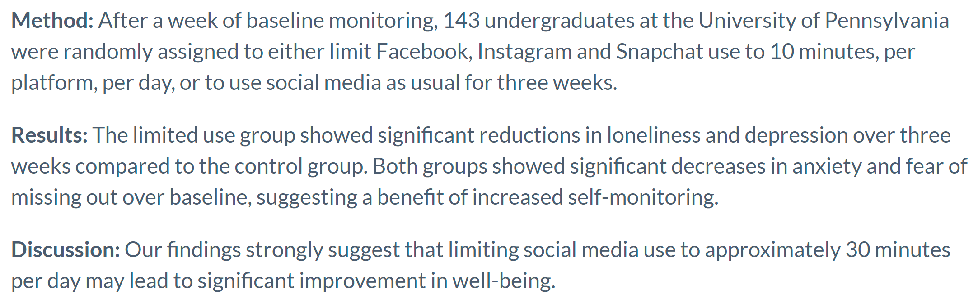
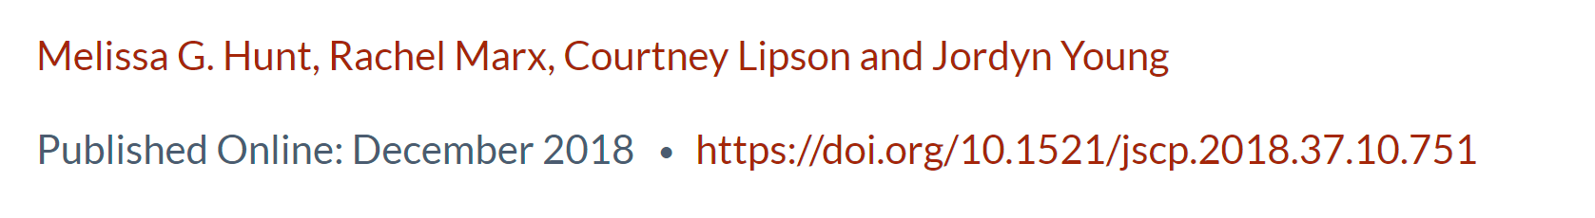
No More FOMO: Limiting Social Media Decreases Loneliness and Depression

Slide 38
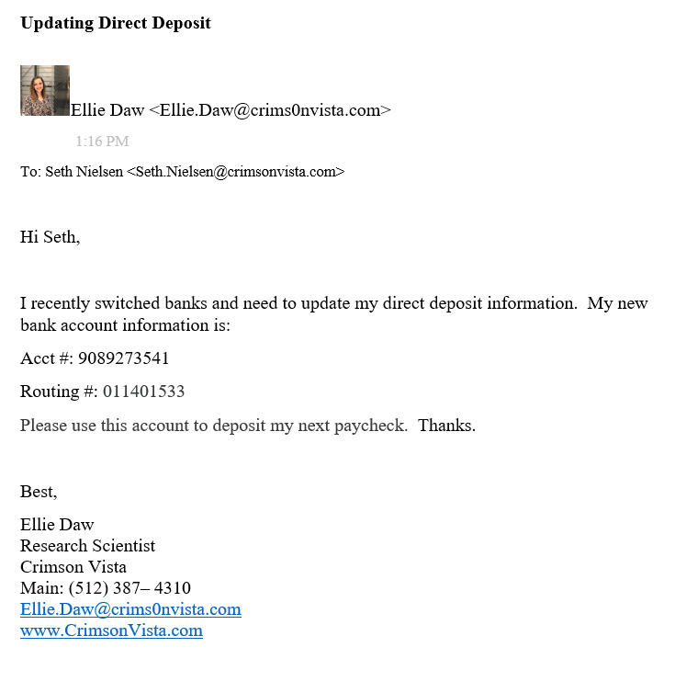
Phishing Competition Submission

