Slide 1
Data Privacy
CS 361S
Fall 2021

Slide 2
References
HAC – Handbook of Applied Cryptography by Alfred J. Menezes, Paul C. van Oorschotm and Scott A. Vanstone (CRC Press, 2001)
O’Keefe – Ethical Data and Information Management by Katherine O’Keefe and Daragh O Brien (Kogan Page, 2018).
McGilvray - Executing Data Quality Projects: Ten Steps to Quality Data and Trusted Information™ by Danette McGilvray (Morgan Kaufmann, 2008)
English – Larry English, Improving Data Warehouse and Business Information Quality (John Wiley & Sons, 1999).

Slide 3
Three States of Digital Data
DATA
at REST
DATA
in Use
DATA
in Motion

Slide 4


Securing Data in Use
Data-In-Use:
information in CPU, RAM, registers, etc. for current processing and applications
Security approaches: full memory encryption, secure enclaves, isolated systems, homomorphic encryption
This sounds interesting…

Slide 5
Securing Data in Motion
Data-At-Motion:
information moving across communications channels including within a computer.
Security approaches: encryption, entity authentication, key management and ephemeral keys, and conscientious governance
“Ephemeral”?

Slide 6
Securing Data at Rest
Data-At-Rest:
inert information stored on physical media such as disks, tapes, databases, etc.
Security approaches: encryption, access controls, key management, audits, tokenization, and conscientious governance
Now this is more like it!

Slide 7
File Encryption
The Quick Brown Fox Jumps Over the Lazy Dog
Alphabet.txt
File Encryption Service
This process can be manual, automated, or semi-automated
?????????????????????????????????????????????????????????
Alphabet.txt.encrypted

Slide 8

Folder Encryption
File 1
File 2
Activating the folder can be manual or automatic
Secure Folder
Once the folder is active, files in/out are automatically encrypted
Encrypted Folder Data

Slide 9
Application Encryption (e.g. Database)
An application, like a MySQL DB, can be manually configured to store data encrypted*
INSERT INTO table… VALUES
(Alice, 1/1/1971, 1 Encryption Rd,
AES_ENCRYPT(555-55-5555, key))
SQL DB
SELECT AES_DECRYPT(SSN, key) as SSN
FROM table WHERE Name=Bob
Name | DOB | Address | SSN
Alice | 1/1/1971 | 1 Encryption Rd. | ????????????????
Bob | 2/2/1972 | 2 Security Way | ????????????????
…
*Encrypted Data cannot be index, searched, etc.

Slide 10
Whole Database Encryption
MySQL can also be configured with whole-db encryption
Example: Enterprise Transparent Data Encryption (TDE)
When enabled, data is automatically encrypted/decrypted
This data can be searched, indexed, etc.
The point is that application encryption varies widely

Slide 11
SIDE NOTE!!
MySQL provides a number of options for AES_ENCRYPT
MANY OF THEM ARE UNSAFE!
You should consult a cryptography expert before using!!!!

Slide 12

Whole Disk Encryption
File 1
File 2
Encrypted Drive Data
Files, folders, etc. are automatically encrypted/decrypted. If the drive is stolen, nothing is readable.

Slide 13
Other Data-at-Rest Encryption Issues
Strong cipher (e.g., AES) with a large key size (256 bit)
Should Fail-Secure: on failure, data remains encrypted

Slide 14
The Other Security Concerns
Recall that encryption does not “create” security
Other security components required to enforce policy
access controls – limiting who has access to data
key management – managing a key’s lifecycle
audits – tracking crypto, access controls, keys over time

Slide 15
The New World of Big Data, Cloud Storage, etc.
The tech world has changed drastically within the last decade
Companies are accelerating moving data resources to the cloud
Big data is… well, big. And technologies are changing to match
New technologies are introducing new security challenges
We’ll talk about just two:
Data Lakes
Cloud Storage in General

Slide 16


Data Lake Overview
A data lake stores raw data, from wide input sources, into a single logical store. Using search and “big data” engines, it provides discovery, analytics, reporting, and so forth.
Alice’s engineering
team
Reports, Analysis, Discovery, etc.
Bob’s Sales
Office
Search/Data Engines
Interconnected Storage Devices
(raw, unformatted data)

Slide 17
Data Lake Security Challenges
Data stored together IN ALL THREE STATES!
Where did data come from?
Who touched it?
Who is authorized to access it?
Encryption questions abound, especially for processing
Access control questions outside, and inside, the lake
Most of the advice I find is about outside access
But a “Data Lake” is a concept on top of hardware. Who has access?
Some experts recommend not storing PII in Data Lakes!

Slide 18
The Point
I’m not criticizing Data Lakes
But when tech changes, security implications change too
Note: poorly used Data Lakes are called Data Swamps
Can data in a Data Swamp be properly secured?

Slide 19


Cloud Considerations
The cloud started out as purely storage, but now is used for processing and entire enterprise infrastructures.

Slide 20
Cloud Security Mindset Concerns
Clouds can be more secure than many enterprises
However incentivize users to stop thinking about security
A CEO told me: “We’re secure. We use the cloud.”
There is no security free lunch

Slide 21
Sample Cloud Security Considerations
Even when data is encrypted, it is often decrypted for processing. Data-in-use security can be a concern.
Some cloud vendors don’t encrypt the data-at-rest. But for those who do, the enterprise still needs a key management architecture.
User Access Control Policies are still determined by the enterprise, not the cloud provider.
Privacy requirements, regulatory burdens, and accountability remain with the enterprise.

Slide 22
Cloud Usability/ Security Trade-off
There is fundamental tension between usability & security
For example, take big data.
Bigger data sets
Search and analysis engines reveal valuable insights
Hence, why data is the “oil of the 21st century”
Problem: data must (usually) be decrypted for analysis
This is a potential security, privacy, regulatory hazard!

Slide 23
The Gmail Example
I still use Google mail for personal and business
I do not end-to-end encrypt my mail
It is encrypted “at rest” on Google servers
But it is un-encrypted and analyzed by Gmail search servers
I could use proton mail for end-to-end security but I don’t.
Why? Because I’ve come to rely on Gmail search.
I’m not sure I could function without this search capability
Unfortunately, I have to trust Google with my data for this

Slide 24
Data Privacy
Data Privacy:
is the relationship between dissemination of data and the gathering/use/management thereof. It includes legal, policy, and technical issues.
For our class, we will only talk about the technology issues.
Who cares?

Slide 25
Why it matters
Data Privacy:
is the relationship between dissemination of data and the gathering/use/management thereof. It includes legal, policy, and technical issues.
For our class, we will only talk about the technology issues.
People care because data collected about them could be used to manipulate, rob, embarrass, blackmail, or even control them.
Control them?!

Slide 26
Data as a Means of Control
Yes, control. Some experts are concerned that genetics might be used to control where you live or go to school.
Where you live? Go to school? How?
A condo association forces you to submit to a DNA test. If you have a predisposition to Alzheimer’s disease, you can’t live there.
That’s terrible!
And right now, some feel Big Data is being used to exploit individuals with addiction issues. Is that “control” or just “manipulation”?
Ugh! It doesn’t matter!

Slide 27
Technology vs Law vs Policy
But shouldn’t we just pass laws banning these kinds of activities?
Maybe. But we also have to develop technologies that can keep data private so that there isn’t even the option to disseminate.

Slide 28
Data Ownership vs Stewardship
Who “owns” data about you? (legal/political question)
In Europe, laws require that you own the data about you
In the United States, laws are generally moving towards this
One who handles data for another: a data steward*
* McGilvray, pp. 53-54
O’Keefe, pp. 102-105, 236-244

Slide 29
Data Privacy Technology Goals*
Enable identification of ownership and stewardship of data
Enable owners to maintain policy for their own data
Enable stewards to communicate data handling to owners
Enable data handling by a steward to adhere to owner policy
Enable permitted data handling to expose minimal privacy risk
Enable accountability of data stewards to data owners
Enable transparency of data, handling, stewardship to owners
*Others have expressed similar goals differently.
These are Dr. Nielson’s formulations.

Slide 30
Personal Information/PII
Data privacy begins with identifying “personal” data
The defined set of personal data varies by legal jurisdiction
Example: in Europe an IP addr is personal but not in the US

Slide 31
PII in the United States
“any information about an individual maintained by an agency, including (1) any information that can be used to distinguish or trace an individual's identity, such as name, social security number, date and place of birth, mother's maiden name, or biometric records; and (2) any other information that is linked or linkable to an individual, such as medical, educational, financial, and employment information.”
(NIST Special Publication 800-122, emphasis added)

Slide 32
PII Audit
Ok Alice, I’m sold. I want to make privacy a priority. Where do I start?
I’m tempted to suggest Privacy by Design*, but for now let’s start with a PII Audit. You can’t protect data you don’t know about.
* See O’Keefe, pp. 259-260, 265

Slide 33

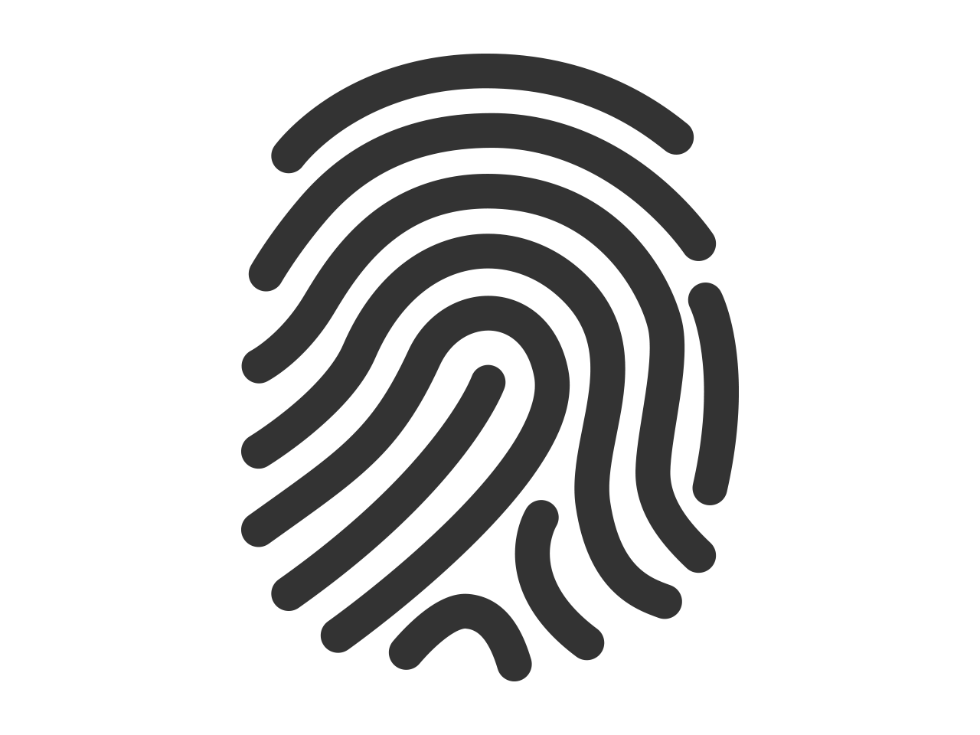

Distinguishing Data
This Photo by Unknown Author is licensed under CC BY-NC
Obviously, any data that directly identifies someone is PII. NIST calls this “distinguishing” data. It includes name, DOB and even biometrics.
This Photo by Unknown Author is licensed under CC BY

Slide 34
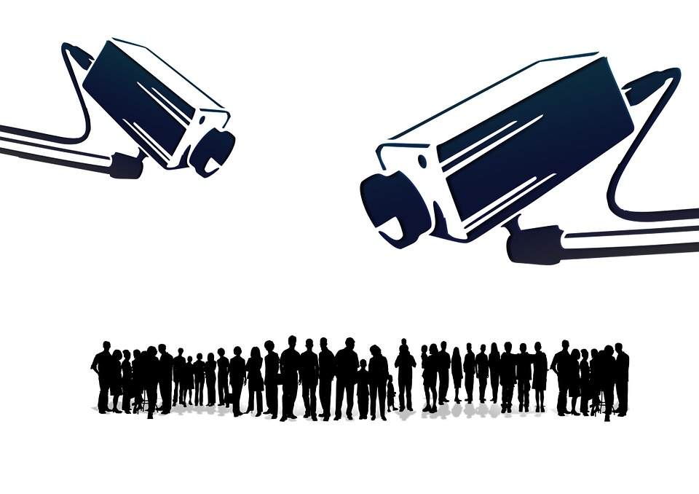
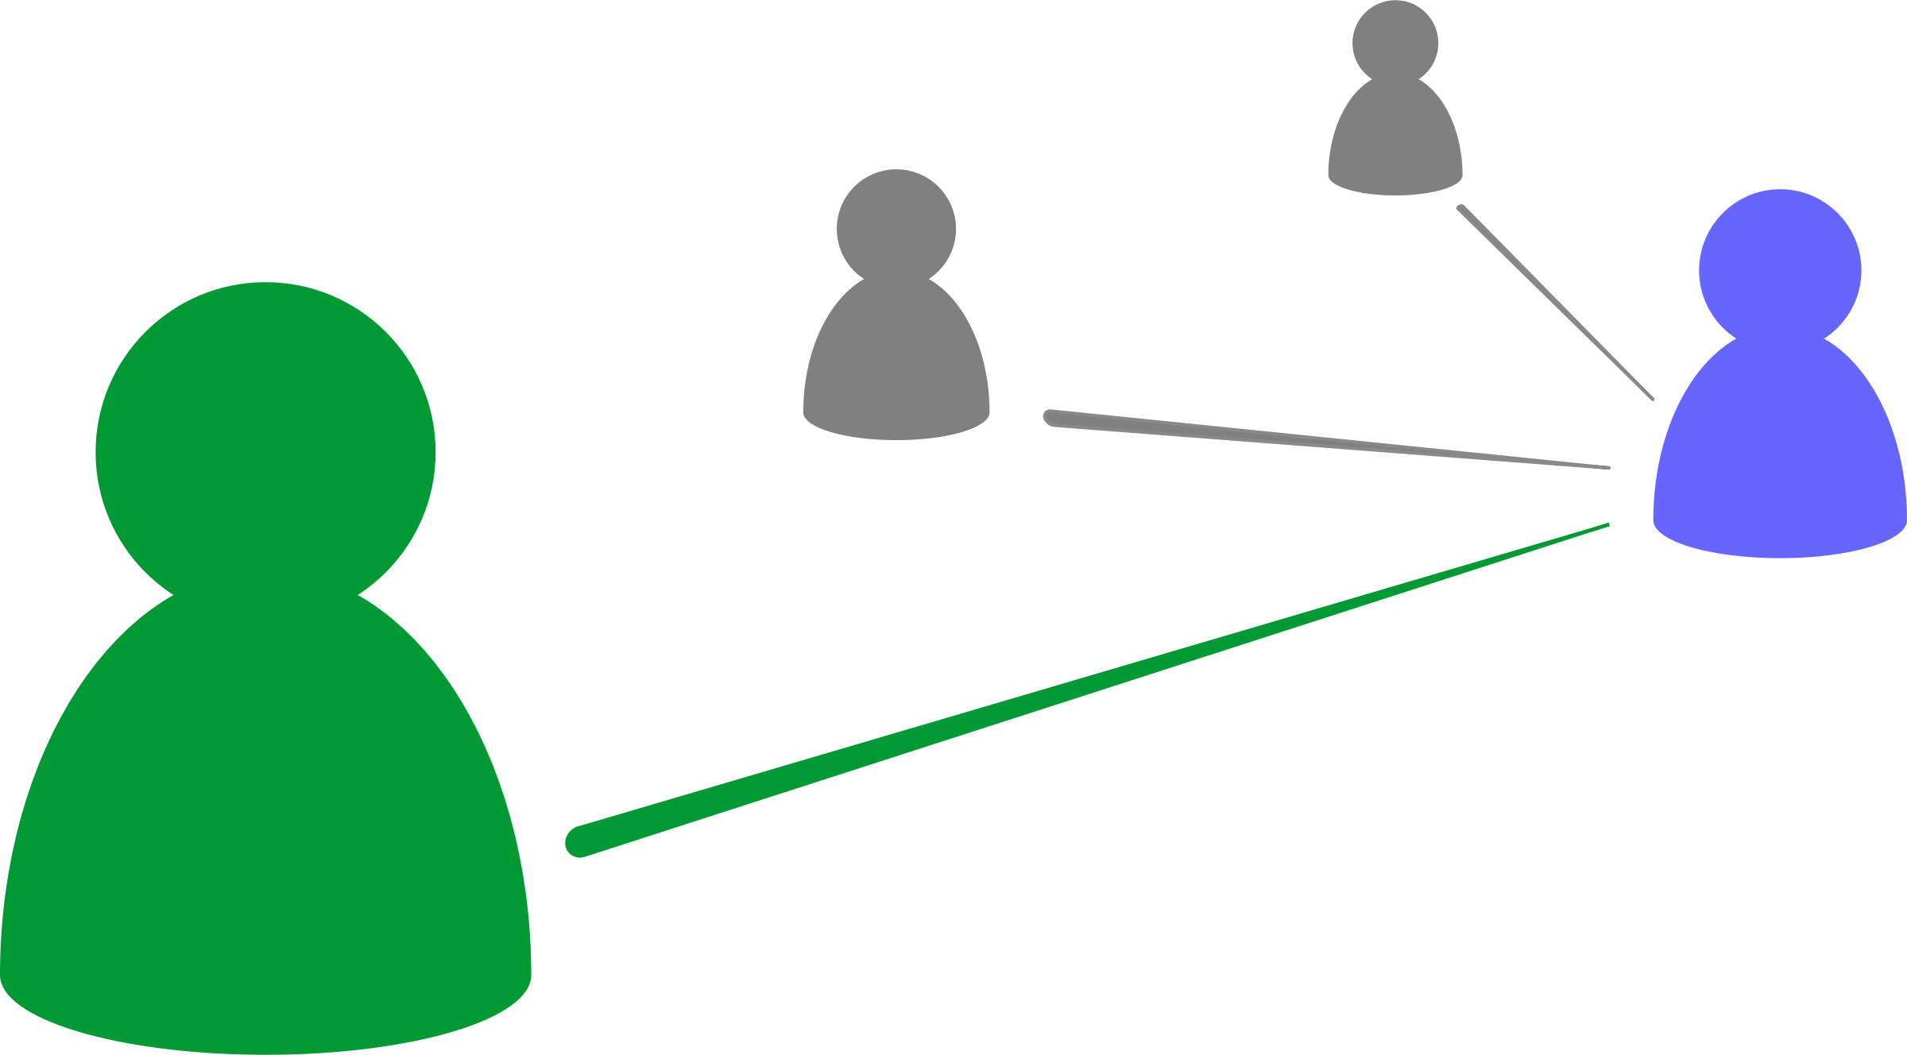
Tracing Data
PII also includes data that could be used to determine an individual’s activities or status. This includes log files or camera recordings.

Slide 35

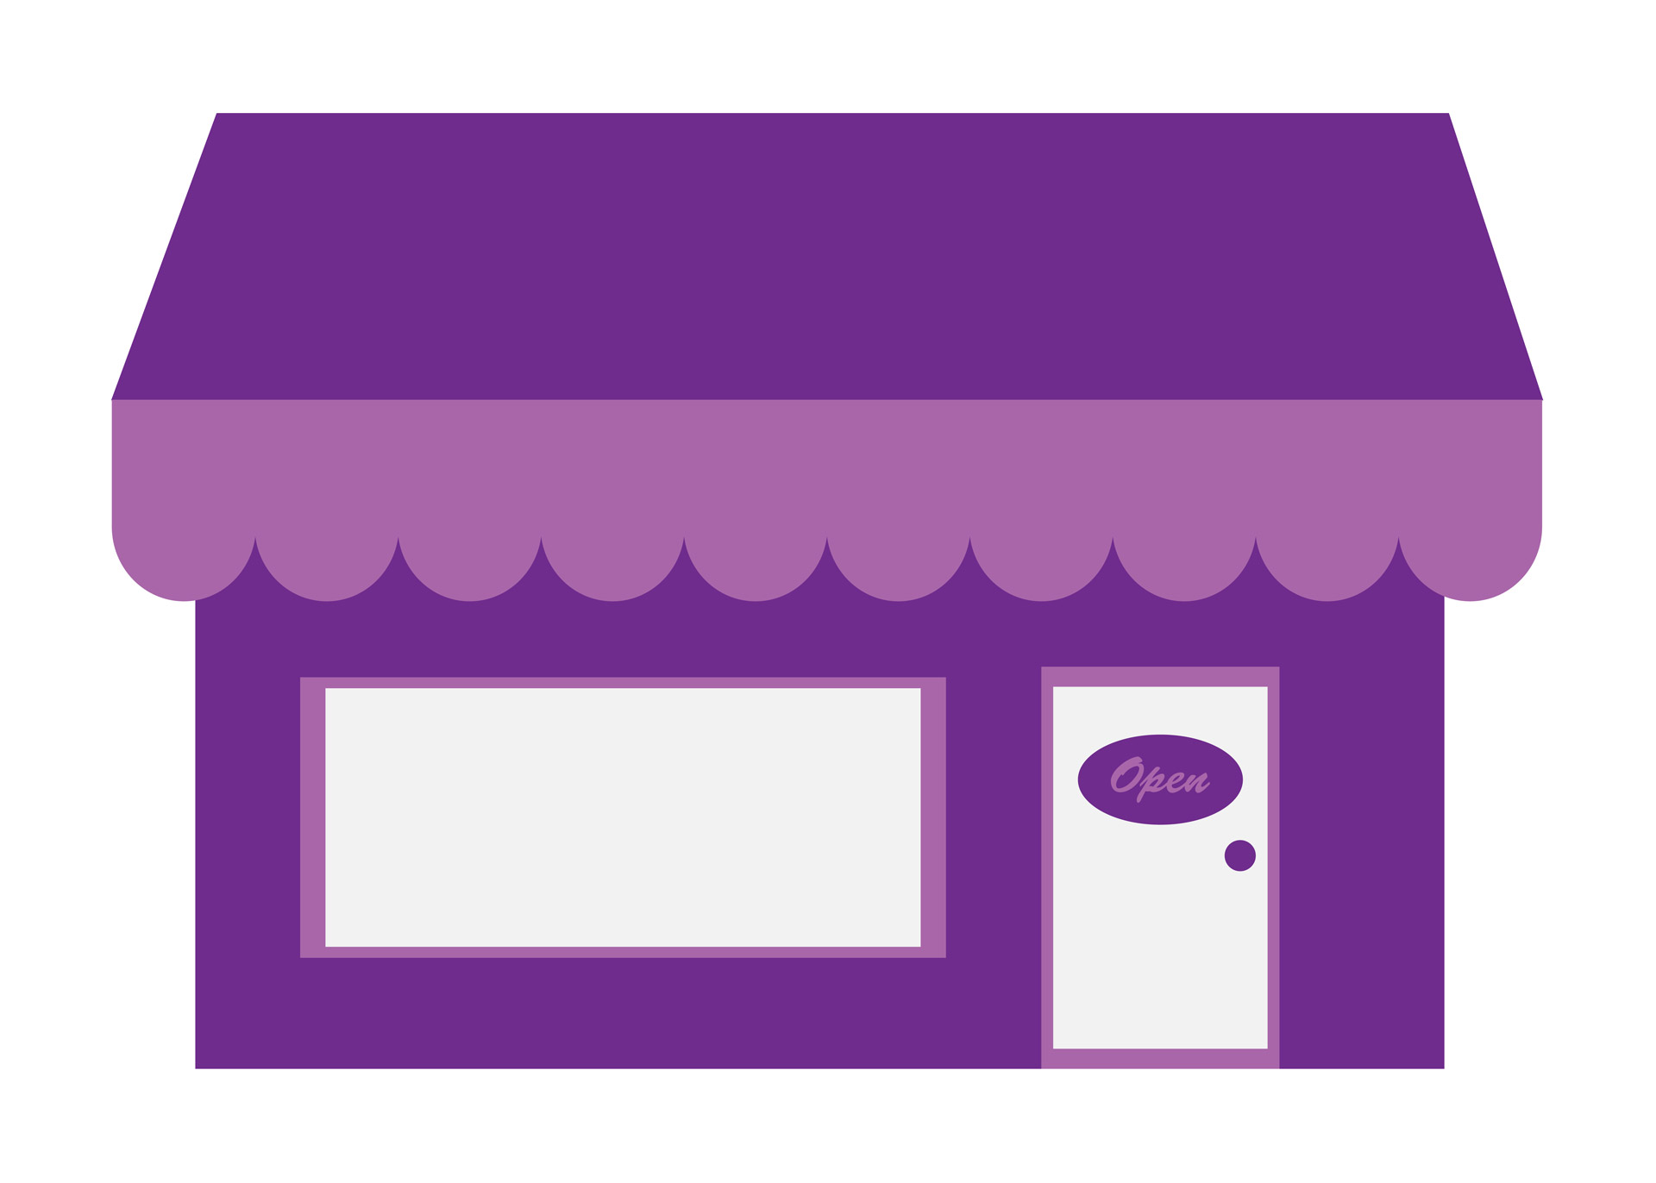
Linking Data (linked or linkable)
This data could be linked to the student
This data is already linked to the student
This Photo by Unknown Author is licensed under CC BY-SA-NC
School Uniforms Online Store
Student | Grade | Height | Weight
Bob Jr. | 5 | 4’5” | 100lbs
Grade | Height | Weight | Purchases
5 | 4’5” | 100lbs | $100.00
“Linked” data is data already linked to the person. “Linkable data” is data that could be linked to the person.

Slide 36
PII Audit Solutions
That’s a lot of PII! How can I find all of it?
Start by reading NIST SP 800-122. It has a number of good starting points. If you’re doing business in Europe, you may need a GDPR specialist.

Slide 37
PII Safeguards*
Privacy-Specific Safeguards
Minimizing the Use, Collection, and Retention of PII
De-Identifying Information
Anonymizing Information
Security Controls
Access Enforcement
Auditable Events
Information System Monitoring
Media Sanitization
* This is a subset of safeguards described in NIST SP 800-122

Slide 38
Minimizing PII Use, Collection, and Retention
The first, and perhaps most important step, in protecting PII is NOT TO COLLECT, USE, and/or RETAIN it.
That’s impossible!
It very well might be! If you’re a medical records company, you have to. But start with this mindset.
We’re a data company. Processing data is what we do.
Start by remembering it isn’t your data. You should only have data you absolutely need.

Slide 39
Minimizing PII Use, Collection, and Retention (2)
If you absolutely must have PII data, minimize all engagement with the data.
Meaning?
Limit the roles that can access the data, limit the users assigned to those roles. Limit PII processing and limit where it is stored.
How do you limit where it is stored?

Slide 40
Limiting PII Storage
Do not permit PII inputs unless explicitly authorized
Fence non PII DB’s to screen for accidental insertion attempts
Block access to PII for unauthorized applications and users
Data Input
Non-PII Processing
Normal Storage
Data Input
PII Processing
Data Input
PII Storage
PII Processing
Ensure PII is deleted from ingress systems
Ensure PII resides in a single (logical) DB. This is harder than it sounds.
Watch out for caching or unauthorized replication

Slide 41
Minimizing PII Use, Collection, and Retention (3)
Minimize retention. Securely delete PII the moment it is no longer needed. This is easier if you limited storage and use.

Slide 42
De-Identification and Anonymization
De-identified data can be re-identified. Must be on a separate system with access controls.
Also, must not be re-identifiable with publicly available data.
De-Identification
Replacing PII fields with an opaque identifier, such as the cryptographic hash.
PII Storage
Normal Storage
Anonymization
Replacing PII fields with aggregates, lower quality variants, or even incorrect values when appropriate.
Replacing fields with a hash or other opaque identifier is sometimes called tokenization
Examples include replacing a specific field with the average across all records or even shuffling PII fields amongst the records in the set.

Slide 43
Access Controls
Obviously, access control to PII is critical.
So, only letting certain users have access.
Yes, but there are other options. You could have a program that grants mediated access to the PII
ACCESS GRANTED
ACCESS DENIED
PII Storage
PII Access

Slide 44
Auditable Events and System Monitoring
Information monitors, such as data loss prevention systems can find and block PII transfers
Data Input
Non-PII Processing
Normal Storage
Data Input
PII Processing
Data Input
PII Storage
PII Processing
Any PII activity that violates policy, even if unsuccessful, should be audited.

Slide 45
Security and Privacy Summary
We’ve covered a lot of ground for both security and privacy.
One point that should be clear: both are complex subjects
Your organization may need an SME to help you navigate
But, as the data person, you hold the keys to the most critical part!

