Slide 1
Host Vulnerabilities
UT LAW379M
Fall 2022
Lecture Notes

Slide 2
Two Broad Subtopics
Software Vulnerabilities
Malware

Slide 3
Brief Overview to Execution
Today: very brief overview of Control Flow Hijacking
There are other types of vulnerabilities (e.g misconfigured)
Control Flow Hijacking is probably the hardest to grasp
Critical Concepts:
The “normal” flow of control for authorized instructions
Inputs that change the flow to unauthorized instructions
ATTRIBUTION: Derived from slides by Dave Brumley, CMU

Slide 4
Basic Execution
File system
Process Memory
Binary
Fetch, decode, execute
Code
Processor
Data
...
Stack
Heap
read and write
Notes:
What is the name of the register that contains the address of the current instruction?

Slide 5
What is “Control Flow”
Computer instructions are generally sequential
Execute instruction 1, then 2, then 3…
But there are instructions that jump around
“Conditional” (decision)
“Loop” (repeats)
“Block” of Code
“Block” of Code
“Block” of Code
“Block” of Code

Slide 6
Function Call
10, 4, 95,-3, 201
“Sum” Function
INPUTS
Sum (10, 4, 95, -3, 201)
“Average” Function
Output:307
Divide(307, 5)
“Divide” Function
Output:61.4
OUTPUT
61.4

Slide 7
Function Calls?
Assembly “function calls” don’t really exist
Rather, jump to new location of instructions in the big long list!!!
Save context of old location
Load context for new location
Include information for “returning” (output)

Slide 8
The “Stack” (Scratch Pad)
Computers need temporary memory for temporary calculations
In the “Average” example, it temporarily needed the number count
Data like this is stored on “The Stack”
It’s a space in memory that “grows”

Slide 9
Average Function Start
Other instructions
“Sum” Function
Previous Stack
Other instructions
PROGRAM COUNTER
“Average” Function
Other instructions
“Divide” Function
Other instructions

Slide 10
Average Function Create Stack
Other instructions
“Sum” Function
Previous Stack
Other instructions
Average Scratch
PROGRAM COUNTER
“Average” Function
Other instructions
“Divide” Function
Other instructions

Slide 11
Call Sum from Average
Other instructions
PROGRAM COUNTER
“Sum” Function
Previous Stack
Other instructions
Average Scratch
“Average” Function
Sum Scratch
Other instructions
“Divide” Function
Other instructions

Slide 12
Return from Sum to Average
Other instructions
“Sum” Function
Previous Stack
Other instructions
Average Scratch
PROGRAM COUNTER
“Average” Function
Other instructions
“Divide” Function
Other instructions

Slide 13
Call Divide from Average
Other instructions
“Sum” Function
Previous Stack
Other instructions
Average Scratch
“Average” Function
Divide Scratch
Other instructions
PROGRAM COUNTER
“Divide” Function
Other instructions

Slide 14
Return from Divide to Average
Other instructions
“Sum” Function
Previous Stack
Other instructions
Average Scratch
PROGRAM COUNTER
“Average” Function
Other instructions
“Divide” Function
Other instructions

Slide 15
Return from Average to ???
PROGRAM COUNTER
Other instructions
“Sum” Function
Previous Stack
Other instructions
“Average” Function
Other instructions
“Divide” Function
Other instructions

Slide 16
Control Flow Again
In this context, controlling the movement between functions.
The system has to keep track of this flow
It has to know which part of the stack to erase
It has to know which instruction to jump to
It has to know which instruction to jump BACK to
Info is stored IN THE STACK

Slide 17
Call Sum from Average
Other instructions
PROGRAM COUNTER
“Sum” Function
Previous Stack
Other instructions
Average Scratch
“Average” Function
Sum Scratch
Return location in Average
Start of scratch space for Average
Other instructions
“Divide” Function
Other instructions

Slide 18
Returning from Sum
Other instructions
“Sum” Function
Previous Stack
Other instructions
Average Scratch
PROGRAM COUNTER
“Average” Function
Sum Scratch
Return location in Average
Start of scratch space for Average
Other instructions
“Divide” Function
Other instructions

Slide 19
What are Buffers?
A buffer is a storage for a sequence of related data
E.g., a program must allocate a buffer for your password
These buffers are often stored on the stack

Slide 20
What are Buffer Overflows?
When a program doesn’t check BOUNDS
That is, the INPUT is TOO BIG for the buffer
The computer keeps putting more data onto the stack…
OVERWRITING WHAT WAS THERE BEFORE

Slide 21
Basic Example
#include <string.h>
int main(int argc, char **argv) {
char buf[64];
strcpy(buf, argv[1]);
}
Dump of assembler code for function main:
0x080483e4 <+0>: push %ebp
0x080483e5 <+1>: mov %esp,%ebp
0x080483e7 <+3>: sub $72,%esp
0x080483ea <+6>: mov 12(%ebp),%eax
0x080483ed <+9>: mov 4(%eax),%eax
0x080483f0 <+12>: mov %eax,4(%esp)
0x080483f4 <+16>: lea -64(%ebp),%eax
0x080483f7 <+19>: mov %eax,(%esp)
0x080483fa <+22>: call 0x8048300 <strcpy@plt>
0x080483ff <+27>: leave
0x08048400 <+28>: ret
…
argv
argc
return addr
Caller stack
buf (64 bytes)
argv[1]
buf
%ebp
%esp
21

Slide 22
“123456”
#include <string.h>
int main(int argc, char **argv) {
char buf[64];
strcpy(buf, argv[1]);
}
Dump of assembler code for function main:
0x080483e4 <+0>: push %ebp
0x080483e5 <+1>: mov %esp,%ebp
0x080483e7 <+3>: sub $72,%esp
0x080483ea <+6>: mov 12(%ebp),%eax
0x080483ed <+9>: mov 4(%eax),%eax
0x080483f0 <+12>: mov %eax,4(%esp)
0x080483f4 <+16>: lea -64(%ebp),%eax
0x080483f7 <+19>: mov %eax,(%esp)
0x080483fa <+22>: call 0x8048300 <strcpy@plt>
0x080483ff <+27>: leave
0x08048400 <+28>: ret
…
argv
argc
return addr
caller’s ebp
buf (64 bytes)
argv[1]
buf
return addr
caller’s ebp
123456\0
%ebp
%esp
22

Slide 23
“A”x68 . “\xEF\xBE\xAD\xDE”
#include <string.h>
int main(int argc, char **argv) {
char buf[64];
strcpy(buf, argv[1]);
}
Dump of assembler code for function main:
0x080483e4 <+0>: push %ebp
0x080483e5 <+1>: mov %esp,%ebp
0x080483e7 <+3>: sub $72,%esp
0x080483ea <+6>: mov 12(%ebp),%eax
0x080483ed <+9>: mov 4(%eax),%eax
0x080483f0 <+12>: mov %eax,4(%esp)
0x080483f4 <+16>: lea -64(%ebp),%eax
0x080483f7 <+19>: mov %eax,(%esp)
0x080483fa <+22>: call 0x8048300 <strcpy@plt>
0x080483ff <+27>: leave
0x08048400 <+28>: ret
…
argv
argc
return addr
caller’s ebp
buf (64 bytes)
argv[1]
buf
0xDEADBEEF
AAAA
AAAA… (64 in total)
corrupted
overwritten
overwritten
%ebp
%esp
23
Notes:
lowest byte of argc is 0; in little endian, that’s the least significant byte

Slide 24
Attackers Exploit These
The overflow can overwrite THE RETURN ADDRESS
Attackers can craft inputs that do this
Then they HIJACK CONTROL FLOW
They change where the computer returns to
So, e.g., they jump to a place with evil instructions

Slide 25
Like in the input…
…
…
argv
argc
&buf
…
EVIL CODE!!!…
argv[1]
buf
%ebp
%esp

Slide 26
Recap
To generate exploit for a basic buffer overflow:
Determine size of stack frame up to head of buffer
Overflow buffer with the right size
computation + control
shellcode | padding | &buf

Slide 27
Dealing With Control Flow Violations
Defenses
Make it harder to control a subverted flow
Make taking control of the flow innocuous
Make it harder to get control of the flow

Slide 28
ASLR
Address Space Layout Randomization
Subversion usually needs to know memory layout
General goal: make layout unpredictable

Slide 29
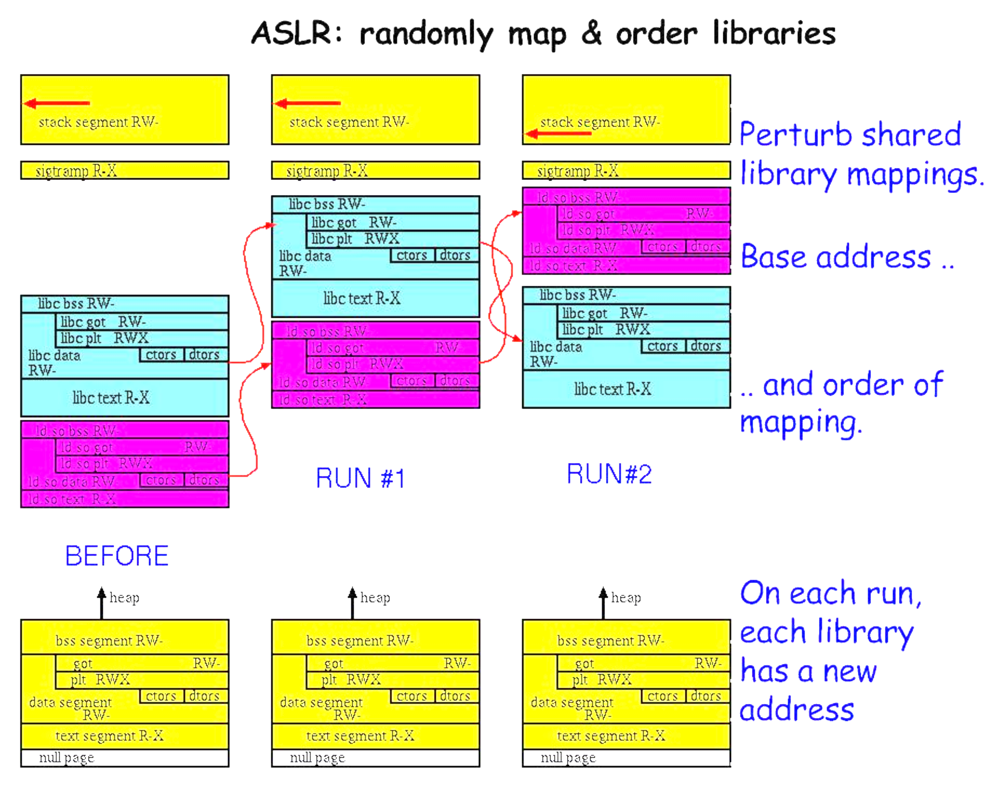
Visualization

Slide 30
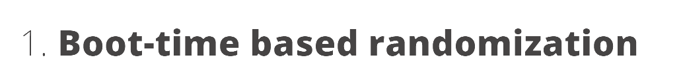
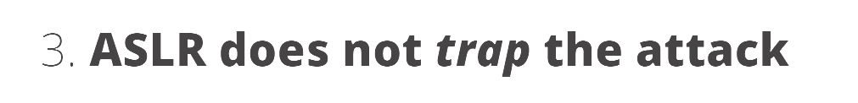
Limitations of ASLR

Slide 31
Making Violations Less Dangerous
W^X Permissions

Slide 32
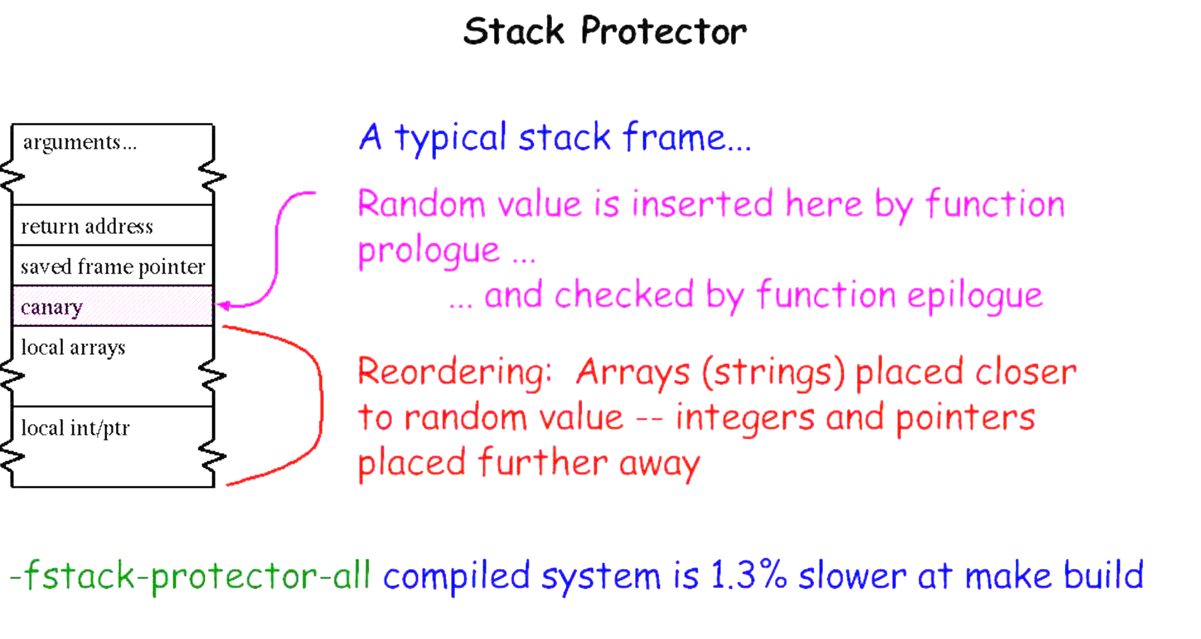
Finally, Blocking Exploits

Slide 33
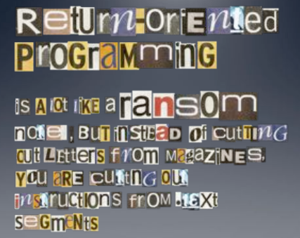
Image by Dino Dai Zovi

Slide 34
Attacker Oriented Programming?
Behavior isn’t a program
We should be able to perfectly detect bad behavior, right?

Slide 35
“Weird Machines”
“Weird machines, exploitability, and provable unexploitability”
Written by Thomas Dullien
Explains that users interacting with a program is a program

Slide 36
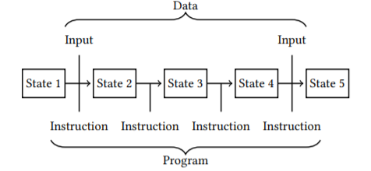
What is a Program?
*From Dullien’s Paper

Slide 37
State Machine View
View a “Program” as a state machine
Program starts in state S_0
Based on instruction, advances to state S_i

Slide 38
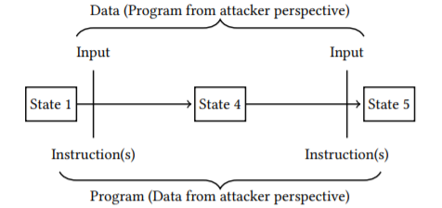
States and User Interactions
Program is in some State. Call it S_0
User interacts with the program
Program advances to state S_1

Slide 39
What is a “User”?
Do we literally mean a flesh-and-blood human?
Really, “user” is just whatever provides the input
This can, of course, just be another process
Thus, two processes interacting IS A PROGRAM
Therefore, determining if “behavior” is good is undecidable

Slide 40
What is “Malicious Code”?
“Software or firmware intended to perform an unauthorized process that will have adverse impacts on the confidentiality, integrity, or availability of a system. A virus, worm, Trojan horse, or other code-based entity that infects a host. Spyware and some forms of adware are also examples of malicious code.”
NIST Special Publication 800-53, Revision 5

Slide 41
Common Malware Classes
Malware can be classified by how it spreads or generically behaves
Virus – typically has to be attached to another program (infection)
Worm – typically spreads via network vulnerabilities
Trojan Horse – typically appears benign but contains hostile operations
Malware can also be classified by its behavior
Spyware – typically designed to steal information, observe behavior, etc.
Adware – typically designed to “trap” a user into viewing certain ads
Ransomware – typically locks data unless the user pays a ransom

Slide 42
Two Primary Components
Payload – The code that performs the (harmful) action
Attack Vector/Exploit/Delivery – The code that enables the payload
May include a transmission component
May include a stealth component
May include a mechanism for bypassing security
May be as simple as an email with an attachment

Slide 43
Malware History
Much of early computer security driven by military concerns
The biggest concern was an unauthorized user or program
Other concerns developed over time
The following slides are a very brief overview/highlight

Slide 44
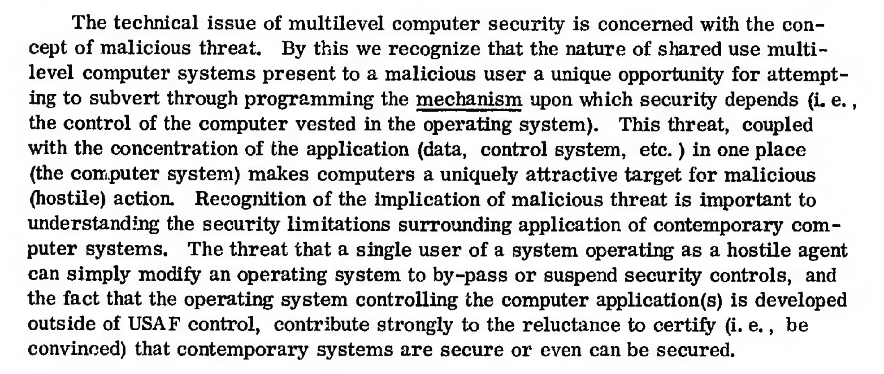
1972 Government Report:
https://apps.dtic.mil/sti/pdfs/AD0758206.pdf

Slide 45
1987: Fred Cohen’s Viruses
“Computer Viruses: Theory and Experiments” Fred Cohen, 1987
Introduced the concept of a self-replicating, evil program
The program attaches to a “good” program infecting it
When the infected program is run, the virus runs
The virus does it’s evil AND spreads itself to other programs
Concepts first proposed by Cohen in 1984

Slide 46
1988: Morris Worm
Robert Morris wrote a self-spreading piece of code (worm)
Spread using exploits in:
send mail,
Finger
rsh/rexec
Also guessed weak passwords
Copied code to new machine, compiled, and executed
Accidentally re-infected machines until machines became unusable
DOS attack brought down the Internet

Slide 47
Early DOS Viruses
PROGRAM
PROGRAM
JUMP
VIRUS

Slide 48
Impact of Early Viruses
Amazingly, most early malware DID MINIMAL DAMAGE
Often just a delivery system with a weak payload
Many viruses spread for the sake of spreading
Even the Morris worm was disruptive by accident
There were exceptions, but also plenty of hype

Slide 49
1995: Concept Macro Virus
Microsoft Word and Excel have limited scripting (“Macros”)
Concept was the first virus written completely as a macro
It was a delivery system only with no payload
But was an important proof-of-concept
Users often open documents directly from email

Slide 50
2000: I Love You
Visual Basic Script virus
Appears as email attachment:
LOVE-LETTER-FOR-YOU.txt.vbs
The .vbs often hidden on Windows
When executed:
Damaged many office files
Sent email out to email address book automatically
Spread worldwide in hours

Slide 51
2004: MyDoom
Fastest spreading mass mailer virus at the time
Slows overall internet performance by about 10%
Slows average web page load times by about 50% percent
Responsible for approximately one in ten e-mail messages.
Appears as a delivery error, mail error, etc
Includes an attachment that, if clicked on, mails out copies
Also attempted to spread via P2P vile sharing Kazaa
Opened a back door for remote control
Attempted to launch a DDOS against the SCO Group’s website

Slide 52
2005: Sony Rootkit
Sony CD’s from the 2004-2005 era installed a “Rootkit”
Rootkit, as name implies, usually installs with elevated access
Using this elevated access, it can change the OS
This bypasses usual security such as antivirus, etc
Also usually very good at being undetectable
Installed at root with an EULA that did not mention the software
In 2005, US-CERT ISSUED AN ADVISORY!!!
Texas, under Greg Abbot, was the first state to sue

Slide 53
Why is the Sony Rootkit So Bad?
In addition to violations of privacy, etc, caused:
Slowing the system, consuming resources
False alarms from antivirus
OPENED HOLES FOR ADDITIONAL MALWARE
“Stinx-E trojan”

Slide 54
2013: Cryptolocker
Modern Ransomware
(1980’s had a ransomware called CyberAIDS)
Locks up system and uses public key crypto
In addition to fiat currency, accepted BitCoin

Slide 55
2016: Mirai
Worm that finds vulnerabilities in IoT devices
Takes over the device (“Zombie”)
Corrdinates all devices with a Command and Control
Launched a powerful DDOS against “krebs on security”

Slide 56
Command and Control Concept
Uninfected Machine
Command and Control
Try to Infect Others
Infected Machine
When infected, contact C&C. Can
then receive updates, instructions, etc.

Slide 57
Malware Defense Strategies
Identify and neutralize
Identify and neutralize malware before the attack
Mitigate
Mitigate malicious activity during the attack
Recover or restore
Recover or restore damaged systems after the attack

Slide 58
Identifying Malware
Primarily a classification problem
Software
?
Benign
Malicious

Slide 59
Classification Approaches
Static Analysis
Analyze the software to categorize it
Compare against known patterns (signatures)
Or determine guess how it will behave (heuristics)
Dynamic Analysis
Analyze the software’s execution
Identify behavior that violates a security policy
Or, determine guess if behavior is dangerous
Typically in a “safe” container (emulation or sandboxing)

Slide 60
Early “Anti Virus”
“Virus Bulletin” started in 1989
Still available at www.virusbulletin.com
Used to print BYTE SEQUENCES of known viruses
Virus Bulletin, January 1991

Slide 61
Virus Advancements
Antivirus scanners emerged with “libraries” of virus signatures
In response, viruses became “polymorphic”’
Each infection encrypts virus under a different key
Decryption engine decrypts virus for operations
Encryption means that each infection has unique bytes

Slide 62
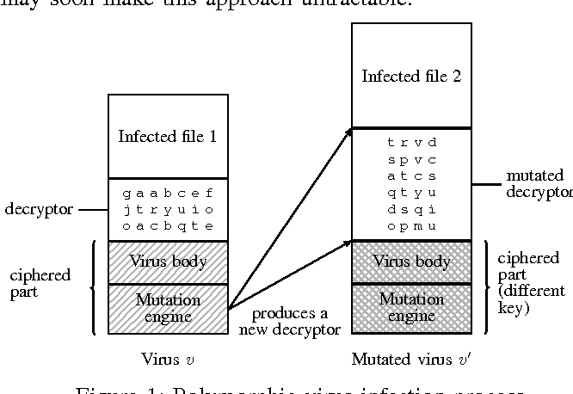
Polymorphic Virus Diagram
“Automated extraction of polymorphic virus signatures
using abstract interpretation” by Chaumette and Tabary

Slide 63
Anti-virus Arms Race
Advanced Signatures
Signature is not just a byte sequence
Each “signature” is a mini-program of detection instructions
Partial Interpreter
Virus usually takes control early
Interpret the first bytes to see if its decrypting
Decrypt and then scan
(Developed in the 1990’s)

Slide 64
Beyond Scanning
Behavior Blockers
Tries to block bad behavior
But what counts as “bad”?
Integrity Checkers
Checksum files
Detect unauthorized changes
But what is authorized?
Heuristics
Look for “telltale” signs
Minimally effective; too many false positives

Slide 65
Emulation and Sandboxing
Emulation simulates execution
Default arguments
Stubbed I/O
Simulate the “beginning” when viruses activate
Sandboxing runs the software in a virtual environment
Default arguments
Usually for a limited amount of time (e.g., 1 minute)
Observe changes to the filesystem
Problems
Non-contextual execution including arguments
Malware that detects sandboxes

Slide 66
Malware Scanning
Antivirus scanning is representative of all malware scanning
Always “behind” the enemy
Signatures can only catch “known” malware
Guesses always have FP and FN
Dynamic execution can be detected/evaded

Slide 67
Enemy: Halting Problem
Decidability is a classic computer science problem
Halting Problem:
Given: a program P and input I
Can you write a program D that determines if P halts on input I
(Halts, meaning e.g., not stuck in an infinite loop)
Over the set of all possible programs, the answer is NO
(Maybe able to determine for some, but not for all)
Alan Turing proved this in 1936!
Halting problem proven to extend to any non-trivial characteristic

Slide 68
In Other Words
There is no program that can detect all malware
Is this just theoretical?
What if we can detect 99.9999999%?
What if we can detect all the “important” threats?

Slide 69
Thoughts from 1995
In 1995, Gryaznov wrote, “Scanners of the year 2000”
He discussed Heuristics
Specifically mentioned the halting problem, but said:
Fortunately, this does not rule out a possibility of 90 or even 99 per cent reliability. And with the remaining one per cent cases we hopefully shall be able to deal with using our traditional virus signatures scanning technique.
GRYAZNOV WAS WRONG.

Slide 70
Gryaznov’s View
All Possible Viruses
Algorithmically Detectable

Slide 71
Why It Doesn’t Work
Gryaznov treats viruses as if they are created at random
Viruses are created by human beings
If an antivirus writer creates an algorithm, the adversary adjusts
The adversary moves into the space not detected by the algorithm

Slide 72
Correct View
All Possible Viruses
Virus Authors
MOVE in the
space
NEXT MONTH’S VIRUSES
THIS MONTH’S VIRUSES
Current Antivirus Algorithm

