Slide 1
Intro to Cybersecurity
UT LAW 379M
Spring 2022
Lecture Notes

Slide 2

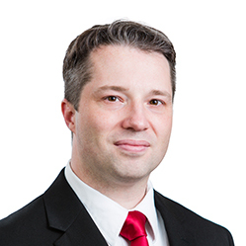



About the Instructor

Slide 3
What about You?
Why did you take this course?
What is your technology background like?
What has been your favorite course so far? Why?
What is your learning style?
What is your favorite teaching style?

Slide 4
The 5 Orders of Ignorance
0th Order: Known Knowns
1st Order: Known Unknowns
2nd Order: Unknown Unknowns
3rd Order: Unknown methods for discovering unknown unknowns
4th Order: Unknown methods for exploring the orders of ignorance
(Adapted from Phillip Armour, “The Five Orders of Ignorance”)

Slide 5
The 5 Orders of Ignorance
0th Order: Known Knowns
1st Order: Known Unknowns
2nd Order: Unknown Unknowns
3rd Order: Unknown methods for discovering unknown unknowns
4th Order: Unknown methods for exploring the orders of ignorance
(Adapted from Phillip Armour, “The Five Orders of Ignorance”)
SKILL
EDUCATION

Slide 6
A Few Introductory Notes
This course is still a little new for me
I’m still developing the materials
Please feel free to make suggestions or raise concerns

Slide 7
Course Objectives
Learn some basics about technology
Learn about how technology protects systems
Learn about how attackers get in anyway
Learn principles that allow you to evaluate technology

Slide 8
Schedule And topics
PART 1 – Tech Background
How Computers Work
How Networks Work
Network Lab
PART 2 – Core Security
Psychology
Authentication/Authorization
Cryptography
Password Lab

Slide 9
Schedule And topics
PART 3 – Protecting the Internet
Protecting Computers
Protecting Local Networks
Protecting the Web
Browser Security Lab
PART 4 – Contemporary Security
Email and Social Media
SOTA Technologies
Phishing Competition

Slide 10
Technology Evaluation
Forces behind design/development
Intended Purpose
Feature Set
Strengths and Weaknesses
Context and Requirements
Deployment in Practice
Lessons Learned

Slide 11
Evaluation of New Tech
GOAL: You can evaluate tech at a basic level
Especially cut through the vendor marketing
No technology is “magic”
Governed by principles
Use the principles to understand the specifics

Slide 12
Peek Ahead Example
Authentication is verifying an identity
Three basic approaches
Something you know (passwords)
Something you have (phone or security token)
Something you are (biometrics)
Knowing just this better enables you to evaluate

Slide 13
Team Presentations
Every student assigned a team
Teams discuss reading together
Teams also do presentations on technology
First presentation: Survey of technologies
Second presentation: Evaluation of specific technology

Slide 14
Presentation Details
I will provide a list of technologies to choose from
Your team will sign up for a time in class to present
Refer to the assignment page for more details.

Slide 15
Class Discussions
I hate slides and I hate “lectures”
I only use them because I haven’t found something better
Please read before class, come prepared to discuss
You will be assigned to discuss out-of-class as well
For each reading, discuss using canvas comments

Slide 16
Grading
40% labs (10% each)
10% participation
20% presentations (10% each)
30% Exams (15% each)
1 Midterm (Mar 7 – 11)
1 “floating” Final (Due May 12)

Slide 17
Readings
I’m writing a book. I think it’s pretty good.
Most readings come from preprints (drafts) of the book
YOU MUST NOT SHARE OR DISTRIBUTE
You can get a copy when it is published later this year
Some additional online readings/videos

Slide 18
Labwork
lab 1 - Wireshark and Browsing
lab 2 - Password Cracking
lab 3 - Certificates and Public Keys
lab 4 - Phishing Contest

Slide 19
Labwork Policies
PASS/FAIL – Not worth it to do part
You may talk to other students about the labs
But you must do your own work
I also will provide help sections as needed

Slide 20
Exams
Essay based thought questions
Open book, open note
I hate memorization/regurgitation
Usually involve a hypothetical

Slide 21
Exam Sample Question
Every one complains about passwords and that they need to be replaced. Although every now and then someone comes up with a new replacement but they never seem to get much traction, so the search continues. Regardless of whatever new technology comes along to replace passwords, there are certain fundamental problems that will have to be solved. Write an essay explaining what kinds of evaluations YOU would do for a password-replacement technology.
Do not speculate about how this imaginary technology works, just imagine it to be some kind of “black box” authentication mechanism. Instead, focus your essay on the psychological, technical, and perhaps even mathematical problems that you would require it to solve or address before you believed it to be a “good” replacement. Because this is hypothetical, you can address this from a number of different angles. Your score for this essay will be based on how well you understand user authentication including principles related to “something you know”, “something you have”, and “something you are.” You may also get score for applying Anderson’s concepts on user psychology and security engineering.

Slide 22
Grading
Standard Scale
Last semester, average was about 93%
This semester, enforcing law school curve
The curve must apply to law students
Non-law students will be slotted into the curve as well

Slide 23
Introducing Cybersecurity
This is a very broad concept
Includes concepts of technology, psychology, etc etc
Where to start?
Let’s start with Ross Anderson’s “Security Engineering”

Slide 24
What is “Security Engineering”?
“[It] is about building systems to remain dependable in the face of …”
Malice
Error
Mischance.
“As a discipline, it focuses on the…”
Tools
Processes
Methods

Slide 25
The Goal
Confidentiality, Integrity, Availability (CIA Triad)
For new systems:
Design security
Implement security
Test security
For existing systems:
Adapt them for increased security
Adapt them as their environment evolves

Slide 26
“Having” Security
Everyone wants “security”. But how?
“Whoever thinks his problem can be solved using cryptography, doesn’t understand his problem and doesn’t understand cryptography.”
— Attributed by Roger Needham and Butler Lampson to Each Other

Slide 27
Key Observation
Anderson, Ch 1, p. 4

Slide 28
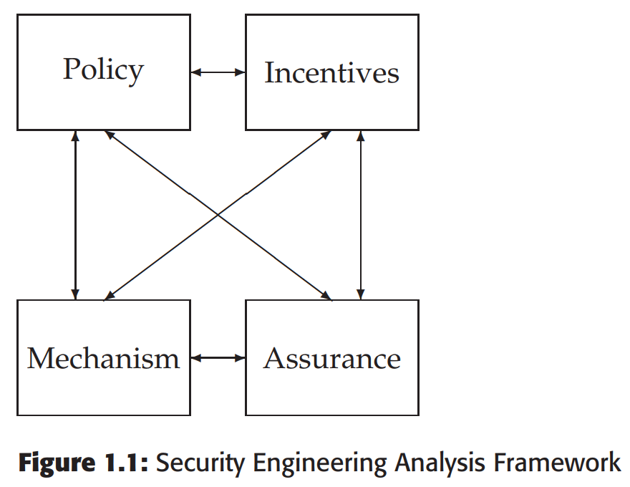
A Framework
Policy
Mechanism
Assurance
Incentives

Slide 29
Some Definitions
System – Tech + Auxiliary Tech + Staff + Users + etc.
Subject – Physical “person”
Principal – Entity in the system
Identity – Unique label attached to a unique principal
Trusted – Failure results in compromise
Trustworthy – Failure is unlikely

Slide 30
CIA (Not the Spies)
Confidentiality – Cannot be read
Integrity – Cannot be altered
Availability – Cannot be interrupted

Slide 31
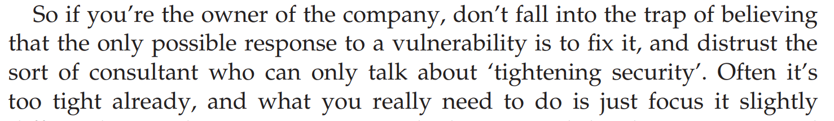

Understand This
Anderson, Ch 25, p. 816

Slide 32
Anderson’s Examples
Bank
Military
Hospital
Home

Slide 33
IAAA
Identity – Unique label for a unique principal
Authentication – Validation of the principal’s identity
Authorization – Permissions granted the prinicpal
Accountability – Metering and auditing of principal
(Message Authenticity – Integrity + Freshness)

Slide 34
Grasp the Context
SECURITY IS ABOUT CONTEXT (Repeat after me)
What does it mean when you say “system X is secure”?
Secure against whom?
Secure under what conditions?
Are we even protecting what matters?!
Take voting security
Who are the potential attackers?
How does the context change if a nation decides to be the attacker?

Slide 35
Start with Policy
“…a succinct statement of a system’s protection strategy” (Anderson ch1 p. 15)
Examples:
Each credit must be matched by an equal and opposite debit
All transactions over $1,000 must be authorized by two managers
Practice:
What are the security policies for TLS?

Slide 36
Then figure out mechanism
This is where most security people like to start
But really we only need mechanism to enforce policy
Some mechanisms aren’t even technical (e.g., legal)
MUST understand threat model

Slide 37
Assurance
Just how strong/resilient/comprehensive is the mechanism?
Requires a solid understanding of the threat model
Applications at every stage!
Design – solid security engineering principles
Implementation – coding practices, development processes
Testing – adversarial, comprehensive assessment

Slide 38
Incentives
Anderson’s example of airport security
What motivates the behavior?
What is “Security Theater?”
Everyone should learn a little game theory
Read up on Prisoner’s dilemma
Understand “mechanism design”
Anderson’s “Moral Hazard” (Chapter 25)

Slide 39
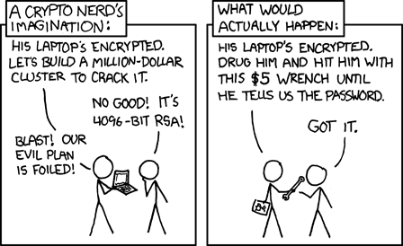
Illustrations
See http://xkcd.com/538/

Slide 40
Important Security Principles
Least privilege
Minimize attack surface
Defense in depth
Separation of duties and responsibilities
Crowdsourcing
Open systems
Fail Safe/Fail Secure

Slide 41
Course Goals
Understand how secure systems are constructed
Underlying concepts, such as policy and mechanism
Tools, such as cryptography
Systems, such as perimeter defense
Understand how “secure” systems are deconstructed (attacked)
Underlying concepts, such as “halting problem”
Tools, such as vulnerabilities
“Systems” such as Advanced Persistent Threats

