Slide 1
Cryptography in Network Security
UT Law 379
Spring 2022
Lecture Notes

Slide 2
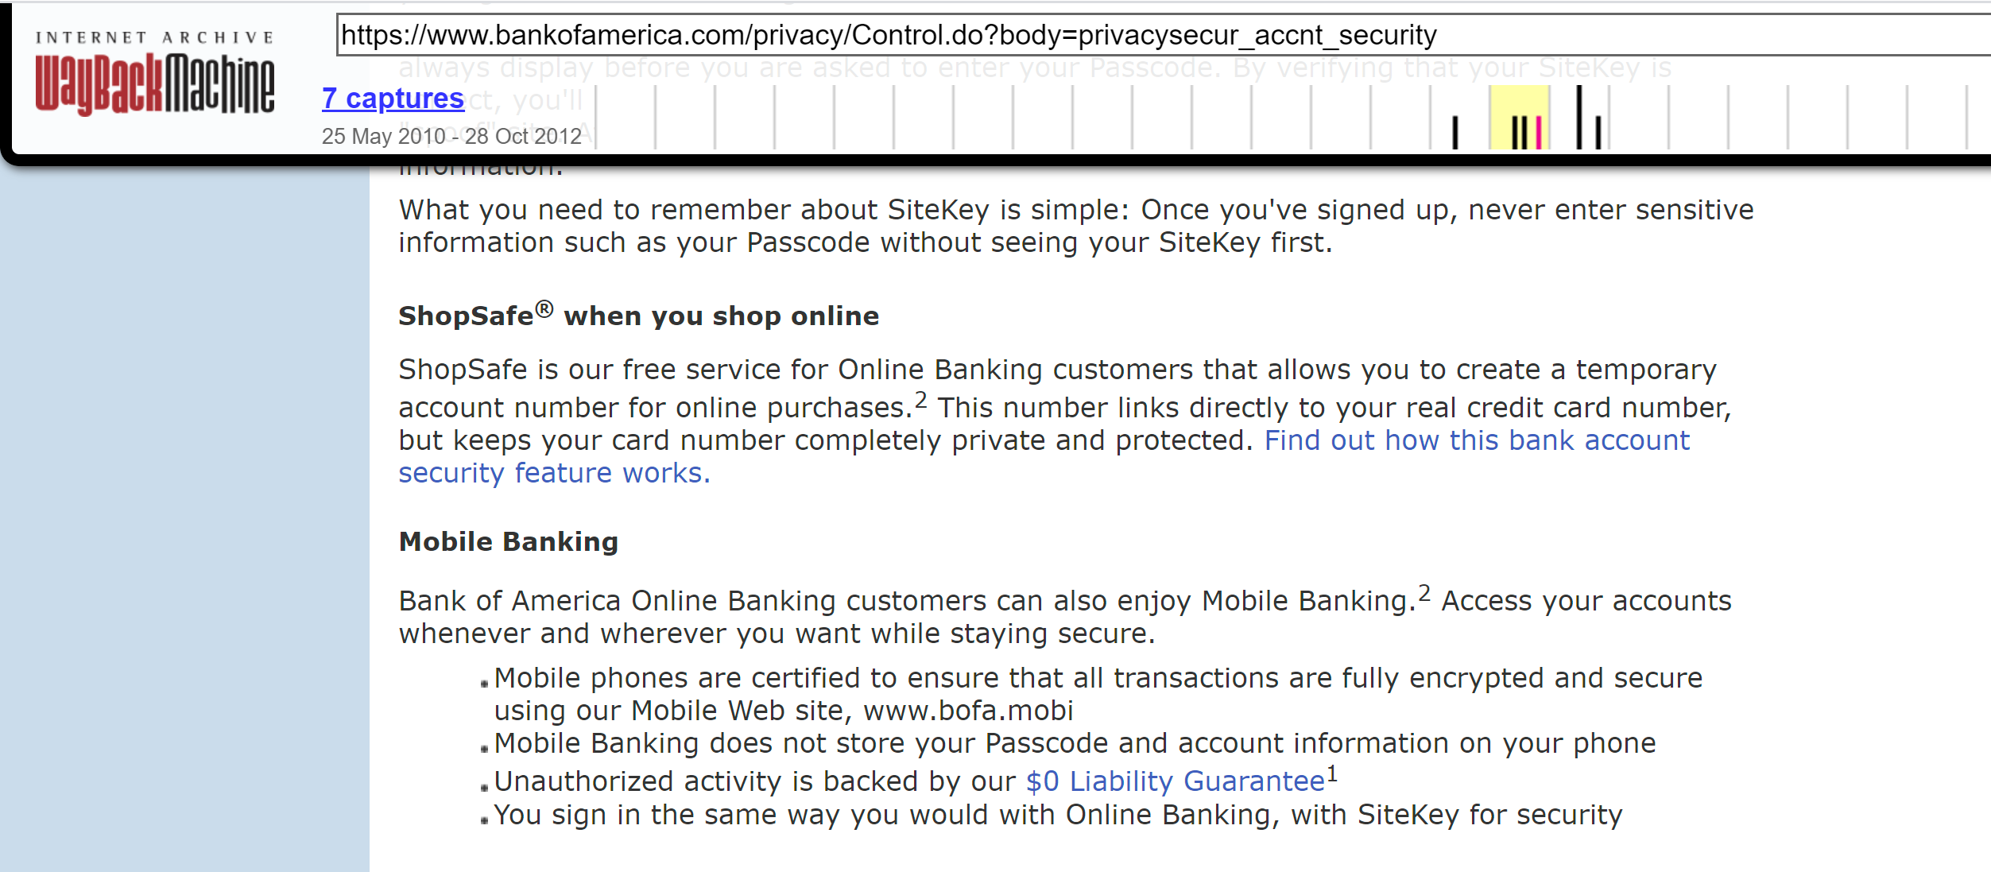
What is “Cryptography”?

Slide 3
Cryptography ≠ Confidentiality
“Secret” codes usually gets the most attention from non-experts
Websites used to emphasize “security” by talking encryption
In crypto terms, encryption typically provides “confidentiality”
Confidentiality is not the only property, nor even the “most important”

Slide 4
Cryptography Definition
Assume definition of “information” is axiomatic
Study of mathematical techniques related to information security such as
confidentiality,
data integrity,
entity authentication, and
data origin authentication
(See, HAC Definition 1.1)

Slide 5
Information Security
“Protect” information
This is the goal (i.e., the (Anderson) security policy)
Cryptography is just one approach (i.e., mechanism) to enforcement

Slide 6
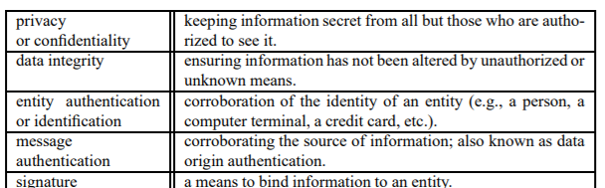
Information Security Objectives

Slide 7
Crypto’s Primary Objectives
Confidentiality
Data Integrity
Authentication
Entity Authentication
Data Origin Authenticaiton
Non-repudiation
Other objectives built on top of these four properties

Slide 8
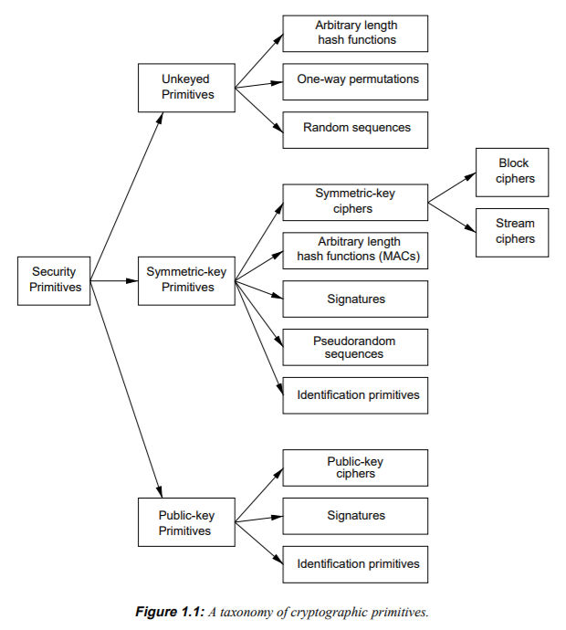
Cryptographic “Primitives”

Slide 9
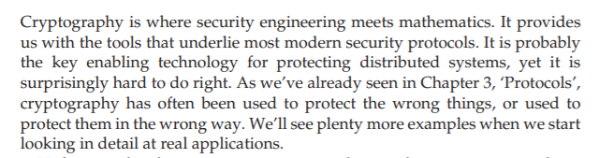
Anderson’s Intro

Slide 10
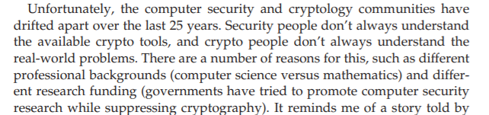
Security vs Cryptography

Slide 11
YANAC
YOU ARE NOT A CRYPTOGRAPHER
You will acquire some knowledge in this class
That could make you more dangerous, not less!
Do NOT roll your own cryptography
Know when to tell your boss to hire a cryptography expert

Slide 12
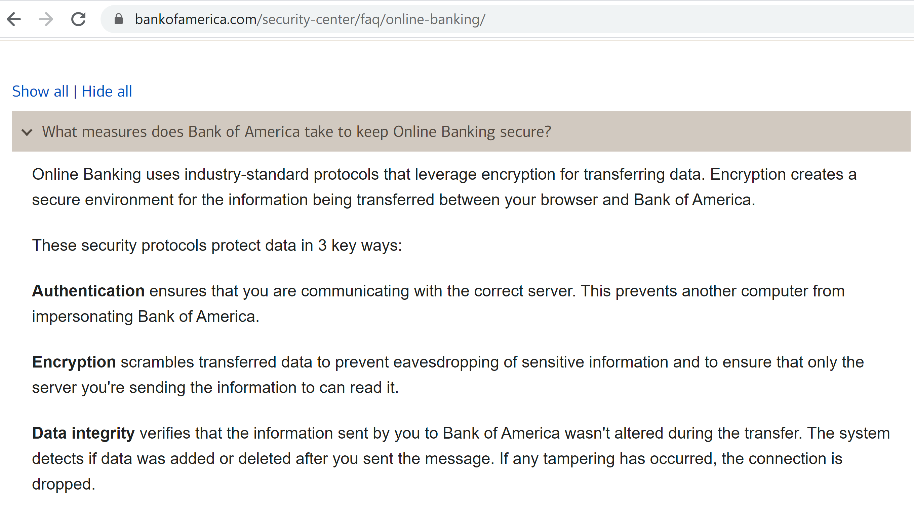
Improvement!

Slide 13
Technology Review

Slide 14
But First, XOR
Boolean algebra – Math with True/False
AND, OR, NOT functions
Truth tables

Slide 15
AND function
INPUT 1 | INPUT 2 | OUTPUT
0 (False) | 0 | 0
0 | 1 (True) | 0
1 | 0 | 0
1 | 1 | 1

Slide 16
OR function
INPUT 1 | INPUT 2 | OUTPUT
0 (False) | 0 | 0
0 | 1 (True) | 1
1 | 0 | 1
1 | 1 | 1

Slide 17
XOR function
INPUT 1 | INPUT 2 | OUTPUT
0 (False) | 0 | 0
0 | 1 (True) | 1
1 | 0 | 1
1 | 1 | 0

Slide 18
XORing Two Numbers
1 | 1 | 0 | 1 | 1 | 0 | 1 | 1
0 | 1 | 0 | 1 | 1 | 1 | 0 | 0
1 | 0 | 0 | 0 | 0 | 1 | 1 | 1

Slide 19
XOR Is Its Own Inverse
1 | 1 | 0 | 1 | 1 | 0 | 1 | 1
0 | 1 | 0 | 1 | 1 | 1 | 0 | 0
1 | 0 | 0 | 0 | 0 | 1 | 1 | 1
1 | 0 | 0 | 0 | 0 | 1 | 1 | 1
0 | 1 | 0 | 1 | 1 | 1 | 0 | 0
1 | 1 | 0 | 1 | 1 | 0 | 1 | 1

Slide 20
Hashing
A “Hash” is a function
The input is any data
The output is a fixed size “fingerprint”

Slide 21
Data 1
Document 10 MB
f(Data 1) -> n-byte hash
Hash Function
f(x)
Data 2
Video
4GB
f(Data 2) -> n-byte hash
Data 3
Name
18 Bytes
f(Data 2) -> n-byte hash
The output size of a hash function is always the same for a given function.

Slide 22
Some Common Hash Functions
MD5 16 byte output (Really Obsolete)
SHA1 20 byte output (Obsolete)
SHA256 32 byte output (Still in use)

Slide 23
Four score and seven years ago our fathers brought forth on this continent, a new nation, conceived in Liberty, and dedicated to the proposition that all men are created equal. Now we are engaged in a great civil war, testing whether that nation, or any nation so conceived and so dedicated, can long endure. We are met on a great battle-field of that war. We have come to dedicate a portion of that field, as a final resting place for those who here gave their lives that that nation might live. It is altogether fitting and proper that we should do this. But, in a larger sense, we can not dedicate -- we can not consecrate -- we can not hallow -- this ground. The brave men, living and dead, who struggled here, have consecrated it, far above our poor power to add or detract. The world will little note, nor long remember what we say here, but it can never forget what they did here. It is for us the living, rather, to be dedicated here to the unfinished work which they who fought here have thus far so nobly advanced. It is rather for us to be here dedicated to the great task remaining before us -- that from these honored dead we take increased devotion to that cause for which they gave the last full measure of devotion -- that we here highly resolve that these dead shall not have died in vain -- that this nation, under God, shall have a new birth of freedom -- and that government of the people, by the people, for the people, shall not perish from the earth.
SHA256 Hash: bac8d5750a7e53bb06e7a1ed93b89e92828e561a562dfbc2e38be96fdbe37d5a

Slide 24
Four score and seven years ago our fathers brought forth on this continent, a new nation, conceived in Liberty, and dedicated to the proposition that all men are created equal. Now we are engaged in a great civil war, testing whether that nation, or any nation so conceived and so dedicated, can long endure. We are met on a great battle-field of that war. we have come to dedicate a portion of that field, as a final resting place for those who here gave their lives that that nation might live. It is altogether fitting and proper that we should do this. But, in a larger sense, we can not dedicate -- we can not consecrate -- we can not hallow -- this ground. The brave men, living and dead, who struggled here, have consecrated it, far above our poor power to add or detract. The world will little note, nor long remember what we say here, but it can never forget what they did here. It is for us the living, rather, to be dedicated here to the unfinished work which they who fought here have thus far so nobly advanced. It is rather for us to be here dedicated to the great task remaining before us -- that from these honored dead we take increased devotion to that cause for which they gave the last full measure of devotion -- that we here highly resolve that these dead shall not have died in vain -- that this nation, under God, shall have a new birth of freedom -- and that government of the people, by the people, for the people, shall not perish from the earth.
SHA256 Hash: 84b26abc41d32e044cdb85bd1355080c6d6b2cf001ab208c8c00dcb832e65382

Slide 25
Fingerprints for Comparison
Sample 1 and Sample 2 look very similar
In fact, the difference is a single character
Spotting this one-character change is hard
Because the hash changed, something must have changed

Slide 26
Four score and seven years ago our fathers brought forth on this continent, a new nation, conceived in Liberty, and dedicated to the proposition that all men are created equal. Now we are engaged in a great civil war, testing whether that nation, or any nation so conceived and so dedicated, can long endure. We are met on a great battle-field of that war. We have come to dedicate a portion of that field, as a final resting place for those who here gave their lives that that nation might live. It is altogether fitting and proper that we should do this. But, in a larger sense, we can not dedicate -- we can not consecrate -- we can not hallow -- this ground. The brave men, living and dead, who struggled here, have consecrated it, far above our poor power to add or detract. The world will little note, nor long remember what we say here, but it can never forget what they did here. It is for us the living, rather, to be dedicated here to the unfinished work which they who fought here have thus far so nobly advanced. It is rather for us to be here dedicated to the great task remaining before us -- that from these honored dead we take increased devotion to that cause for which they gave the last full measure of devotion -- that we here highly resolve that these dead shall not have died in vain -- that this nation, under God, shall have a new birth of freedom -- and that government of the people, by the people, for the people, shall not perish from the earth.
SHA256 Hash: bac8d5750a7e53bb06e7a1ed93b89e92828e561a562dfbc2e38be96fdbe37d5a

Slide 27
Four score and seven years ago our fathers brought forth on this continent, a new nation, conceived in Liberty, and dedicated to the proposition that all men are created equal. Now we are engaged in a great civil war, testing whether that nation, or any nation so conceived and so dedicated, can long endure. We are met on a great battle-field of that war. we have come to dedicate a portion of that field, as a final resting place for those who here gave their lives that that nation might live. It is altogether fitting and proper that we should do this. But, in a larger sense, we can not dedicate -- we can not consecrate -- we can not hallow -- this ground. The brave men, living and dead, who struggled here, have consecrated it, far above our poor power to add or detract. The world will little note, nor long remember what we say here, but it can never forget what they did here. It is for us the living, rather, to be dedicated here to the unfinished work which they who fought here have thus far so nobly advanced. It is rather for us to be here dedicated to the great task remaining before us -- that from these honored dead we take increased devotion to that cause for which they gave the last full measure of devotion -- that we here highly resolve that these dead shall not have died in vain -- that this nation, under God, shall have a new birth of freedom -- and that government of the people, by the people, for the people, shall not perish from the earth.
SHA256 Hash: 84b26abc41d32e044cdb85bd1355080c6d6b2cf001ab208c8c00dcb832e65382

Slide 28
Idealized Hash Function
Pretend “magic” function
Magically picks a random number for each new input
If the input is hashed again, output same number
Random number always has N bits

Slide 29
Cryptographic Hashing
Compression
Ease of Computation
Preimage Resistance
2nd Preimage Resistance
Collision Resistance
In practice, also has the Avalanche property

Slide 30
Real Hash Functions
Cannot be as perfect as the ideal
Try to get “close” using good algorithms
Is “broken” when way is found to violate properties

Slide 31
Symmetric Cryptography
All parties in the protocol share a unique key
If |parties| is 1, “secret key”
If |parties| > 1, “shared key”
For today’s examples, assume pre-shared key

Slide 32
Symmetric-Cipher Types
Block Cipher
Data split in fixed-size blocks
1:1 map from plaintext block to ciphertext block
“Substitution Cipher”
Stream Cipher
Encrypted 1 symbol at a time
Combined with a Stream of key material (key stream)

Slide 33
Monoalphabetic Substitution (Caesar cipher)
Each letter of plaintext maps to exactly one cipher symbol
(Block Size: 1 letter)
Let’s race! Decrypt the following:
RYG WKXI CSLVSXQC NY IYE RKFO?
It’s a question, when you decrypt it, shout out the answer!

Slide 34
Caesar Cipher: “Shift” Cipher
Write out all letters and move them over (wrapping around)
A B C D E F … X Y Z
X Y Z A B C … U V W
KEY SPACE: How many keys are there for this algorithm?

Slide 35
Permutation Cipher
Any letter can be mapped to any letter:
A B C D E F G H I J K L M
X N B Y A M L S V P R K W
N O P Q R S T U V W X Y Z
Z C G I U D T F O H J Q E
Key space is now how big?
Block size is still 1

Slide 36
Why Size Matters
Key Space is related to exhaustive/brute-force search
Even without a computer, a 25/26 key space is easy to brute force
Block Size is related to cryptanalysis e.g., frequency analysis
A one-letter block does not conceal enough information

Slide 37
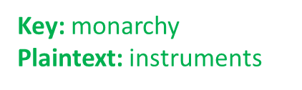
Playfair Cipher
1854 by Charles Wheatstone
Named after Lord Playfair who promoted it (classic politician)
Example: https://geeksforgeeks.org/playfair-cipher-with-examples

Slide 38
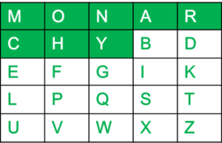
Playfair Keyblock
5×5 grid of alphabets that acts as the key (Key Expansion)
One letter of the alphabet (usually J) is omitted from the table
(If the plaintext contains J, then it is replaced by I)

Slide 39
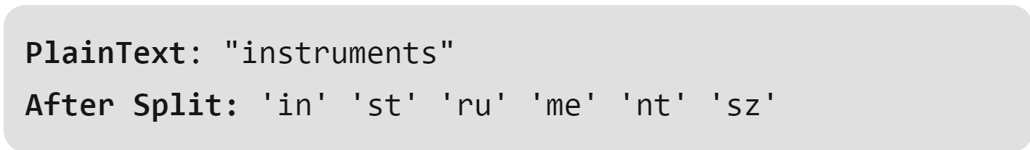
Playfair Encipherment
The plaintext is split into pairs of two letters (digraphs).
If there is an odd number of letters, a Z is added to the last letter

Slide 40
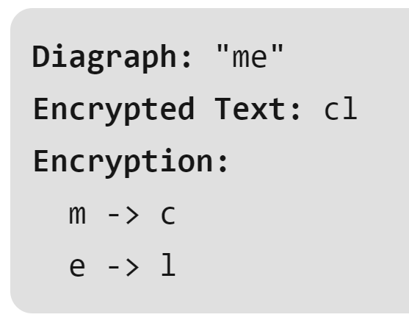
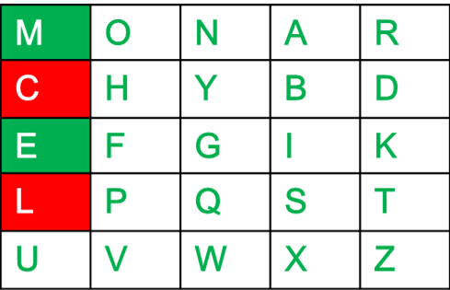
Playfair Encipherment
If both the letters are in the same column:
Take the letter below each one

Slide 41
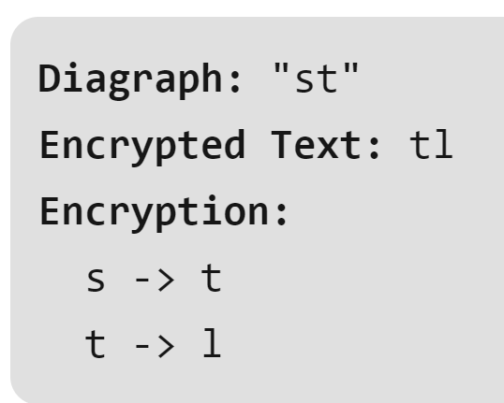
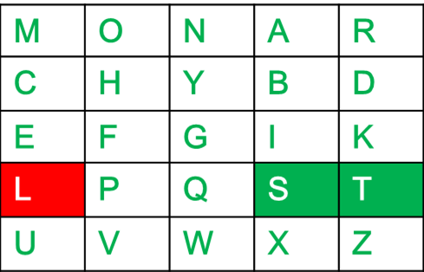
Playfair Encipherment
If both the letters are in the same row:
Take the letter to the right of each one

Slide 42
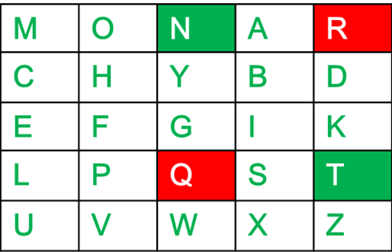
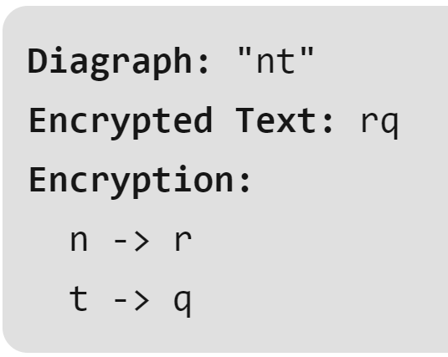
Playfair Encipherment
If letters do not share a row or column:
Form a rectangle with the two letters and take the letters on the horizontal opposite corner of the rectangle

Slide 43
Playfair Ciphertext:
Plain Text: "instrumentsz"
Encrypted Text: gatlmzclrqtx

Slide 44
How “Strong” is Playfair?
What’s the key space? How long to brute force?
What about “cryptanalysis”?

Slide 45
Cryptanalysis Considerations
Our example playfair ciphertext might be “uncrackable”
But what if the plaintext was longer?
How much ciphertext before patterns emerge?
Digraph (2-letter “blocks”) are better, but not good enough

Slide 46
Vigenère cipher
Plaintext
A | T | T | A | C | K | N | O | W
P | A | S | S | W | O | R | D | P
P | T | L | S | Y | Y | E | R | L
Password
Ciphertext

Slide 47
Vigenère cipher
A | T | T | A | C | K | N | O | W
P | A | S | S | W | O | R | D | P
P | T | L | S | Y | Y | E | R | L
A shifted by P is P
Each plaintext symbol is encrypted using the Caesar Cipher, but the key for each one is based on the letter of the repeating password
T shifted by A is T

Slide 48
Vigenère cipher
The letters can be converted to numbers: A = 0, B = 1, etc
C | 2
W | 22
Y | 22+2 = 24

Slide 49
Vigenère cipher
“Modulo-26” Addition (wraps around at 26)
N | 13
R | 17
E | 13+17 = 30 30 % 26 = 4

Slide 50
Modern Requirements*
Symbols are just bits (can represent all info)
Blocks are large (used to be 64, now 128 bit)
Key size is large (currently 128 min, soon 256 bit min)
Algorithm has “Avalanche” property
*Not a formal list of all requirements; These are the ones that
Dr. Nielson runs into most often

Slide 51
AES: Common Block Cipher
Block size is ALWAYS 128 bits
Key size can be 128, 192, or 256
But at its core, still a “substitution” cipher.
AES-128 encryption of ”My name is Seth!” w/ a “zero” key:
E94B 69E7 13C6 B4F9 B834 FEA5 95F7 8F2A

Slide 52

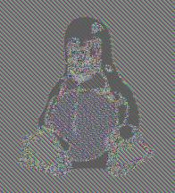
Block Cipher Weaknesses
What happened here?

Slide 53
Patterns
Remember, AES still 1-to-1 mapping of 128 bits
If input 128 bits is the same, output 128 bits is the same
Patterns between blocks NOT ERASED
Solution: “link” output in some way

Slide 54
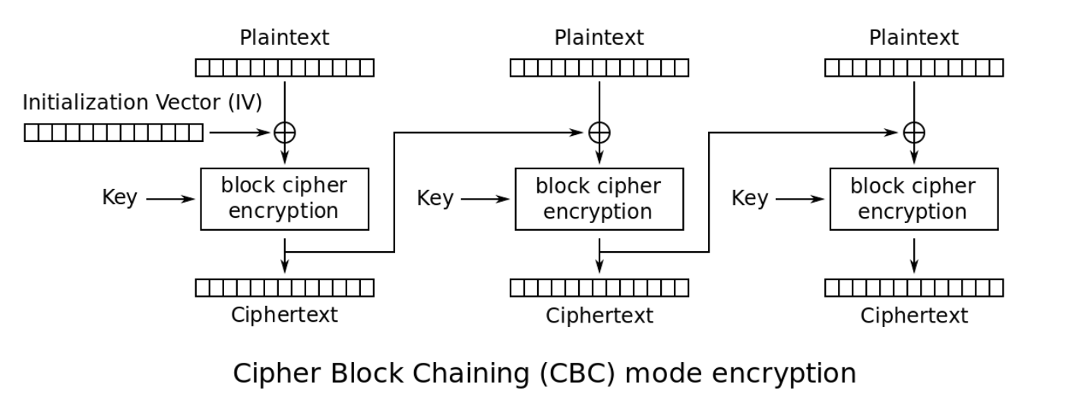
Cipher-Block Chaining (CBC)

Slide 55
What is an IV?
Initialization Vector
Similar to “salting” a hash
Eliminates deterministic output
You should almost never reuse a key
BUT YOU SHOULD NEVER EVER reuse a KEY and IV

Slide 56
Quasi-Deprecated CBC
CBC “works” when used correctly
However, has various weaknesses and is error prone
In many cases, CBC is being deprecated

Slide 57
Stream Ciphers
Unlike block ciphers, one symbol at a time
Can change as it goes (state)

Slide 58
One Time Pad
Step one: Create a random key as big as the plaintext
Step two: XOR the plaintext and key
THAT’s IT!!!

Slide 59
OTP is Really Strong
Ciphertext is meaningless
Key could literally be anything
Output determined by key
Even brute force is meaningless

Slide 60
Confidentiality is NOT Integrity
Suppose C1 = K XOR M1
Suppose an attacker knows the plaintext M1 (or part of it!)
Suppose attacker can intercept/change the message
Attackers wants to change M1 to M2
Attacker produces C2 = C1 xor (M1 xor M2)
= K xor M1 xor M1 xor M2
= K xor M2

Slide 61
Don’t Reuse Key
C1 = K1 xor M1
C2 = K1 xor M2
C1 xor C2 = K1 xor M1 xor K1 xor M2
= K1 xor K1 xor M1 xor M2
= M1 xor M2

Slide 62
OTP problems
Key is the same size as the input!
This is impractical for almost all applications
Storing, managing, protecting, distributing key
Many stream ciphers emulate OTP

Slide 63
AES Counter Mode (CTR)
Converts a block cipher into a STREAM CIPHER
Instead of an OTP key, generates a key stream
Keystream = AES( IV + 0 ), AES( IV + 1 ), AES( IV + 2 )…
Ciphertext = Plaintext XOR Keystream
Plaintext = Ciphertext XOR Keystream

Slide 64
Salsa20 and ChaCha20
Modern stream ciphers
Similar to AES-CTR but hashes counter
Designed to be fast and simple
Design transparently as possible

Slide 65
No Integrity
Like OTP, stream ciphers do not provide integrity
Neither do block ciphers for that matter
Solution: MAC or “combined” mode of operation

Slide 66
Message Authentication Code
MAC is a symmetric key code that is used for message integrity
Commonly implemented as a keyed hash
Super simple (insecure) MAC: hash(message + key)
HMAC is more complicated, but same basic idea:

Slide 67
Encrypting and Mac
What order do you do things?
MAC the plaintext data?
MAC the ciphertext data?
RECOMMEND: “encrypt, then MAC”

Slide 68
Composite Mode
Also known as
Authenticated Encryption or
AEAD – Authenticated Encryption with Additional Data
Integrity + Confidentiality
AES-GCM is counter mode with a built-in MAC (called a “tag”)
AES-CCM is counter mode with CBC-MAC
Only AEAD ciphers supported in TLS 1.3
TAKEAWAY MESSAGE: USE AEAD WHENEVER POSSIBLE!!!!!!!!

