Slide 1
Psychology and Computer SEcurity
Technology of Cybersecurity
Spring 2023

Slide 2

Psychology is Significant

Slide 3
The Most Powerful Security Tech
Year ago a Dental Hygienist asked me what was the best home security for her computer.
Her question was obviously broad
Security against worms/vulnerabilities?
Security against viruses?
Data security?
Anyone wish to guess my answer?

Slide 4

What is a warrior’s Most Powerful Tool?

Slide 5
NO! NO! NO! NO! NO!
This scene convinced me the Jedi were idiots!
It isn’t the Lightsaber that made the Jedi so dangerous
Battles aren’t won during the fighting; they are won in the thinking before hand
Weapons aren’t you most powerful weapon
What is your most powerful weapon?
My answer to my Dental Hygienist?

Slide 6
YOUR MIND!

Slide 7
Your Mind is your Most Powerful Tool
“There is no knowledge that is not power”
(Ralph Waldo Emerson)
Tools serve to amplify, not replace, mental powers
Many effective attacks primarily target the brain, not computers
The Hygienist was disappointed. She wanted to not think
Many want a technology that eliminates the need for thinking
At least at this point, such technology does not exist.
“The real question is not whether machines think but whether men do”
(B.F. Skinner)

Slide 8
Security “Smarts” Won’t Get Better
Some of the problem is human weakness:
Laziness – don’t want to learn
Ignorance – lack of opportunity to learn
Bigger problem: specialization of complex society
Nobody can be an expert in everything
Complex society requires experts to do things
Harder to self-maintain cars, houses, etc
Everyone trains, a lot, for their specialty
Little time/energy less for studying something else

Slide 9
What about Out-sourcing?
For our cars, we can go to a mechanic every 15,000 miles
For our houses, we can call a repair service to fix things
For medical, we can have yearly check-ups
Why can’t we do this for cyber-security?

Slide 10
The problem is: THIS IS WAR!
Your car is not trying to break down
Your house is not trying to fall apart
Your body is not trying to kill you
Cyber-villains are actively strategizing about how to attack you
THIS IS NOT RANDOM CHANCE
THESE ARE HIGHLY MOTIVATED PEOPLE

Slide 11
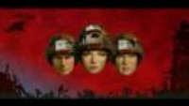
Solution?

Slide 12
Sounds like Out-sourcing?
Maybe, but please understand the difference
Somebody (or multiple somebodies) must do the thinking
Somebody has to engage in the warfare with the bad guys
Thinking has to be contextualized to the target, not defender
Understand protecting the mind, not just tech/assets
“Only amateurs attack machines; professionals target people”
(Bruce Schneier)

Slide 13
The mind as technology
Forces behind design and development
Intended purposes
Feature set
Strengths
Weaknesses
Contextual requirements
Deployment in practice (intentional or not)
Lessons learned and future directions

Slide 14
How did the Mind Develop?
Evolutionary development of the mind
Higher cognitive functions are very powerful
BUT, have limitations for the pre-historic world
Can’t out think the predator running you down
Can’t think without sufficient information
Can’t think through certain necessary social cohesion
Evolutionary Solution: Intuition and Reaction
Evolutionary Solution: DISABLE THINKING

Slide 15
Understanding Human Cognition
Incorrect: humans minds are 100% logical and rational
More correct: logical thinking often fails
Example 1: human error
Example 2: human manipulation
Security impact:
Impacts correct human use/deployment of security systems
Impacts correct defenses of the human targets

Slide 16
Lecture Roadmap
Human Error
Source #1: Automation
Source #2: Complex Rules
Source #3: Meta Ignorance
Source #4: Wrong Model
How attackers manipulate errors
Human Manipulation
Attacking human bias (e.g., toward action)
Attacking emotional fallback
Attacking via social engineering (e.g., tribal or authority)
Attacking via visual-emotional
Psychology-aware Security Engineering

Slide 17
The Psychology of Human Error
Many cybersecurity incidents happen because of error
Giving the wrong access
Not updating a vulnerable system
Some designers blow off errors as “stupid human errors”
Condescending attitude of “it’s their own fault”
Doesn’t understand limitations of the brain
Doesn’t solve the problem
Understanding why humans “fail” can improve design

Slide 18
Source of Error: Automation
We spend a lot of time not thinking
When performing a skill:
Very conscious during the learning phase
Eventually shifts to automatic operation
Example: Driving
“Slip and capture” errors: wrong automated task
Dangerous to assume a person is thinking

Slide 19
Source of Error: Complex Rules
Some errors happen even while thinking
Humans can consciously choose the wrong rule
Impacted by complicated hierarchies:
More general rules verses more specific
Rules that change the rules
Edge case rules
User doesn’t recognize error because “followed the rules”
Dangerous to assume a person follows the right rule(s)

Slide 20
Source of Error: Meta Ignorance
Humans sometimes struggle to ask for help
They either:
Don’t know how much trouble they’re in
Or, are pressured to act anyway
For example, cybersecurity is hard because it is abnormal
Up until the attack, everything looks/feels fine
When trouble starts, can be unpracticed getting help
Cryptography is also an example
Dangerous to assume correctly skilled people are acting

Slide 21
Source of Error: Wrong Model
Everything we “think” is based on models
We cannot understand or know every possible detail
Models help us understand, compare, predict, etc
Models of things: chair, car, window
Models of people: spouse, friend, co-worker
Wrong Model Error
Incorrect or incomplete model
Application of wrong model altogether
Dangerous to assume a person is using the correct model

Slide 22
Note about Civic Discourse
One of the real challenges with healthy, respectful discourse in politics, religion, and other sensitive subjects is an inability to figure out ``the other side's" modeling. If you find there are a large number of people that seem to take a point of view you just cannot understand, it may be worth exploring the models that you and they are using. Working to understand and explain your model, and figure out theirs, can lead to better mutual understanding and an improvement in working others.

Slide 23
Refusal to Abandon Wrong Models
This is another “wrong model error” problem
It appears to be human nature (pride, ego, etc)
Unfortunately shows up in the justice system
Officers become convinced of a “theory” (model)
Prosecutors don’t change their minds after DNA evidence

Slide 24
WRONG MODEL ERROR!
The recurring theme of these cautionary tales—and the dynamic on which this article will focus—is the prosecutor’s tendency to develop a fierce loyalty to a particular version of events; the guilt of a particular suspect or group of suspects. This loyalty is so deep it abides even when the version of events is thoroughly discredited, or the suspect exculpated. It results in a refusal to consider alternative theories or suspects during the initial investigation, or to accept the defendant’s exoneration as evidence of wrongful conviction.

Slide 25
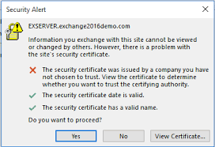
Attacking Humans via Human Errors
Attackers often want to control the target’s behavior
If attackers can induce an error, may lead to desired behavior
Example, redirect a user to a fake website
What problems might a user have with this?

Slide 26
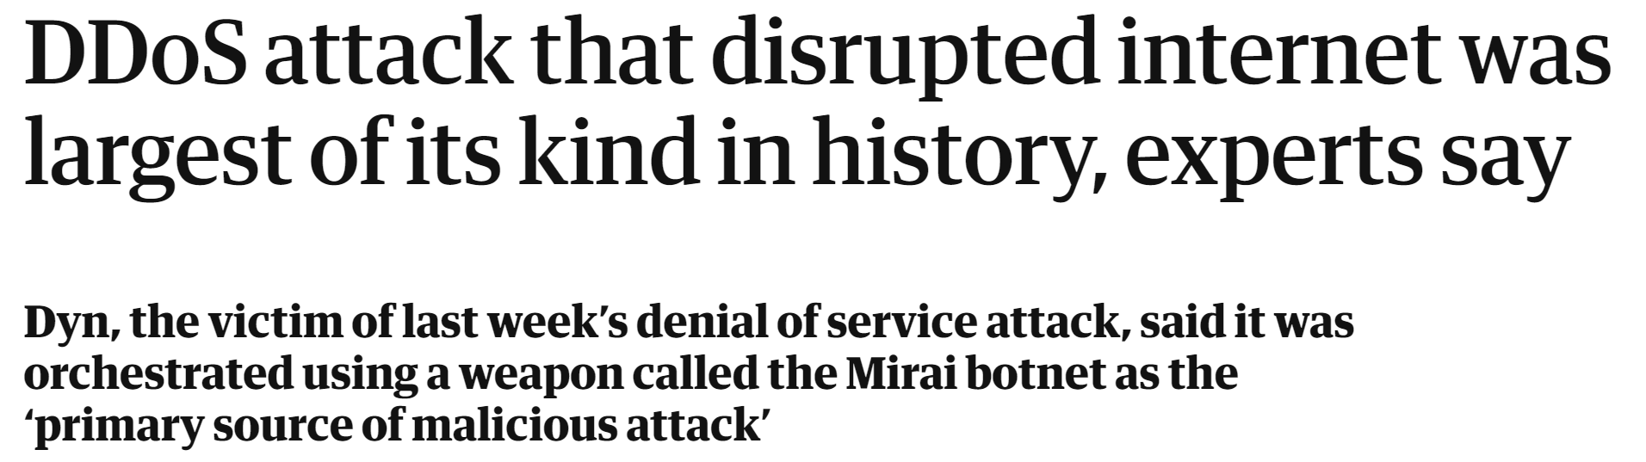
Attacking Machines via Human Errors
Many systems are error-prone already
Attacker need not directly manipulate to induce the problem
For example, many devices ship with default passwords
Users are supposed to change the password before deploying
But many don’t. This was used to create a “bot net” in 2016

Slide 27
Psychology of Manipulation
To repeat: attackers want to control target behavior
Even if attacking a system, want defender behavior predictable
We all like to think we’re to smart to be tricked.
ALL Human minds have vulnerabilities (yours and mine too)
Understanding these limitations leads to solutions

Slide 28
Human Bias Toward Action
Humans are designed with a bias toward action
There are GOOD reasons for this:
If we thought about everything we’d never do anything
Can lead to an initial action with follow-up refinement
But there are some very BAD consequences
Act without sufficient information is sometimes worse than not acting
In the 21st century, there is a lot of information required to act
This is especially true in cybersecurity

Slide 29
A word about “bias”
Bias has a negative connotation (e.g., racial, gender, etc)
Bias means preferences that are automatic, not based on study
Bias is an essential part of life for basic function/operation
We accept as an axiom that some biases are immoral
Through social/other training, can increase/reduce biases
This is probably also evolutionary

Slide 30
Exploiting Bias
If an attacker knows/predicts bias, can predict human behavior
Serious problem:
A “good” bias might lead to the “right” decision 99% of the time
Attacker will still figure out how to exploit the 1%
With action bias, attacker knows that urgency leads to action
If the target believes the urgency, will act unless trained
Commonly seen in phishing

Slide 31
Emotional Fallback
Pushing someone out of logical thinking into emotional response
Can be explicitly triggered through emotional statements
Can also happen when the target “runs out” of logic
This appears to also be evolutionary
We cannot know or reason through everything
What should we do when we don’t know what to do?
People often call this “intuition”

Slide 32
Intuition
Intuition (gut feel) only works with evolution (lots of time!!!)
Humanity has not had time to evolve with the technology
Complexity is accelerating (this will continue to get worse)

Slide 33
Exploiting Emotional Fallback
Extremely emotional language triggers emotional responses
Anterior Cingulate Cortex
Reciprocal Repression Model
Emotion shuts down Logic
Push the target to the “edge” of training
No matter how well trained, always something unknown
Attacker will almost always know more than the target

Slide 34
Social Engineering - Trust
Obtaining unauthorized services through false pretenses
Often obtained in stages, across multiple targets
Build a small degree of trust, then leverage for more trust
Common tricks to build trust:
We’re part of the same group: gossip, banter
I’m already part of the system: I know how it works
You can help me out: I need you
I can help you out: you need me

Slide 35
Social Engineering - Authority
Thinking also tends to shut down in deference to authority
Of course there are examples during war time
But how many of us have deferred to social authority?
Ironically, “rejecting” authority is often deferring to other authority.

Slide 36

Example Abuse of Authority

Slide 37
Let’s analyze this Scene
Dead Poets Society was a whole movie about learning to think
Yet, here in a key scene, how does this teacher convince
Thinking? Analysis? Debate? Discussion?
No. He uses emotional statements and emotional activities
He doesn’t accept any opposition.
Students required to think the way he does

Slide 38
Visual-Emotional Stimulation
Our visual processing system is complicated
Pattern matching, video smoothing, etc
But also, there is emotional processing in it as well
Man with brain damage studied for his issues in this
He could recognize his parents
But it didn’t feel right.
Convinced they were imposters
We feel when we see things
Attackers attempt to manipulate with emotional visuals

Slide 39
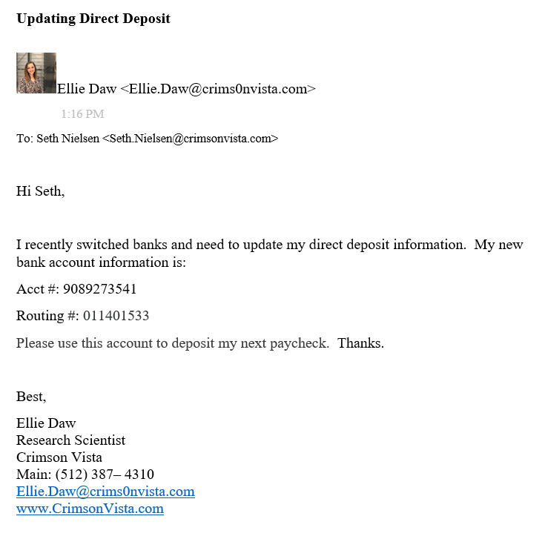
Visual Stimulation Example
This was a phishing submission from a previous class
It “got” me

Slide 40
Psychology-Aware Design
First, recognize that everyone is, in fact, human
Design to mitigate human weaknesses
Build on human psychology rather than fighting it

Slide 41
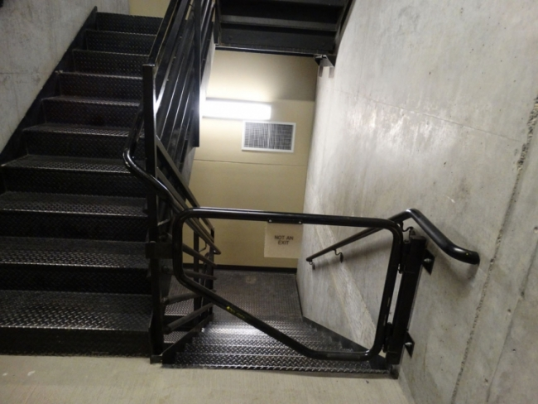
An example of Good Psychology

Slide 42
Why is the psychology good?
ASSUMES that the human will panic!
Understands that they just need a mild cue to go the right way
No training required, expected
NOTE: still dealing with fires, which are not conscious enemies

Slide 43
Six Psychology-Aware Design Points
Affordance – Design for proper thinking/use
Modes for irrational user behavior
Inhibit emotional response (logic inhibits emotion)
Design to be resilient in the face of mistakes
Design to be resilient to failures
Pushing decisions to experts

Slide 44
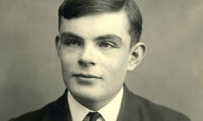
Security Example: CAPTCHAs
Good case study!
Combine psychology, usability, and system design nicely
Designed around what humans do well that computers do not
“Completely Automated Public Turing Test to Tell Computers and Humans Apart”
Thanks Alan Turing!

