Slide 1
The Technology of Cybersecurity
UT LAW 396V
Spring 2024
Lecture Notes

Slide 2

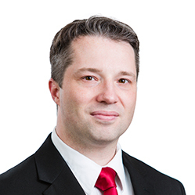



About the Instructor

Slide 3
What about You?
Why did you take this course?
What is your technology background like?
What has been your favorite course so far? Why?
What is your learning style?
What is your favorite teaching style?

Slide 4
A Few Introductory Notes
This course continues to develop and evolve
I make changes based on what works and what doesn’t
Every semester has new labs and assignments
Textbook is published! (but it is not perfect)
Please feel free to make suggestions or raise concerns

Slide 5
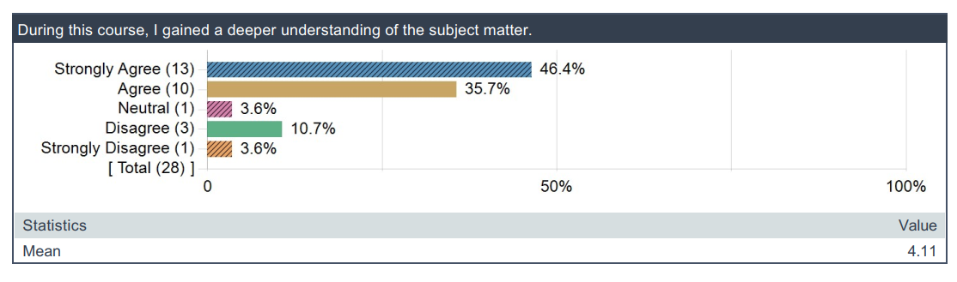
Review of Spring 2023 Feedback
This really surprised me.

Slide 6
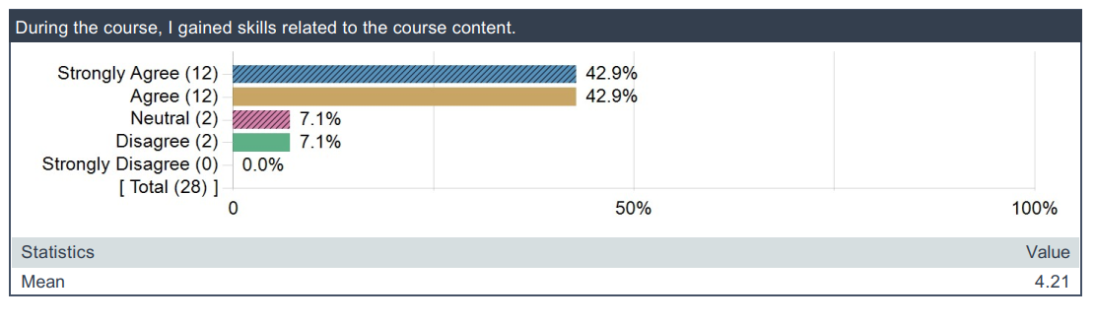
Review of Spring 2023 Feedback
How is this possible?

Slide 7
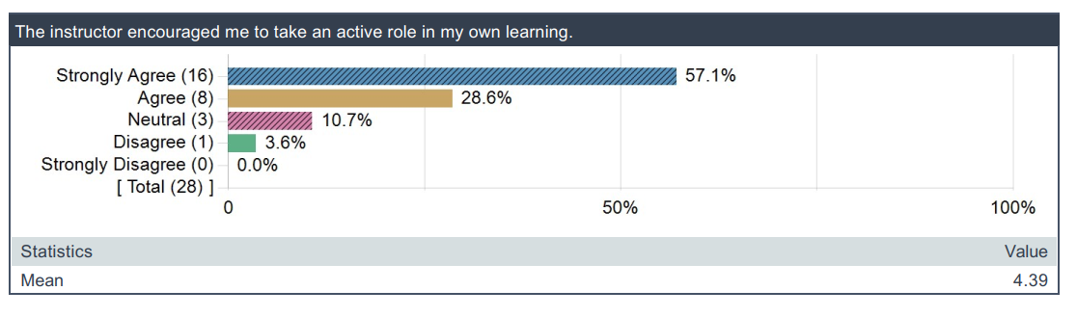
Review of Spring 2023 Feedback
Ok, seriously?

Slide 8
Your Responsibilities
If you don’t feel like you’re understanding, come talk to me
If you don’t get new skills, come talk to me
You will largely decide your outcomes in this class

Slide 9
More Interesting Feedback

Slide 10
This is a Technical Class
If you don’t think it’s technical, you don’t understand
There are other policy classes. This is not one of them.
I was asked to teach at technical class.

Slide 11
…For Students with No Background
This is insanely hard to do
I have put in hundreds of hours trying to find ways to do it
It works best when YOU work WITH me

Slide 12
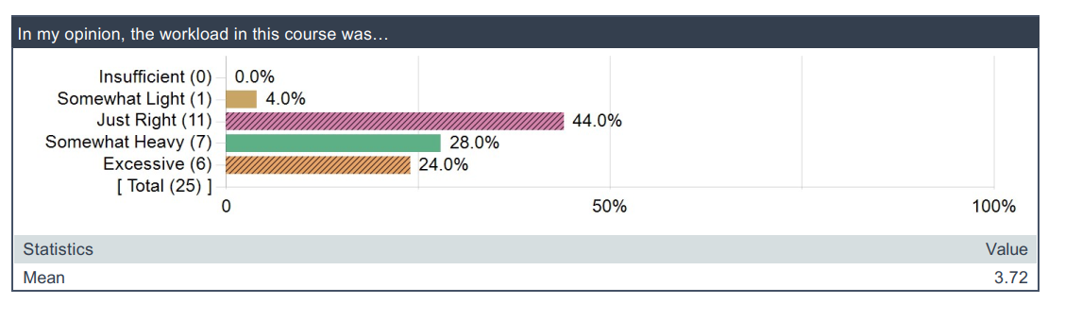
Workload Feedback

Slide 13
No Good Deed Goes Unpunished
This class was not originally pass/fail
But I felt the curve was unfair for material that was new
We switched to pass/fail to not mess with grades
But the workload remains the same
Any questions?

Slide 14
Please Don’t Whine at the End
I am very approachable
I never retaliate
I really want students to learn
I teach part time because I love teaching
Early, constructive feedback is better for me and you

Slide 15
The 5 Orders of Ignorance
0th Order: Known Knowns
1st Order: Known Unknowns
2nd Order: Unknown Unknowns
3rd Order: Unknown methods for discovering unknown unknowns
4th Order: Unknown methods for exploring the orders of ignorance
(Adapted from Phillip Armour, “The Five Orders of Ignorance”)

Slide 16
The 5 Orders of Ignorance
0th Order: Known Knowns
1st Order: Known Unknowns
2nd Order: Unknown Unknowns
3rd Order: Unknown methods for discovering unknown unknowns
4th Order: Unknown methods for exploring the orders of ignorance
(Adapted from Phillip Armour, “The Five Orders of Ignorance”)
SKILL
EDUCATION

Slide 17
Course Objectives
Learn some basics about technology
Learn about how technology protects systems
Learn about how attackers get in anyway
Learn principles that allow you to evaluate technology

Slide 18
Syllabus Review
Review Schedule
Review Topics
Review Reading
Review Labs
Review Midterms

Slide 19
Why These Topics?
Cybersecurity is broader than you can imagine
I had to pick a small subset of topics
And I had to include enough background for these topics
This is my best effort to pick the right set of topics
If you have other interests, please send me requests by email

Slide 20
Class Discussions
I hate slides and I hate “lectures”
I only use them because I haven’t found something better
Please read before class, come prepared to discuss
In an effort to make this easier, you can text me questions:
410-497-7384

Slide 21
More Feedback
This one actually made me really frustrated
I added in all the in-class labs to make it better
Also, I practically beg you students to participate
You want it more interactive? COME PREPARED TO DISCUSS

Slide 22
Readings
I wrote the textbook for this class
Previous classes got the preprints
You are the first class to get a published version
It can still improve; please be willing to help future students
ASSIGNMENT: Post a discussion/comment for each reading

Slide 23
Labwork
lab 1 - Class contract, binary numbers, learning about your computer
lab 2 - Password Cracking
lab 3 - Ransomware Lab
lab 4 - Phishing Contest
(Note, this last lab is easy and fun)

Slide 24
In-class Experiences (ICX)
lab 1 - Binary, Mini Processor Demo
lab 2 - Symmetric/Asymmetric Cryptography
lab 3 - Wireshark, Creating a Secure Authenticated Channel
lab 4 - Website Cookie Demo

Slide 25
Labwork Policies
PASS/FAIL – Not worth it to do part
You may talk to other students about the labs
But you must do your own work
I also will provide help sections as needed

Slide 26
Individual Presentations
Students will record themselves teaching a lecture
You will pick the class topic you wish to teach
You will share a YouTube video with me
I request them to be public (private if you must)
They do need to be visible to other classmates

Slide 27
Presentation Details
Your video is due by the last day of class (2024-04-29)
You will also watch 2 videos of classmates
Please submit a brief 1 paragraph review for each
Due by the end of finals

Slide 28
Grading
Ha Ha, Just kidding. It’s Pass/Fail
You must complete all labs and in-class experiences (ICXs)
10/12 readings
Pass on both midterms
Submit your video and watch/review 2 others

Slide 29
Midterm Exams
Essay based thought questions
Open book, open note
I hate memorization/regurgitation
Usually involve a hypothetical
REQUIRED CHAT-GPT

Slide 30
Technology Evaluation
Forces behind design/development
Intended Purpose
Feature Set
Strengths and Weaknesses
Context and Requirements
Deployment in Practice
Lessons Learned

Slide 31
Evaluation of New Tech
GOAL: You can evaluate tech at a basic level
Especially cut through the vendor marketing
No technology is “magic”
Governed by principles
Use the principles to understand the specifics

Slide 32
Peek Ahead Example
Authentication is verifying an identity
Three basic approaches
Something you know (passwords)
Something you have (phone or security token)
Something you are (biometrics)
Knowing just this better enables you to evaluate

Slide 33
Exam Sample Question
Every one complains about passwords and that they need to be replaced. Although every now and then someone comes up with a new replacement but they never seem to get much traction, so the search continues. Regardless of whatever new technology comes along to replace passwords, there are certain fundamental problems that will have to be solved. Write an essay explaining what kinds of evaluations YOU would do for a password-replacement technology.
Do not speculate about how this imaginary technology works, just imagine it to be some kind of “black box” authentication mechanism. Instead, focus your essay on the psychological, technical, and perhaps even mathematical problems that you would require it to solve or address before you believed it to be a “good” replacement. Because this is hypothetical, you can address this from a number of different angles. Your score for this essay will be based on how well you understand user authentication including principles related to “something you know”, “something you have”, and “something you are.” You may also get score for applying Anderson’s concepts on user psychology and security engineering.

Slide 34
New This Semester
Stories, stories, stories
Marketing literature from current technology

Slide 35
Introducing Cybersecurity
This is a very broad concept
Includes concepts of technology, psychology, etc etc
Where to start?
Let’s start with Ross Anderson’s “Security Engineering”

Slide 36
What is “Security Engineering”?
“[It] is about building systems to remain dependable in the face of …”
Malice
Error
Mischance.
“As a discipline, it focuses on the…”
Tools
Processes
Methods

Slide 37
The Goal
Confidentiality, Integrity, Availability (CIA Triad)
For new systems:
Design security
Implement security
Test security
For existing systems:
Adapt them for increased security
Adapt them as their environment evolves

Slide 38
“Having” Security
Everyone wants “security”. But how?
“Whoever thinks his problem can be solved using cryptography, doesn’t understand his problem and doesn’t understand cryptography.”
— Attributed by Roger Needham and Butler Lampson to Each Other

Slide 39
Key Observation
Anderson, Ch 1, p. 4

Slide 40
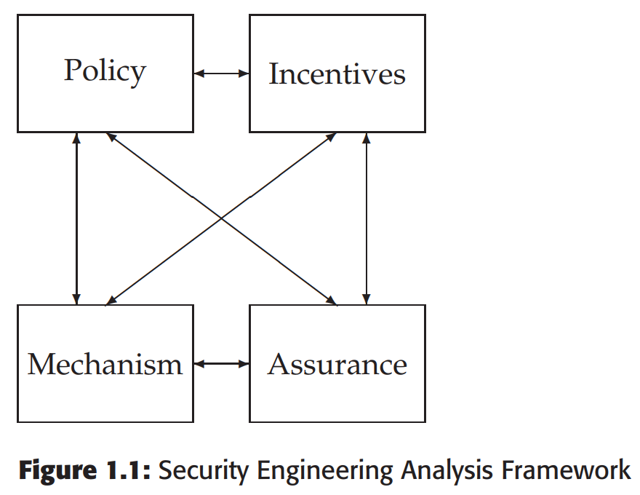
A Framework
Policy
Mechanism
Assurance
Incentives

Slide 41
Some Definitions
System – Tech + Auxiliary Tech + Staff + Users + etc.
Subject – Physical “person”
Principal – Entity in the system
Identity – Unique label attached to a unique principal
Trusted – Failure results in compromise
Trustworthy – Failure is unlikely

Slide 42
CIA (Not the Spies)
Confidentiality – Cannot be read
Integrity – Cannot be altered
Availability – Cannot be interrupted

Slide 43
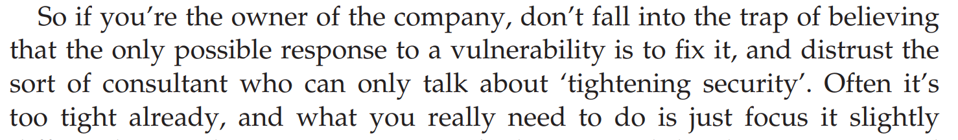

Understand This
Anderson, Ch 25, p. 816

Slide 44
Anderson’s Examples
Bank
Military
Hospital
Home

Slide 45
IAAA
Identity – Unique label for a unique principal
Authentication – Validation of the principal’s identity
Authorization – Permissions granted the prinicpal
Accountability – Metering and auditing of principal
(Message Authenticity – Integrity + Freshness)

Slide 46
Grasp the Context
SECURITY IS ABOUT CONTEXT (Repeat after me)
What does it mean when you say “system X is secure”?
Secure against whom?
Secure under what conditions?
Are we even protecting what matters?!
Take voting security
Who are the potential attackers?
How does the context change if a nation decides to be the attacker?

Slide 47
Start with Policy
“…a succinct statement of a system’s protection strategy” (Anderson ch1 p. 15)
Examples:
Each credit must be matched by an equal and opposite debit
All transactions over $1,000 must be authorized by two managers
Practice:
What are the security policies for TLS?

Slide 48
Then figure out mechanism
This is where most security people like to start
But really we only need mechanism to enforce policy
Some mechanisms aren’t even technical (e.g., legal)
MUST understand threat model

Slide 49
Assurance
Just how strong/resilient/comprehensive is the mechanism?
Requires a solid understanding of the threat model
Applications at every stage!
Design – solid security engineering principles
Implementation – coding practices, development processes
Testing – adversarial, comprehensive assessment

Slide 50
Incentives
Anderson’s example of airport security
What motivates the behavior?
What is “Security Theater?”
Everyone should learn a little game theory
Read up on Prisoner’s dilemma
Understand “mechanism design”
Anderson’s “Moral Hazard” (Chapter 25)

Slide 51
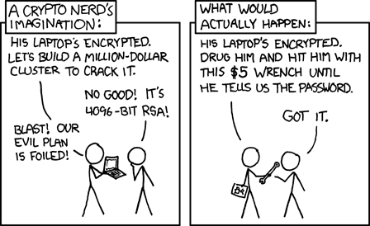
Illustrations
See http://xkcd.com/538/

Slide 52
Important Security Principles
Least privilege
Minimize attack surface
Defense in depth
Separation of duties and responsibilities
Crowdsourcing
Open systems
Fail Safe/Fail Secure

Slide 53
Course Goals
Learn basics of how computer systems work
Learn about some of the current security technology
More importantly, the principles behind the technology
Know how to think and evaluate technology
It will change; be ready to change with it

Slide 54
Testing for Class Software
This semester is much easier
Install Wireshark
Test JavaScript

